Slide 1
Chapter 6
Circular Motion
and
Other Applications of Newton’s Laws
Dr. Awos Alsalman

Slide 2
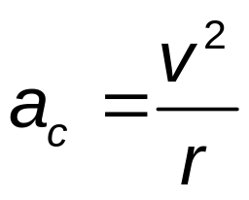

Uniform Circular Motion, Acceleration
A particle moves with a constant speed in a circular path of radius r with an acceleration:
  The centripetal acceleration, is directed toward the center of the circle
The centripetal acceleration is always perpendicular to the velocity

Slide 3

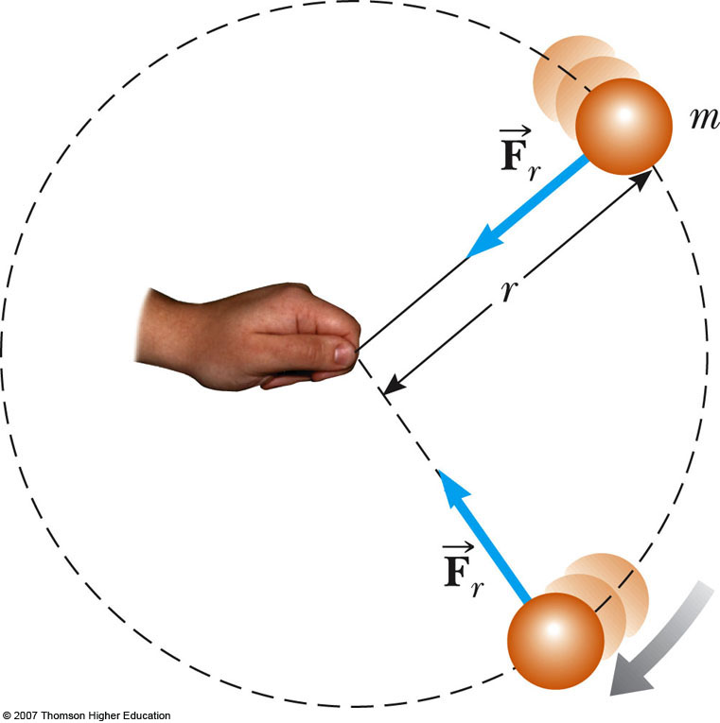
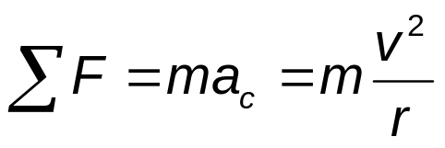
Uniform Circular Motion, Force
A force, , is associated with the centripetal acceleration
The force is also directed toward the center of the circle
Applying Newton’s Second Law along the radial direction gives

Slide 4
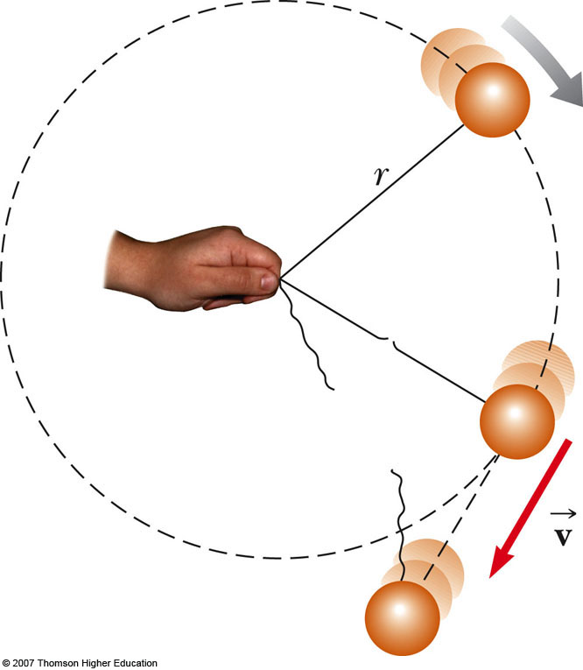
Uniform Circular Motion, cont
A force causing a centripetal acceleration acts toward the center of the circle
It causes a change in the direction of the velocity vector
If the force vanishes, the object would move in a straight-line path tangent to the circle

Slide 5
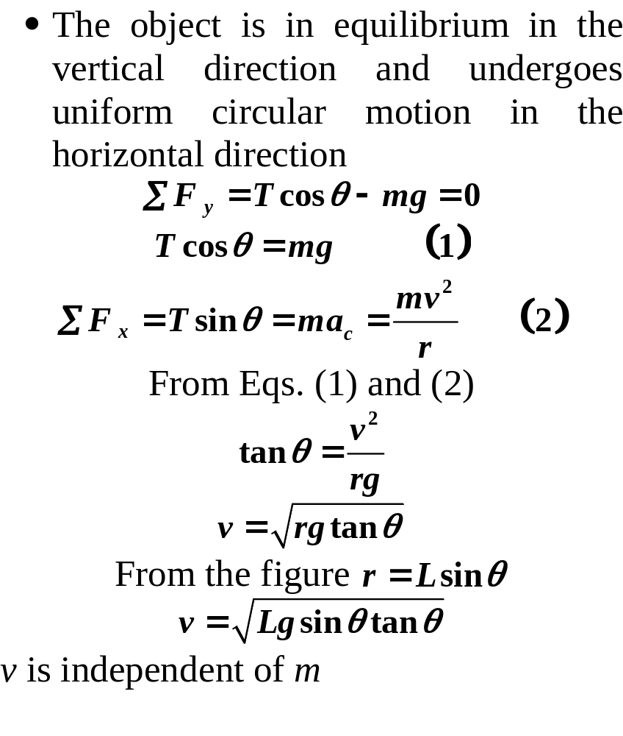
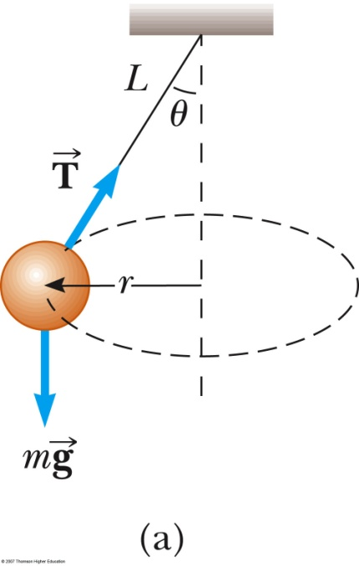
Conical Pendulum

Slide 6
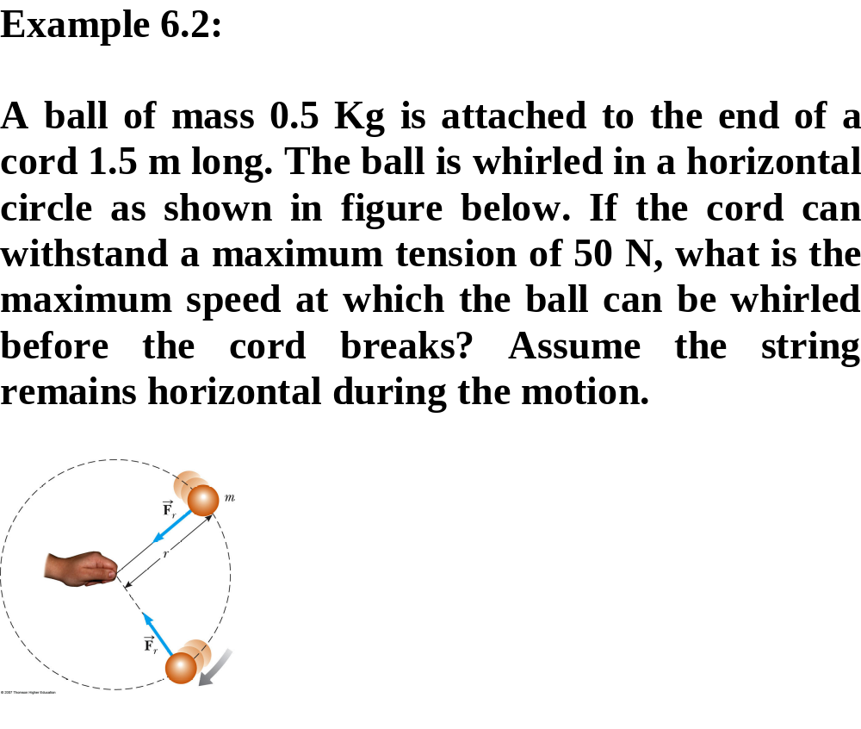
Motion in a Horizontal Circle

Slide 7
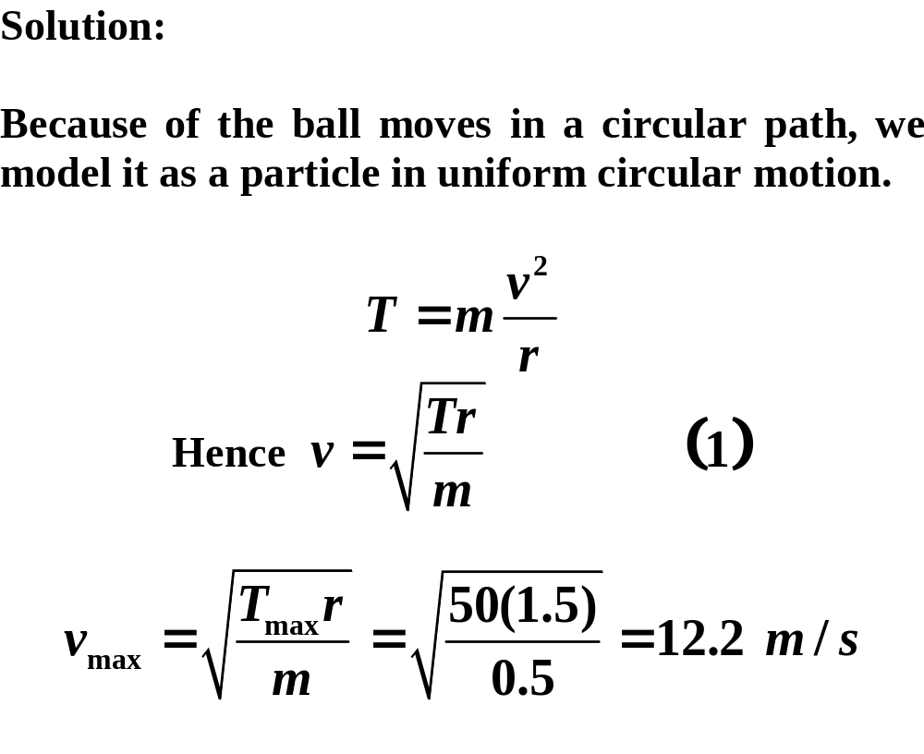
Motion in a Horizontal Circle

Slide 8
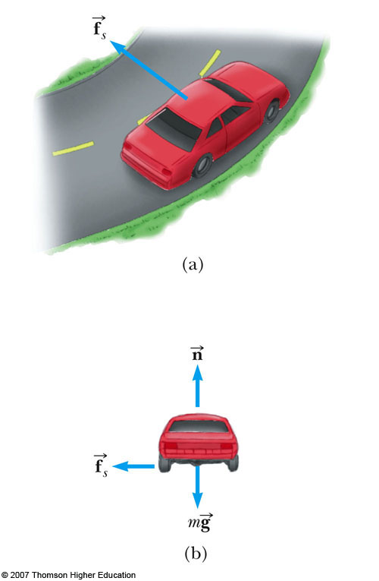
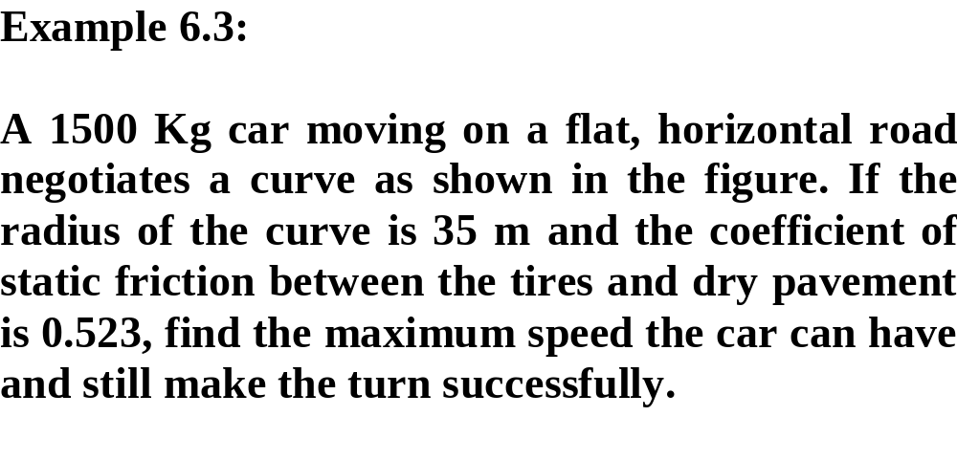
Horizontal (Flat) Curve

Slide 9
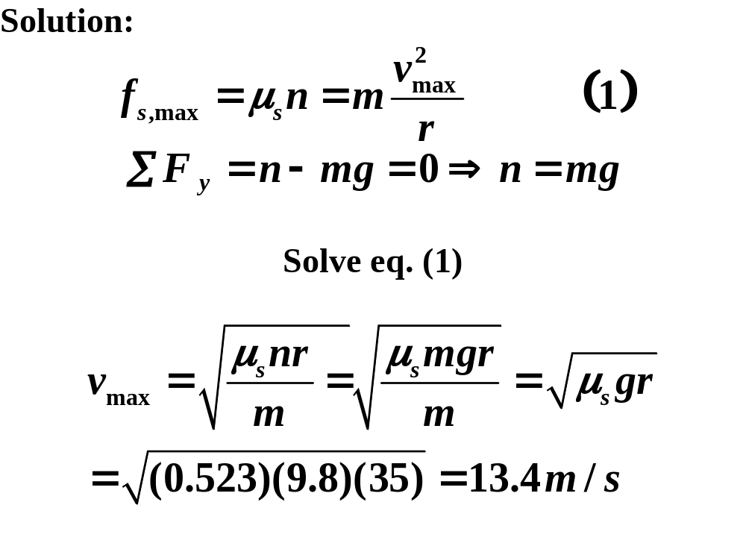

Slide 10
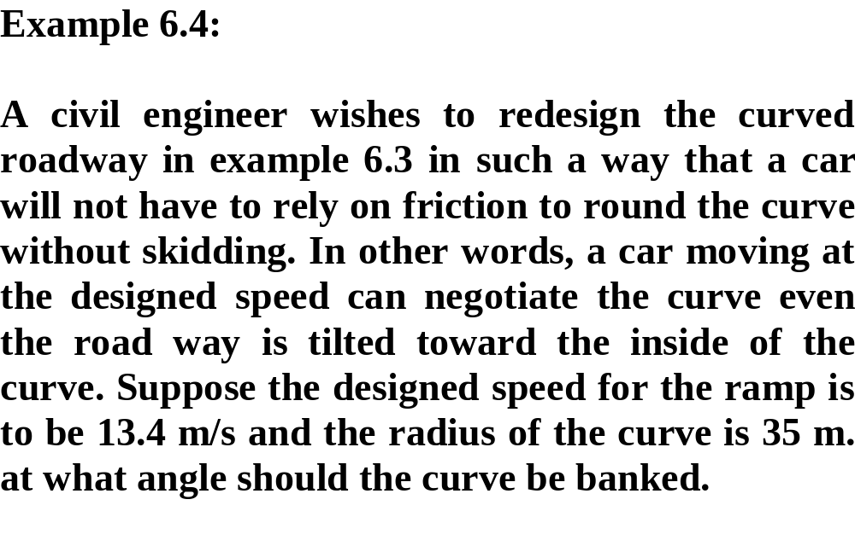
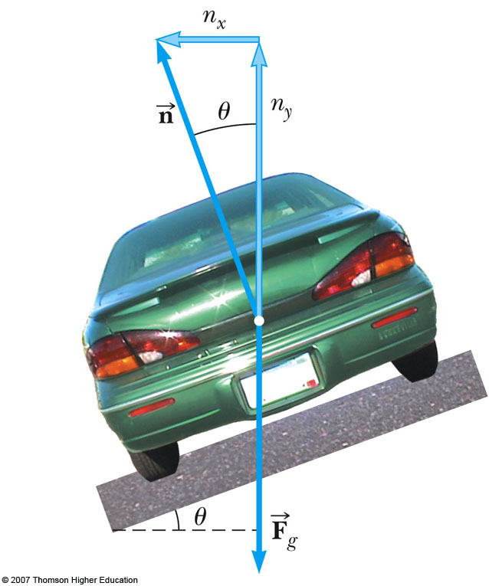
Banked Curve

Slide 11
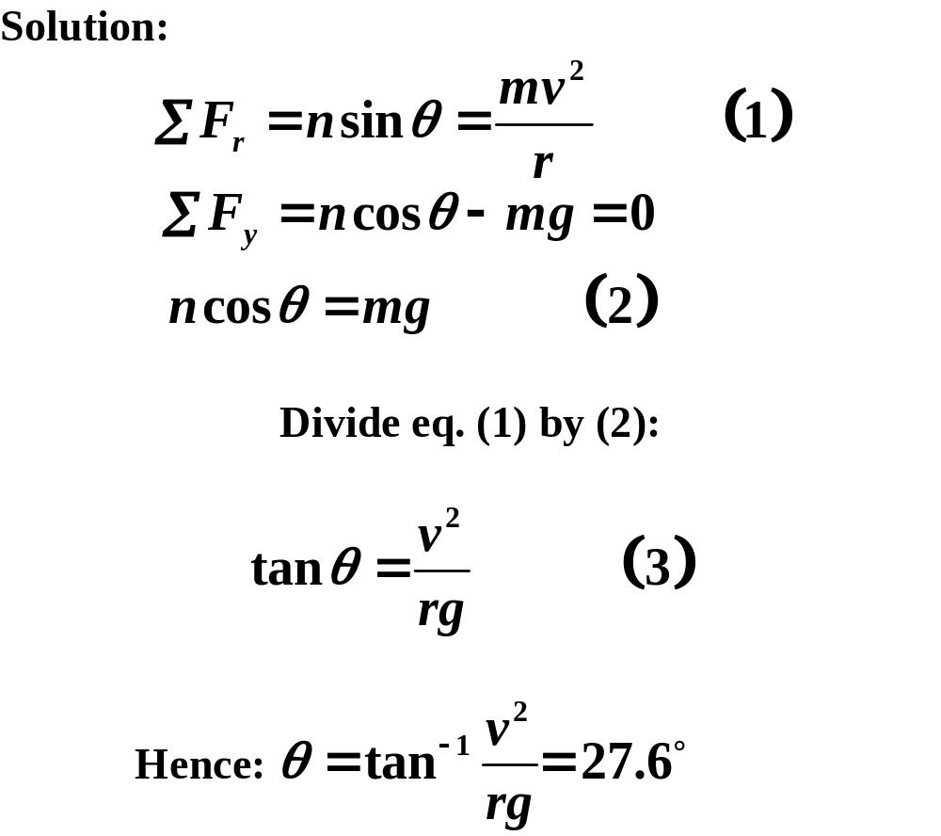

Slide 12
Banked Curve, 2
The banking angle is independent of the mass of the vehicle
If the car rounds the curve at less than the design speed, friction is necessary to keep it from sliding down the bank
If the car rounds the curve at more than the design speed, friction is necessary to keep it from sliding up the bank

