Slide 1
General Physics (1) For Engineering
Textbook:
Physics for Scientists and Engineers, seventh edition, Jewett / Serway
Dr. Awos Alsalman

Slide 2
Chapter 7
Energy
of a
System

Slide 3
Introduction to Energy
The concept of energy is one of the most important topics in science and engineering
Every physical process that occurs in the Universe involves energy and energy transfers or transformations
Energy is not easily defined

Slide 4
Energy Approach to Problems
The energy approach to describing motion is particularly useful when Newton’s Laws are difficult or impossible to use
An approach will involve changing from a particle model to a system model
  This can be extended to biological organisms, technological systems and engineering situations

Slide 5
Systems
A system is a small portion of the Universe
  We will ignore the details of the rest of the Universe
A critical skill is to identify the system

Slide 6
Valid System Examples
A valid system may
  be a single object or particle
  be a collection of objects or particles
  be a region of space
  vary in size and shape

Slide 7
Work
The work, W, done on a system by an agent exerting a constant force on the system is the product of the magnitude F of the force, the magnitude Δr of the displacement of the point of application of the force, and cos θ, where θ is the angle between the force and the displacement vectors

Slide 8
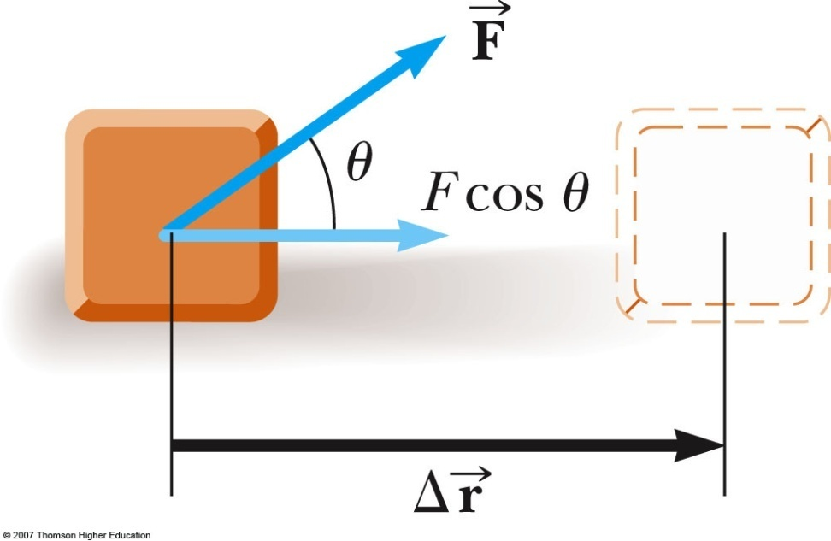
Work, cont.
W = F Δr cos θ
  The displacement is that of the point of application of the force
  A force does no work on the object if the force does not move through a displacement
  The work done by a force on a moving object is zero when the force applied is perpendicular to the displacement of its point of application

Slide 9
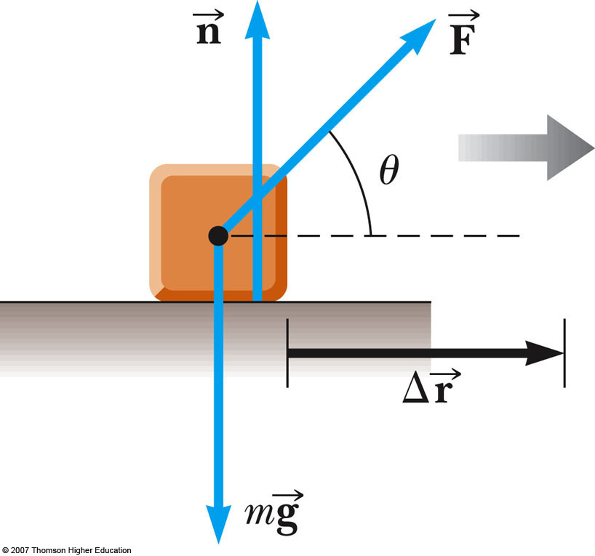

Work Example
The normal force and the gravitational force do no work on the object
  cos θ = cos 90° = 0
The force is the only force that does work on the object

Slide 10

More About Work
The system and the agent in the environment doing the work must both be determined
  The part of the environment interacting directly with the system does work on the system
    Work by the environment on the system
      Example: Work done by a hammer (interaction from environment) on a nail (system)
The sign of the work depends on the direction of the force relative to the displacement
  Work is positive when projection of onto is in the same direction as the displacement
  Work is negative when the projection is in the opposite direction

Slide 11
Units of Work
Work is a scalar quantity
The unit of work is a joule (J)
  1 joule = 1 newton . 1 meter
  J = N · m

Slide 12
Example 7.1
A man cleaning a floor pulls a vacuum cleaner with a force of magnitude F=50 N at an angle of 30 degree with the horizontal. Calculate the work done by the force on the vacuum cleaner as the vacuum cleaner is displaced 3 m to the right.

Slide 13
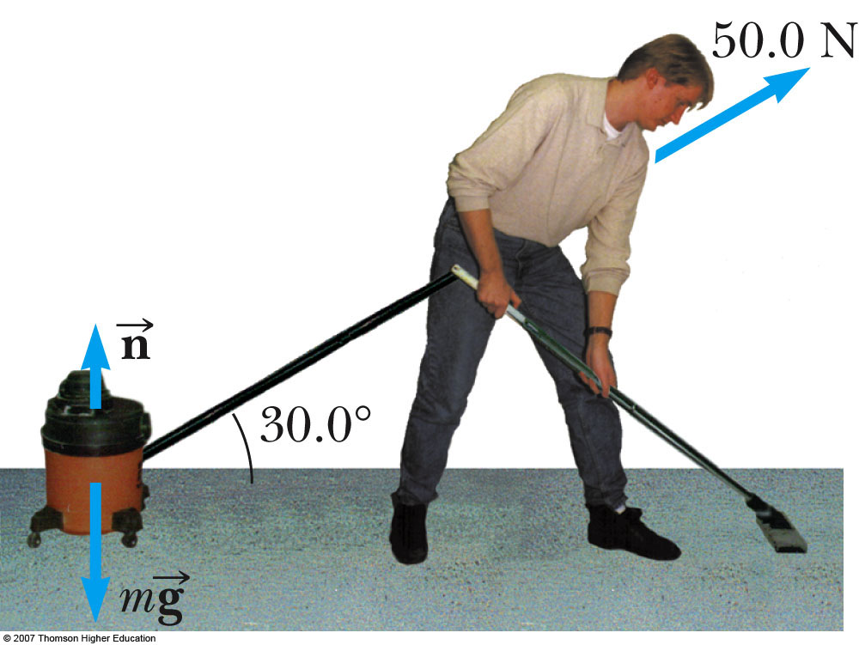
Example 7.1, solution:

Slide 14
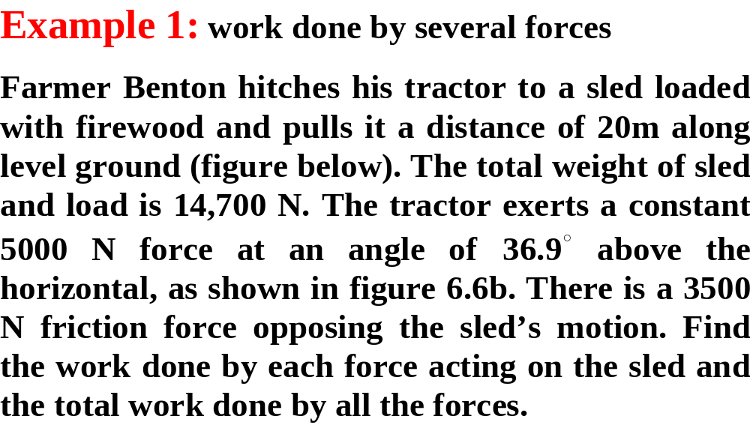
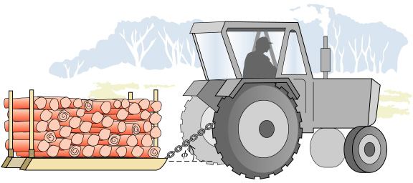

Slide 15




Example 1, solution:

Slide 16
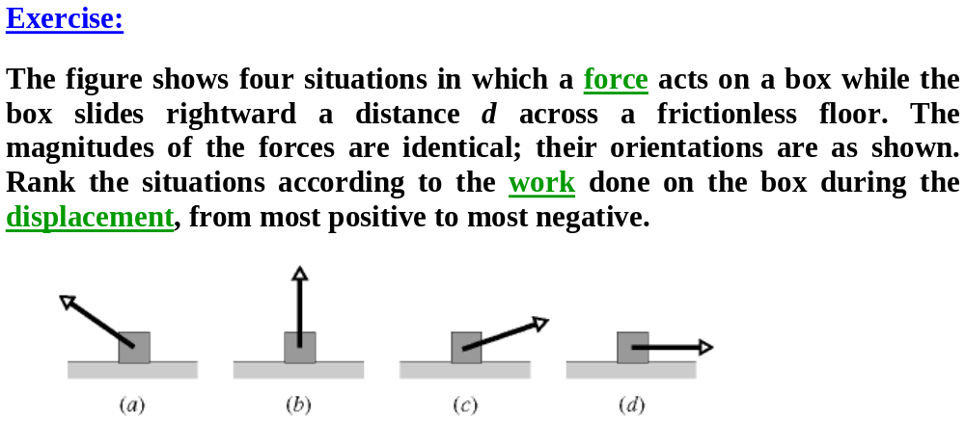

Slide 17

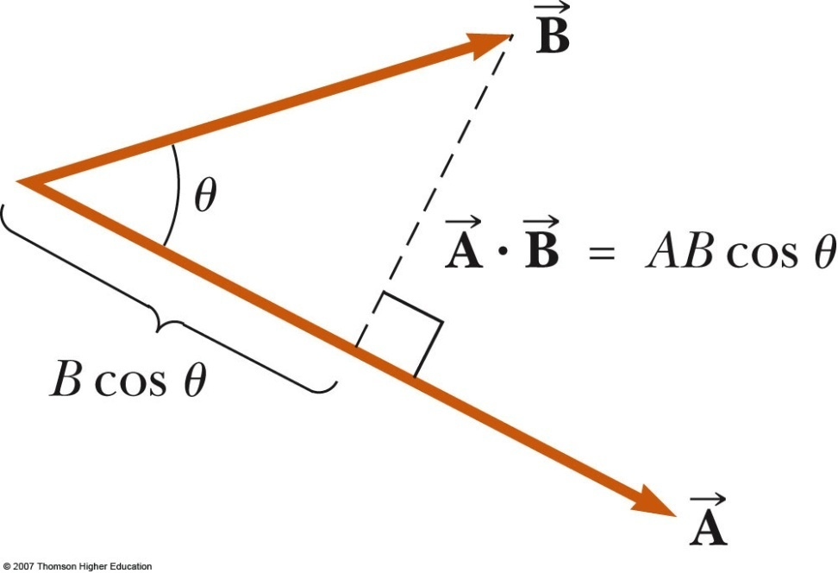
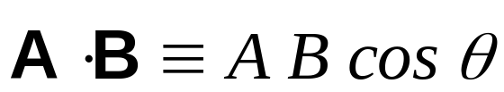
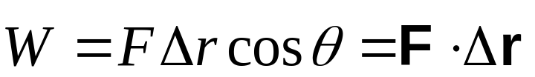
Scalar Product of Two Vectors
The scalar product of two vectors is written as
  It is also called the dot product
  θ is the angle between A and B
Applied to work, this means

Slide 18

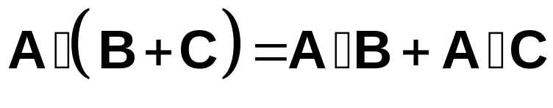
Scalar Product, cont
The scalar product is commutative
The scalar product obeys the distributive law of multiplication

Slide 19
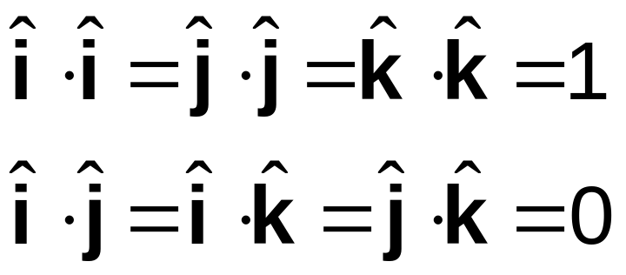
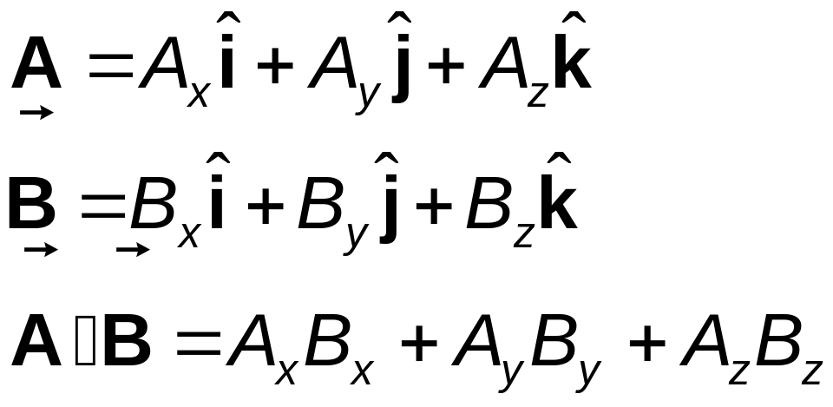
Dot Products of Unit Vectors
Using component form with vectors:

Slide 20
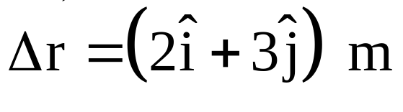
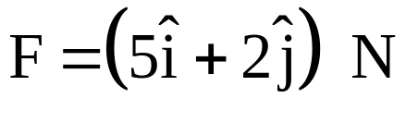
Example 7.3
A particle moving in the xy plane undergoes a displacement given by as a constant force acts on the particle.
Calculate the magnitudes of the force and the displacement of the particle.
Calculate the work done by the force on the particle.

Slide 21
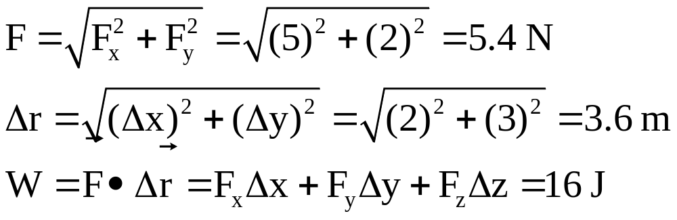
Example 7.3, solution:

Slide 22
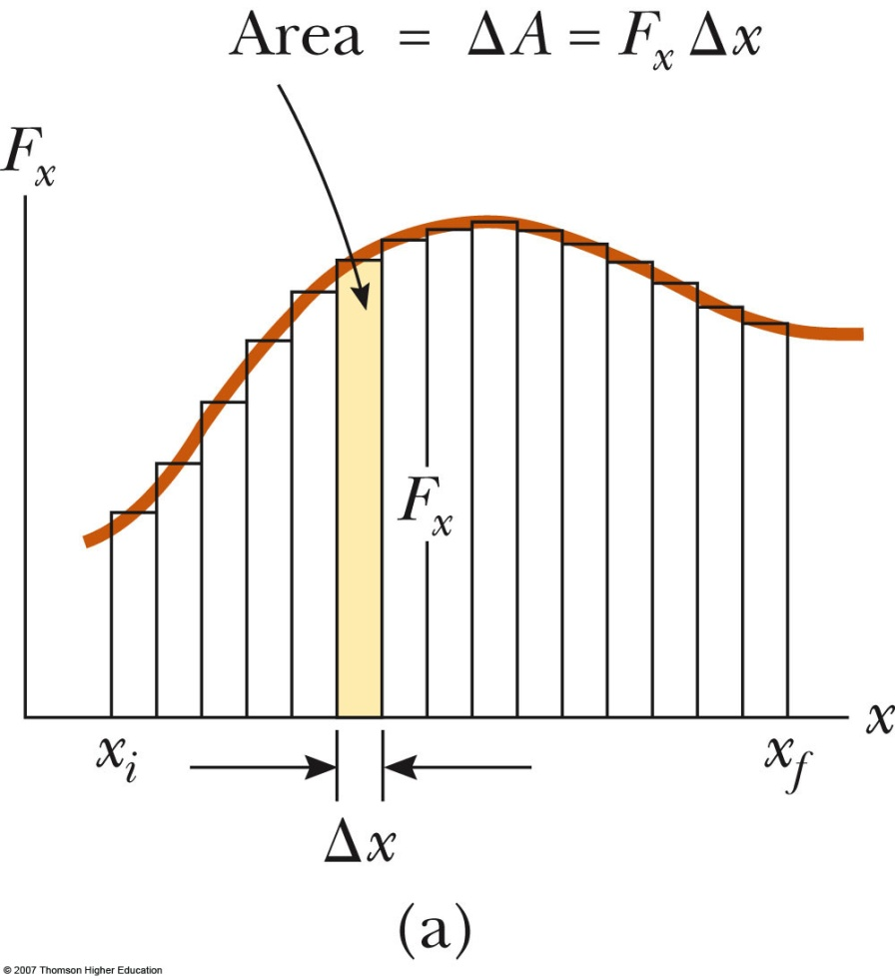
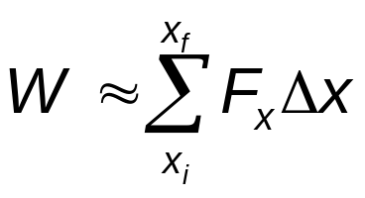
Work Done by a Varying Force
Assume that during a very small displacement, Δx, F is constant
For that displacement, W ~ F Δx
For all of the intervals,

Slide 23
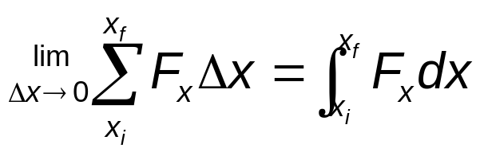
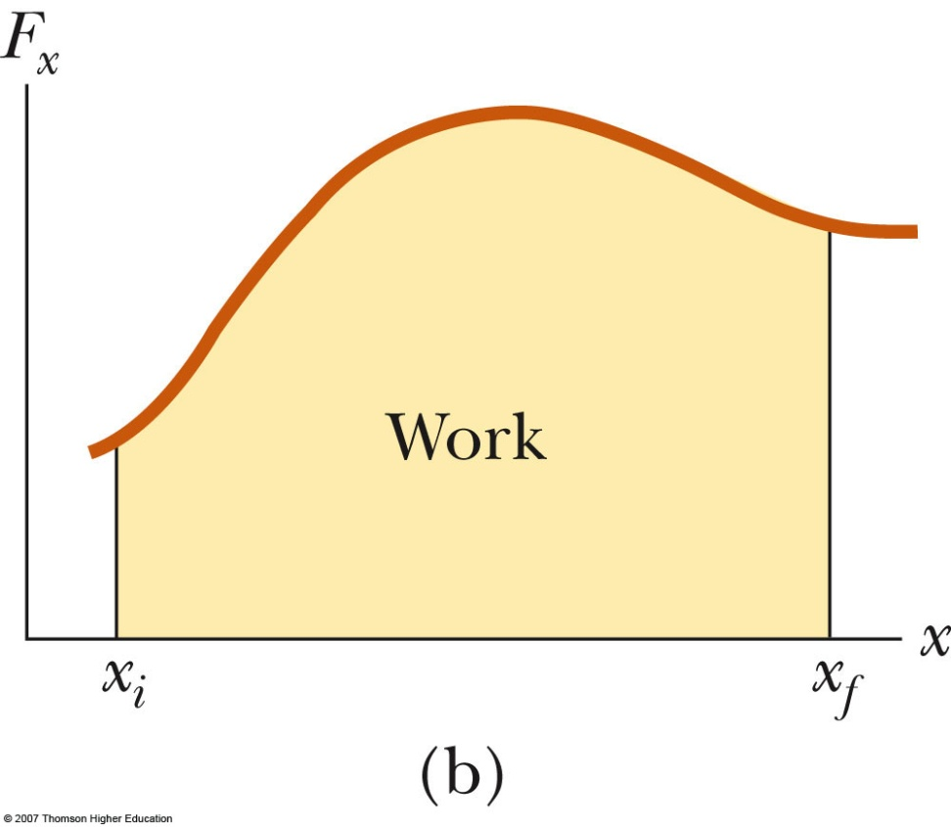
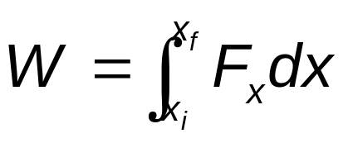
Work Done by a Varying Force, cont
Therefore,
The work done is equal to the area under the curve between x_{i} and x_{f}

Slide 24
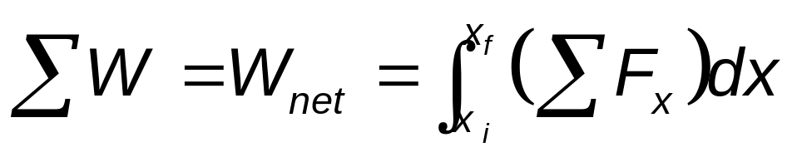
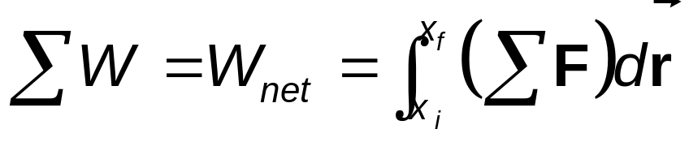
Work Done By Multiple Forces
If more than one force acts on a system and the system can be modeled as a particle, the total work done on the system is the work done by the net force
In the general case of a net force whose magnitude and direction may vary

Slide 25

Work Done by Multiple Forces, cont.
If the system cannot be modeled as a particle, then the total work is equal to the algebraic sum of the work done by the individual forces
  Remember work is a scalar, so this is the algebraic sum

Slide 26
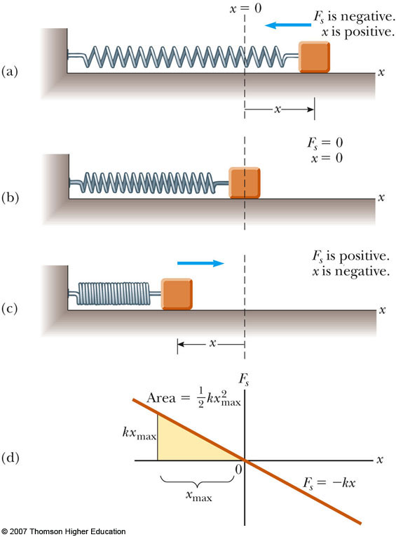
Work Done By A Spring
A model of a common physical system for which the force varies with position
The block is on a horizontal, frictionless surface
Observe the motion of the block with various values of the spring constant

Slide 27
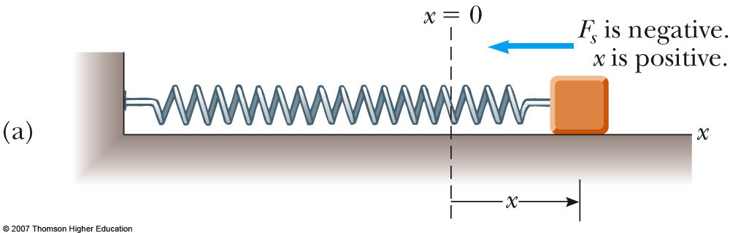
Hooke’s Law
The force exerted by the spring is
F_{s} = - kx
  x is the position of the block with respect to the equilibrium position (x = 0)
  k is called the spring constant or force constant and measures the stiffness of the spring
This is called Hooke’s Law

Slide 28
Hooke’s Law, cont.
When x is positive (spring is stretched), F is negative
When x is 0 (at the equilibrium position), F is 0
When x is negative (spring is compressed), F is positive

Slide 29
Hooke’s Law, final
The force exerted by the spring is always directed opposite to the displacement from equilibrium
The spring force is sometimes called the restoring force
If the block is released it will oscillate back and forth between –x and x

Slide 30
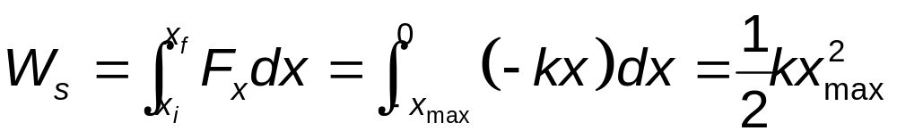
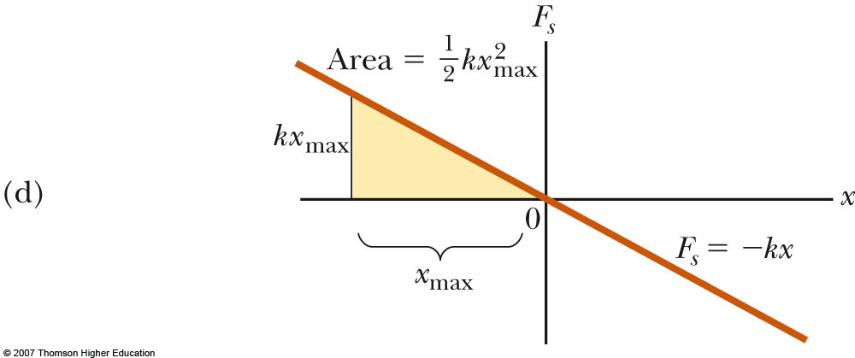
Work Done by a Spring
Identify the block as the system
Calculate the work as the block moves from x_{i} = - x_{max} to x_{f} = 0
The total work done as the block moves from
–x_{max} to x_{max} is zero

Slide 31
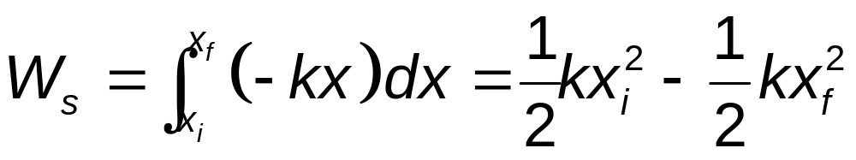
Work Done by a Spring, cont.
Assume the block undergoes an arbitrary displacement from x = x_{i} to x = x_{f}
The work done by the spring on the block is
  If the motion ends where it begins, W = 0

Slide 32
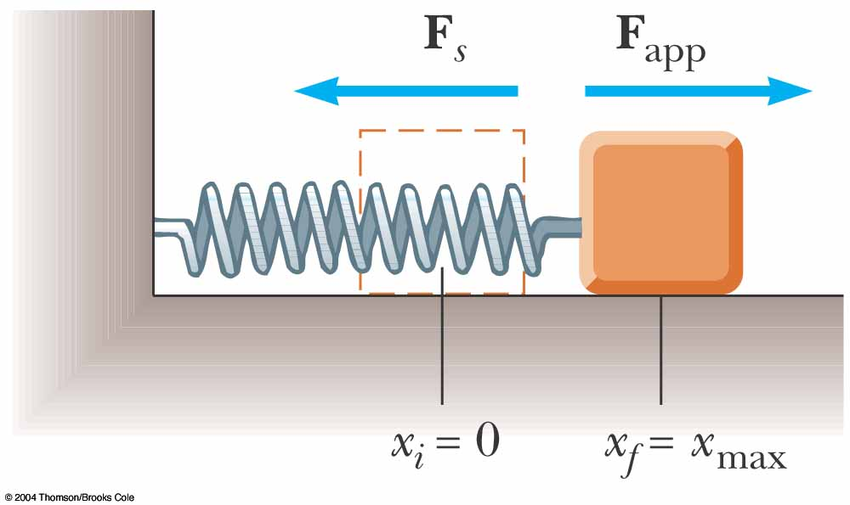
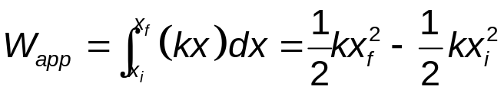
Spring with an Applied Force
Suppose an external agent, F_{app}, stretches the spring
The applied force is equal and opposite to the spring force
F_{app} = -F_{s} = -(-kx) = kx
Work done by F_{app} is equal to -½ kx²_{max}
The work done by the applied force is

Slide 33
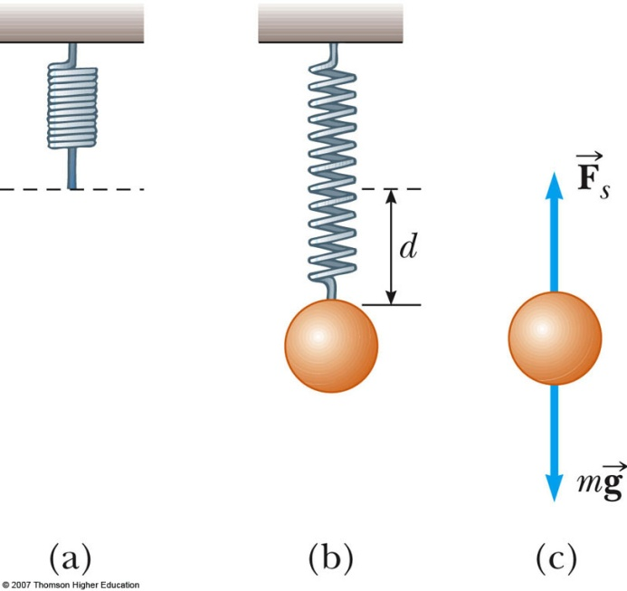
Example 7.5
A common technique used to measure the force constant of a spring is demonstrated by the setup in figure below. The spring is hung vertically, and an object of mass m is attached to its lower end. Under the action of the “load” mg, the spring stretches a distance d from its equilibrium position.
If a spring is stretched 2 cm by a suspended object having a mass of 0.55 kg, what is the force constant of the spring?
How much work is done by the spring on the object as it stretches through this distance?

Slide 34
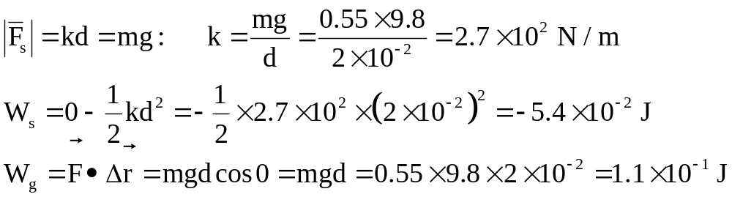

Example 7.5, solution:

Slide 35
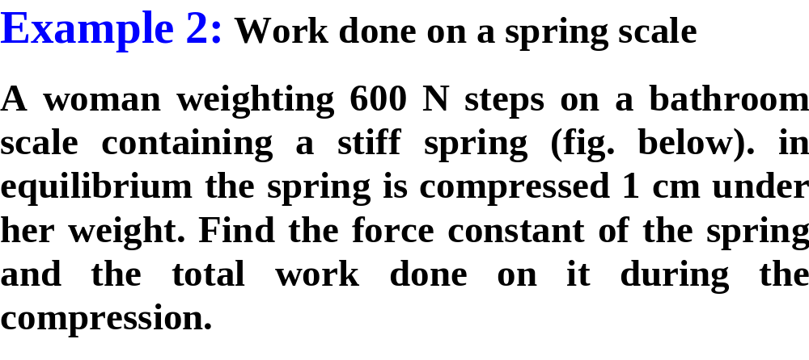
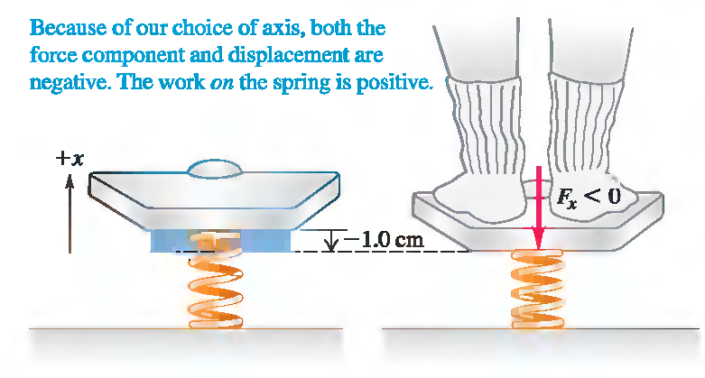

Slide 36
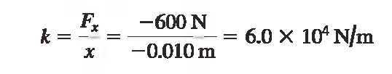
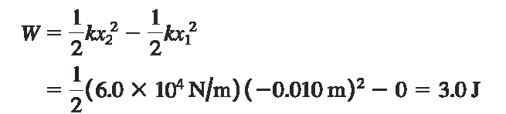

Slide 37
Kinetic Energy
Kinetic Energy is the energy of a particle due to its motion
  K = ½ mv²
    K is the kinetic energy
    m is the mass of the particle
    v is the speed of the particle
A change in kinetic energy is one possible result of doing work to transfer energy into a system

Slide 38
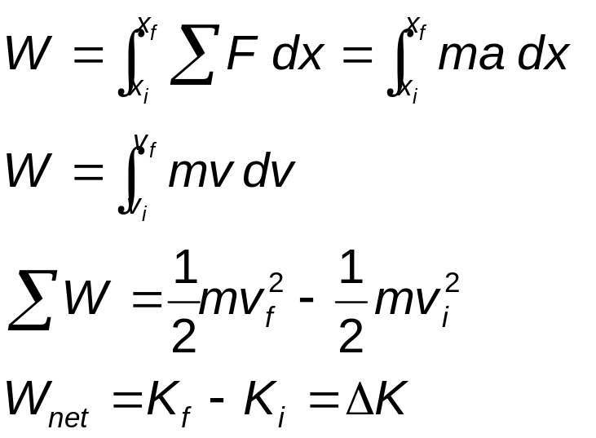
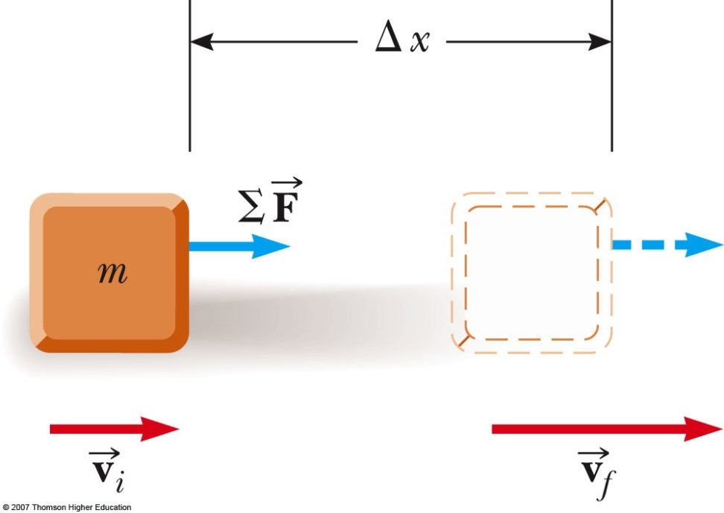
Kinetic Energy, cont
Calculating the work:

Slide 39
Work-Kinetic Energy Theorem
The Work-Kinetic Energy Theorem states ΣW = K_{f} – K_{i} = ΔK
When work is done on a system and the only change in the system is in its speed, the work done by the net force equals the change in kinetic energy of the system.
  The speed of the system increases if the work done on it is positive
  The speed of the system decreases if the net work is negative
  Also valid for changes in rotational speed

Slide 40
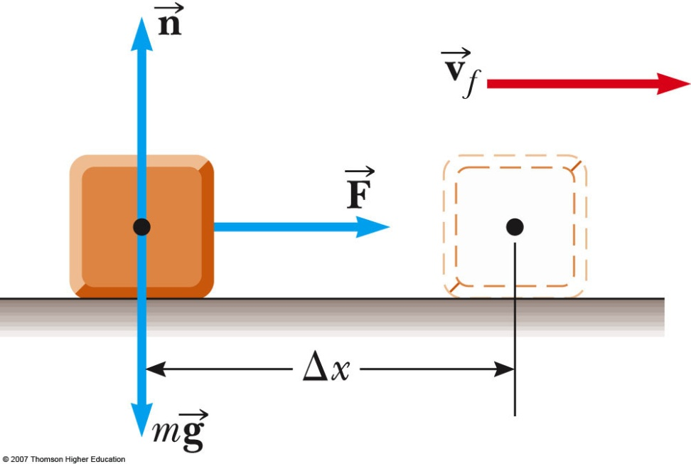
Work-Kinetic Energy Theorem – Example
The normal and gravitational forces do no work since they are perpendicular to the direction of the displacement
W = F Δx
W = ΔK = ½ mv_{f}² - 0

Slide 41

Example 7.6
A 6 kg block initially at rest is pulled to the right along a horizontal, frictionless surface by a constant horizontal force of 12 N. Find the block’s speed after it has moved 3 m.

Slide 42
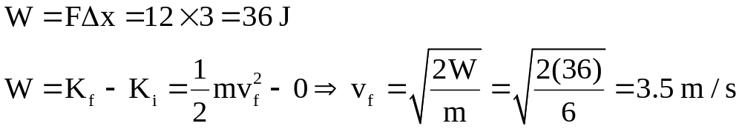
Example 7.6, solution:

Slide 43
Potential Energy
Potential energy is energy related to the configuration of a system in which the components of the system interact by forces
  The forces are internal to the system
  Can be associated with only specific types of forces acting between members of a system

Slide 44
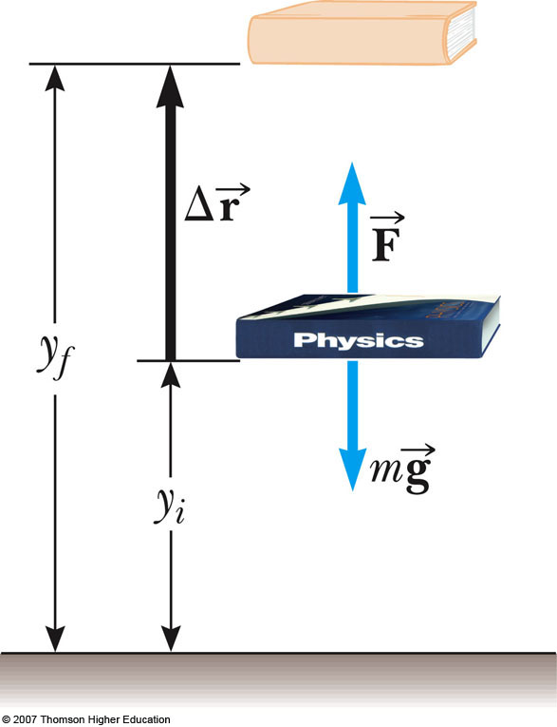
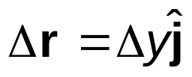
Gravitational Potential Energy
The system is the Earth and the book
Do work on the book by lifting it slowly through a vertical displacement
The work done on the system must appear as an increase in the energy of the system

Slide 45
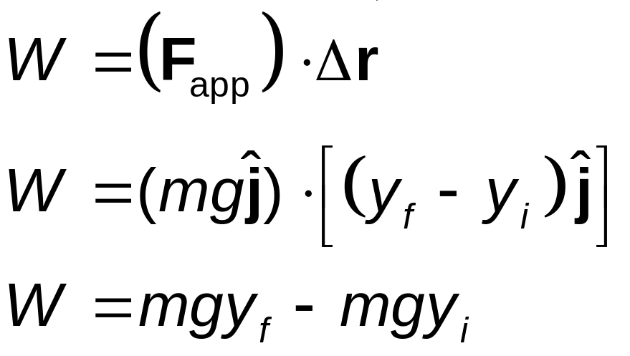
Gravitational Potential Energy, cont
There is no change in kinetic energy since the book starts and ends at rest
Gravitational potential energy is the energy associated with an object at a given location above the surface of the Earth

Slide 46
Gravitational Potential Energy, final
The quantity mgy is identified as the gravitational potential energy, U_{g}
  U_{g} = mgy
Units are joules (J)
Is a scalar
Work may change the gravitational potential energy of the system
  W_{net} = ΔU_{g}

Slide 47
Example 7.8
A bowling ball held by careless bowler slips from the bowler’s hands and drops on the bowler’s toe. Choosing floor level as the y=0 point of your coordinate system, estimate the charge in gravitational potential energy of the ball-earth system as the ball falls. Repeat the calculation, using the top of the bowler’s head as the origin of coordinates.

Slide 48
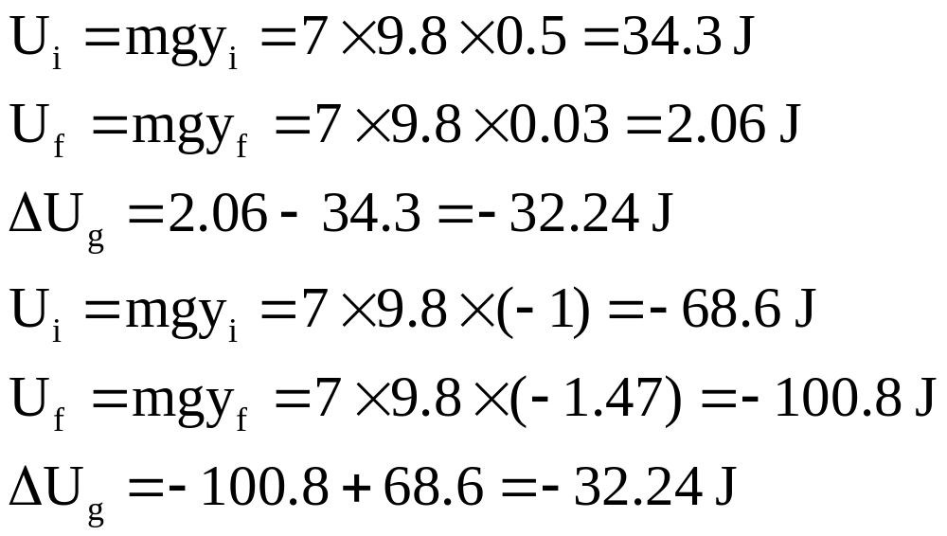
Example 7.8, Solution:

Slide 49
Elastic Potential Energy
Elastic Potential Energy is associated with a spring
The force the spring exerts (on a block, for example) is F_{s} = - kx
The work done by an external applied force on a spring-block system is
  W = ½ kx_{f}² – ½ kx_{i}²
  The work is equal to the difference between the initial and final values of an expression related to the configuration of the system

Slide 50
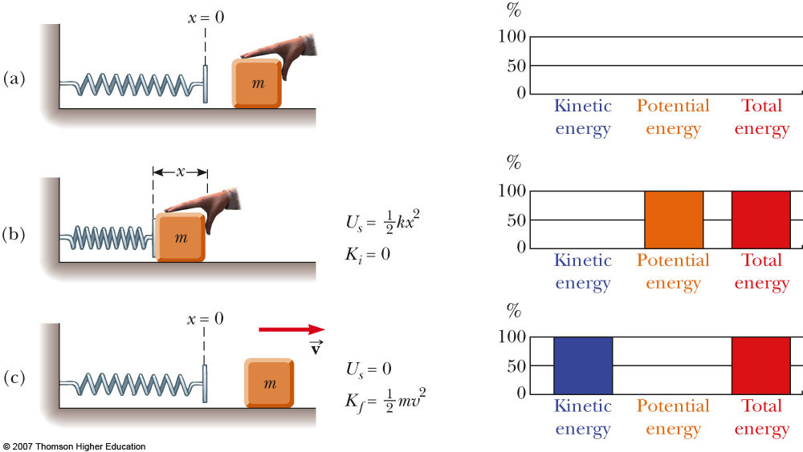
Elastic Potential Energy, cont
This expression is the elastic potential energy:
U_{s} = ½ kx²
The elastic potential energy can be thought of as the energy stored in the deformed spring
The stored potential energy can be converted into kinetic energy
Observe the effects of different amounts of compression of the spring

Slide 51
Elastic Potential Energy, final
The elastic potential energy stored in a spring is zero whenever the spring is not deformed (U = 0 when x = 0)
  The energy is stored in the spring only when the spring is stretched or compressed
The elastic potential energy is a maximum when the spring has reached its maximum extension or compression
The elastic potential energy is always positive
  x² will always be positive

Slide 52
Conservative Forces
The work done by a conservative force on a particle moving between any two points is independent of the path taken by the particle
The work done by a conservative force on a particle moving through any closed path is zero
  A closed path is one in which the beginning and ending points are the same

Slide 53
Conservative Forces, cont
Examples of conservative forces:
  Gravity
  Spring force
We can associate a potential energy for a system with any conservative force acting between members of the system
  This can be done only for conservative forces
  In general: W_{C} = - ΔU

Slide 54
Nonconservative Forces
A nonconservative force does not satisfy the conditions of conservative forces
Nonconservative forces acting in a system cause a change in the mechanical energy of the system

Slide 55
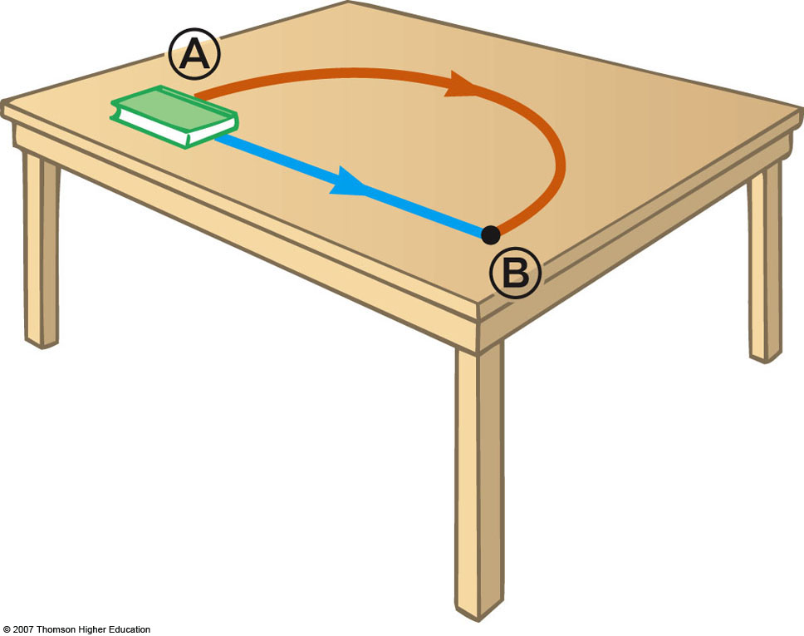
Nonconservative Forces, cont
The work done against friction is greater along the brown path than along the blue path
Because the work done depends on the path, friction is a nonconservative force

Slide 56
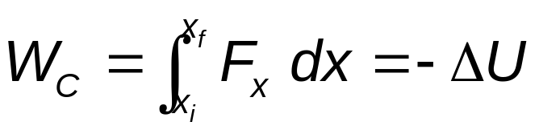
Conservative Forces and Potential Energy
Define a potential energy function, U, such that the work done by a conservative force equals the decrease in the potential energy of the system
The work done by such a force, F, is
  ΔU is negative when F and x are in the same direction

Slide 57
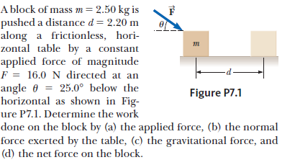

Slide 58
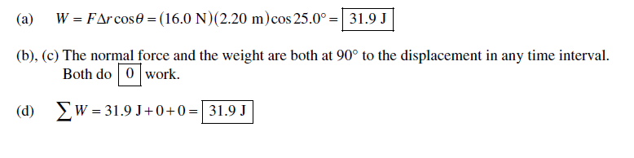

Slide 59

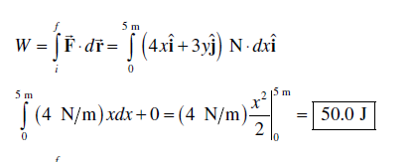

Slide 60

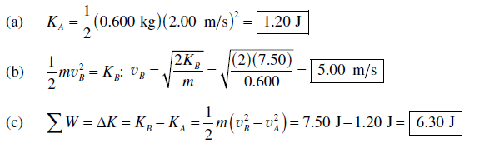

Slide 61



Slide 62
7-32) A 400 N child is in a swing that is attached to ropes 2.00 m long.
Find the gravitational potential energy of the child-Earth system relative to the child ‘s lowest position when (a) the ropes are horizontal, (b) the ropes make 30.0 angle with the vertical , and © the child is at the bottom of circular arc.

Slide 63


