Slide 1
Chapter 9
Linear Momentum and Collisions
Dr. Awos Alsalman

Slide 2

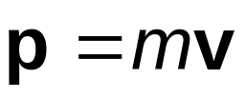
Linear Momentum
The linear momentum of a particle, or an object that can be modeled as a particle, of mass m moving with a velocity is defined to be the product of the mass and velocity:
    The terms momentum and linear momentum will be used interchangeably in the text

Slide 3
Linear Momentum, cont
Linear momentum is a vector quantity
  Its direction is the same as the direction of the velocity
The dimensions of momentum are ML/T
The SI units of momentum are kg · m / s
Momentum can be expressed in component form:
  p_{x} = m v_{x} p_{y} = m v_{y} p_{z} = m v_{z}

Slide 4
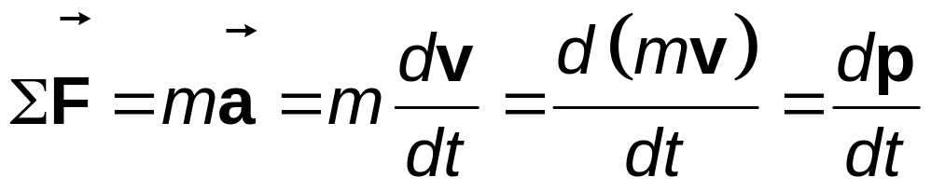
Newton and Momentum
Newton’s Second Law can be used to relate the momentum of a particle to the resultant force acting on it
with constant mass

Slide 5
Newton’s Second Law
The time rate of change of the linear momentum of a particle is equal to the net force acting on the particle
  This is the form in which Newton presented the Second Law
  It is a more general form than the one we used previously
  This form also allows for mass changes
Applications to systems of particles are particularly powerful

Slide 6
Conservation of Linear Momentum
Whenever two or more particles in an isolated system interact, the total momentum of the system remains constant
  The momentum of the system is conserved, not necessarily the momentum of an individual particle
  This also tells us that the total momentum of an isolated system equals its initial momentum

Slide 7


Conservation of Momentum, 2
Conservation of momentum can be expressed mathematically in various ways
In component form, the total momenta in each direction are independently conserved
  p_{ix} = p_{fx} p_{iy} = p_{fy} p_{iz} = p_{fz}
Conservation of momentum can be applied to systems with any number of particles
This law is the mathematical representation of the momentum version of the isolated system model

Slide 8
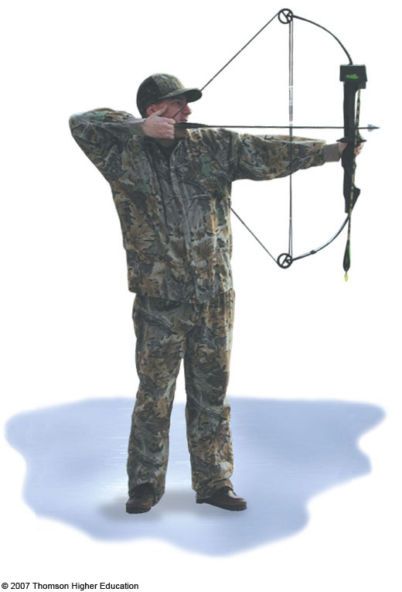
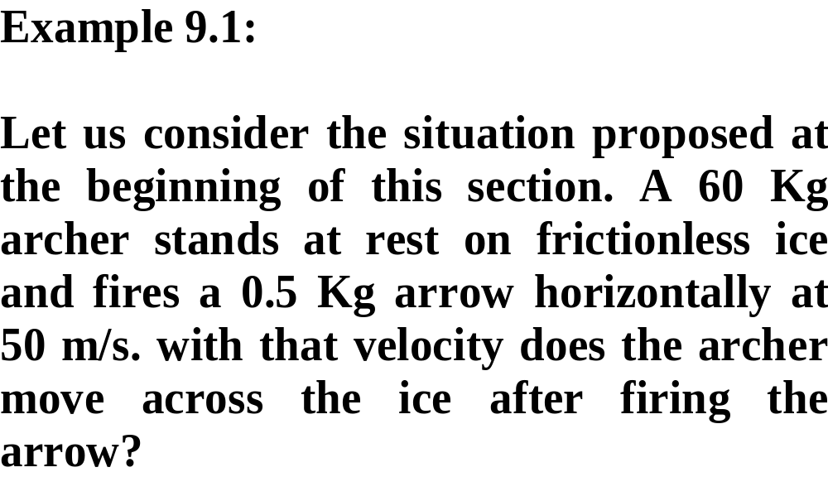
Conservation of Momentum, Archer Example

Slide 9
Conservation of Momentum, Archer Example
The archer is standing on a frictionless surface (ice)
Approaches:
  Newton’s Second Law – no, no information about F or a
  Energy approach – no, no information about work or energy
  Momentum – yes

Slide 10
Archer Example, 2
Conceptualize
  The arrow is fired one way and the archer recoils in the opposite direction
Categorize
  Momentum
    Let the system be the archer with bow (particle 1) and the arrow (particle 2)
    There are no external forces in the x-direction, so it is isolated in terms of momentum in the x-direction
Analyze
  Total momentum before releasing the arrow is 0

Slide 11
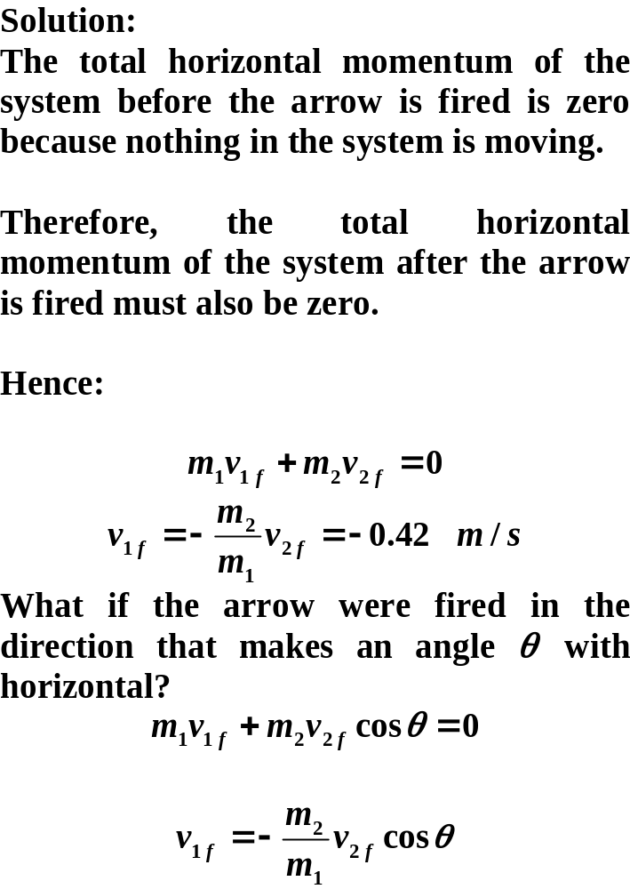

Slide 12
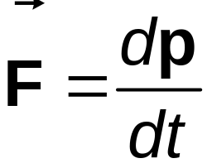
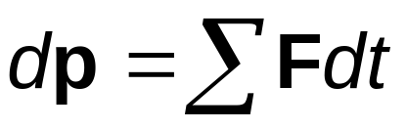
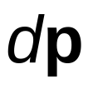
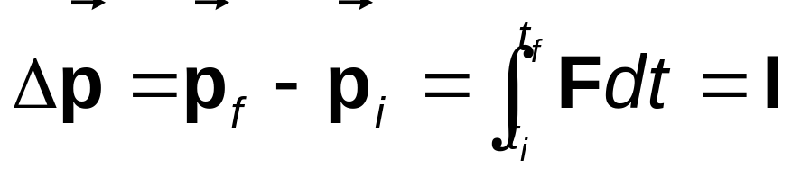

Impulse and Momentum
From Newton’s Second Law,
Solving for gives
Integrating to find the change in momentum over some time interval
The integral is called the impulse, , of the force acting on an object over Δt

Slide 13
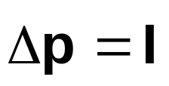
Impulse-Momentum Theorem
This equation expresses the impulse-momentum theorem: The impulse of the force acting on a particle equals the change in the momentum of the particle
  This is equivalent to Newton’s Second Law

Slide 14
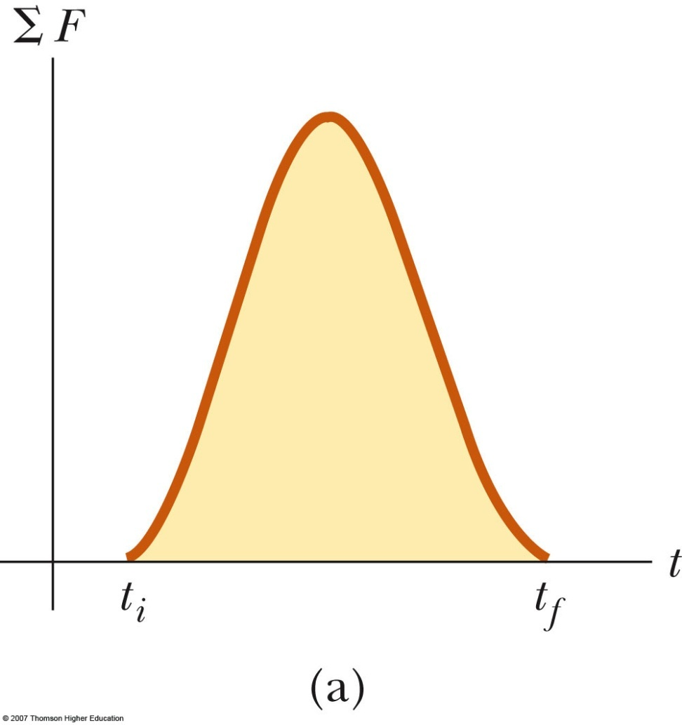
More About Impulse
Impulse is a vector quantity
The magnitude of the impulse is equal to the area under the force-time curve
  The force may vary with time
Dimensions of impulse are M L / T
Impulse is not a property of the particle, but a measure of the change in momentum of the particle

Slide 15
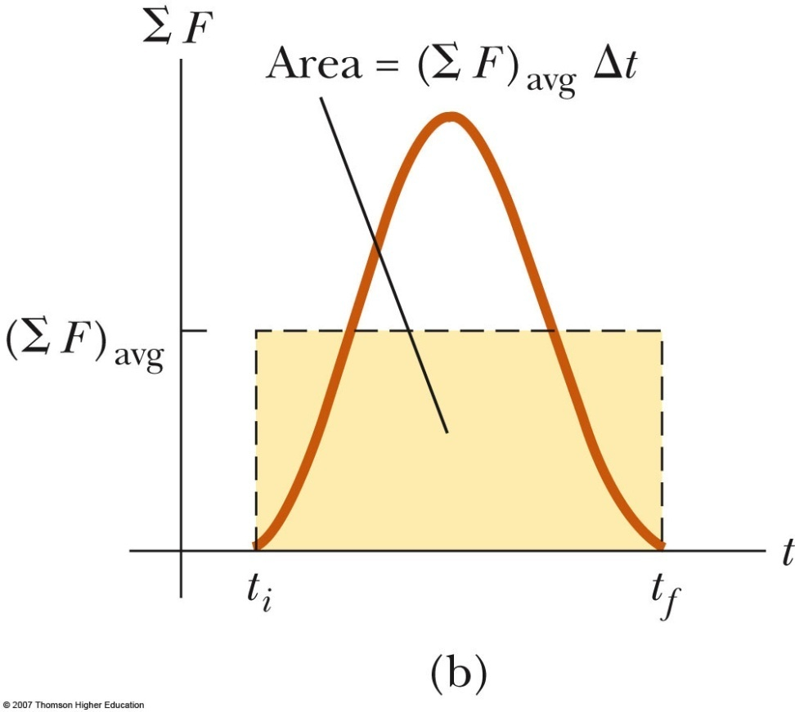
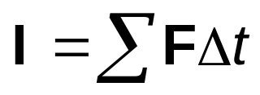
Impulse, Final
The impulse can also be found by using the time averaged force
This would give the same impulse as the time-varying force does

Slide 16
Collisions – Characteristics
We use the term collision to represent an event during which two particles come close to each other and interact by means of forces
  May involve physical contact, but must be generalized to include cases with interaction without physical contact
The time interval during which the velocity changes from its initial to final values is assumed to be short
The interaction forces are assumed to be much greater than any external forces present
  This means the impulse approximation can be used

Slide 17
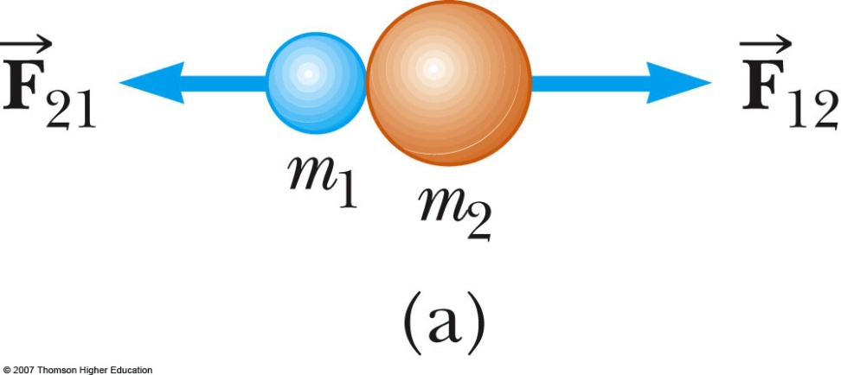
Collisions – Example 1
Collisions may be the result of direct contact
The impulsive forces may vary in time in complicated ways
  This force is internal to the system
  Observe the variations in the active figure
Momentum is conserved

Slide 18
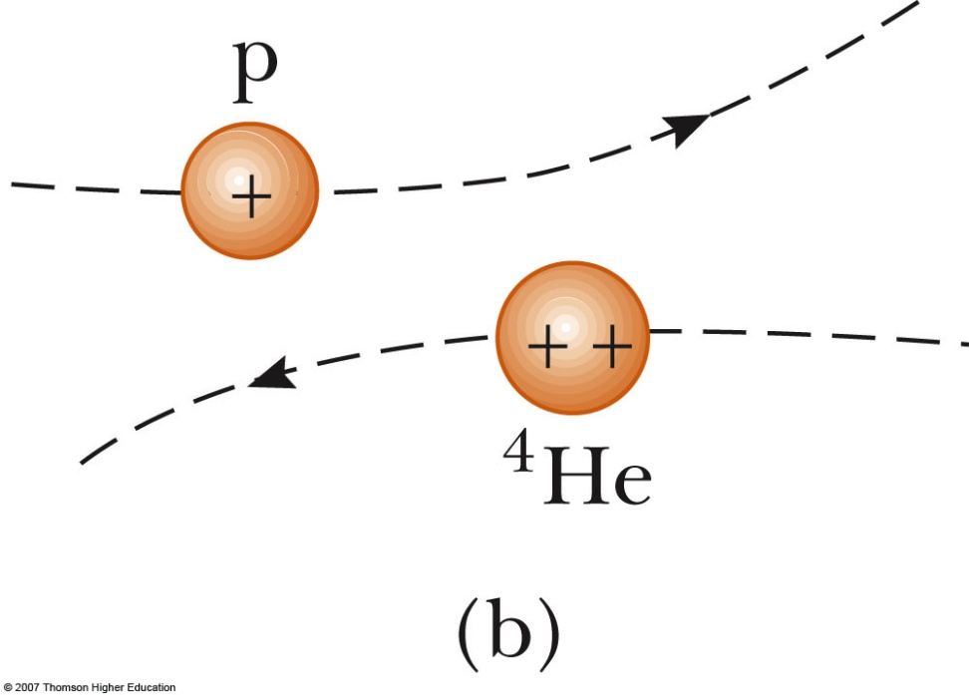
Collisions – Example 2
The collision need not include physical contact between the objects
There are still forces between the particles
This type of collision can be analyzed in the same way as those that include physical contact

Slide 19
Types of Collisions
In an elastic collision, momentum and kinetic energy are conserved
  Perfectly elastic collisions occur on a microscopic level
  In macroscopic collisions, only approximately elastic collisions actually occur
    Generally some energy is lost to deformation, sound, etc.
In an inelastic collision, kinetic energy is not conserved, although momentum is still conserved
  If the objects stick together after the collision, it is a perfectly inelastic collision

Slide 20
Collisions, cont
In an inelastic collision, some kinetic energy is lost, but the objects do not stick together
Elastic and perfectly inelastic collisions are limiting cases, most actual collisions fall in between these two types
Momentum is conserved in all collisions

Slide 21
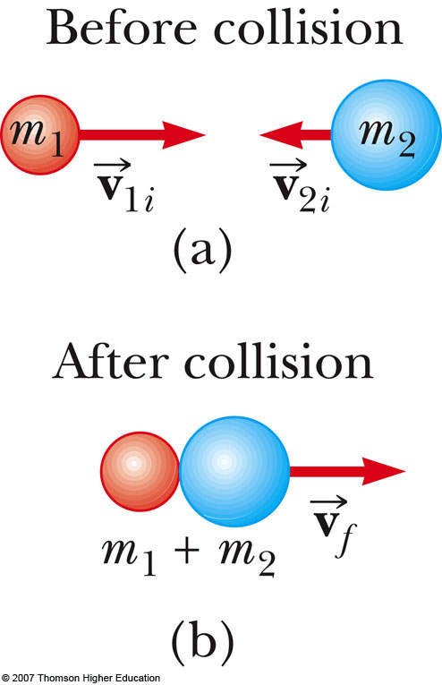
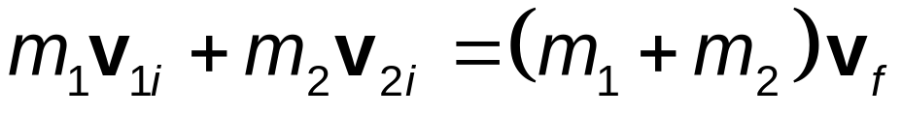
Perfectly Inelastic Collisions
Since the objects stick together, they share the same velocity after the collision

Slide 22
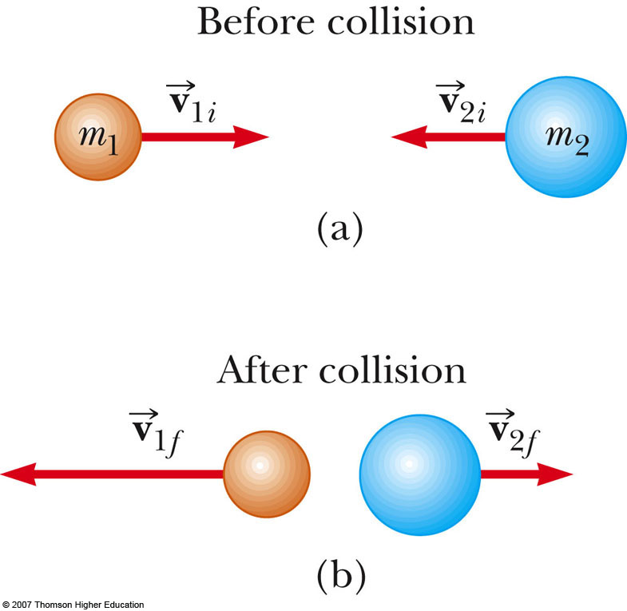
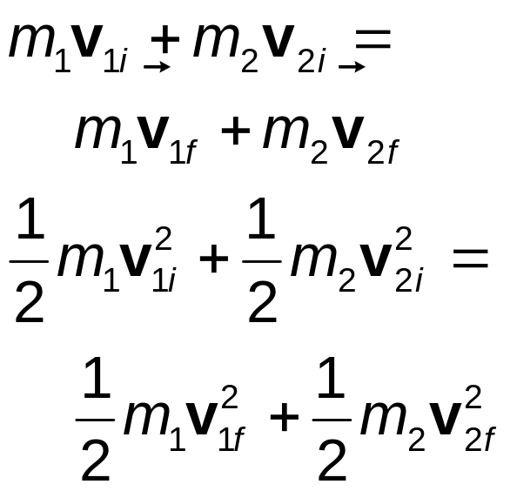
Elastic Collisions
Both momentum and kinetic energy are conserved

Slide 23
Elastic Collisions, cont
Typically, there are two unknowns to solve for and so you need two equations
The kinetic energy equation can be difficult to use
With some algebraic manipulation, a different equation can be used
  v_{1i} – v_{2i} = v_{1f} + v_{2f}
This equation, along with conservation of momentum, can be used to solve for the two unknowns
  It can only be used with a one-dimensional, elastic collision between two objects

Slide 24
Elastic Collisions, final
Example of some special cases
  m₁ = m₂ – the particles exchange velocities
  When a very heavy particle collides head-on with a very light one initially at rest, the heavy particle continues in motion unaltered and the light particle rebounds with a speed of about twice the initial speed of the heavy particle
  When a very light particle collides head-on with a very heavy particle initially at rest, the light particle has its velocity reversed and the heavy particle remains approximately at rest

Slide 25
Problem-Solving Strategy: One-Dimensional Collisions
Conceptualize
  Image the collision occurring in your mind
  Draw simple diagrams of the particles before and after the collision
  Include appropriate velocity vectors
Categorize
  Is the system of particles isolated?
  Is the collision elastic, inelastic or perfectly inelastic?

Slide 26
Problem-Solving Strategy: One-Dimensional Collisions
Analyze
  Set up the mathematical representation of the problem
  Solve for the unknown(s)
Finalize
  Check to see if the answers are consistent with the mental and pictorial representations
  Check to be sure your results are realistic

Slide 27
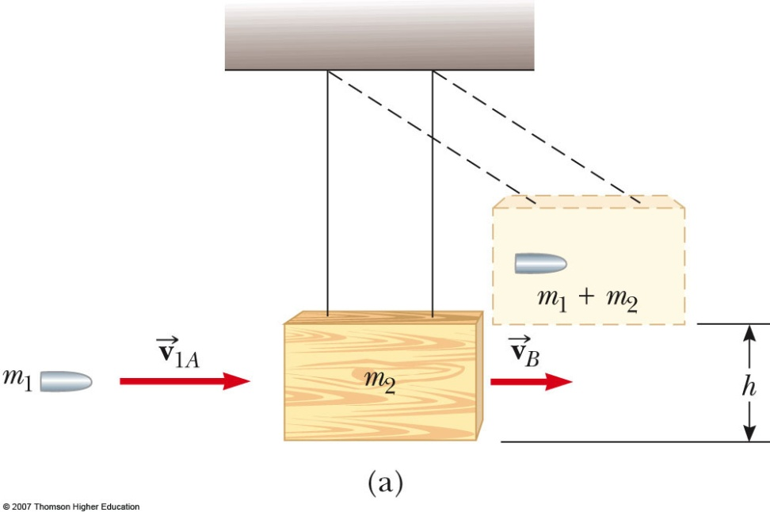
Collision Example – Ballistic Pendulum
Conceptualize
  Observe diagram
Categorize
  Isolated system of projectile and block
  Perfectly inelastic collision – the bullet is embedded in the block of wood
  Momentum equation will have two unknowns
  Use conservation of energy from the pendulum to find the velocity just after the collision
  Then you can find the speed of the bullet

Slide 28
The Center of Mass
There is a special point in a system or object, called the center of mass, that moves as if all of the mass of the system is concentrated at that point
The system will move as if an external force were applied to a single particle of mass M located at the center of mass
  M is the total mass of the system

Slide 29
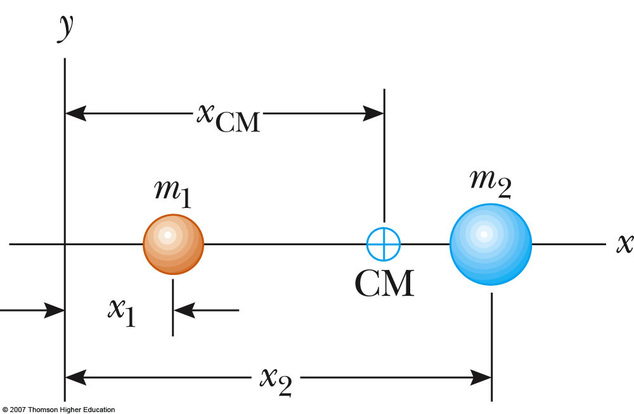
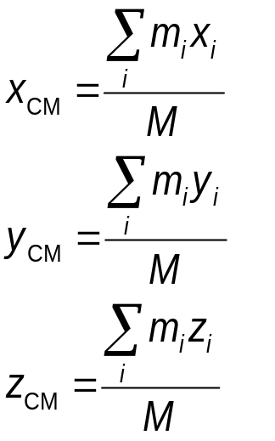
Center of Mass, Coordinates
The coordinates of the center of mass are
  M is the total mass of the system
    Use the active figure to observe effect of different masses and positions

Slide 30
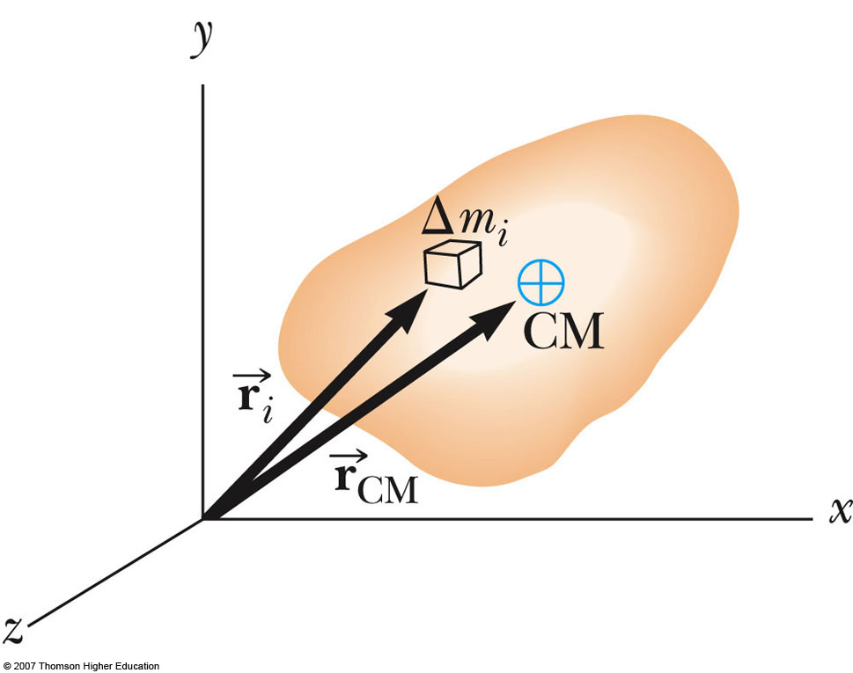
Center of Mass, Extended Object
Similar analysis can be done for an extended object
Consider the extended object as a system containing a large number of particles
Since particle separation is very small, it can be considered to have a constant mass distribution

Slide 31
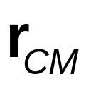
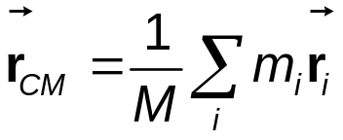

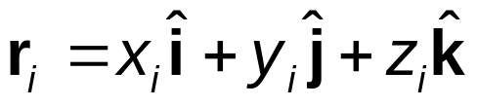
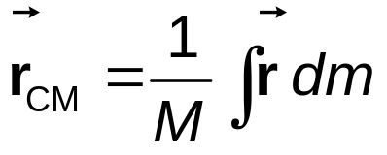
Center of Mass, position
The center of mass in three dimensions can be located by its position vector,
  For a system of particles,
    is the position of the i^{th} particle, defined by
  For an extended object,

Slide 32
Center of Mass, Symmetric Object
The center of mass of any symmetric object lies on an axis of symmetry and on any plane of symmetry
  If the object has uniform density

Slide 33
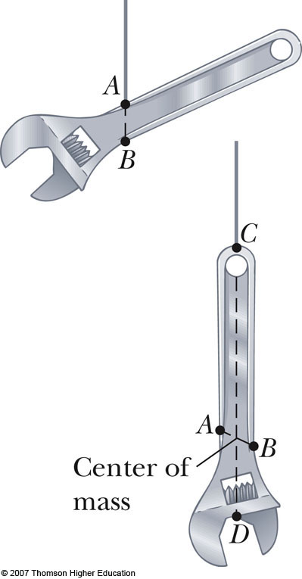
Finding Center of Mass, Irregularly Shaped Object
Suspend the object from one point
The suspend from another point
The intersection of the resulting lines is the center of mass

Slide 34
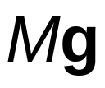

Center of Gravity
Each small mass element of an extended object is acted upon by the gravitational force
The net effect of all these forces is equivalent to the effect of a single force acting through a point called the center of gravity
  If is constant over the mass distribution, the center of gravity coincides with the center of mass

Slide 35

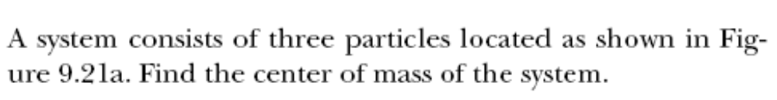
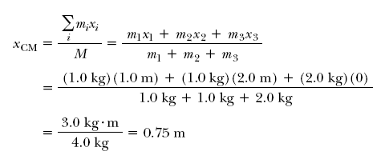
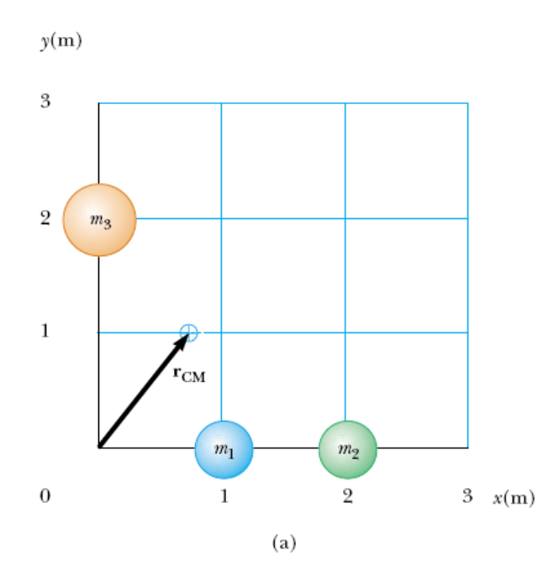

Slide 36
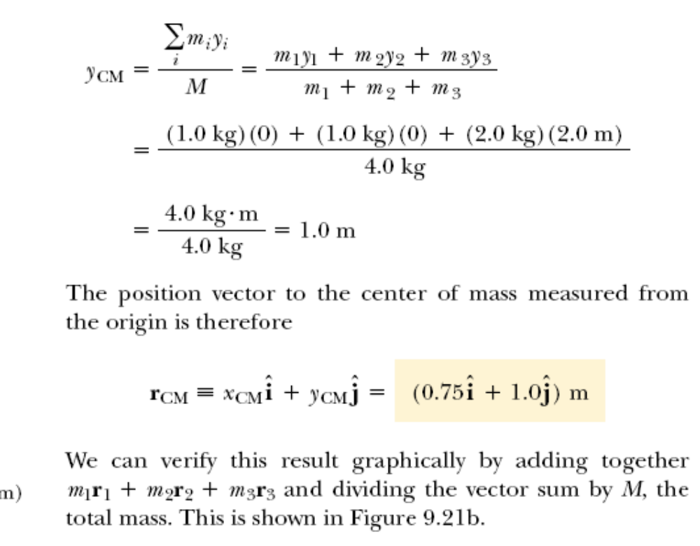

Slide 37
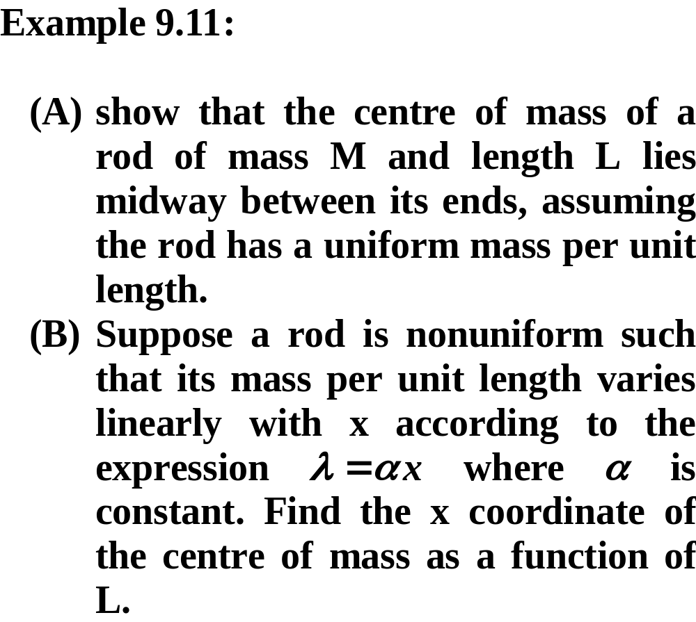
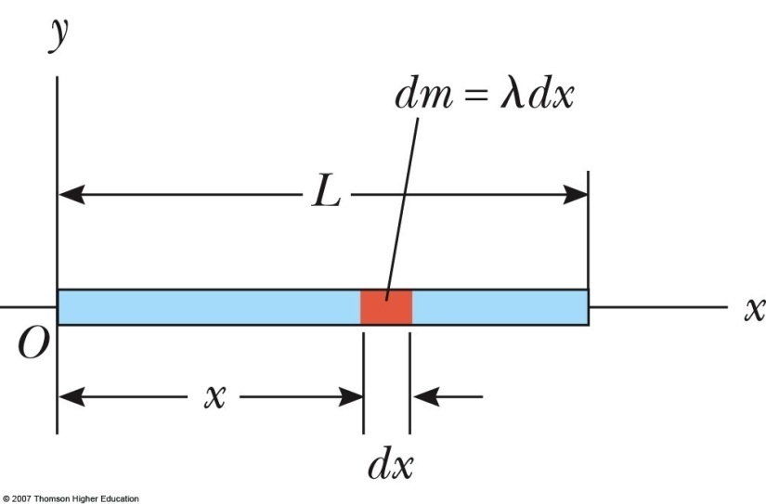

Slide 38

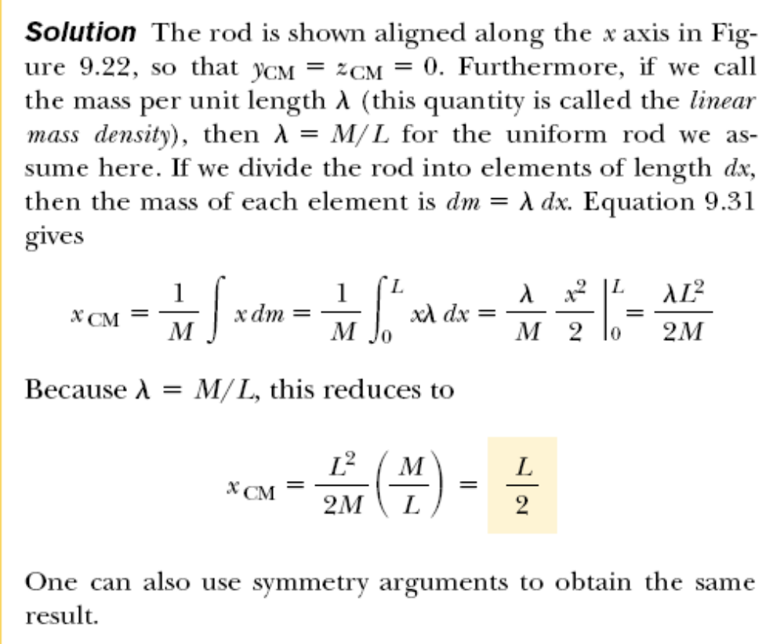


Slide 39


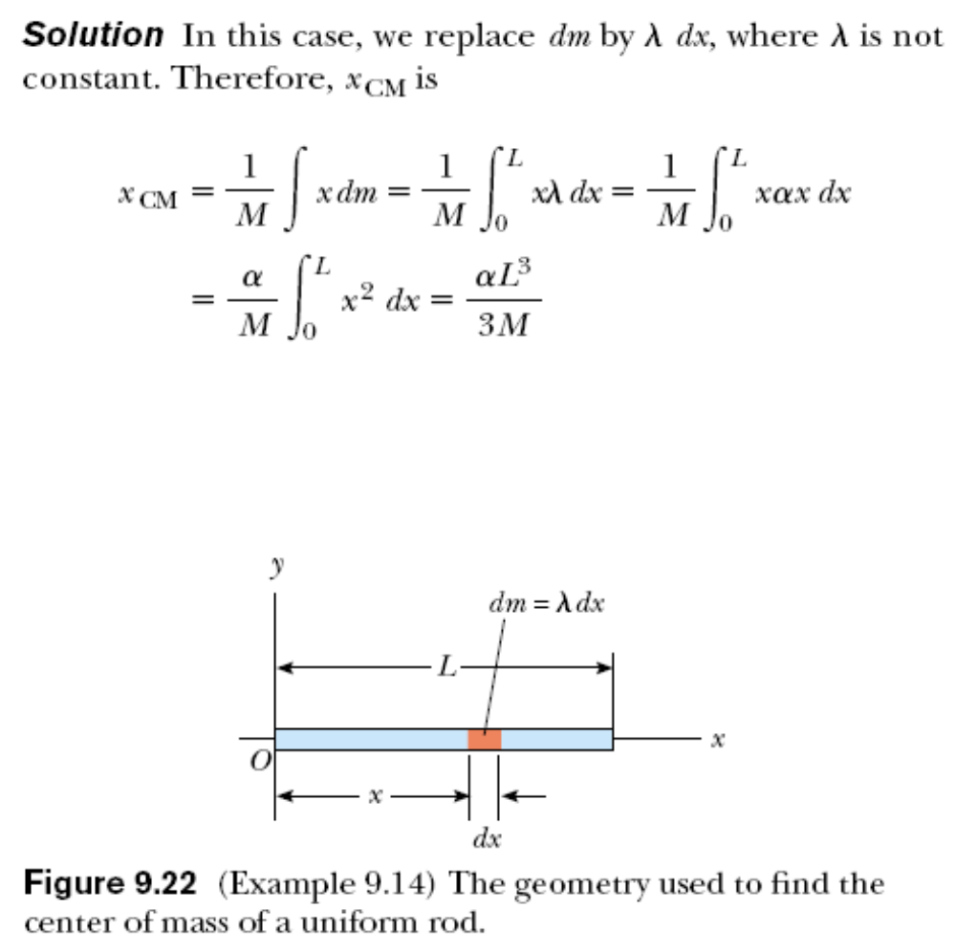


Slide 40

Center of Mass, Rod
Conceptualize
  Find the center of mass of a rod of mass M and length L
  The location is on the x-axis (or y_{CM} = z_{CM} = 0)
Categorize
  Analysis problem
Analyze
  Use equation for x_{cm}
  x_{CM} = L / 2

Slide 41
Motion of a System of Particles
Assume the total mass, M, of the system remains constant
We can describe the motion of the system in terms of the velocity and acceleration of the center of mass of the system
We can also describe the momentum of the system and Newton’s Second Law for the system

Slide 42
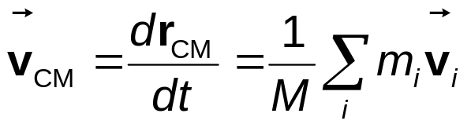
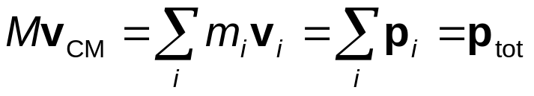
Velocity and Momentum of a System of Particles
The velocity of the center of mass of a system of particles is
The momentum can be expressed as
The total linear momentum of the system equals the total mass multiplied by the velocity of the center of mass

Slide 43
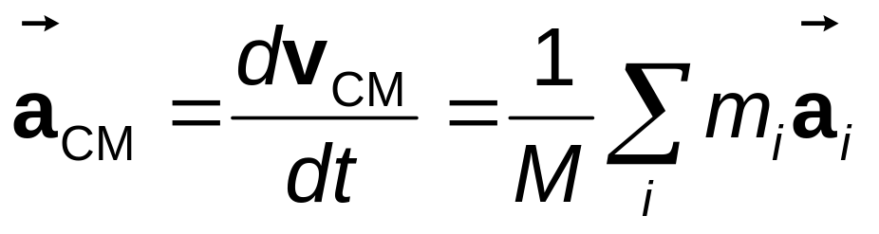
Acceleration of the Center of Mass
The acceleration of the center of mass can be found by differentiating the velocity with respect to time

Slide 44
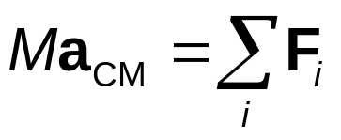
Forces In a System of Particles
The acceleration can be related to a force
If we sum over all the internal forces, they cancel in pairs and the net force on the system is caused only by the external forces

Slide 45
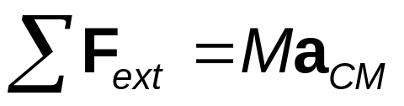
Newton’s Second Law for a System of Particles
Since the only forces are external, the net external force equals the total mass of the system multiplied by the acceleration of the center of mass:

The center of mass of a system of particles of combined mass M moves like an equivalent particle of mass M would move under the influence of the net external force on the system

Slide 46
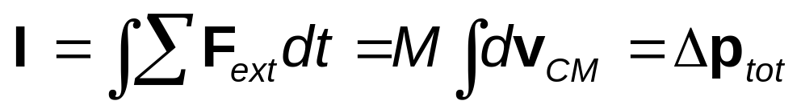
Impulse and Momentum of a System of Particles
The impulse imparted to the system by external forces is
The total linear momentum of a system of particles is conserved if no net external force is acting on the system

Slide 47
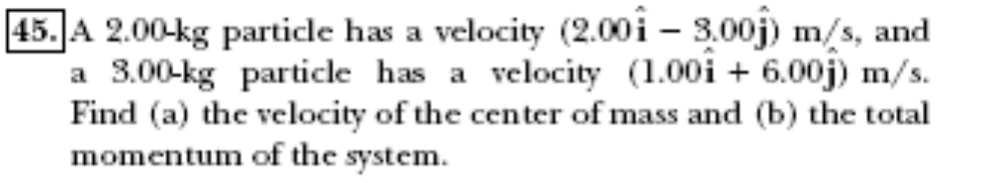
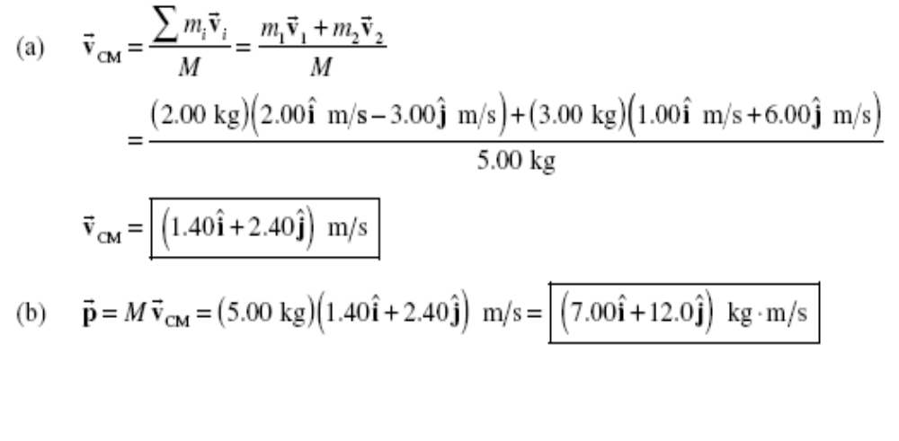

Slide 48
Extra Example1
A 40-kg skater traveling at 4 m/s overtakes a 60-kg skater traveling at 2 m/s in the same direction and collides with her.
(a) If the two skaters remain in contact, what is their final velocity?
(b) How much kinetic energy is lost?

Slide 49
Extra Example2
A 40-kg skater traveling at 4 m/s overtakes a 60-kg skater traveling at 2 m/s If The two skaters are moving in opposite directions and collide head-on.
(a) If they remain in contact, what is their final velocity?
(b) How much kinetic energy is lost?

