Slide 1
AI Powered Offline Object Detection Device for Visually Impaired User.
Guide: Prof. A.M. Shah
Submitted By:
Nilesh Mahajan (21004043)
Ahesan Zafir (21004060)
Atharv Talokar (21004066)

Slide 2
Introduction to Object Detection
Object detection involves identifying and locating multiple objects in images or videos using machine learning and computer vision techniques.
It plays a critical role in applications such as surveillance, autonomous driving, and assistive technologies for visually impaired users.
Modern object detection methods use deep learning to improve detection accuracy and reduce the time required for inference.

Slide 3
Problem Statement
Visually impaired individuals face daily challenges navigating their surroundings due to limited visual information about obstacles and environments.
Traditional aids like canes or guide dogs provide limited feedback and cannot identify or name specific objects in the environment.
This project proposes a system that uses computer vision to provide real-time auditory feedback, enhancing the user’s spatial awareness.

Slide 4
Objectives of the Project
To develop a portable device that detects everyday objects in real-time using Raspberry Pi and a deep learning model.
To integrate Text-to-Speech (TTS) functionality that converts detected object names into audio for the user via headphones.
To optimize performance for real-time use on low-power edge devices without relying on external computing resources.

Slide 5
Significance of the Project
It empowers visually impaired individuals by offering real-time awareness of their surroundings through audio feedback.
The system combines affordable open-source hardware and software, making it accessible to a wide range of users globally.
This project highlights the potential of AI to build inclusive technologies that directly impact daily life and personal independence.

Slide 6
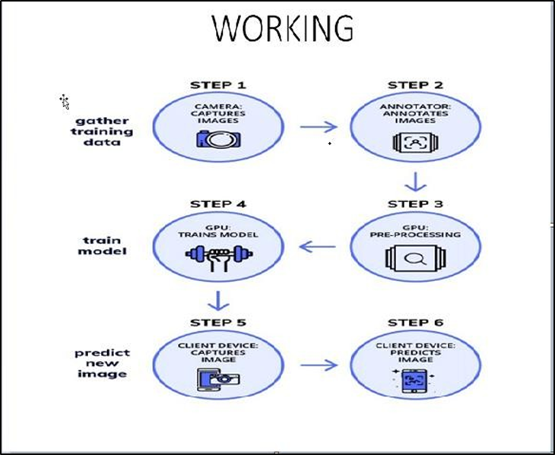
Overview of the System
The hardware includes a Raspberry Pi 3B+, Pi Camera, and headphones for capturing images and delivering audio feedback.
The software stack uses TensorFlow’s Object Detection API, a deep learning model, and TTS libraries to process and respond to input.
Training data includes labeled images of household objects, enhancing recognition of items commonly encountered by users.

Slide 7
Introduction to Computer Vision (CV)
Computer Vision refers to the field of enabling machines to interpret and understand digital images and video streams.
Applications of CV include facial recognition, augmented reality, industrial inspection, and object classification or localization.
The integration of deep learning in CV allows more accurate detection, segmentation, and tracking in complex visual tasks.

Slide 8
Object Detection vs Classification
Image classification identifies the overall category of an image, while object detection locates and labels specific objects within it.
Detection involves predicting bounding boxes and class labels for all objects present in an image.
Unlike classification, detection handles multiple objects and their spatial positions, making it more complex and powerful.

Slide 9
Methods of Object Detection
Traditional machine learning approaches rely on handcrafted features.
Deep learning methods like YOLO, SSD, and Faster R-CNN automatically learn features through convolutional layers.
For this project, SSD with MobileNet V2 was chosen due to its balance between speed and accuracy on embedded devices.

Slide 10
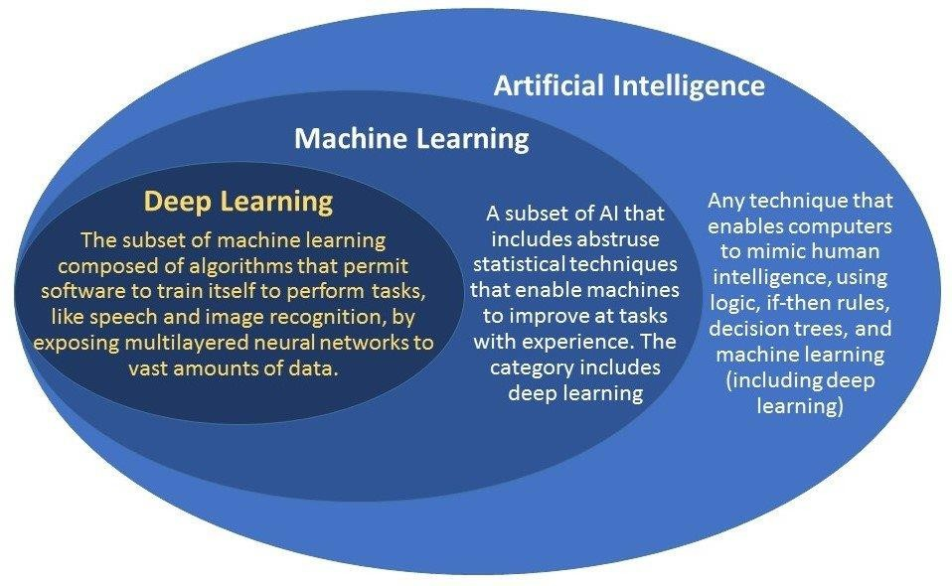
What is Deep Learning?
Deep learning refers to neural networks with multiple hidden layers that learn hierarchical representations of data.
It allows end-to-end learning where the model automatically discovers the best features and patterns for a task.
Deep learning has revolutionized fields like speech recognition, image classification, and autonomous navigation.

Slide 11
Working of Deep Learning Models
Input data is transformed through layers that extract increasingly abstract and complex features from the raw data.
Each layer builds upon the previous one, allowing the model to recognize patterns like edges, shapes, and entire objects.
The final layer outputs predictions, such as object categories and bounding boxes, based on learned features.

Slide 12
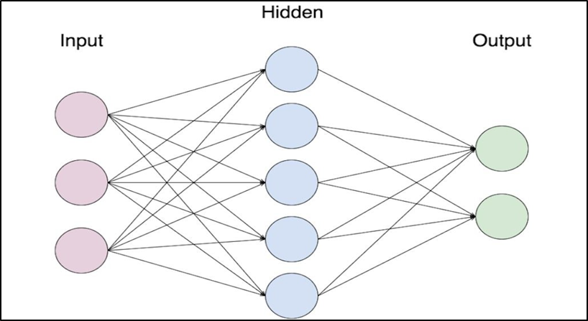
What are Neural Networks?
Neural networks are inspired by biological neurons, with interconnected nodes passing signals to each other through weighted connections.
These networks learn by adjusting weights during training to minimize prediction errors across a dataset.
Activation functions like ReLU or Sigmoid introduce non-linearity, enabling the network to model complex relationships.

Slide 13
Types of Neural Networks
Artificial Neural Networks (ANNs) are basic networks used for simple pattern recognition and regression tasks.
Deep Neural Networks (DNNs) include many hidden layers and excel at modeling non-linear, high-dimensional data.
Convolutional Neural Networks (CNNs) are specialized for image data, using filters to detect features like edges and textures.

Slide 14
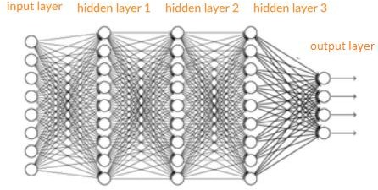
Convolutional Neural Networks (CNN)
CNNs use convolutional layers to scan input images and detect important spatial patterns or textures.
Pooling layers reduce dimensionality, making computations faster while preserving essential information.
CNNs are the backbone of most object detection systems due to their efficiency and accuracy in visual tasks.

Slide 15
Proposed Model Setup
Raspberry Pi 3B+ serves as the main processing unit due to its low cost, small size, and reasonable performance.
Pi Camera captures live video feed for analysis and headphones deliver real-time audio feedback using TTS.
SSD MobileNet model is used for detection and converted to TensorFlow Lite for compatibility with Raspberry Pi.

Slide 16
Dataset Preparation
A dataset of 150 labeled images featuring cups, flasks, and jugs was created for training the object detection model.
Images were annotated using the LabelImg tool, which produced XML files for each labeled object in the dataset.
The labeled data was split into training and testing sets to evaluate the model’s generalization capabilities.

Slide 17
Training the Model
The training process involved running 2000 steps on a machine with an Intel i5 processor using the TensorFlow API.
The SSD MobileNet model was fine-tuned on the dataset to improve detection accuracy for specific household items.
After training, model performance was evaluated using test images, achieving an accuracy of approximately 96%.

Slide 18
Conversion to TensorFlow Lite
The trained model was converted into TensorFlow Lite (.tflite) format to run efficiently on the Raspberry Pi.
TFLite models are optimized for low-latency inference on edge devices with limited memory and compute power.
Despite lower frame rates (~0.9 FPS), the system maintained high detection accuracy after conversion

Slide 19
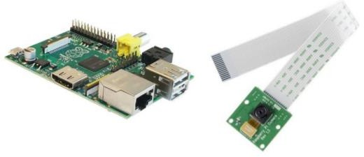
Hardware Components
The setup includes Raspberry Pi 3B+, Pi Camera, SD card, headphones, and optional USB webcams or microphones.
Raspberry Pi provides GPIO pins and networking features, enabling easy integration with additional peripherals.
Power supply and thermal management are important to ensure stability during continuous operation

Slide 20
Software Requirements
The software stack includes Raspbian OS, Python, OpenCV, TensorFlow Lite, and other supporting libraries.
Tools like PuTTY and VNC Viewer are used for remote access and configuration of the Raspberry Pi.
OpenCV is critical for handling image processing tasks such as reading video streams and manipulating frames

Slide 21
Performance Analysis
TensorFlow Lite provides sufficient performance for basic real-time object detection on Raspberry Pi without needing a GPU.
Audio feedback is generated using lightweight TTS libraries, enabling quick and clear responses to detected objects.
The system maintains consistent performance across different environments, making it reliable for daily use.

Slide 22
Conclusion
This project showcases the successful integration of hardware and AI to build an assistive device for the visually impaired.
Real-time detection and auditory feedback allow users to better understand their surroundings and move independently.
Future improvements could include facial recognition, gesture detection, and text reading capabilities for broader use.

Slide 23
Future Scope
Incorporate GPS and voice-based navigation for complete indoor and outdoor mobility assistance.
Extend object detection to include dynamic hazards like vehicles or moving people using tracking algorithms.
Implement cloud connectivity for automatic updates and enhanced training using larger shared datasets.

Slide 24
REFERENCECS
[1] G. E. Sakr, M. Mokbel, A. Hadi, and A. Darwich, “Comparing deep learning and support vector machines for autonomous waste sorting,” in 2016 IEEE International Multidisciplinary Conference on Electrical Technology (IMCET), vol. 26, no. 3, pp. 657–853, March 2016.
[2] V. Tiagarajah and M. S. Subuhan, “Traffic light using TensorFlow object detection framework,” in 2017 IEEE 9th International Conference on System Engineering and Technology (ICSET), vol. 27, no. 4, pp. 567–598, March 2017.
[3] A. Zeroual, P. F. Rocha, and M. P. Silva, “SSD MultiBox object detection,” in Proceedings of the International Conference on Networking and Advanced Systems (ICNAS), IEEE, vol. 25, no. 2, pp. 543–538, March 2018.
[4] W. Liu, D. Anguelov, D. Erhan, and C. Szegedy, “SSD: Single shot multibox detector,” arXiv preprint, Cornell University, 2019.

Slide 25
THANK YOU

