Slide 1
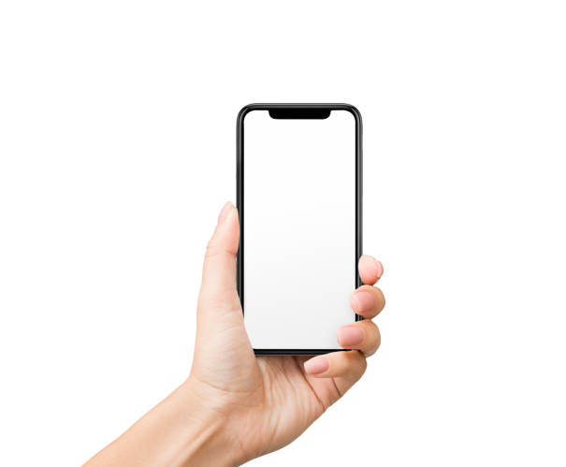
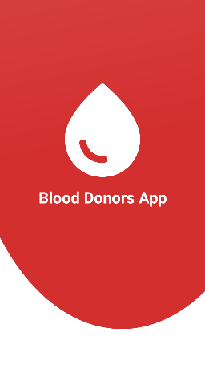
BLOOD DONATION TRACKING APP

Slide 2
APP FLOW
Log in
Registeration
Home Screen
Donor summary
Profile
Favorite Posts

Slide 3
APP GOALS
Our app helps you track the amount of blood donation you have donated.
You can share your thoughts and achievements with others
You can save your favorite posts for later
You can view your own amount of donation

Slide 4
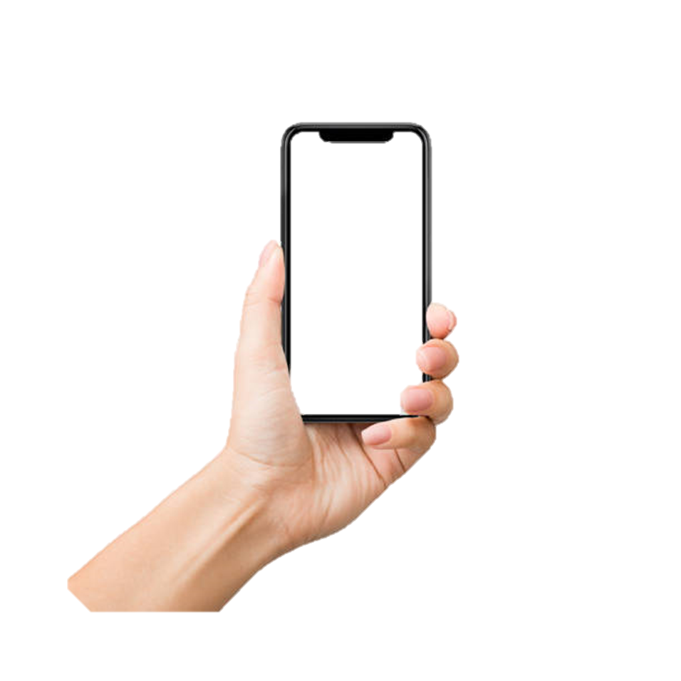
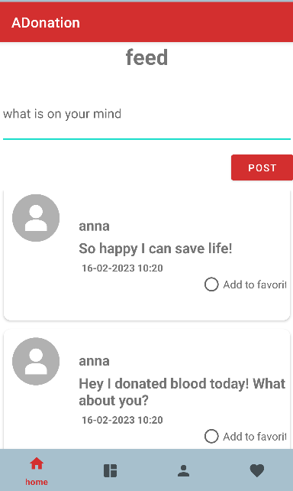
HOME SCREEN
Option to add post
Option to remove post
Gives motivation to share and encourage other to donate blood.

Slide 5
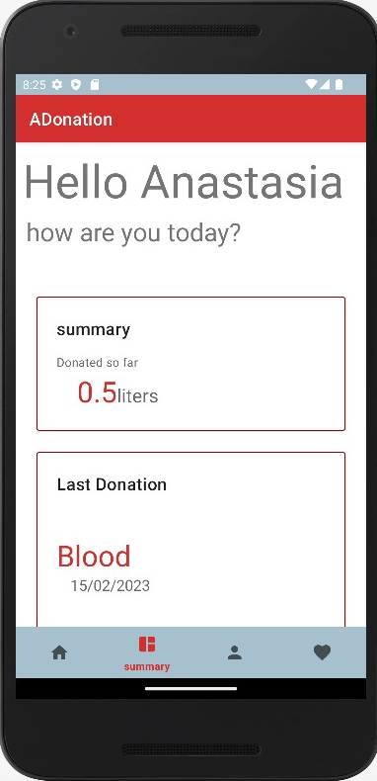
SUMMARY SCREEN
Option to watch the amount of donation
Option to add donation.

Slide 6
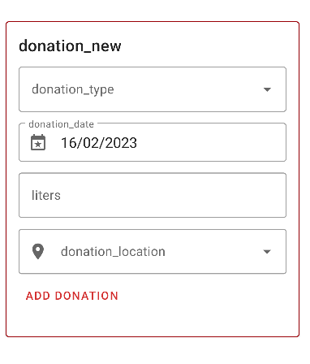
ADD DONATION SCREEN

Slide 7
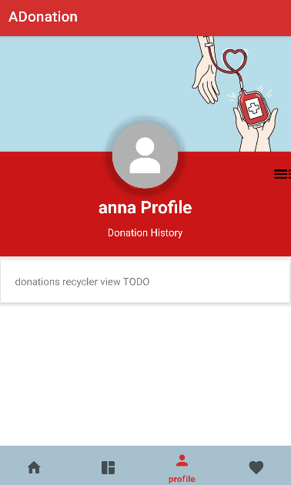
PROFILE SCREEN
The doner can upload a photo.

Slide 8
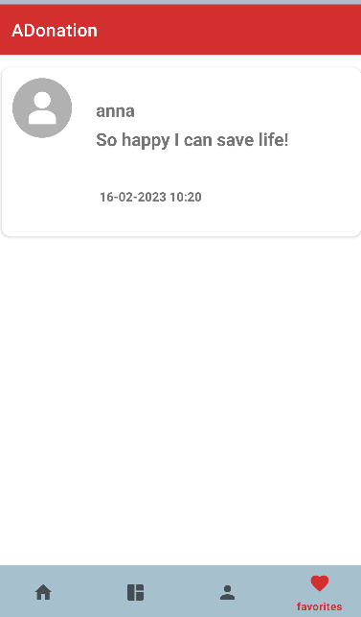
FAVORITE SCREEN
Inculdes doner favorite posts.

