Slide 1
AQI over the world
data mining and machine learning
Anastasia Potemkin
Tal Ben-Zur

Slide 2

Our research - intro
Research questions:
01
What is the main cause of air pollution? (Population, temperature, factories,amount of cars…)
02
Is it possible to predict the air pollution index in a particular area?
03
What pattern can we observe and which conclusions can we learn from them? (according to the data)
04

Slide 3
Our research - intro
Data Acquisition
Data
Cleaning
Exploratory data
analysis
Machine Learning
Conclusions

Slide 4
Data sources
Crawling:
https://www.iqair.com/
https://en.wikipedia.org
https://www.indexmundi.com
https://worldpopulationreview.com/

Slide 5

IQAir- crawling
We used beautiful soup to crawl the relevant tables from IQAir web.
We did it step by step:
First, searching for all the countries and keeping the
link for each country.
In each link of a country, we found the regions and the links to regions.
In each link of an area, we found the cities and city links , which contained the desired information.
Eventually, from the cities we could find the data:
AQI, temperature, humidity, wind and pressure.

Slide 6
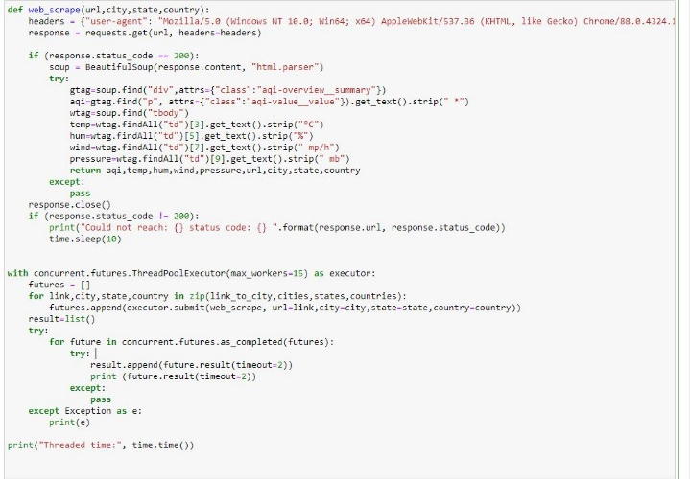
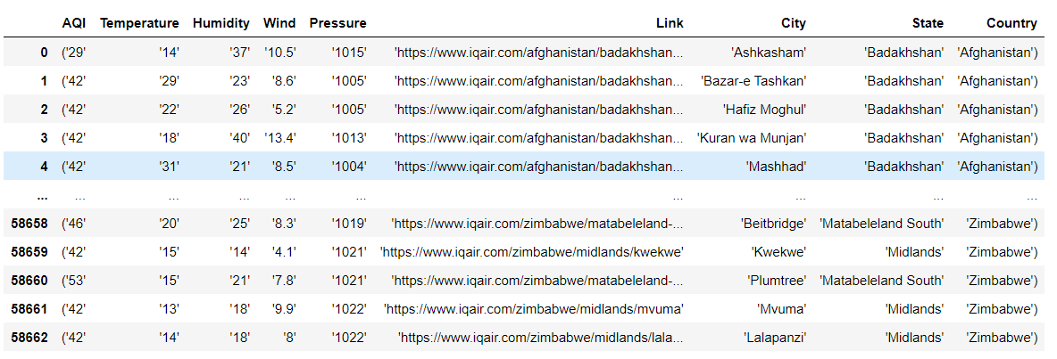
At the end we found more than 56,000 points , 56,000 links to send a request for data.
To speed up the process we’ve used concurrent.futures
And ended up with DB that needed a lot of cleaning !

Slide 7
But we wanted more data
According to many sources, the main air pollution factor is fossil fuels burning — such as coal and petroleum. But also wood.
So we looked for information to give us perspective on car usage, factories and forests.

Slide 8


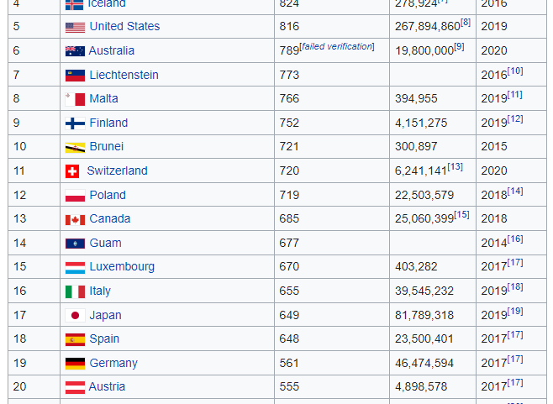
Wikipedia- crawling
We used beautiful soup to crawl the relevant tables from Wikipedia web

Slide 9

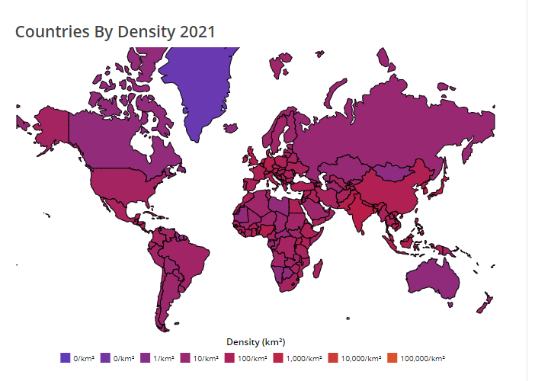
Indexmundi & worldpopulationreview- crawling
We used beautiful soup to crawl the relevant tables.

Slide 10
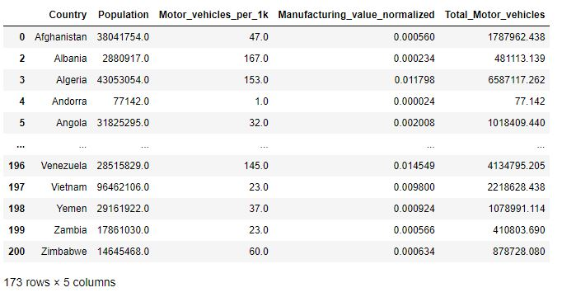
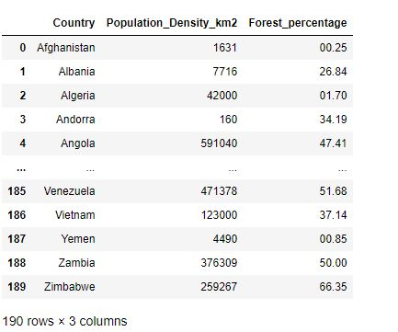
We combined all the data into two
data frames and started roughly analyzing it
More Scarping

Slide 11
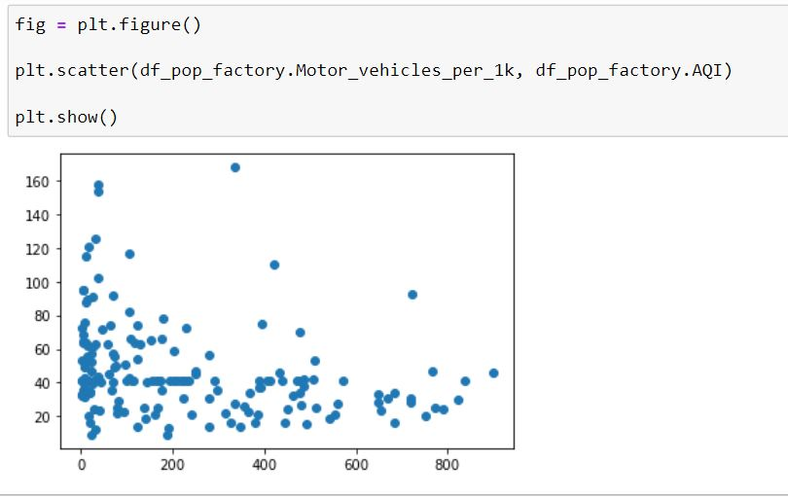
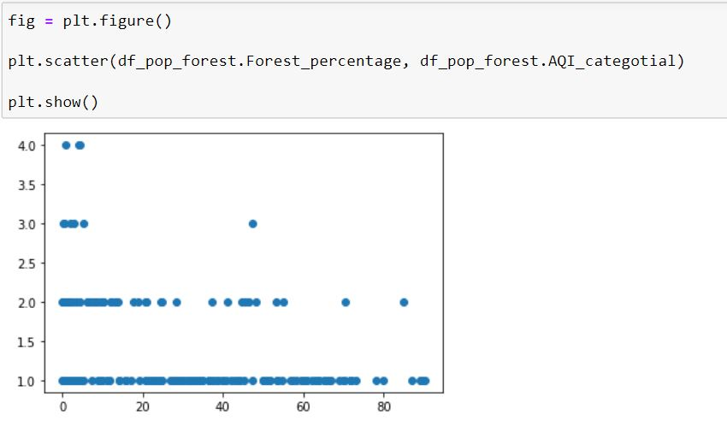
Although we didn’t find a strong correlation between any of the variables,
we’ve definitely seen some kind of it .
In case of number of motor vehicles per
1k we were surprised to see inverse relation
After analyzing correlations we ended up with one csv file

Slide 12
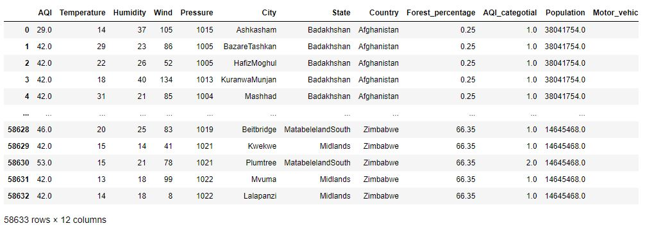

Slide 13
Data cleaning
Concatenation of all the information into one table while adjusting the columns into a uniform format
Outliners handling
Filter duplicates and empty values
Delete unnecessary characters (“, %, °C, mb)

Slide 14
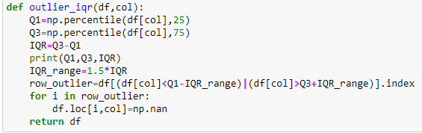
After we received the final DF, we handled the data.
We deleted all the outliers with IQR:
The information was filtered from about 58K records to 34K.
Outliers Handling

Slide 15
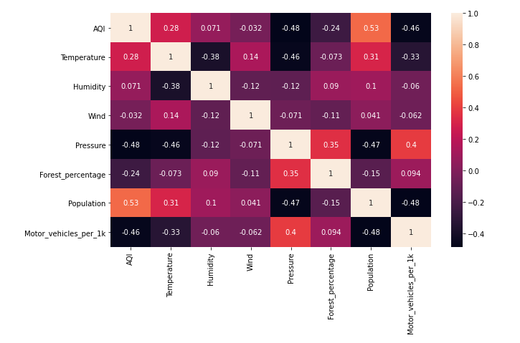
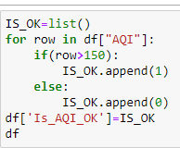
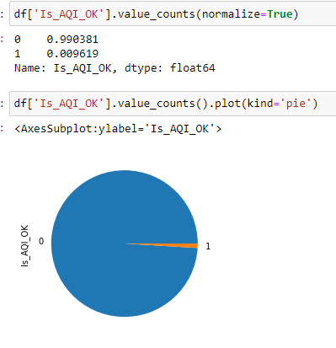
Exploratory data analysis
We added a column that show if the AQI is good(smaller than 150).
We found that the most records are “Good”.
We found high correlation between:
AQI and Population
AQI and Temperature

Slide 16

Machine Learning
Using `sklearn` library and logistic regression we were able to train a model that predicts if AQI in a particular city will be good
or not
The model was able to find a match between the various variables,
and the AQI as we expected.
94% match

Slide 17
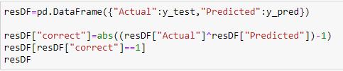

Machine Learning Prosses
Apply Machine Learning Algorithm - Train
01
Apply Machine Learning Algorithm - Predict
02
Res for Logistic Regression:
03
Evaluation
04

Slide 18
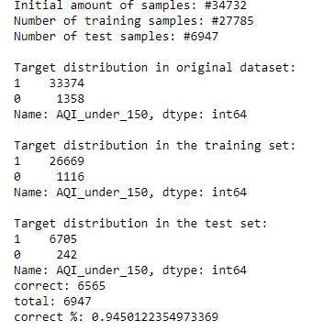
Evaluation
The total number of lists is: 34,732.
Of these, we trained 27,784 records,
And we did a check on 6,947 records.
From 6,947 records,
we were able to predict 6,565 records.
Which are over 94% success.

Slide 19
Thank you!

