Slide 1
DIT5411 Machine Learning Project
Forecasting Hong Kong Daily Grass Minimum Temperature
Using RNN, LSTM, and BiLSTM
Fok Tsz Ching 220134800

Slide 2
Background & Motivation
Grass Minimum Temperature is important for frost prediction, agriculture, and environmental monitoring.
  Hong Kong shows strong temperature seasonality.
  Deep learning handles nonlinear temporal patterns in climate data.

Slide 3
Project Objectives
Preprocess HKO grass minimum temperature data (1980–2025).
  Train and compare RNN, LSTM, and BiLSTM.
  Evaluate models on unseen 2025 data using MAE and RMSE.
  Interpret results and publish reproducible code on GitHub.

Slide 4
Dataset Description
Source: Hong Kong Observatory (HKO).
  Daily grass minimum temperature from 1980–2025.
  Training: 1980–2024; Testing: Jan–Oct 2025.
  Data exhibits strong seasonality and smooth transitions.

Slide 5
Data Preprocessing
Datetime conversion and cleaning.
Missing-value interpolation.
Normalization using MinMaxScaler.
45-day sliding window → next-day prediction.

Slide 6
Model Overview: RNN
SimpleRNN (64 units).
Dense (32, ReLU).
Output: 1 unit.
Efficient for smooth, single-variable climate data.

Slide 7
Model Overview: LSTM / BiLSTM
LSTM (64 units) + Dropout (0.2).
BiLSTM (64 units).
Both followed by Dense (32) → Output (1).

Slide 8
Training Configuration
Optimizer: Adam (0.001).
  Loss: MSE.
  Epochs: 80; Batch size: 32.
  Validation split: 10%.

Slide 9
Results Summary
RNN — MAE: 0.9539, RMSE: 1.3089.
LSTM — MAE: 1.9091, RMSE: 2.1487.
BiLSTM — MAE: 1.0022, RMSE: 1.2943.
RNN achieved best overall performance.

Slide 10
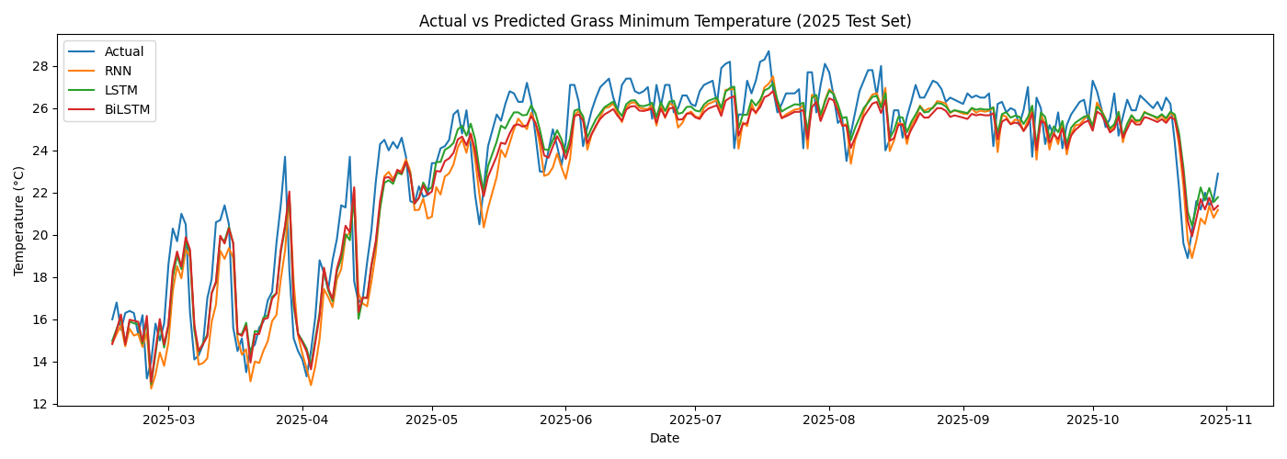
Actual vs Predicted Temperature

Slide 11
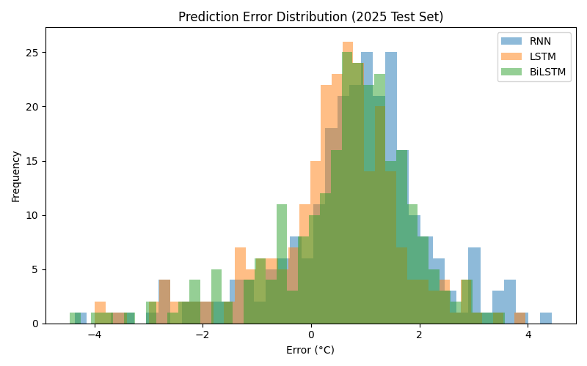
Error Distribution

Slide 12
Discussion
RNN outperformed due to smooth, seasonal dataset.
LSTM overfitted on single-variable climate data.
BiLSTM improved stability but remained less consistent than RNN.
Cold anomalies increased error across all models.

Slide 13
Conclusion & Future Work
RNN is the most suitable model for this dataset.
LSTM and BiLSTM complexity did not provide advantages.
Future work: multivariate models, GRU, hybrid architectures, probabilistic forecasting.

Slide 14
GitHub Repository
https://github.com/Ahhaeyy/DIT5411-RNN-LSTM-Temperature-Forecasting

