Slide 1

Apartment Society Management System
Designing a relational + document database for a housing society
DBMS project · MySQL 8 · MongoDB · 31 October 2026
Notes:
Introduce the project: a database for running an apartment society. The focus of this talk is the database design: the ER model, the relational schema and its constraints, normalization, SQL, transactions, and how a document database complements MySQL. The web app is just the interface on top.

Slide 2






What the database has to manage
Flats
Residents
Maintenance bills
Blocks, floors, flat numbers, size
Owners and tenants; one person can have several flats
One bill per flat per month, paid or pending
Parking & vehicles
Complaints & staff
Visitors & notices
Car and bike slots; one vehicle per slot
Raised by residents, assigned to staff, tracked to resolution
High-volume logs and announcements
10 relational tables in MySQL 4 document collections in MongoDB 5 user roles
Notes:
These are the real-world things the system tracks. The core data (flats, people, bills, parking, complaints) needs strict relationships, so it goes in MySQL. Visitor logs, notices, feedback and complaint history are event-like and grow fast, so they go in MongoDB. Five roles use it: admin, owner, tenant, maintenance staff and security.

Slide 3
Two databases, one application
MySQL 8 (InnoDB)
Flats, residents, staff, bills, parking, vehicles, complaints, logins
Keys, foreign keys, transactions
Browser
Application server
Pages for each role
Never touches a database
Validates input
Checks role + ownership
Runs SQL / queries
MongoDB
Visitor log, notices, feedback, complaint timeline
Flexible documents, append-heavy
MongoDB documents point to MySQL rows by integer id (apartmentId, residentId, complaintId). Nothing is copied between the two.
Notes:
The browser only ever talks to the application server, which is the single place where queries are built. Relational, integrity-critical data lives in MySQL with InnoDB, which gives us foreign keys and ACID transactions. Event-style data lives in MongoDB. The two are linked only by MySQL integer ids, so there is no duplicated data to keep in sync.

Slide 4
ER diagram
Notation
PK primary key FK foreign key
UK unique key
1, N, 0..1 = cardinality at that end
AccountRequest
UserAccount
Staff
PK request_id
FK created_account_id
username, email
status, reviewed_at
0..1
0..1
PK user_id
UK username, UK email
FK staff_id
password_hash, role
0..1
1
PK staff_id
UK phone
name, role
salary DECIMAL(10,2)
creates
logs in as
0..1
0..1
one login, many flats
assigned to
N
N
MaintenancePayment
Apartment
Resident
Complaint
PK payment_id
FK apartment_id
UK (apartment_id, payment_month)
amount, status, payment_date
N
1
PK apartment_id
UK (block, flat_no)
floor_no
bhk
1
N
PK resident_id
FK apartment_id
FK account_id
name, phone, resident_type
1
N
PK complaint_id
FK resident_id
FK staff_id (nullable)
category, status, date
billed to
houses
raises
0..1
1
allocated to
owns
N
N
MongoDB (by id)
visitors → apartmentId
feedback → residentId
complaint_activity → complaintId
notices
ParkingSpace
Vehicle
LoginAttempt
PK parking_id
FK apartment_id (nullable)
UK slot_number
vehicle_type, status
0..1
0..1
PK vehicle_id
FK resident_id
FK + UK parking_id
UK vehicle_number, type
PK identifier
failures
reset_at
(no relationships)
parks
Notes:
This is the full ER model. Apartment is the hub: a flat has many residents, many monthly bills and possibly some parking slots. A resident row is one person in one flat, and a login account can be linked to several resident rows, which is how one person owning two flats is modelled. A resident owns vehicles and raises complaints; a complaint is optionally assigned to a staff member. Each parking slot holds at most one vehicle. AccountRequest stores public sign-up requests, and LoginAttempt is a standalone throttle table. The dashed box shows what MongoDB references by id.

Slide 5
Relationships and cardinality
Relationship | Cardinality | Participation | Implemented as
Apartment houses Resident | 1 : N | Resident must have a flat | Resident.apartment_id NOT NULL → Apartment
Apartment billed MaintenancePayment | 1 : N | Bill must belong to a flat | FK + UNIQUE (apartment_id, payment_month)
Apartment allocated ParkingSpace | 1 : N | Optional (free slots have no flat) | ParkingSpace.apartment_id NULL allowed
Resident owns Vehicle | 1 : N | Vehicle must have an owner | Vehicle.resident_id NOT NULL
ParkingSpace parks Vehicle | 1 : 1 | Optional on both sides | Vehicle.parking_id UNIQUE, NULL allowed
Resident raises Complaint | 1 : N | Complaint must have a resident | Complaint.resident_id NOT NULL
Staff assigned Complaint | 1 : N | Optional (unassigned = OPEN) | Complaint.staff_id NULL allowed
UserAccount linked to Resident | 1 : N | Optional (not everyone logs in) | Resident.account_id + UNIQUE (account_id, apartment_id)
UserAccount logs in as Staff | 1 : 1 | Optional | UserAccount.staff_id UNIQUE
Notes:
Each relationship and how it becomes a constraint. Total participation becomes NOT NULL on the foreign key; partial participation allows NULL. The one-to-one between parking slot and vehicle is enforced with a UNIQUE index on Vehicle.parking_id. The interesting one is the last-but-one: an account to many residencies, with a composite unique key so one login cannot appear twice in the same flat.

Slide 6
Relational schema
Apartment ( apartment_id, block, floor_no, flat_no, bhk )
Resident ( resident_id, apartment_id, account_id, name, phone, email, resident_type, is_active )
Staff ( staff_id, name, role, phone, salary, is_active )
ParkingSpace ( parking_id, apartment_id, slot_number, vehicle_type, status )
Vehicle ( vehicle_id, resident_id, parking_id, vehicle_number, vehicle_type, brand, is_active )
MaintenancePayment ( payment_id, apartment_id, amount, payment_month, payment_date, status )
Complaint ( complaint_id, resident_id, staff_id, category, description, complaint_date, status )
UserAccount ( user_id, staff_id, username, email, password_hash, role, is_active, sessions_valid_after )
AccountRequest ( request_id, created_account_id, full_name, username, email, password_hash, requested_role, status, reviewed_at )
LoginAttempt ( identifier, failures, reset_at )
underlined = primary key italic = foreign key Every table also has created_at and updated_at.
Notes:
The ER diagram mapped to relations. Every table uses a surrogate integer primary key with AUTO_INCREMENT; natural keys such as (block, flat_no) are kept as unique constraints instead. The lab baseline had seven tables; we added UserAccount, AccountRequest and LoginAttempt for real authentication.

Slide 7




Keys and integrity constraints
Primary keys
Candidate / unique keys
Surrogate INT AUTO_INCREMENT on every table
Stable even if a flat number or phone changes
InnoDB clusters rows by primary key
(block, flat_no) on Apartment
(apartment_id, payment_month): no duplicate bill
Vehicle.parking_id: one vehicle per slot
(account_id, apartment_id), username, email
Foreign keys (10)
Domain constraints
ON DELETE RESTRICT: cannot delete a flat that has bills or residents
ON DELETE SET NULL: slot freed if a vehicle row goes
History is kept: rows are deactivated, not deleted
ENUM: status, resident_type, vehicle_type
DECIMAL(10,2) for money, never FLOAT
NOT NULL for mandatory attributes; DATE for dates
Notes:
Four kinds of constraint. Surrogate primary keys everywhere. Business uniqueness as UNIQUE indexes, including composite ones: the duplicate-bill rule is enforced by the database itself, not just the app. Ten foreign keys with deliberate referential actions: RESTRICT where history matters, SET NULL where the child can live without the parent. Domain constraints through ENUM, DECIMAL and NOT NULL.

Slide 8
Normalization
Relation | Key functional dependencies | Form
Apartment | apartment_id → all; (block, flat_no) → apartment_id | BCNF
MaintenancePayment | payment_id → all; (apartment_id, payment_month) → payment_id | BCNF
Vehicle | vehicle_id → all; vehicle_number → vehicle_id | BCNF
Complaint, Staff, UserAccount | Every determinant is a key | BCNF
Resident | resident_id → all; (account_id, apartment_id) → resident_id | 3NF*
ParkingSpace | parking_id → all; status derivable from Vehicle | 3NF*
* Deliberate redundancy
Resident
A person with two flats has two rows, so name and phone repeat. A Person table would remove this; we kept one row per residency because type and status differ per flat.
ParkingSpace.status
Could be derived from Vehicle. Stored for fast "free slots" queries; both rows change in one transaction, and a check query confirms 0 inconsistent rows.
All relations are in 1NF (atomic values) and 2NF (single-column surrogate keys leave no partial dependencies).
Notes:
Most relations are in BCNF: every determinant is a candidate key. We are honest about two places that are not fully normalized. Resident repeats a person's contact details across their flats, which risks an update anomaly; the textbook fix is a separate Person table, which is listed as future work. ParkingSpace.status is technically derivable from Vehicle; we keep it for query speed and protect it with transactions plus a consistency query.

Slide 9
DDL: constraints in the actual tables
CREATE TABLE MaintenancePayment (
payment_id INT NOT NULL AUTO_INCREMENT,
apartment_id INT NOT NULL,
amount DECIMAL(10,2) NOT NULL,
payment_month VARCHAR(20) NOT NULL,
payment_date DATE NULL,
status ENUM('PAID','PENDING') NOT NULL,
PRIMARY KEY (payment_id),
UNIQUE (apartment_id, payment_month),
INDEX (status),
FOREIGN KEY (apartment_id)
REFERENCES Apartment (apartment_id)
ON DELETE RESTRICT ON UPDATE CASCADE
);
CREATE TABLE Vehicle (
vehicle_id INT NOT NULL AUTO_INCREMENT,
resident_id INT NOT NULL,
parking_id INT NULL,
vehicle_number VARCHAR(20) NOT NULL,
vehicle_type ENUM('CAR','BIKE') NOT NULL,
brand VARCHAR(50) NULL,
is_active BOOLEAN NOT NULL DEFAULT TRUE,
PRIMARY KEY (vehicle_id),
UNIQUE (vehicle_number),
UNIQUE (parking_id), -- one car per slot
FOREIGN KEY (resident_id) REFERENCES Resident
(resident_id) ON DELETE RESTRICT,
FOREIGN KEY (parking_id) REFERENCES ParkingSpace
(parking_id) ON DELETE SET NULL
);
Simplified from SHOW CREATE TABLE on the live database (timestamps and index names omitted).
Notes:
Two tables from the real database. MaintenancePayment shows the composite unique key that blocks a second bill for the same flat and month, DECIMAL for money, and RESTRICT so a flat with bills cannot be deleted. Vehicle shows a nullable foreign key that is also UNIQUE, which is how a one-to-one optional relationship is implemented, plus two different referential actions.

Slide 10
Queries: joins and grouping
-- Pending bills and the owner to contact
SELECT CONCAT(a.block,'-',a.flat_no) AS flat,
p.payment_month, p.amount, r.name AS owner
FROM MaintenancePayment p
JOIN Apartment a ON a.apartment_id = p.apartment_id
JOIN Resident r ON r.apartment_id = a.apartment_id
AND r.resident_type = 'OWNER'
AND r.is_active
WHERE p.status = 'PENDING';
flat | month | amount | owner
A-201 | 2026-10 | 3500.00 | Arjun Rao
B-101 | 2026-10 | 3500.00 | Vikram Singh
B-202 | 2026-10 | 4000.00 | Neha Kapoor
-- People who have more than one flat
SELECT u.username, COUNT(*) AS flats,
GROUP_CONCAT(CONCAT(a.block,'-',a.flat_no,
' (',r.resident_type,')')) AS residencies
FROM UserAccount u
JOIN Resident r ON r.account_id = u.user_id
JOIN Apartment a ON a.apartment_id = r.apartment_id
GROUP BY u.user_id, u.username
HAVING COUNT(*) > 1;
username | flats | residencies
resident | 2 | A-101 (OWNER), A-201 (OWNER)
Results are real output from the project database.
Notes:
Two reporting queries with their real output. The first is a three-way join with extra conditions inside the join so that only the active owner is returned; an earlier version without the OWNER condition returned the tenant too, which is a good example of why join conditions matter. The second uses GROUP BY with HAVING to find people who own or rent more than one flat.

Slide 11
Queries: aggregation and integrity checks
-- Collected vs pending per month
SELECT payment_month,
SUM(CASE WHEN status='PAID'
THEN amount ELSE 0 END) AS collected,
SUM(CASE WHEN status='PENDING'
THEN amount ELSE 0 END) AS pending
FROM MaintenancePayment
GROUP BY payment_month;
-- Integrity check: slot marked ALLOCATED but no vehicle in it
SELECT ps.slot_number
FROM ParkingSpace ps
LEFT JOIN Vehicle v ON v.parking_id = ps.parking_id
WHERE ps.status = 'ALLOCATED' AND v.vehicle_id IS NULL;
0 rows
the redundant status column is consistent
Notes:
Conditional aggregation with SUM over CASE gives collected and pending side by side; the chart is that exact result. The second query is an anti-join: a LEFT JOIN where the right side is NULL. It looks for slots marked ALLOCATED that have no vehicle, which would mean the redundant status column has drifted. It returns zero rows.

Slide 12
Transactions and concurrency
Two admins try to give the last free slot to two different cars at the same moment
Admin A
BEGIN
UPDATE slot
1 row ✓
UPDATE car
COMMIT
Admin B
BEGIN
waits for lock
0 rows ✗
ROLLBACK
409 Conflict
START TRANSACTION;
UPDATE ParkingSpace
SET status = 'ALLOCATED', apartment_id = 3
WHERE parking_id = 11
AND status = 'AVAILABLE'; -- guard
-- affected rows must be 1, else ROLLBACK
UPDATE Vehicle SET parking_id = 11
WHERE vehicle_id = 7;
COMMIT;
Atomicity
Slot and car change together or not at all
Consistency
FK + UNIQUE(parking_id) as a safety net
Isolation
InnoDB row lock: B's UPDATE waits, then sees 'ALLOCATED'
Durability
Committed change survives a crash (redo log)
Notes:
A classic lost-update race. Both transactions issue an UPDATE guarded by status = 'AVAILABLE'. InnoDB takes a row lock, so B's UPDATE waits until A commits, then re-reads the row, sees ALLOCATED, and matches zero rows. The application checks the affected-row count and rolls back, returning 409. Even if that check were missing, the UNIQUE index on Vehicle.parking_id would stop two cars sharing a slot. Our integration test fires both requests at once and asserts exactly one succeeds. The same pattern guards complaint status changes and account-request approval.

Slide 13
Indexes and the queries they serve
Index | Kind | Used by
PRIMARY KEY on every table | Clustered | Lookups by id, every join
Apartment (block, flat_no) | Unique, composite | No duplicate flats; search by flat
MaintenancePayment (apartment_id, payment_month) | Unique, composite | Duplicate-bill guard; a flat's bills
Resident (account_id, apartment_id) | Unique, composite | One row per login per flat; login → flats
Vehicle (parking_id) | Unique | One car per slot
FK columns: resident, vehicle, complaint | Secondary | Joins from parent to child
status on payment, parking, complaint | Secondary | Dashboards: pending, free slots, open
visitors { apartmentId: 1, entryTime: -1 } | MongoDB compound | A flat's visitor history, newest first
35
MySQL indexes, including primary keys
10
foreign keys
7
MongoDB secondary indexes
Notes:
Every index exists for a query or a rule. The composite unique indexes double as integrity constraints and as lookup paths; for example (apartment_id, payment_month) answers 'bills for this flat' using its left prefix. Foreign-key columns are indexed so joins and RESTRICT checks are fast. Status columns are indexed for the dashboard counts. In MongoDB the compound index matches the query shape exactly: filter by flat, sort by entry time descending.

Slide 14
Schema evolution with migrations
init
session_revocation
login_throttle
account_requests
multi_flat_residents
10 tables from the
lab baseline + accounts
sessions_valid_after
column
LoginAttempt
table
AccountRequest
table + FK
login ↔ many flats,
data preserved
-- Migration 5: move the login link without losing data
ALTER TABLE Resident ADD COLUMN account_id INT NULL;
UPDATE Resident r
JOIN UserAccount u ON u.resident_id = r.resident_id
SET r.account_id = u.user_id; -- copy links first
ALTER TABLE UserAccount DROP COLUMN resident_id; -- then drop
CREATE UNIQUE INDEX Resident_account_id_apartment_id_key
ON Resident (account_id, apartment_id);
Why it matters
Changing 1 : 1 into 1 : N on a live database.
An auto-generated script would drop the column first and lose every link. Copy, then drop.
Notes:
The schema is versioned: five ordered migration files, applied the same way on every machine and in CI. The last one changed a one-to-one relationship into one-to-many on a database that already had data. The tool's generated script would have dropped UserAccount.resident_id before copying, losing every account link, so we rewrote it to add the new column, copy with an UPDATE-JOIN, then drop. All five migrations were re-run on an empty database to prove they apply cleanly.

Slide 15



The document side: MongoDB
Append-only events
// visitors (real document)
{
"visitorName": "Sana Khan",
"purpose": "Plumbing work",
"apartmentId": 8, // → MySQL Apartment
"hostResidentId": 8, // → MySQL Resident
"entryTime": "2026-10-27T11:00:00Z",
"exitTime": "2026-10-27T13:00:00Z",
"recordedByUserId": 4,
"status": "EXITED"
}
Complaint timeline only ever grows; never updated
Flexible shape
Notices and visits carry optional fields
High write volume
Every gate entry is a write; no joins needed
Collection | Docs
visitors | 10
notices | 10
feedback | 10
complaint_activity | 21
No transaction spans both databases. If MySQL commits but the MongoDB write fails, the MySQL change is kept and the user gets 207 Partial Success with a warning, never a false "all saved".
Notes:
MongoDB holds data that is event-like: it is mostly appended, its shape varies, and it never needs joins with itself. Documents reference MySQL rows by integer id, as the comments show. The honest limitation is that there is no distributed transaction across the two systems, so we report partial failure explicitly. A future improvement would be the outbox pattern.

Slide 16




Security at the database level
Passwords are never stored
Only bcrypt hashes (cost 12, random 16-byte salt) in password_hash, 60 characters:
$2b$12$/onRGqooCQCHezi19iRTLehEg6vdMK62UluoVnYXWpt6CvcizMskO
No SQL injection
Every query is parameterized: values are sent separately from the SQL text.
Row-level scoping
Every query is filtered to the user's own flats, e.g. WHERE apartment_id IN (owned flats).
Revocable sessions
UserAccount.sessions_valid_after: logout or password reset invalidates older tokens.
Notes:
Security as it touches the database. Passwords are stored only as bcrypt hashes; the example is a made-up password's hash: algorithm, cost 12, then a 22-character salt and the 31-character hash. Hashing takes about 0.3 seconds, which makes brute force against a stolen table impractical. All queries are parameterized, so input can never change the SQL. Access control is applied inside the WHERE clause of every query. Session revocation is a single timestamp column checked on every request.

Slide 17
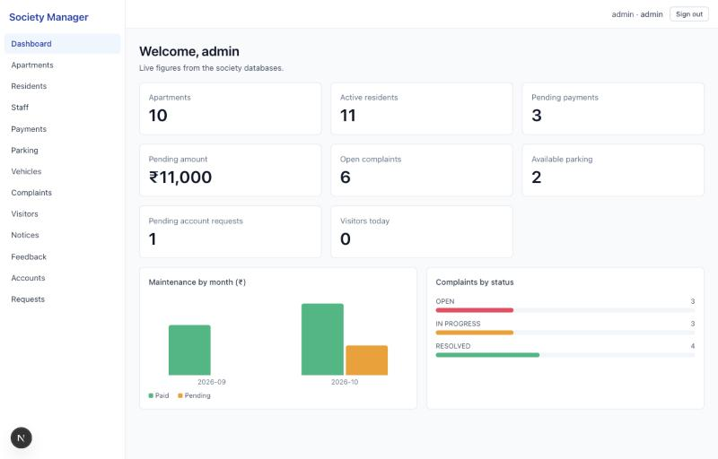
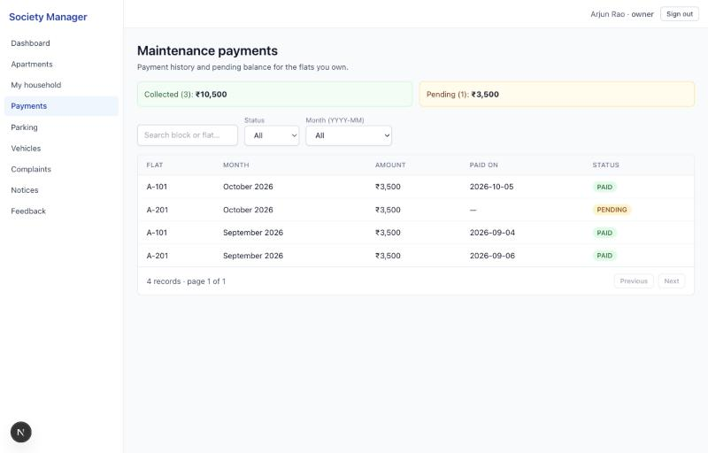
The application on top
Admin dashboard: live counts and the aggregation chart from slide 11
An owner of two flats: bills scoped to the flats they own
Notes:
Briefly show the interface. The admin dashboard numbers are aggregate queries, and the chart is the collected-versus-pending query. The second screen is the multi-flat owner from the queries slide: his bills come from a query scoped to the apartments he owns, so he sees A-101 and A-201 and nothing else. If there is time, do a live demo here.

Slide 18
Testing and results
18
21
0
integration tests run against live MySQL and MongoDB
unit tests for rules and validation
inconsistent rows found by integrity checks
What the database tests prove
Duplicate monthly bill rejected by the unique key (409)
Two simultaneous slot allocations: exactly one commits
Bike cannot take a car slot; a taken slot cannot be reused
Deactivating a resident frees their slots in one transaction
One login with two flats sees bills only for flats it owns
All 5 migrations + seed apply cleanly on an empty database
Notes:
The tests run against real databases, not mocks, and clean up after themselves. They cover the constraints, the concurrency case and the cascading updates. Continuous integration runs everything on every push, including migrating a fresh MySQL and MongoDB.

Slide 19




Limitations and future work
Reach BCNF for people
Push rules into the database
Split Resident into Person + Residency so contact details are stored once
CHECK (status = 'PENDING' OR payment_date IS NOT NULL); triggers for complaint status transitions
Views for reports
Cross-database consistency
CREATE VIEW for dues and staff workload, so reports share one definition
Outbox table in MySQL to guarantee the MongoDB write eventually happens
Notes:
What we would do next, all database-side. Normalize Resident into Person and Residency to remove the update anomaly. Move business rules that are currently enforced by the application into the database: MySQL 8 supports CHECK constraints, and triggers could enforce complaint status transitions. Define views for the standard reports. And use an outbox table to make the MySQL-to-MongoDB write reliable.

Slide 20
Thank you
Questions?
github.com/AhidwishJavali/Apartment-society-management
Notes:
Summary: an ER model mapped to ten relations, constraints enforced in the schema, most relations in BCNF with two documented trade-offs, transactions for concurrency, indexes tied to queries, versioned migrations, and MongoDB for event data. Open the floor for questions.

