Slide 1
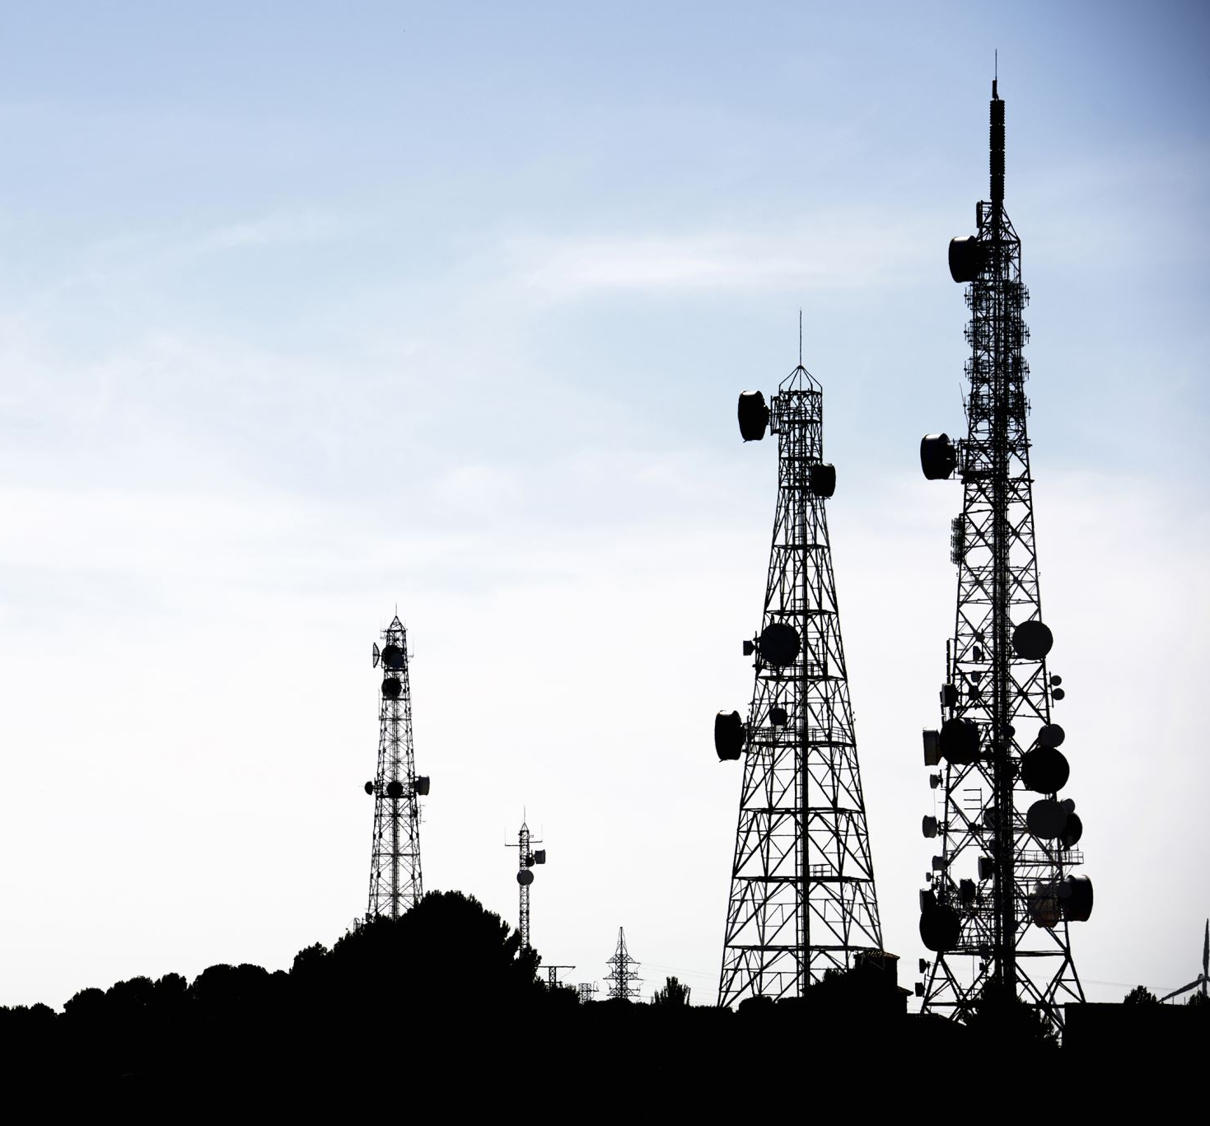
RF ENERGY HARVESTING
E

Slide 2
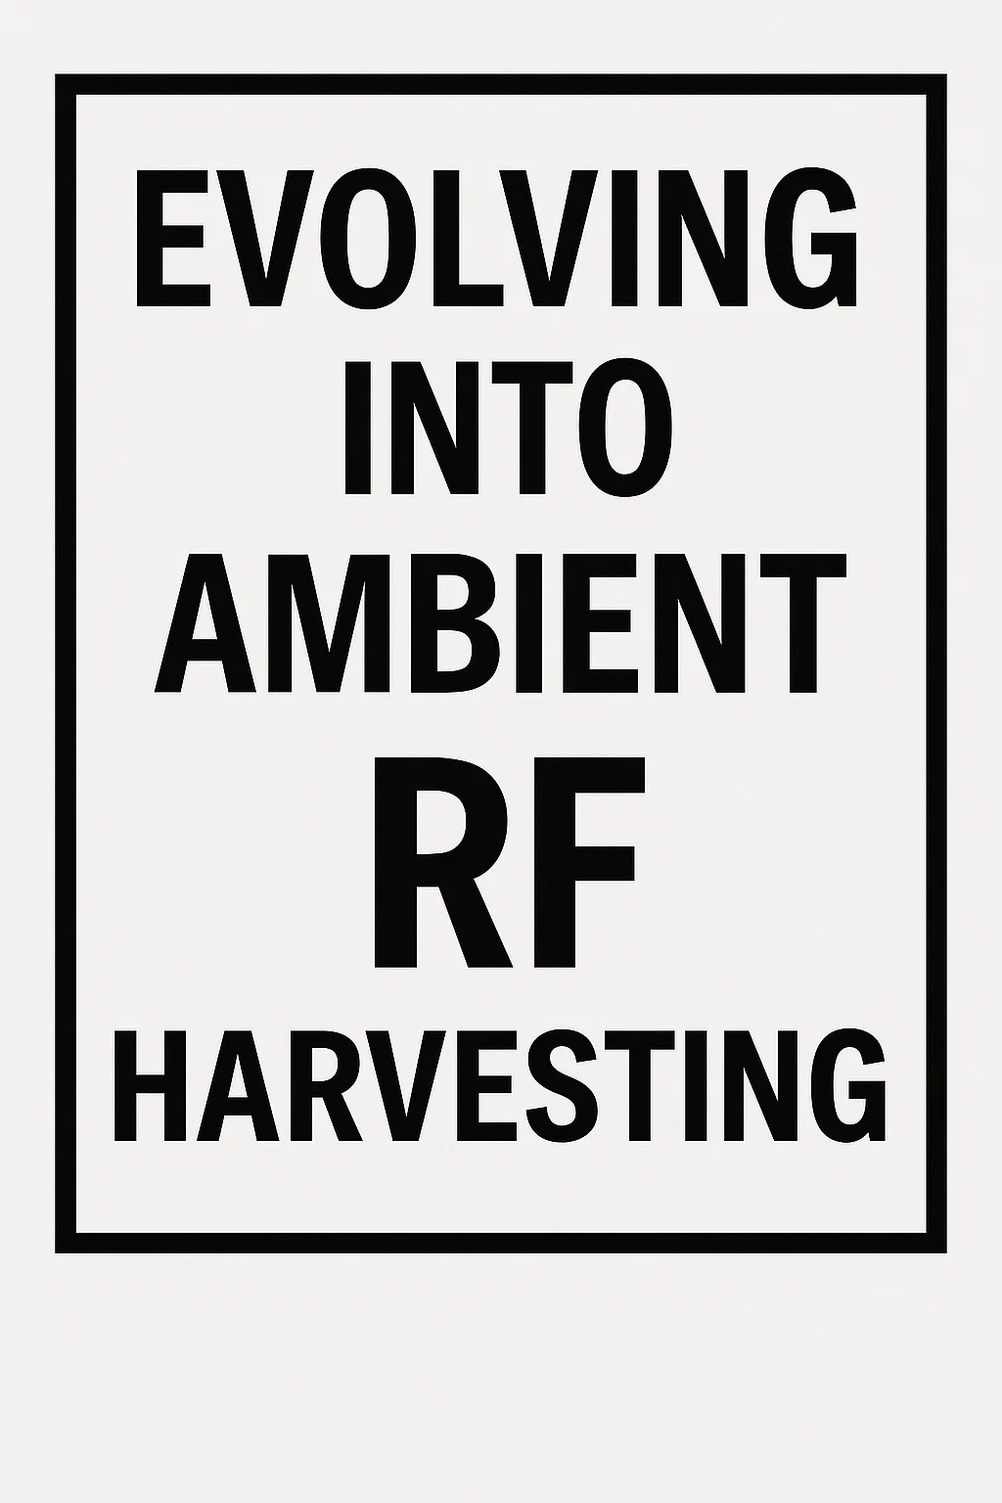
A BRIEF INTRO
RF power harvesting, is the process of capturing and converting radio frequency (RF) energy from the environment into usable electrical power.
Ubiquity of RF Signals
Radio waves are omnipresent in today’s environment.
Their constant presence makes them a reliable source for energy harvesting.
Perfect Match for IoT Requirements
Ideal for small-scale (micro/nano-sized) IoT devices.
Suitable for remote or harsh environments where maintenance is difficult.
Useful in embedded systems like health monitors and industrial sensors, where battery access is restricted.
Advantages Over Battery Power
RF energy is essentially free once infrastructure exists.
Batteries have high lifetime costs due to recharging, replacement, and labor.
Not economically feasible to manage batteries in large-scale IoT deployments.
Cost-Effective and Self-Sustaining
RF harvesting solutions are designed to be low-maintenance.
Operate reliably over many years, often without any manual intervention.
Enhance the long-term sustainability of IoT networks.
Wide Frequency Range
Operates in the RF spectrum from 9 kHz to 300 GHz.
Includes multiple usable bands for different applications.
1892 – Nikola Tesla: Designed an antenna–earth resonant circuit
Early 1900s – Guglielmo Marconi Attempted to power devices like motors and bulbs wirelessly using RF energy.
1980s–1990s: Academic research demonstrated harvesting energy from ambient broadcast sources
2001 – John Perkin’s Patent

Slide 3
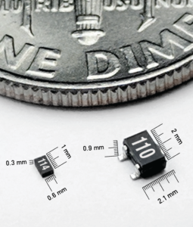


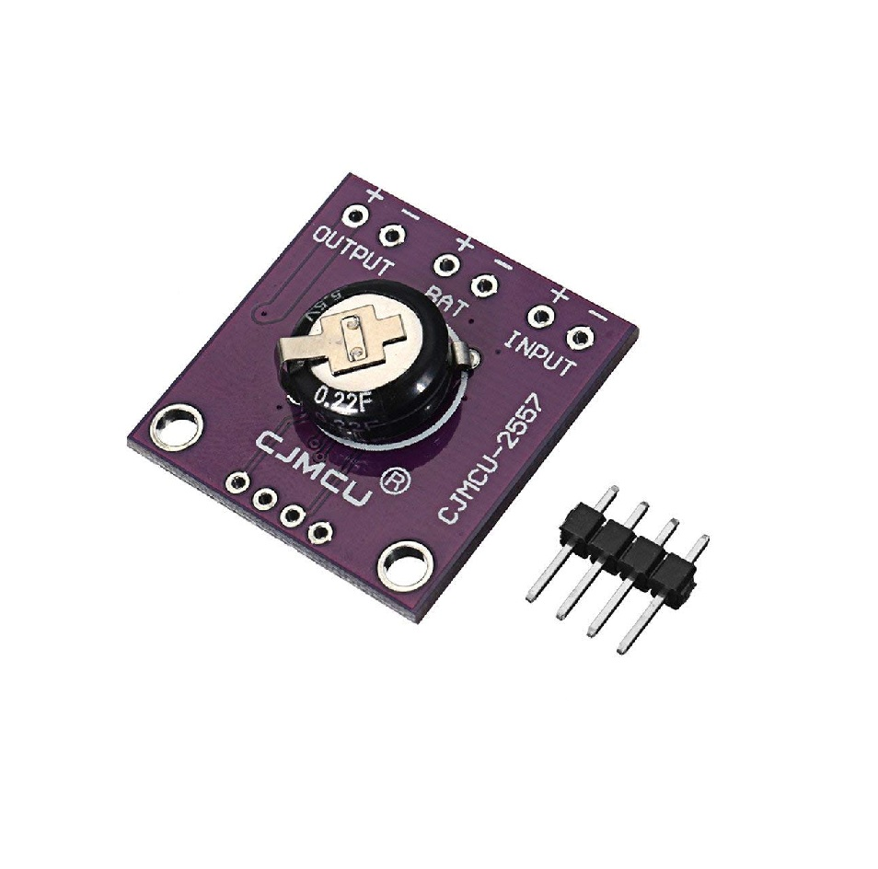
SOME EXISTING SOLUTIONS
Ultra Low power Harvester power Management IC with boost charger, and Nanopower Buck Converter
Powercast’s Powerharvester RF-to-DC Converter Chips are the core component which convert RF energy to DC power. When paired with tuning components and an antenna, these chips can harvest RF energy from 10MHz to 6GHz.

Slide 4
POWER LEVELS
RF Source | Received Power (dBm) | Received Power (Watts) | Usable Output Power (Watts)
Strong TV/FM | -20 to -10 dBm | 10 µW to 100 µW | 1 µW to 30 µW
Wi-Fi (Indoor) | -35 to -20 dBm | ~0.3 µW to 10 µW | 0.03 µW to 3 µW
Cellular (Urban) | -40 to -20 dBm | ~0.1 µW to 10 µW | 0.01 µW to 3 µW
RFID Reader (near) | 0 to +10 dBm | 1 mW to 10 mW | 100 µW to 1 mW
Power Beacon (Lab) | +20 to +30 dBm | 100 mW to 1 W | 10 mW to 500 mW

Slide 5
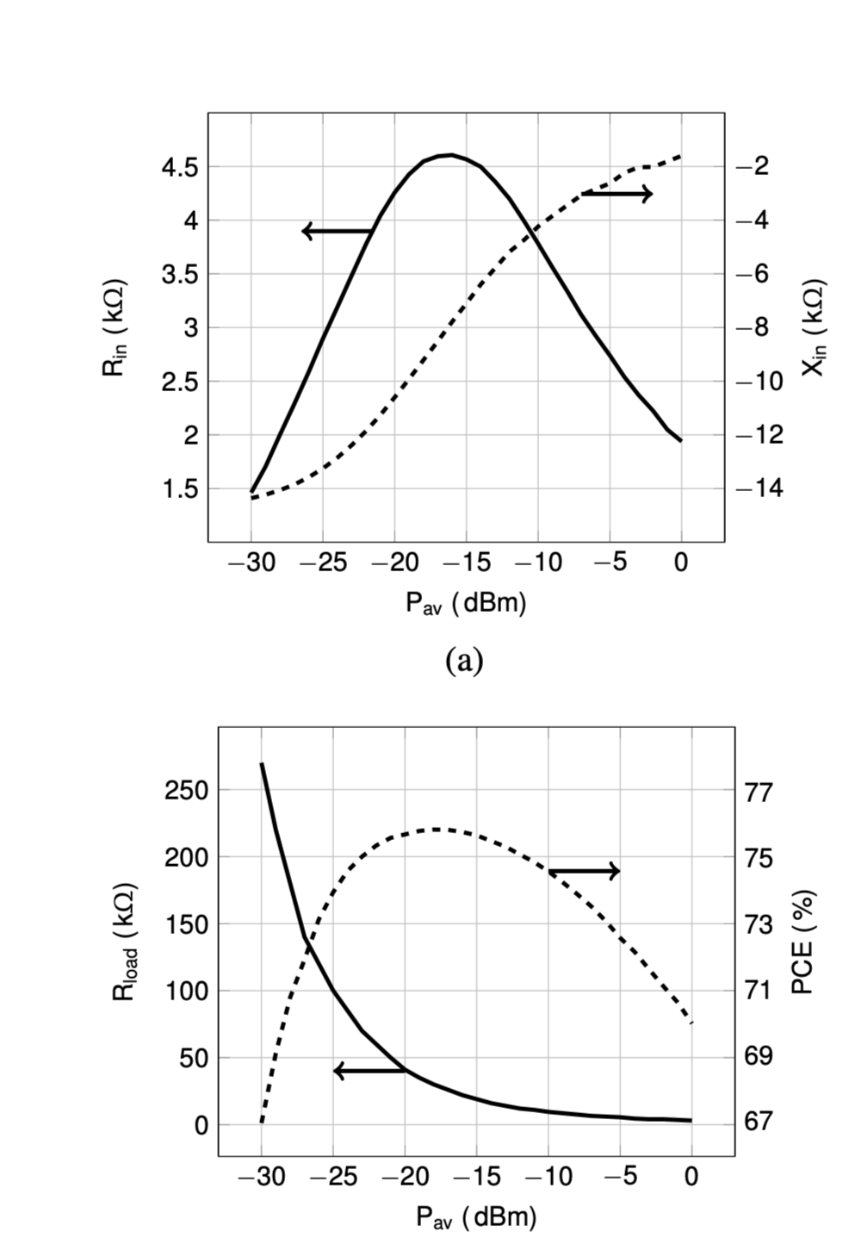
MPPT (MAXIMUM POWER POINT TRACKING)
In RF power harvesting, Maximum Power Point Tracking (MPPT) is a crucial technique used to optimize the efficiency of converting radio frequency energy into usable power. MPPT circuits dynamically adjust the impedance matching between the antenna/rectifier and the storage capacitor to extract the maximum possible power from the RF source, even when the input power fluctuates.
One of the most widely used methods is perturb and observe.

Slide 6
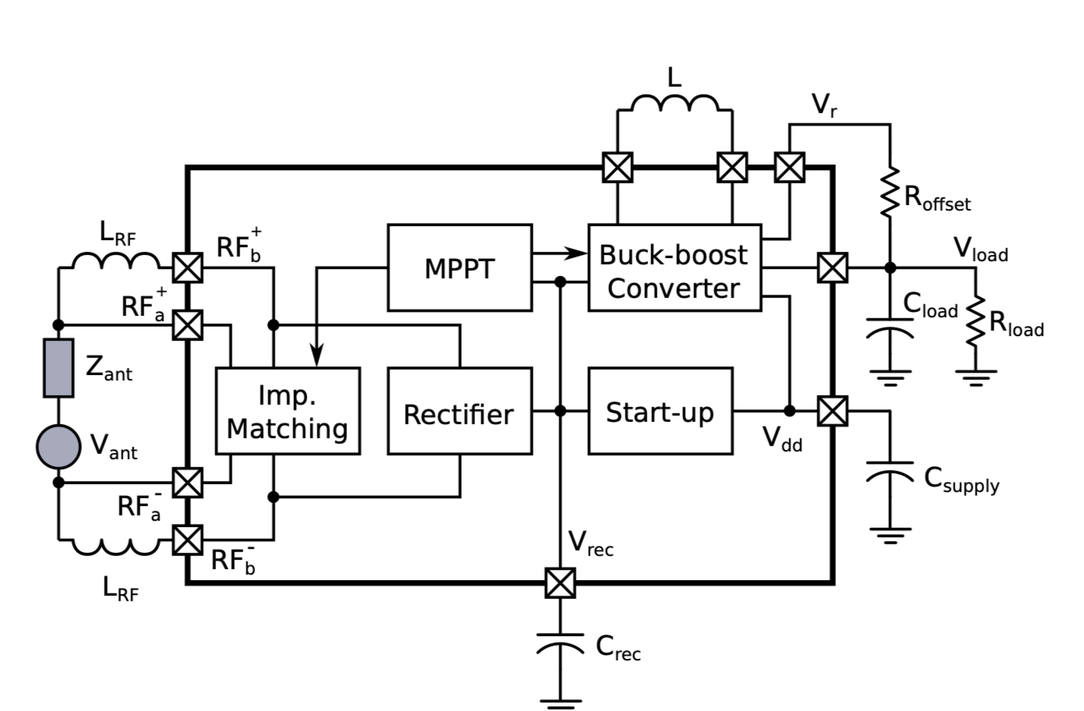
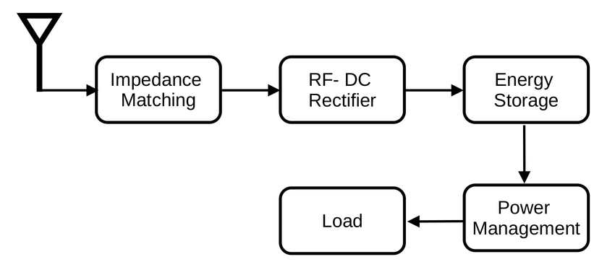
SYSTEM BLOCK DIAGRAM

Slide 7
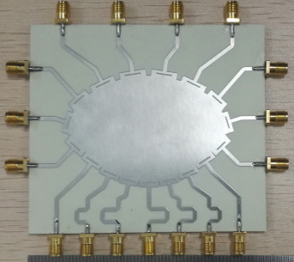
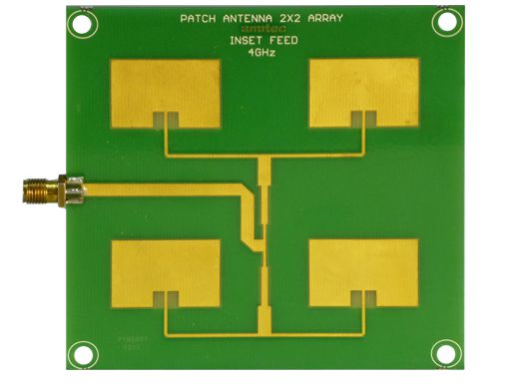
Antenna
ROTMAN LENS
Forms directional beams, it helps instead of actively trying to follow which direction has most energy
PATCH ANTENNA
It consists of a planar rectangular or circular sheet or "patch" of metal, mounted over a larger sheet of metal called a ground plane.

Slide 8
MAKING USE OF THE ML WAVE
Most Energy harvesters have an activation energy, And if It is found that the ambient RF energy is too low it can be kept switched of for that interval. A Time series data could be used for this purpose as RF energy follows temporal patterns. There are multiple such datasets on Kaggle and IEEE Dataport.
Another way ML could be used is instead of relying on Perturb and Observe method for M.P.PT we could have a ML based M.P.P.T algorithm that gives a faster convergence to M.P.P and eliminates need for continuous probing.

