Slide 1

Weather Data App
AN unforgettable p0 experience.

Slide 2
Your best quote that reflects your approach… “It’s one small step for man, one giant leap for mankind.”
- Neil Armstrong

Slide 3
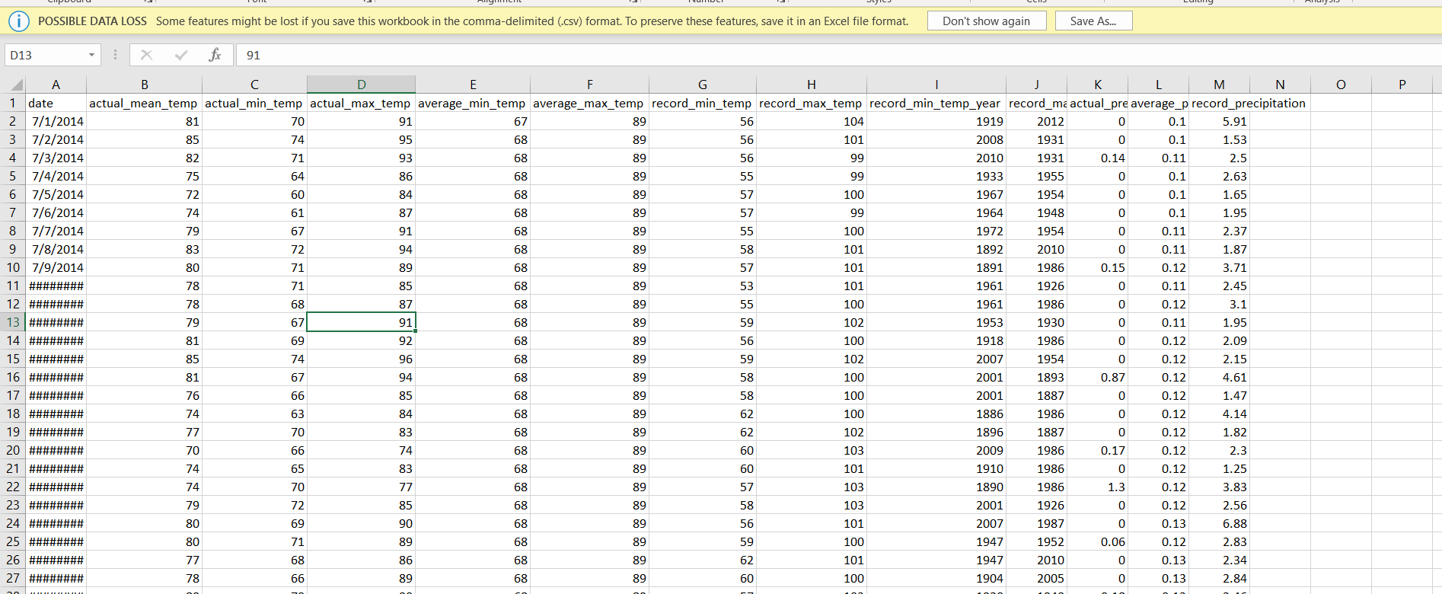
CSV Weather Data
I found several CSVs of local weather data for different cities.
I wanted to be able to explore that data visually via the CLI
I explored data visualization libraries for Scala, but couldn’t find any appropriate and well maintained libraries.

Slide 4
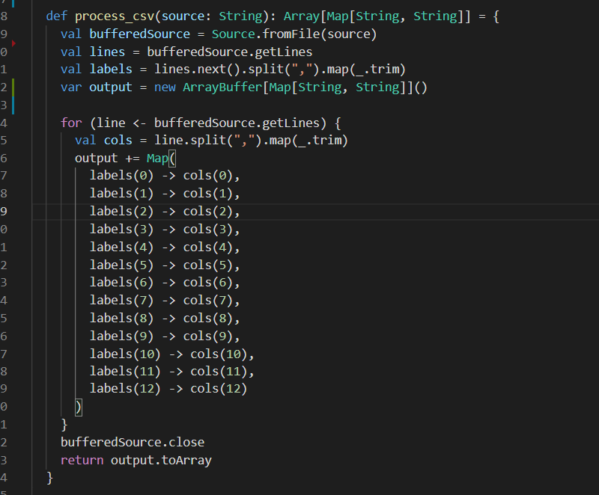
Processing a CSV in Scala
We can use Scala IO to read a CSV as a buffered string.
CSV stands for comma separated values. By splitting our CSV on commas, we can split the cells.
I split each input CSV into an array of maps, with the column headers as keys.

Slide 5
Exploring the data
I used a simple Do/While Loop to create the CLI.
The while condition is set to a variable called “cont”. I.e. do {//code} while (cont).
cont = true by default. If the user types “quit”, then cont is set to “false” and the do/while loop quits, which completes execution of the program.
The program processes 10 total CSVs, each containing weather data for a different city.

Slide 6
Demo the program

Slide 7
Future Development
The current status of the program is minimum viable product. It is capable of processing CSVs and allowing the user to explore the data on the command line.
Here are some thoughts for possible future additions:
Allowing the user to supply the file location of the csv to be processed (currently these are hardcoded)
Allowing the user to perform operations on the data and interact with it more fully
Uploading the data to a database for more advanced manipulation.

