Slide 1
Digital twin for energy industry
Wind Turbine Modeling Workshop
Adrien Hirvoas, Ph.D. - FEM
ISEN Yncréa Ouest
January 16th-18th, 2024

Slide 2
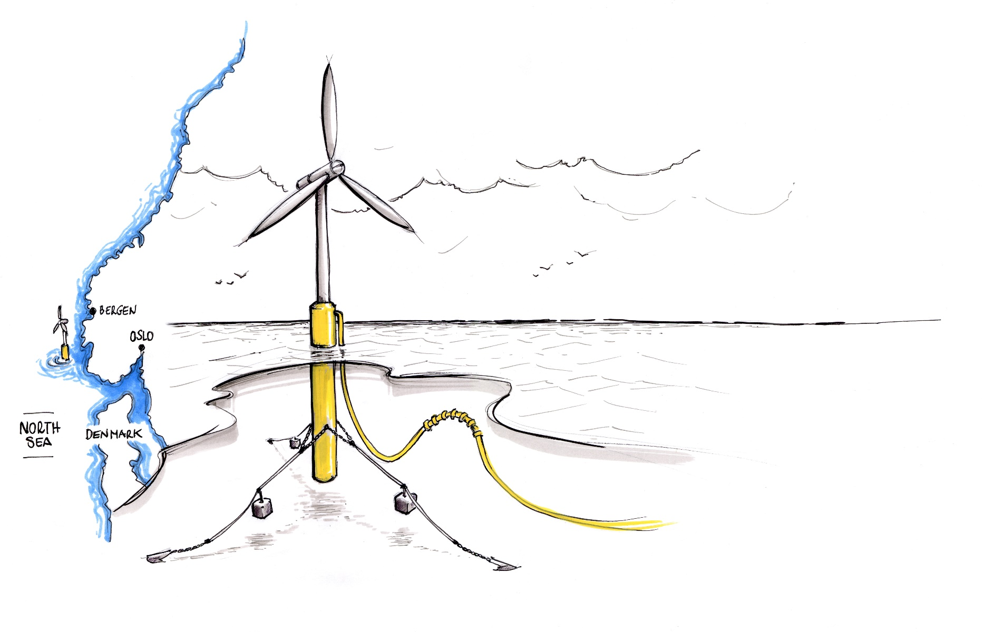
Wind Turbine Modeling Workshop - Agenda
Day 1: Welcome and Introductions Wind Turbine Modeling Overview Overview of OpenFAST Practical work: Installation Inputs and outputs workflow OpenFAST Modules OpenFAST tool: python-toolbox Practical work: Practicing Run your first simulation | Day 2: Introduction OpenFAST tutorial Practical work: Floating Offshore Wind Turbine Post-Processing A digital twin approach Conclusion & Question

Slide 3
Day 2 - Agenda
Introduction
OpenFAST tutorial
Conclusion & Question

Slide 4
Welcome and Introductions
About this workshop
A GitHub repository is provided with some simulation folder and slides
2 x 3 hours – 16/01/2024 and 18/01/2024
Don’t hesitate to ask questions (even during the presentation)
Objectives
Clarify the concept of Wind Turbine Modeling
Clarify the concept of Digital Twin
Allow you to build your first wind turbine numerical model

Slide 5
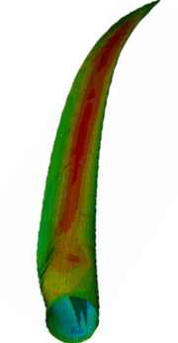
Wind Turbine Modeling Overview
Coupling Between Fluids, Structures, and Controls
Controls
Aerodynamics
Hydrodynamics
Structures

Slide 6
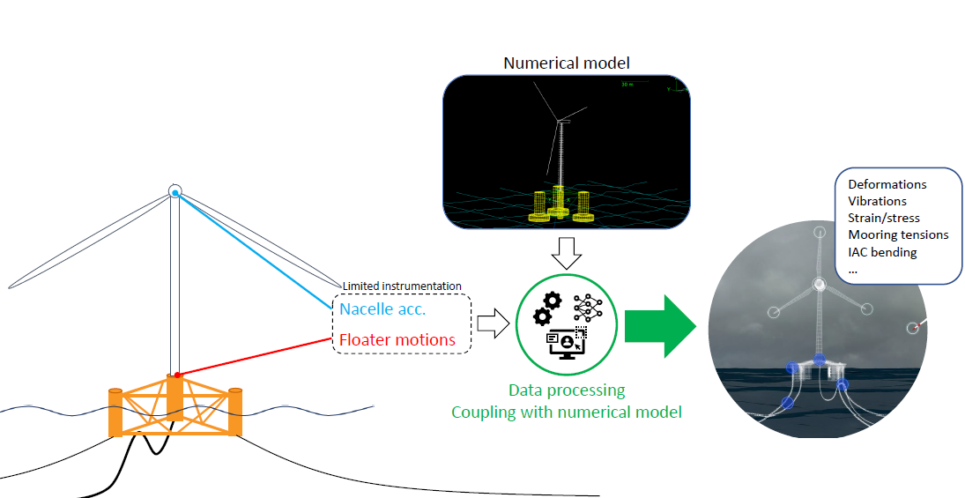
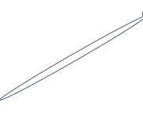
Digital Twin – Introduction
Digital Twin - Wind Turbine
What for ?
Improve availability
Reduce operational expenditure (OPEX)
Streamline inspection
Anticipate life extension
Improve future designs
Detect Anomaly

Slide 7

Anomaly Detection – Definition
Definition of anomaly
An observation that can be considered significantly outside what is « normal »
Requires some idea what consitutes « normal »
That is very much non-trivial
Statistically: Given input data $X$, an anomaly is a sample with a specific value for its pdf, $p(X)$
Calculating

Slide 8
Anomaly Detection – Idea
Expectation: in a healthy system there should be robust relationships between states of components
Example: the motion of a FOWT dominantly deponds on wind speed and other environmental conditions
Therefore, statistical modeling should deliver good predictions of first from the former
Deviations can be explained by defects

Slide 9
Day 2 - Agenda
Welcome and Introductions
OpenFAST tutorial
Conclusion & Question

Slide 10

Practice – Offshore wind turbine – Google Colab
What is Google Colab?
Google Colab which stands for Google Colaboratory is a cloud platform
provided by Google to run Python Notebook’s without need to install
anything on your local machine.
Features of Google Colab
Zero Setup Required
Free GPU Access
Pre-installed Libraries
Accessing Google Colab
https://github.com/Ahirvoas/Training-Day2/blob/main/Tutorial_day2.ipynb

Slide 11
Day 2 - Agenda
Welcome and Introductions
OpenFAST tutorial
Conclusion & Question

