Slide 1
Digital twin for wind energy industry
Adrien Hirvoas, Ph.D. - FEM
ISEN Yncréa Ouest

Slide 2
Digital twin for wind energy industry
Day 1: Welcome and Introduction Why wind energy ? Digital Twin Overview Practical work - Python: TP – Python introduction TP – Pandas introduction TP – Anomaly detection | Day 2: Introduction Data-driven science Practical work: TP – Anomaly detection Conclusion & Question

Slide 3
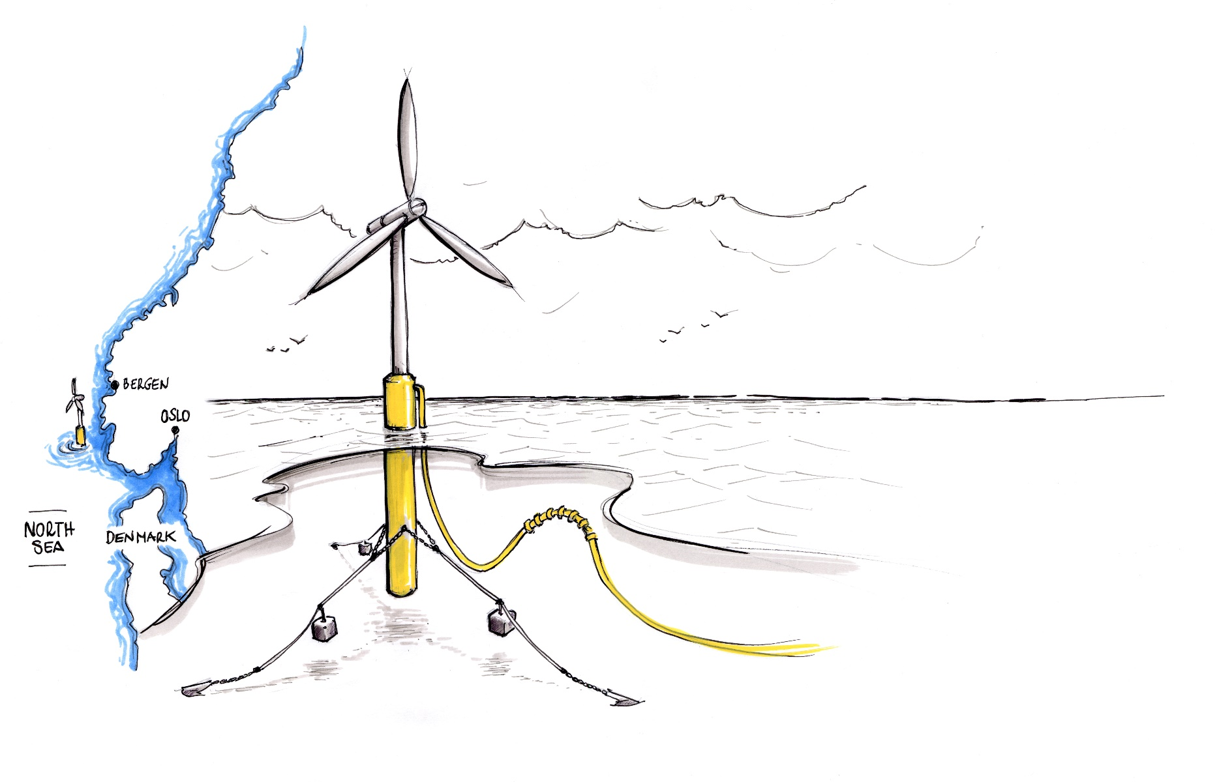
Day 3 - Agenda
Introduction
Data-driven science
Conclusion & Question

Slide 4
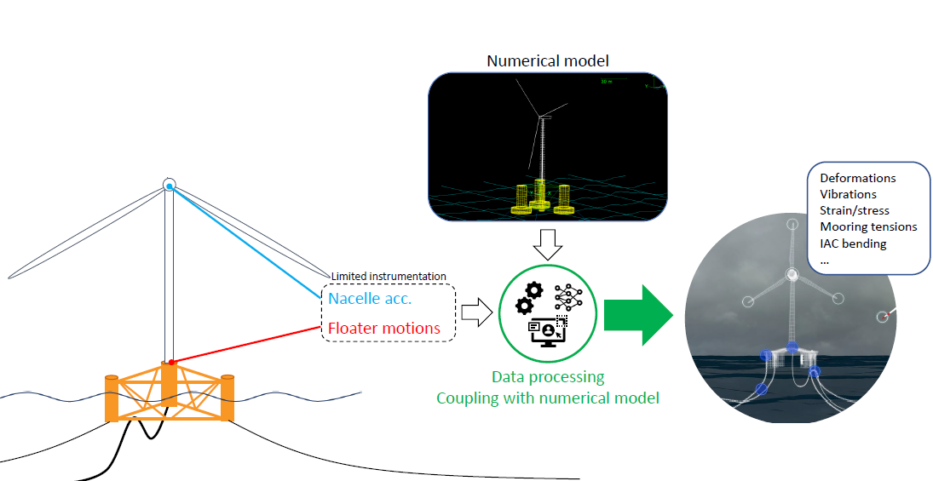
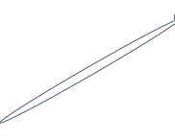
Introduction – Digital Twin Goal
Digital Twin - Wind Turbine
What for ?
Improve availability
Reduce operational expenditure (OPEX)
Streamline inspection
Anticipate life extension
Improve future designs

Slide 5
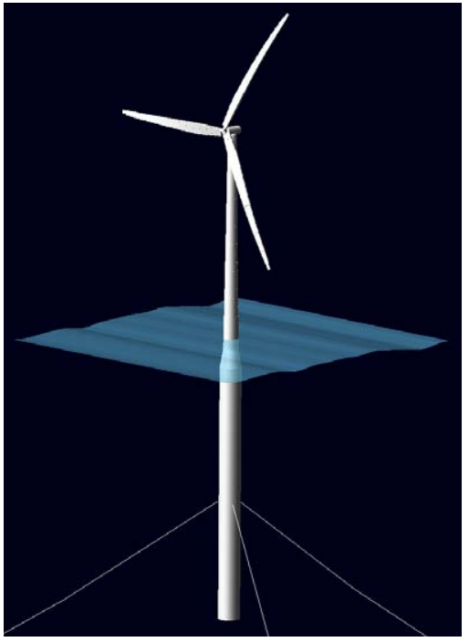







Digital Twin Overview – Benefits
 | Full sensor monitoring | Numerical monitoring | DT monitoring
Installation & maintenance costs
Accuracy
Reliability

Slide 6
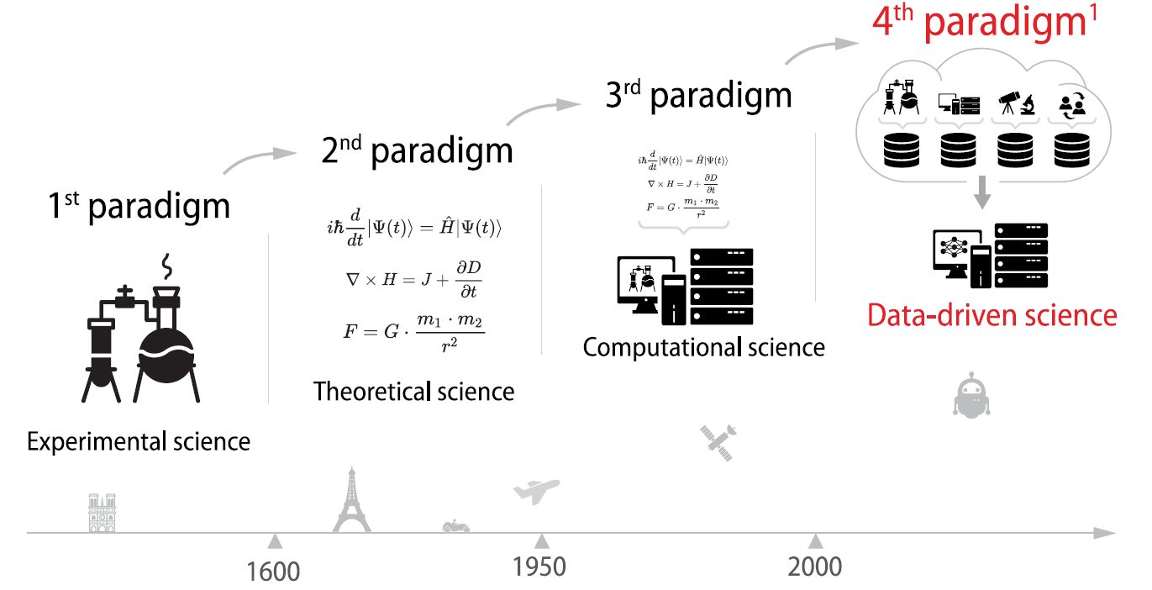
Introduction – Scientific paradigm
1 Jim Gray,2007

Slide 7
Day 3 - Agenda
Introduction
Data-driven science
Conclusion & Question

Slide 8

Data-driven science - Machine Learning
Learning types
Supervised learning: there is a target to predict
$$D=\{\left(x_{1}, t_{1}\right), ⋯,\left(x_{N},t_{N}\right)\}$$
Unsupervised learning: not target available
$$D=\{x_{1}, ⋯,x_{N}\}$$
Reinforcement learning

Slide 9
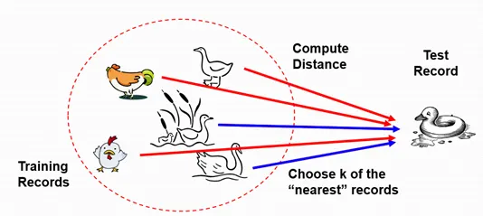
Data-driven science – k-nearest neighbours
BASIC IDEA BEHIND KNN
KNN assumes that if it walks like a duck, quacks like a duck, then it’s a duck
Source: B. S. Panda (IIT Delhi)

Slide 10
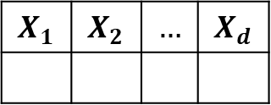
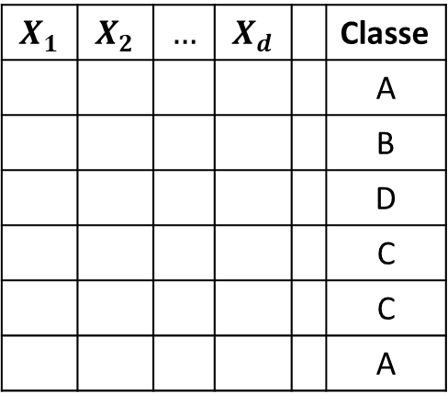
Data-driven science – k-nearest neighbours
BASIC IDEA BEHIND KNN
A training set
Store the training data.
Use this data to predict the class of the test set.
$$X_{1}$$ | $$X_{2}$$ | $$…$$ | $$X_{d}$$ |  | Classe
 |  |  |  |  | A
 |  |  |  |  | B
 |  |  |  |  | D
 |  |  |  |  | C
 |  |  |  |  | C
 |  |  |  |  | A
$$X_{1}$$ | $$X_{2}$$ | $$…$$ | $$X_{d}$$

Slide 11
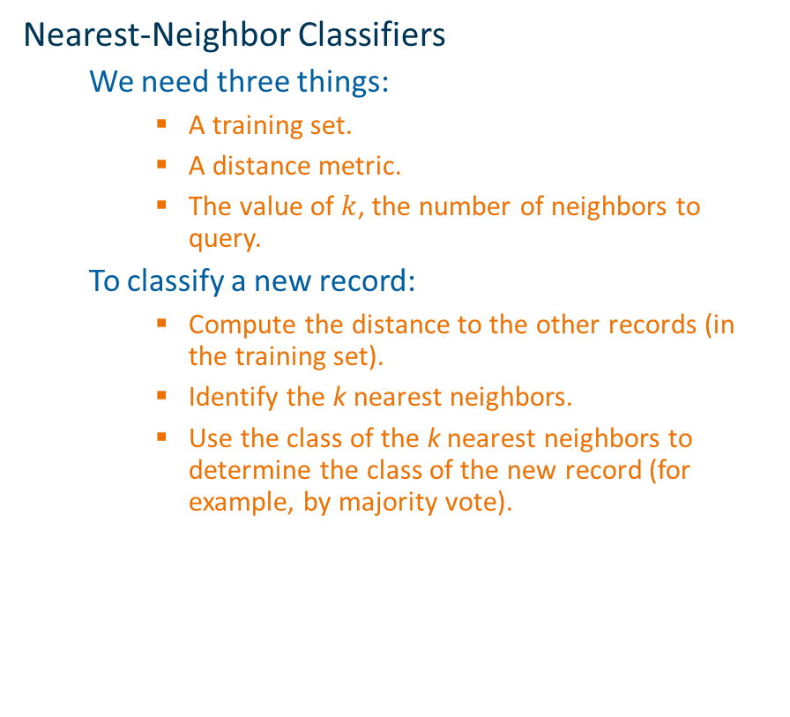
Data-driven science – k-nearest neighbours
Nearest-Neighbor Classifiers
We need three things:
A training set.
A distance metric.
The value of $k$, the number of neighbors to query.
To classify a new record:
Compute the distance to the other records (in the training set).
Identify the k nearest neighbors.
Use the class of the k nearest neighbors to determine the class of the new record (for example, by majority vote).

Slide 12
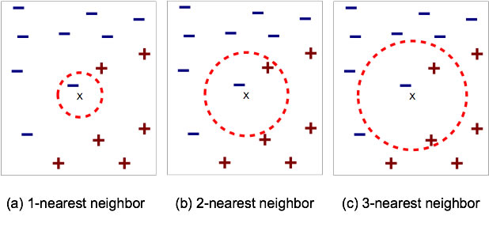
Data-driven science – k-nearest neighbours
Nearest-Neighbor ?
A 2-dimensional example

Slide 13
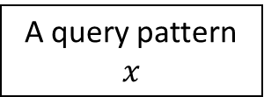
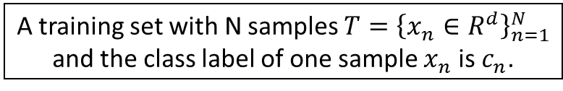
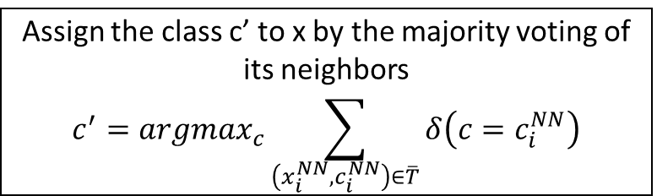
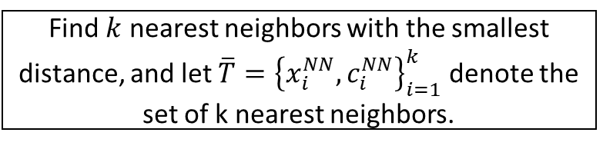
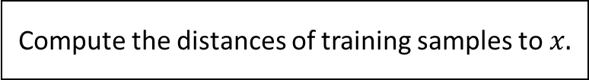
Data-driven science – k-nearest neighbours
A training set with N samples $T={\left\{x_{n}∈R^{d}\right\}}_{n=1}^{N}$ and the class label of one sample $x_{n}$ is $c_{n}$.
A query pattern $x$
Algorithm
Compute the distances of training samples to $x.$
Rank these distances by increasing order.
Find $k$ nearest neighbors with the smallest distance, and let $\overline{T}={\left\{x_{i}^{NN}, c_{i}^{NN}\right\}}_{i=1}^{k}$ denote the set of k nearest neighbors.
Assign the class c’ to x by the majority voting of its neighbors
$$c^{′}=argmax_{c}\sum_{\left(x_{i}^{NN},c_{i}^{NN}\right)∈\overline{T}}{δ\left(c=c_{i}^{NN}\right)}$$

Slide 14

Practice – Offshore wind turbine – Google Colab
What is Google Colab?
Google Colab which stands for Google Colaboratory is a cloud platform
provided by Google to run Python Notebook’s without need to install
anything on your local machine.
Features of Google Colab
Zero Setup Required
Free GPU Access
Pre-installed Libraries
Accessing Google Colab
https://github.com/Ahirvoas/Training-Day2/blob/main/Tutorial_day2.ipynb

Slide 15
Day 3 - Agenda
Introduction
Data-driven science
Conclusion & Questions

