Slide 1
Digital twin for wind energy industry
Adrien Hirvoas, Ph.D. - FEM
ISEN Yncréa Ouest

Slide 2
Digital twin for wind energy industry
Day 1: Welcome and Introduction Why wind energy ? Digital Twin Overview Practical work - Python: TP – Python introduction TP – Pandas introduction TP – Anomaly detection introduction | Day 2: Introduction Overview of OpenFAST Practical work: Inputs and outputs workflow Running OpenFAST OpenFAST Modules OpenFAST tool: python-toolbox Practical work: Practicing Run your first simulation | Day 3: OpenFAST reminder OpenFAST tutorial Practical work: Post-Processing A digital twin approach Anomaly detection Conclusion & Question

Slide 3
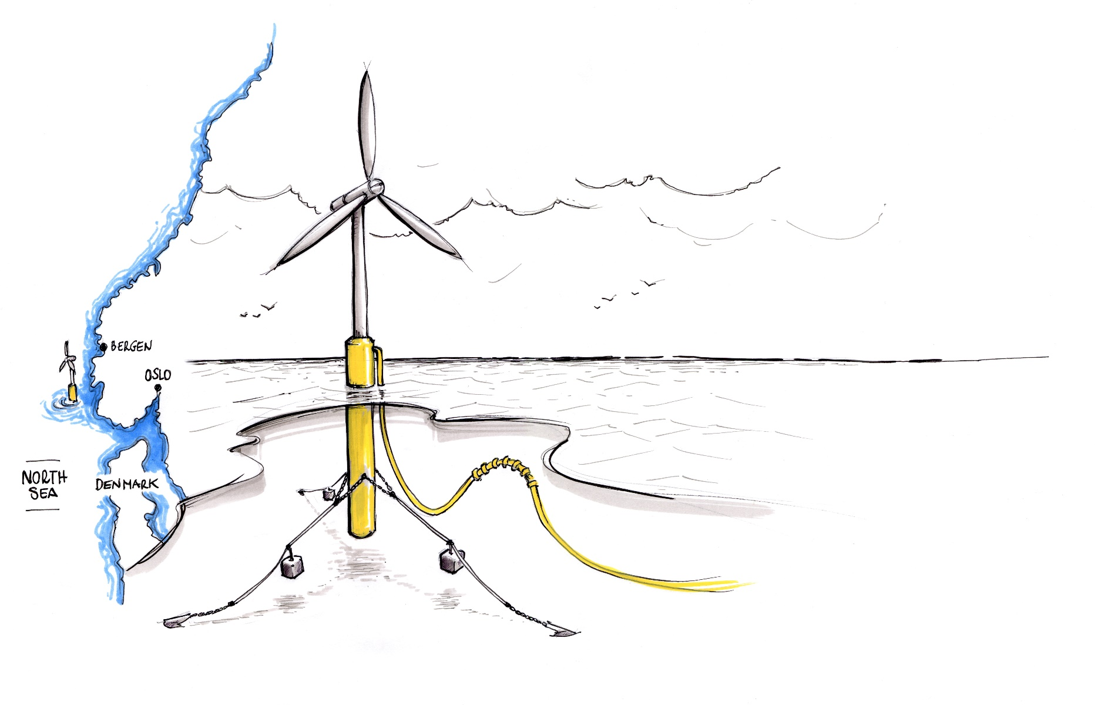
Day 3 - Agenda
Introduction
OpenFAST excercise
Conclusion & Question

Slide 4
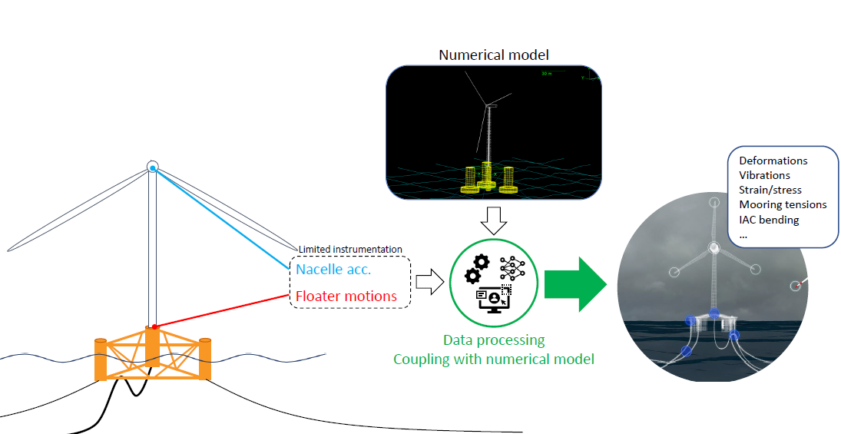
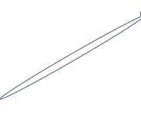
Introduction – Digital Twin Goal
Digital Twin - Wind Turbine
What for ?
Improve availability
Reduce operational expenditure (OPEX)
Streamline inspection
Anticipate life extension
Improve future designs

Slide 5
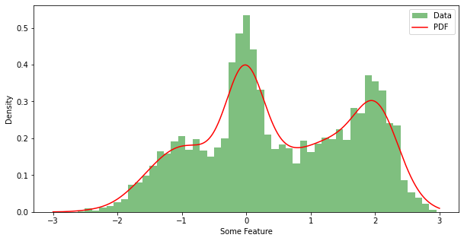

Introduction – Anomaly detection
Definition of anomaly
An observation that can be considered significantly outside what is « normal »
Requires some idea what consitutes « normal »
That is very much non-trivial
Statistically: Given input data $X$, an anomaly is a sample with a specific value for its pdf, $p(X)$
Calculating $p$ is also very much non-trivial

Slide 6

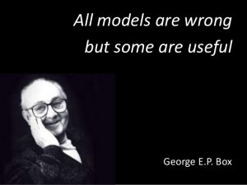
Introduction – Anomaly detection
Expectation: in a healthy system there should be robust relationships between states of components
Example: the motion of a FOWT dominantly deponds on wind speed and other environmental conditions
Therefore, statistical modeling should deliver good predictions of first from the former
Deviations can be explained by defects between numerical model and measure
Environmental inputs
Wind speed & direction
Wave amplitude & direction
Current speed & direction
Atmospheric conditions
Output signals

Slide 7
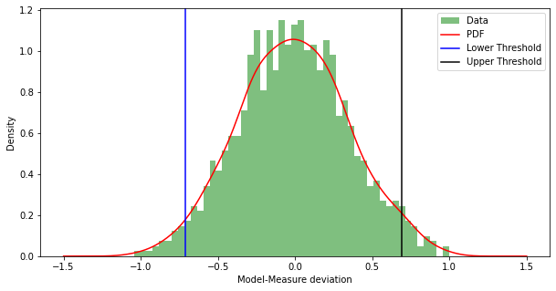
Introduction – Anomaly detection
Threshold
Arguably biggest challenge: when is a model/measure deviation « unusual »
Statistical modeling of distribution
Some quantile of modeled distribution taken to be alert threshold

Slide 8
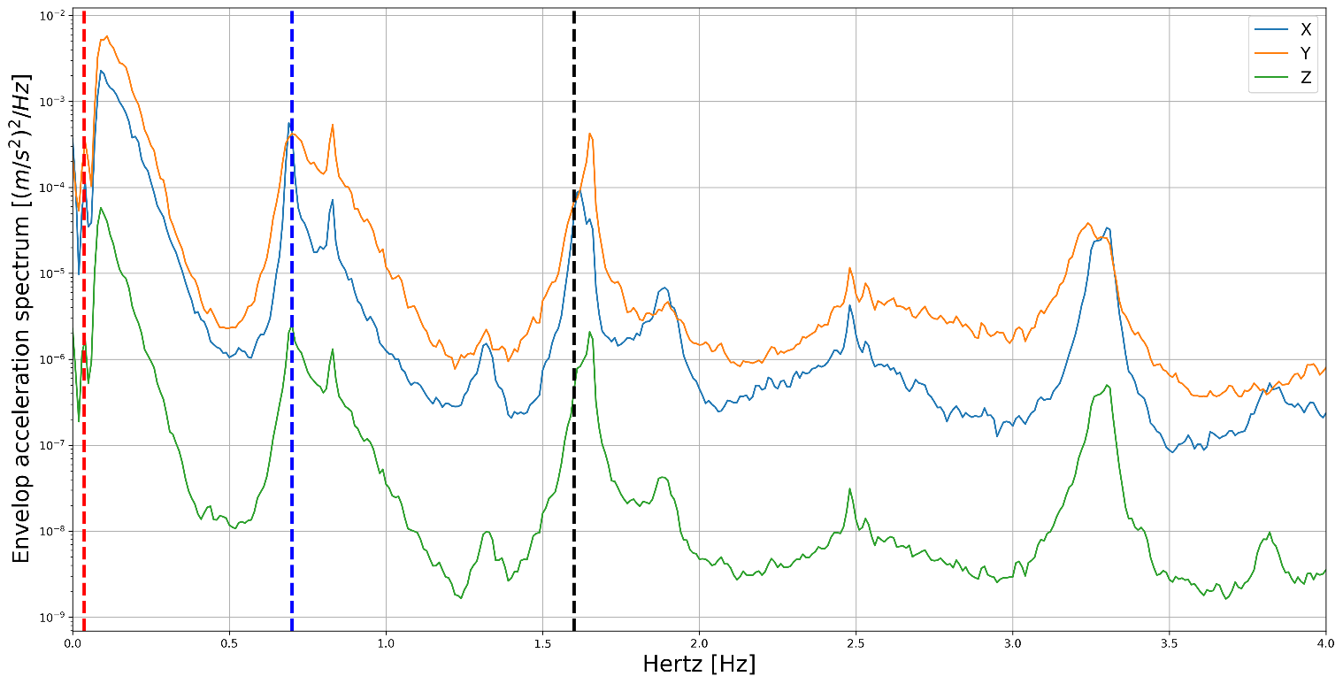
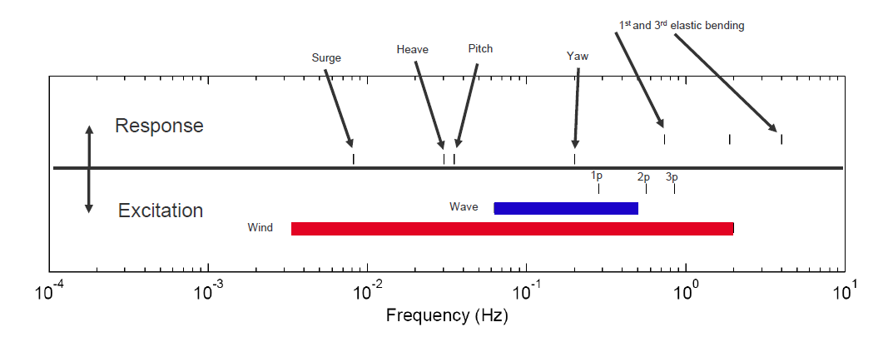
Introduction – Wind Turbine Post Treatment
Power spectrum density
Visual explanation
Rigid body modes
Tower + platform

Slide 9
Introduction – Wind Turbine Post Treatment
Power spectrum density
Visual explanation
1 FA/SS

Slide 10
Day 2 - Agenda
Introduction
OpenFAST exercise
Conclusion & Questions

Slide 11

Practice – Offshore wind turbine – Google Colab
What is Google Colab?
Google Colab which stands for Google Colaboratory is a cloud platform
provided by Google to run Python Notebook’s without need to install
anything on your local machine.
Features of Google Colab
Zero Setup Required
Free GPU Access
Pre-installed Libraries
Accessing Google Colab
https://github.com/Ahirvoas/Training-Day3/blob/main/Tutorial_day3.ipynb

Slide 12
Day 2 - Agenda
Introduction
OpenFAST exercise
Conclusion & Questions

