Slide 1
Failed Banking Transaction Analysis

Slide 2
Problem Statement
Challenge: Banks encounter difficulties in monitoring and managing failed transactions across various branches, which can affect operational efficiency and customer satisfaction.
Objective: The goal is to consolidate transaction data, identify and analyze failed transactions, and generate actionable insights through visualization to aid decision-making processes.

Slide 3
Tools used:
01
Hadoop
02
PySpark
03
MySQL
04
BigQuery

Slide 4
Transaction ID Branch ID Branch Name City Transaction Date Transaction Amount Transaction Status Transaction Type Customer ID Error Message Bank Name Branch Pincode
Column used for Analysis:

Slide 5
Implementation
Data Sources: 15 CSV files containing a total of 4021 transaction records, sourced from 3 cities, each having 5 branches. Data Merging & Processing: Utilized PySpark to clean and merge the data into a single, consolidated dataset.

Slide 6
Querying and Analysis with BigQuery
The cleaned and structured data stored in Cloud SQL (MySQL) is connected to BigQuery.
BigQuery is used to run SQL queries for analyzing transaction trends, failure rates, error types, and branch performance.
Enables fast, scalable analysis and integration with visualization tools.

Slide 7

Insights Derived from the Following Metrics
Total Failed Transactions by City
Total Failed Transactions by Branch
Count of success and failure transactions in each branch
Failures by Day of the Week
Failed Transactions by Reason
Daily Failed Transactions Trend
Which Branches Have the Most Diverse Error Types
Identify Any Branch with Failures > 50 in a Single Day

Slide 8
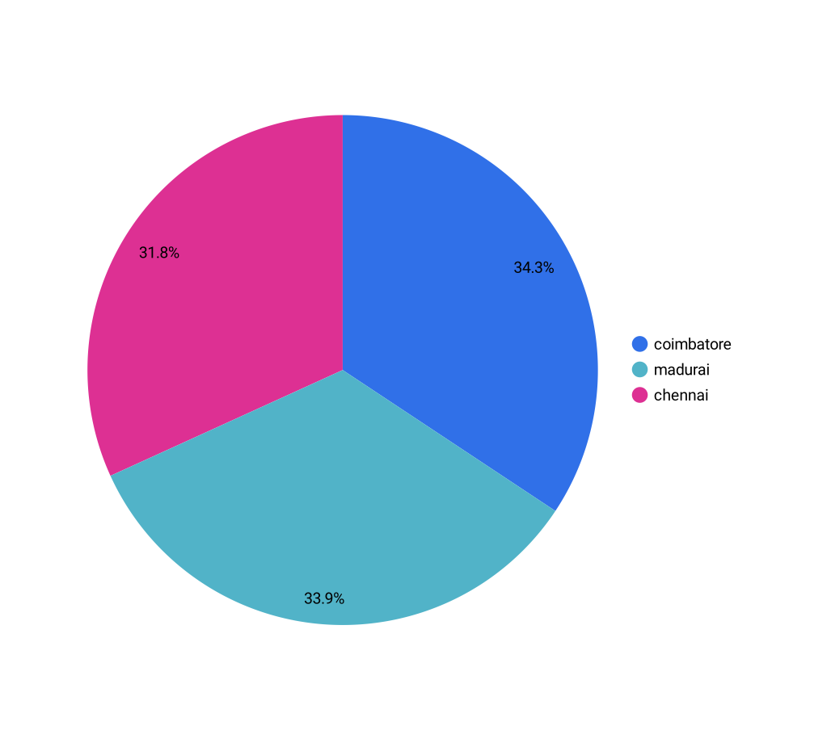
Total Failed Transactions by City

Slide 9
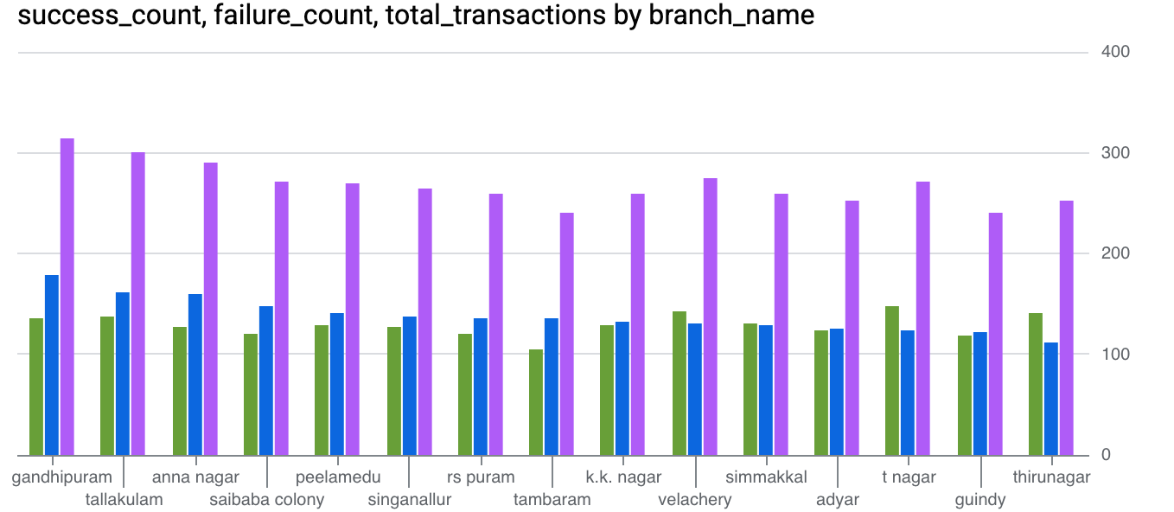
Count of success and failure transactions in each branch

Slide 10
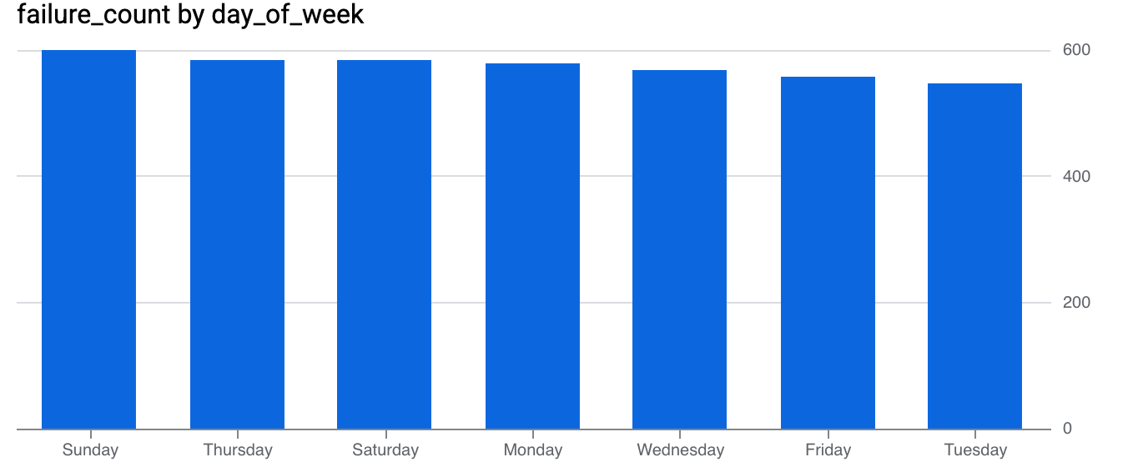
Failures by Day of the Week

Slide 11
Conclusions
Transaction Type Insights: Specific transaction types (e.g., Withdrawals, Deposits) are more prone to failure, indicating areas for deeper investigation.
Time-based Trends: Peaks in failures on certain dates suggest external factors or system strain during those periods.
Customer Impact: Failed transactions can harm customer experience, emphasizing the need for timely notifications and resolutions.
Recommendations: Focus on high-failure branches, implement real-time monitoring, and enhance customer communication to improve transaction success rates.

Slide 12
Thank you

