Slide 1




Unsupervised Learning with Autoencoders
Using TensorFlow and the Caltech101 Dataset
Group - 9
Ahkar Htet
Thai Kien Nguyen
Thiri Than Myint
Su Mon Hpan
Professor: Dr. Magdalene Ravichandran
Date: 27 November 2024

Slide 2
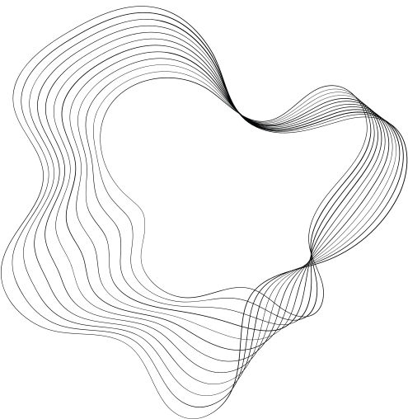


Objective
This project develops for image preprocessing and anomaly detection using autoencoders, focusing on the Caltech-101 dataset. It involves loading and normalizing images, building a convolutional autoencoder for image reconstruction, and identifying anomalies based on reconstruction errors with optimized thresholds. The approach emphasizes effective visualization, robust model evaluation, and actionable recommendations for improving dataset design to enhance detection accuracy.

Slide 3
Dataset
Use Caltech101
Contains 9,146 images across : 101 object classes + 1 background class
Use about 3000 images for overall process with unsupervised approach
Images vary in shape and size, with typical edge lengths of 200-300 pixels.
Remove background_google images because Backgrounds are harder to reconstruct

Slide 4
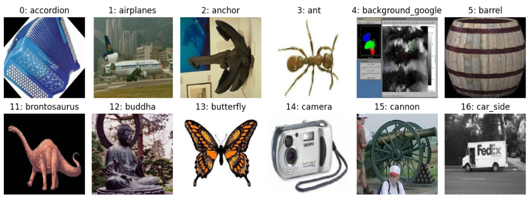
Data Preprocessing
Split data into training(70%), validation(15%), and test(15%) datasets.
Resize all images to 256x256x3 pixels.
Normalize pixel values to the range [0, 1].

Slide 5
Training Process
Train the data using convolutional autoencoder model to learn normal pattern within the data.
Training Settings
Optimizer: Adam
Learning_rate: 0.001
Loss function: MSE
Latent Dimension: [256]
Epoch: 20
Validation: Used 15% of training data for validation during training.

Slide 6
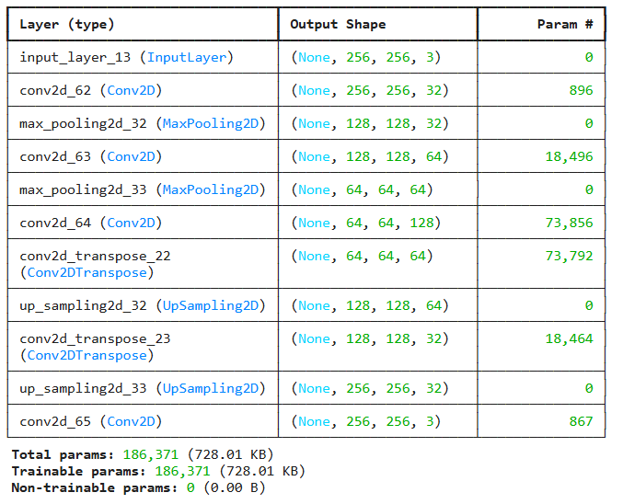
Training Process
Summary of Autoencoder

Slide 7
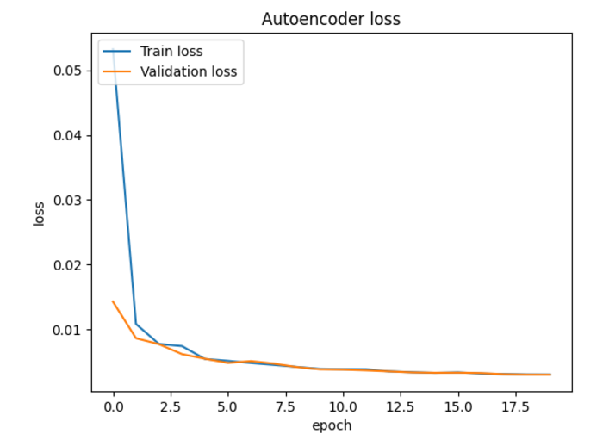
Results
Validation Loss Over Epochs: 0.0029

Slide 8
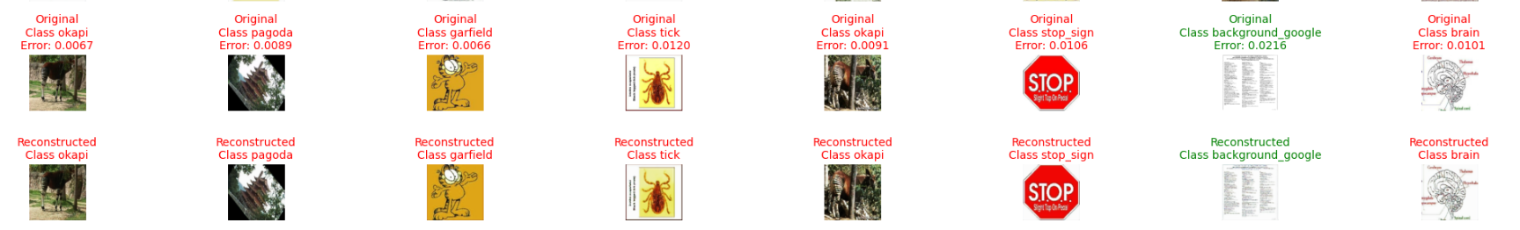
Anomaly Detection
Anomaly Detection Using Reconstruction Errors
Anomalies are identified based on reconstruction errors from the autoencoder.
Thresholds (75% to 95% percentile of reconstruction errors) are used to flag anomalies.
Evaluation Metrics for Detection Accuracy
Key metrics include total anomalies, false positives (clean images flagged), and true positives (correctly identified "background_google" anomalies).
True anomalies are determined by comparing predicted indices with actual indices (class ID 4).
Threshold Tuning for Optimal Balance
Thresholds are iteratively adjusted to balance false positives and true positives.
This tuning improves the accuracy and robustness of the anomaly detection system.

Slide 9
Actionable Recommendations
Crop image to minimize error of backgrounds in some object images
Images in the background class should not contain any object, which belongs to a class of the classification problem.
Images in the classification dataset often contain many patterns in the background. It may not be possible to construct a background class containing all of those background patterns. However, the background dataset developer should try to cover common patterns.
The background class may contain a few monochromatic images so that, the learned models do not give a classification result by seeing only the color

Slide 10
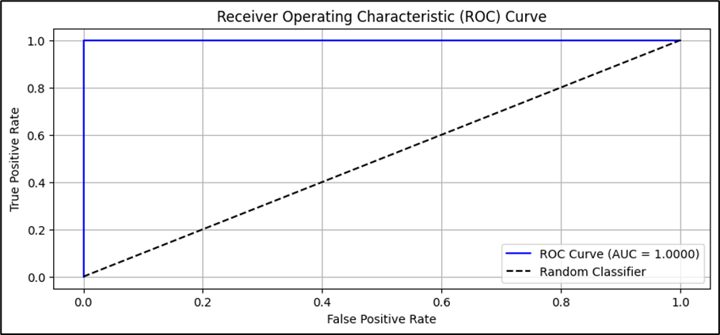
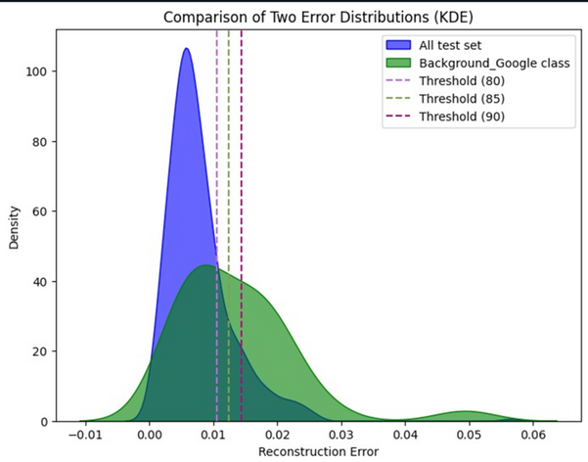
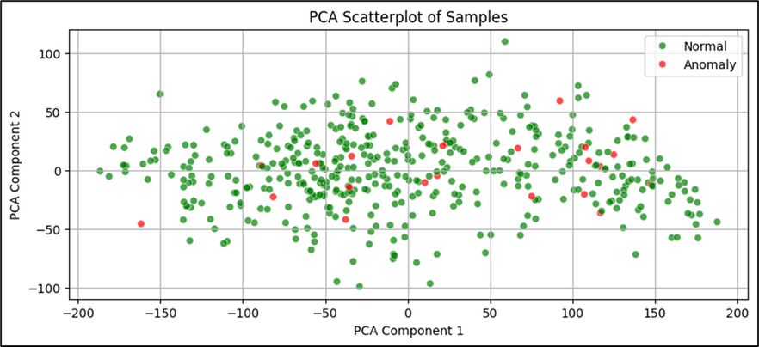
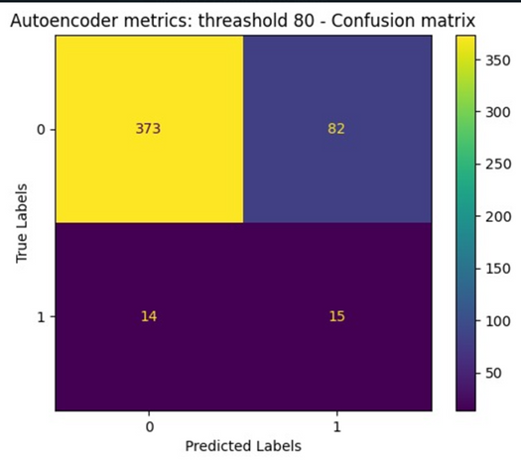
Evaluation and Visualization
Illustrated anomaly detection model's performance using visualization techniques such as the ROC curve, confusion matrix, PCA scatterplot for dimensionality reduction and Kernel Density Estimation (KDE).

Slide 11
Model Refinement and Optimization
Architectural Exploration: Experiment with various autoencoder designs and hyperparameters to enhance anomaly detection accuracy.
Threshold Tuning: Optimize reconstruction error thresholds to balance false positives and true positives effectively.
Generalization Techniques: Use learning rate scheduling, regularization, and dropout to improve model robustness and prevent overfitting.
Performance Evaluation: Iteratively evaluate and compare refined models to ensure consistent improvements in detection results.

Slide 12
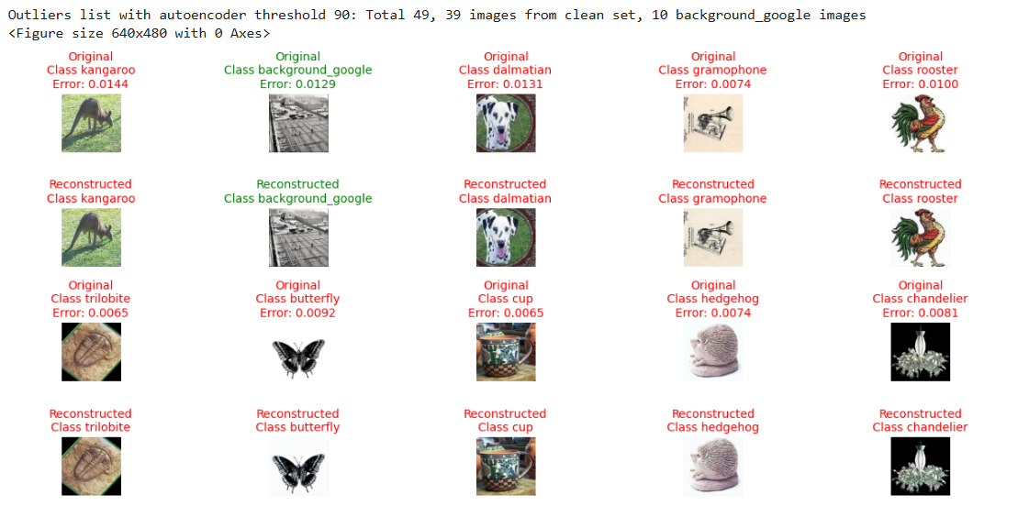
Original and reconstructed images
Outliers list with autoencoder threshold 90: Total 49, 39 images from clean set, 10 background_google images

Slide 13
Insights and Observations
Key Findings:
The latent space effectively captured patterns in the data.
Higher latent dimensions provided better reconstructions but were slower to train.
Challenges:
Fine-tuning hyperparameters required careful validation.
Computational cost increases with larger latent dimensions.
Time-consuming, requires expert knowledge
We spend a lot of time tuning features

Slide 14
Challenges
Backgrounds Are Harder to Reconstruct: Autoencoders struggle to reconstruct backgrounds like grass or picture frames, while objects are reconstructed well.
Art Images Cause High Errors: Drawings or stylized images often have high reconstruction errors due to their unique patterns.
Detailed Images Have Higher Errors: Images with intricate details lead to higher reconstruction errors, regardless of content.
Some Backgrounds Are Misclassified: Background images with terrains or textures common in training data are reconstructed well, causing low errors.

Slide 15
Conclusion
Successfully trained an autoencoder to learn patterns in the Caltech101 dataset.
Optimized hyperparameters for the best performance.
Demonstrated effectiveness using reconstruction error and visual results.

Slide 16
References
https://www.tensorflow.org/datasets/catalog/caltech101
https://www.analyticsvidhya.com/blog/2022/01/complete-guide-to-anomaly-detection-with-autoencoders-using-tensorflow/
https://github.com/AhkarHtet/Tensorflow_project2_group9_?fbclid=IwY2xjawGzgTtleHRuA2FlbQIxMAABHcEyGxErDPtgnHUCBHtvUsU5aCtxJJvjvHR4KPZEl7S0rXNVNCBV8YT1HQ_aem_vZqL7udbv29QNWrxkHmwgg
https://paperswithcode.com/paper/reduction-of-class-activation-uncertainty

Slide 17

THANK YOU

Slide 18
CODE DEMO

