Slide 1

Data Lake Project
Ahkkash, Emmanuel, Zayed, Martin

Slide 2
Parts of our project
Script generating bank transactions in France for the month of January 2024
Data Ingestion => Kafka and Zookeeper
Data Lake => MongoDB
Data Processing => Spark
Data Warehouse => Postgres
Data Visualization => Graphana
Notes:
Data Ingestion => Kafka and Zookeeper Data ingestion to capture of real-time data streams.
Data Lake => MongoDB The collected to stored in a data coming from the producer of kafka
Data Processing => Spark (batch processing) Data processing to transform data.
Data Warehouse => Postgres The processed data is stored clean dataset
Data Visualization => Grafana Finally, data visualization is view dashboards and dynamic visualizations to interpret the results.

Slide 3


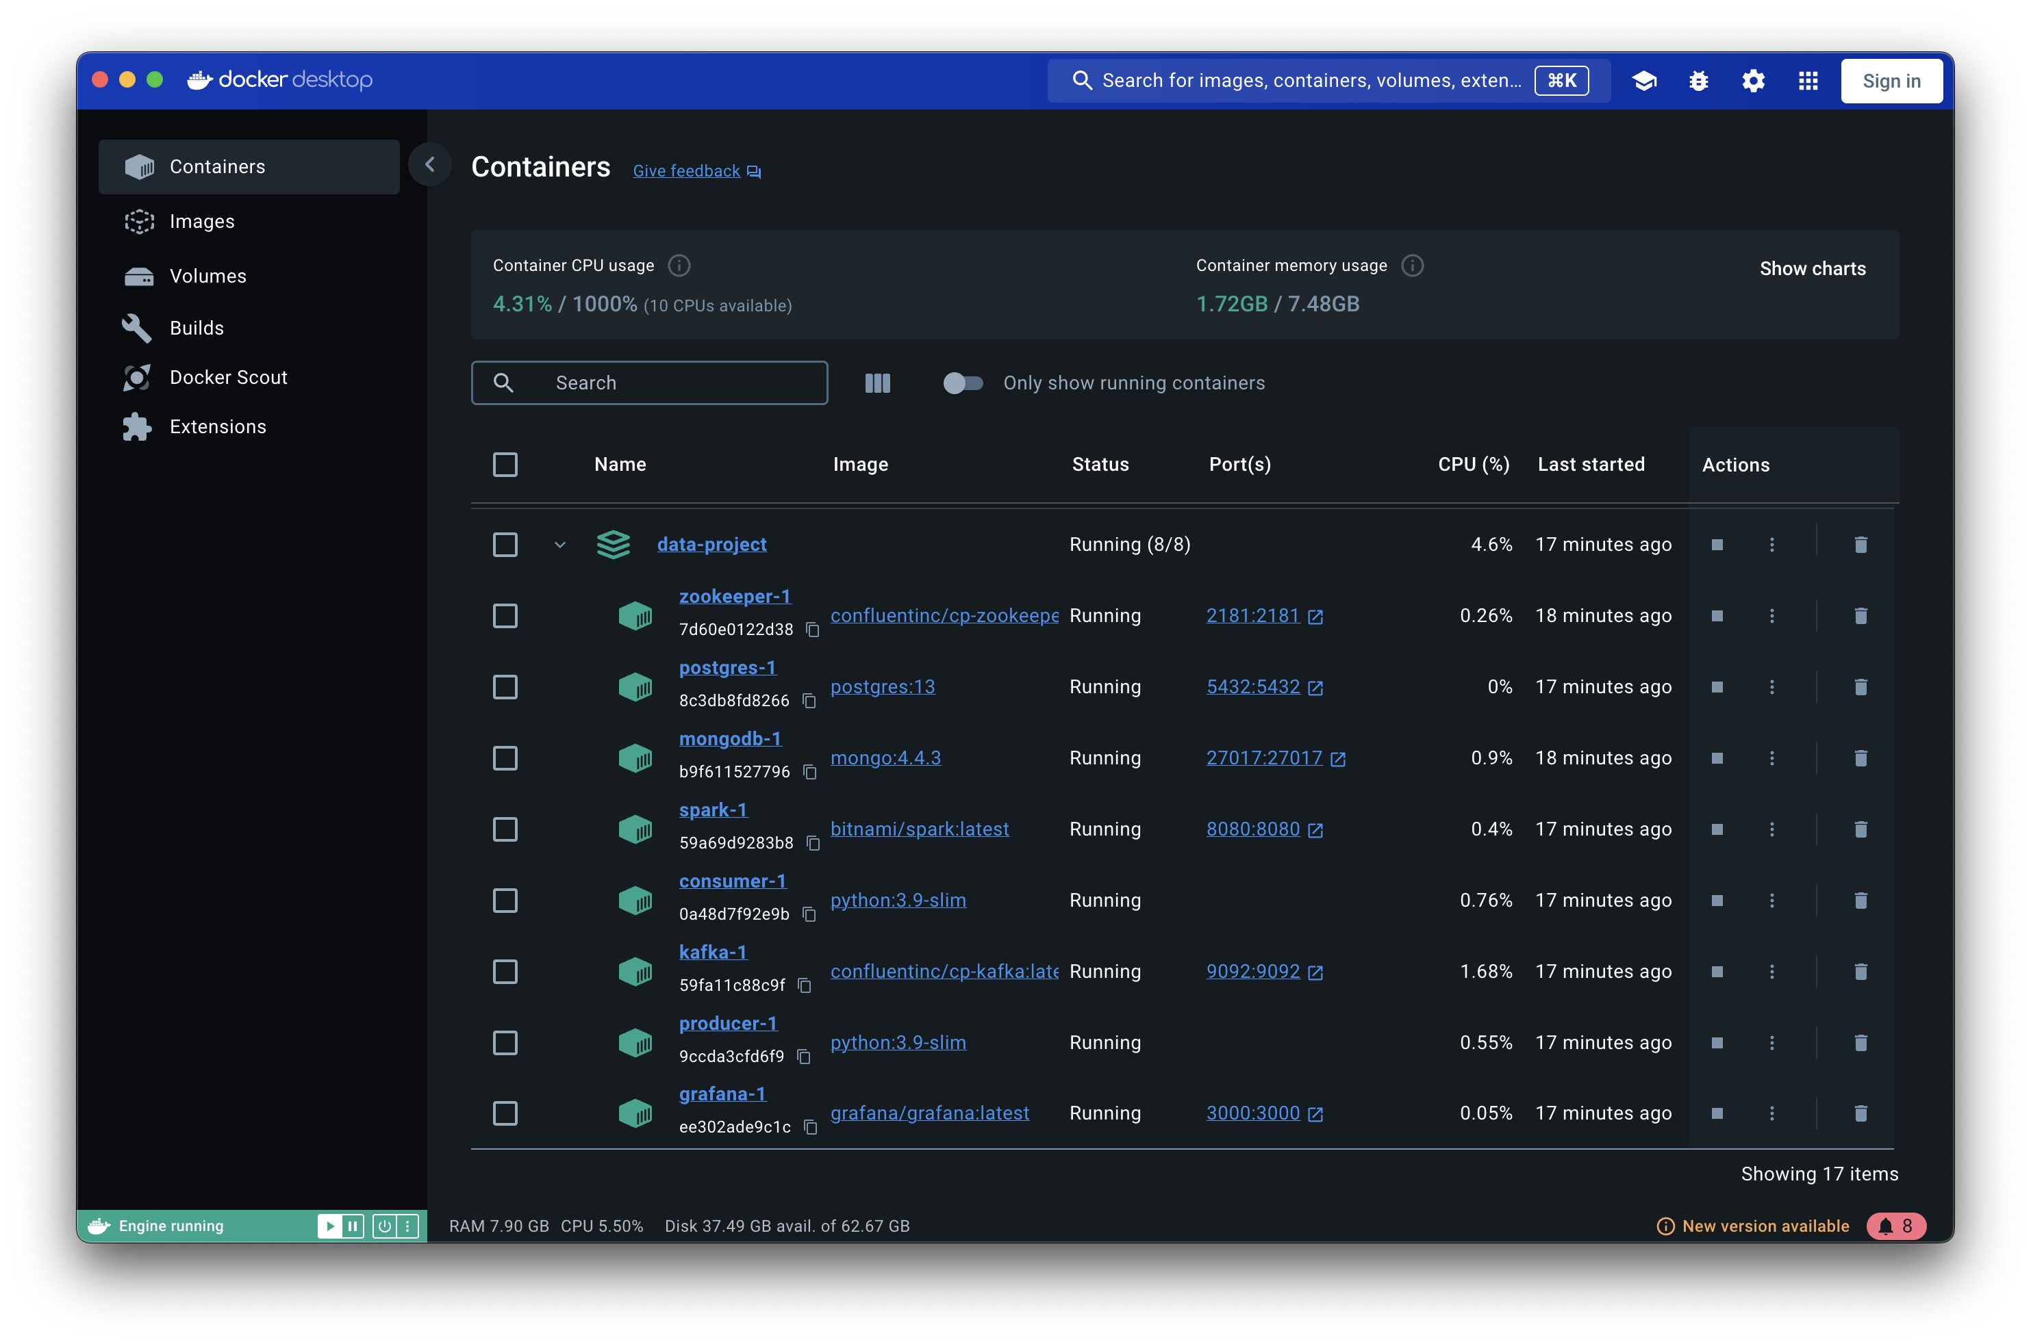
Data ingestion
This pipeline can work on any computer thanks to docker

Slide 4

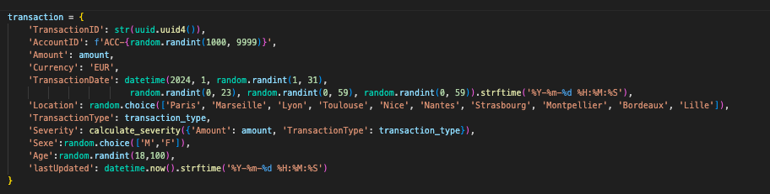
Data Lake
New transaction generated every 5 secondes

Slide 5

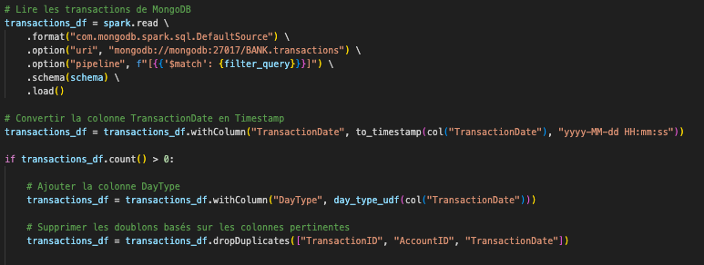
Data processing
Transformations with Spark

Slide 6

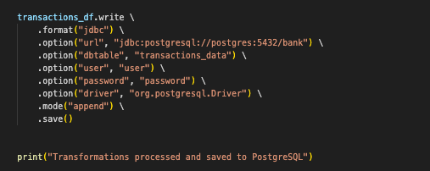
Data WAREHOUSE - POSTGRESQL
Storage data
After retrieved data from Mongodb
Data transformation

Slide 7


Data Visualization

Slide 8
