Slide 1
Platform Technology PFIT 01
Instructor: Yul Bryan M. Varca

Slide 2


Slide 3
What is a mobile app (mobile application)?
A mobile app (or mobile application) is a software application developed specifically for use on small, wireless computing devices, such as smartphones and tablets, rather than desktop or laptop computers. Mobile apps are sometimes categorized according to whether they are web-based or native apps, which are created specifically for a given platform. A third category, hybrid apps, combines elements of both native and web apps.
In today's digital age, mobile apps are an essential part of most people's daily lives. From social networking and entertainment to productivity and business, mobile apps play a vital role in how we interact with technology.

Slide 4
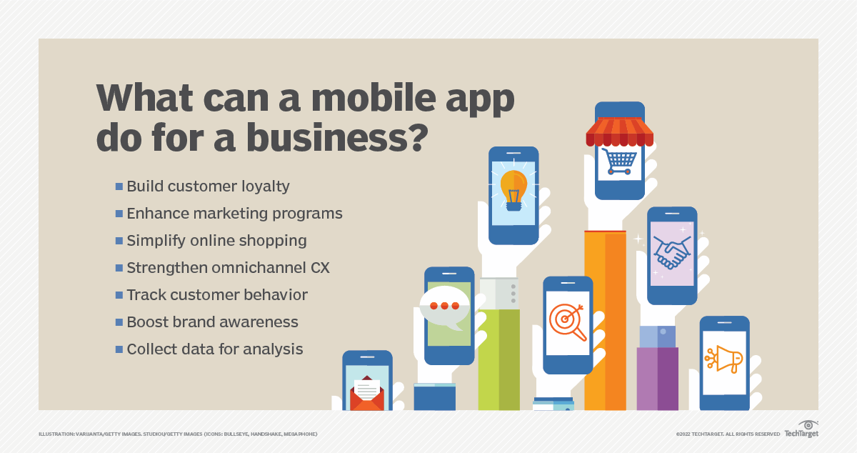

Slide 5
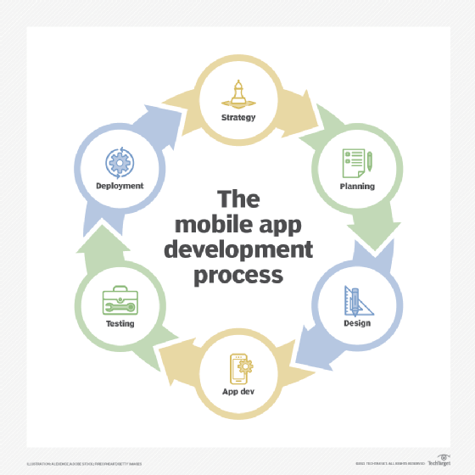

Slide 6
How does a mobile app work?
Mobile apps are designed to run on specific mobile operating systems such as iOS, Android and Windows Phone. When a mobile app is downloaded and installed on a device, it is stored in the device's memory and is launched using the device's operating system.
When a user opens a mobile app, the app communicates with the device's operating system and other built-in software components to access the device's hardware and services such as the camera, GPS and internet connection. The app then uses this information to provide its specific functions and services to the user.

Slide 7
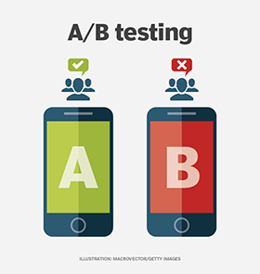
Advantages of mobile apps
There are numerous advantages to using mobile apps, namely:
Convenience. Mobile apps can be downloaded and installed on a device, allowing users to access the app's functions and services at any time, from anywhere.
Personalization. Mobile apps can be customized to meet the specific needs of individual users, providing a personalized experience.
Offline access. Many mobile apps can be used offline, providing access to important information and features even when an internet connection is not available.
Push notifications. Mobile apps can send push notifications to users, providing real-time updates on important information and events.

Slide 8
Disadvantages of mobile apps
However, there are some disadvantages and considerations to keep in mind when using mobile apps. These include:
Limited functionality. Mobile apps are designed to provide specific functions and services, and they might not be able to provide the same level of functionality as a desktop application.
Limited compatibility. Mobile apps are designed to run on specific mobile operating systems, and they might not be compatible with all devices.
Security concerns. Mobile apps can access sensitive information on a device, and they might not have the same level of security as a desktop application.
Limited updating capability. Some mobile apps might not be easily updated, and users might need to download a new version of the app to access the latest features and bug fixes.

Slide 9
Platform Technology PFIT 01
Instructor: Yul Bryan M. Varca

Slide 10
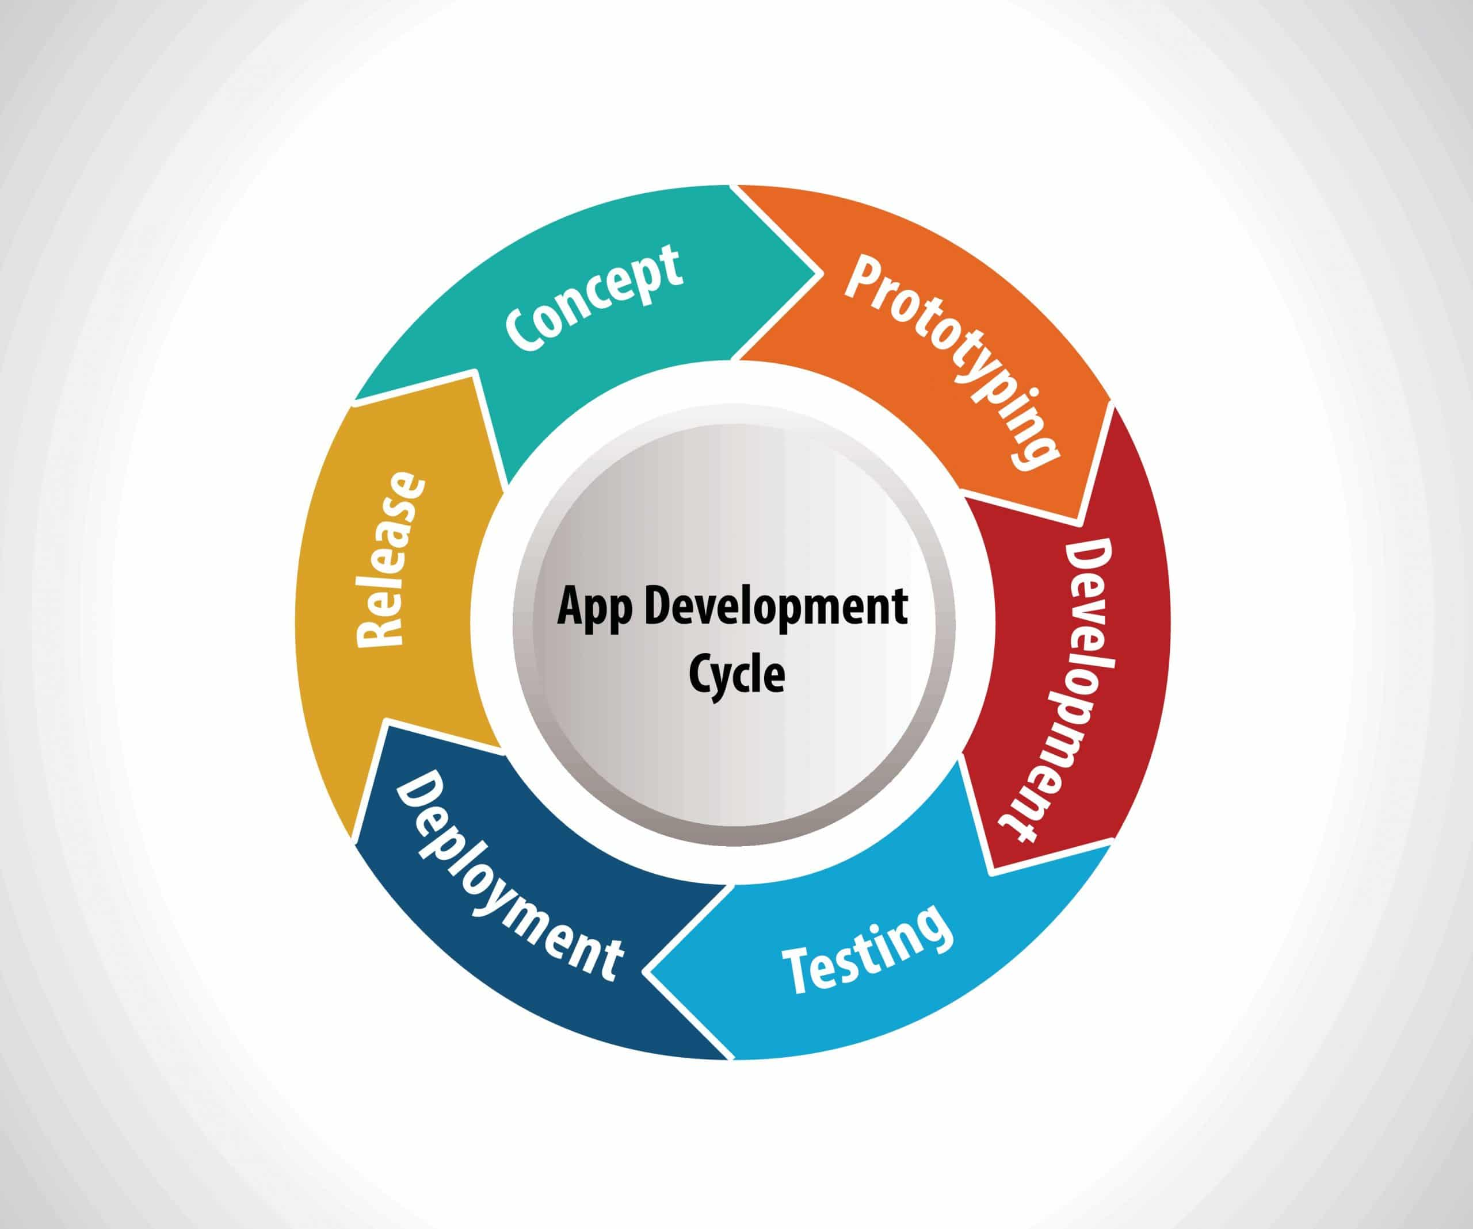
Mobile App Development Implementation | Lifecycle

Slide 11
Mobile App Development Implementation | Lifecycle
Understanding Mobile app development implementation and lifecycle is one of the essential aspect if your business would like to create smartphone applications.
Android & IOS apps has become an essential aspect of business strategies, enabling companies to reach and engage with their customers on a whole new level.

Slide 12
Mobile App Development Implementation | Lifecycle
Any app development requires a proper step-by-step process involved in creating and launching a mobile application.
It encompasses everything from conceptualizing the app idea to designing, developing, testing, and deploying the final product.
These stages ensures that the process is structured and efficient, leading to a successful and user-friendly application.

Slide 13

Phases and Lifecycles of Mobile App Development
There are various phases and stages through which any mobile app development moves and every phase become important as well as crucial of the overall lifecycle. It involves several key steps that contribute to the creation of a functional and engaging Implementation.

Slide 14


Phases and Lifecycles of Mobile App Development
Planning & Analysis
This initial phase involves defining the app's purpose, target audience, and goals. It also includes conducting market research, competitor analysis, and identifying the app's unique selling points. Proper planning and analysis help in setting clear objectives and creating a roadmap for the development process.

Slide 15
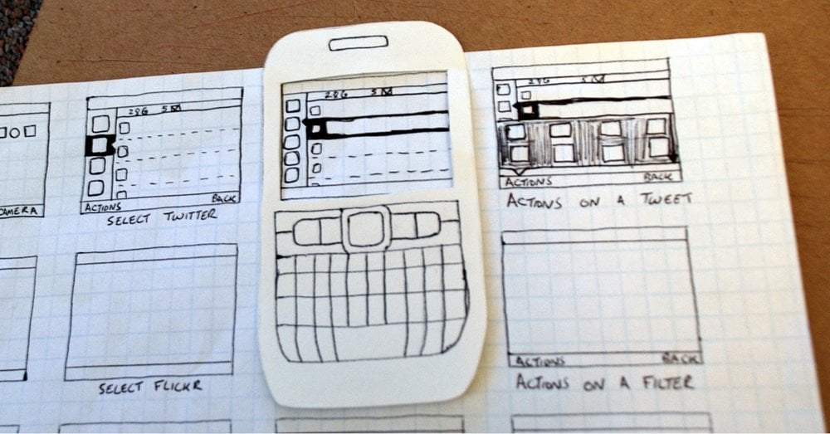
Phases and Lifecycles of Mobile App Development
2. Design & Prototyping
In this phase, the app's visual design, user interface (UI), and user experience (UX) are created. Wireframes and prototypes are developed to provide a visual representation of the app's layout, navigation, and interactions. This step allows for early feedback and refinement of the app's design before moving forward.

Slide 16

Phases and Lifecycles of Mobile App Development
3. Development & Programming
Once the design is finalized, the actual development and programming work begin. This involves writing the code, implementing the app's features and functionalities, and integrating with backend systems if required. Developers use programming languages, frameworks, and tools specific to the target platform (such as iOS or Android) to build the app.

Slide 17
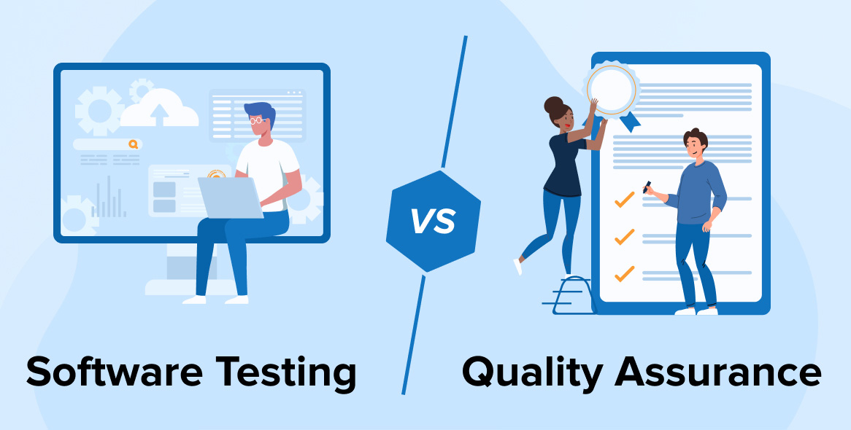
Phases and Lifecycles of Mobile App Development
4. Testing & Quality Assurance
Testing is a critical phase to ensure the app works as intended and provides a seamless user experience. It involves various types of testing, including functional testing, usability testing, performance testing, and security testing. Bugs and issues are identified, reported, and fixed during this phase to enhance the app's quality and stability.

Slide 18

Phases and Lifecycles of Mobile App Development
5. Deployment & Launch
After rigorous testing and fine-tuning, the app is ready to be deployed and launched in the respective app stores (such as Apple's App Store or Google Play Store). App store guidelines and submission processes are followed to ensure compliance and maximize visibility. Proper marketing and promotional strategies are also implemented to generate awareness and drive downloads.
This phase sets the foundation for a successful and functional application. Each step contributes to the overall quality and user experience, making it essential to invest time and effort into every aspect of the process.

Slide 19

Implementation Lifecycle: After Launch
The implementation lifecycle of a mobile app begins once the app is launched and available to users. It involves ongoing activities aimed at maximizing the app's performance, user satisfaction, and overall success. Let's explore the key steps after the launch of your mobile application:
Adoption & Integration
After the app is launched, the focus shifts to driving user adoption and integrating the app into users' daily lives. This phase includes marketing and promotional strategies to create awareness, attract users, and encourage them to download and use the app. It also involves user onboarding processes to guide users through the app's features and functionalities, ensuring a smooth and positive first-time experience.

Slide 20
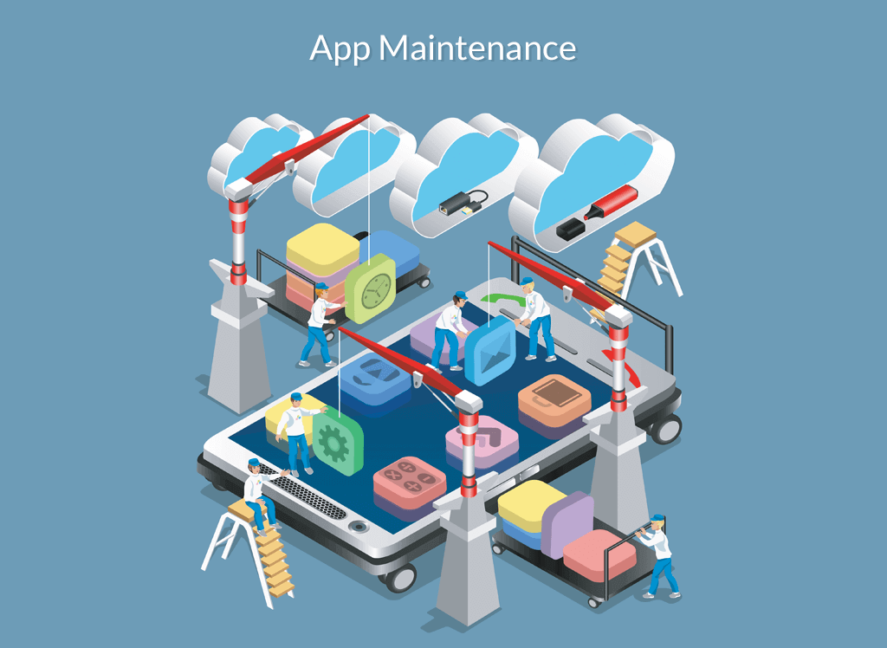
Maintenance & Updates
To keep the app running smoothly and address any issues or bugs that may arise, regular maintenance and updates are necessary. This phase involves monitoring the app's performance, collecting user feedback, and addressing reported issues promptly. Regular updates are released to fix bugs, improve performance, and introduce new features based on user needs and market trends.

Slide 21

Optimization & Enhancement
In the world of mobile apps, continuous optimization is essential to stay competitive. This phase involves analyzing user behavior and app analytics to identify areas for improvement. User feedback and reviews are valuable sources of insights for enhancing the app's usability, functionality, and overall user experience. Optimization efforts may include performance optimization, UI/UX enhancements, feature additions, and integration with emerging technologies.
The implementation lifecycle is an ongoing process that requires consistent attention and adaptation to meet evolving user expectations and market demands.

Slide 22

Best Practices for Mobile App Development & Implementation Lifecycle
To ensure a successful mobile app development and implementation lifecycle, it is crucial to follow best practices that prioritize user satisfaction, efficient development processes, and the security of user data. Here are some key best practices to consider:
1. Importance of User-Centered Design
Putting the user at the center of the design process is vital for creating an app that meets their needs and expectations. Conduct thorough user research to understand their preferences, behaviors, and pain points.

Slide 23
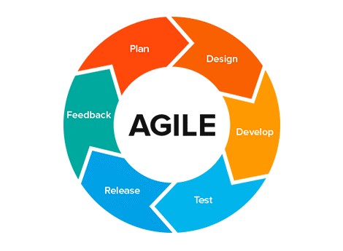
2. Agile Development Methodology
Adopting an agile development methodology allows for flexibility, collaboration, and quick iterations. Break the development process into manageable sprints, each focused on delivering specific features or improvements. Regularly assess progress, gather feedback, and adjust priorities accordingly. Agile development promotes faster time-to-market, increased adaptability, and better alignment with user requirements.

Slide 24

3. Continuous Testing & Integration
Implementing a robust testing and integration strategy throughout the development lifecycle is essential for delivering a high-quality app. Conduct comprehensive testing across various devices, platforms, and network conditions to ensure compatibility, functionality, and performance.
4. Security & Privacy Considerations
With the increasing concerns about data security and privacy, it is crucial to prioritize these aspects in the app development and implementation process. Implement robust security measures to protect user data, such as encryption, secure authentication, and data anonymization. Comply with relevant data protection regulations and regularly update security features to address emerging threats.

Slide 25
By adhering to these best practices, app developers and organizations can enhance the quality of their mobile apps, optimize the development process, and provide users with secure and satisfying experiences. Incorporating user-centered design, agile methodologies, continuous testing, and robust security measures will contribute to the overall success of the app throughout its lifecycle.

Slide 26
END

