Slide 1
Data Structures and Algorithm
Instructor: Yul Bryan M. Varca

Slide 2
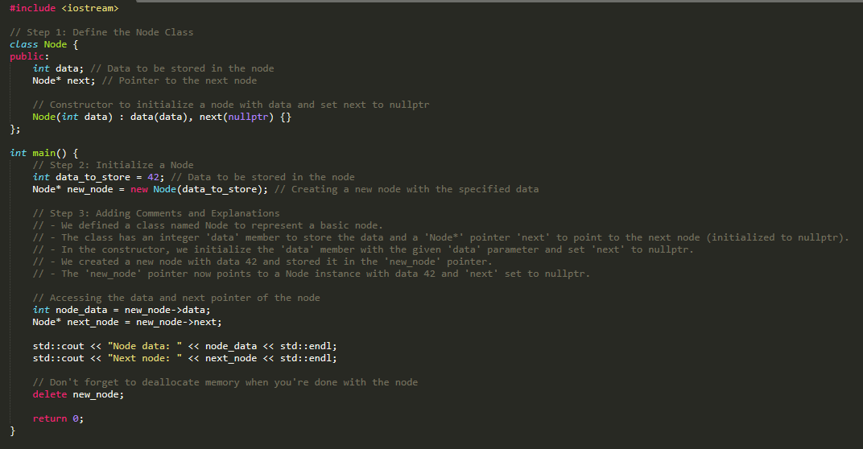

Slide 3
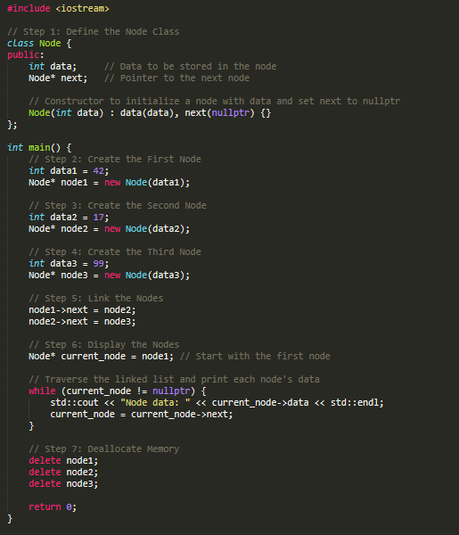
Displaying the elements of a link list

Slide 4
QUEUE

Slide 5
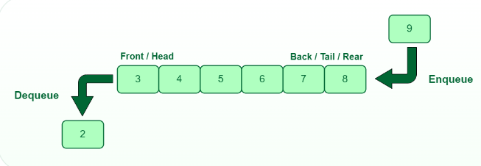
What is Queue?
A queue is defined as a linear data structure that is open at both ends and the operations are performed in First In First Out (FIFO) order.
We define a queue to be a list in which all additions to the list are made at one end, and all deletions from the list are made at the other end. The element which is first pushed into the order, the operation is first performed on that.

Slide 6

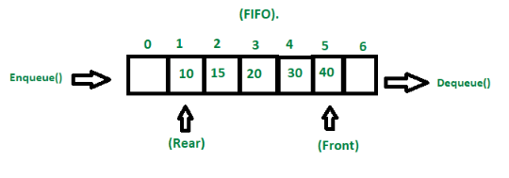
FIFO Principle of Queue:
A Queue is like a line waiting to purchase tickets, where the first person in line is the first person served. (i.e. First come first serve).
Position of the entry in a queue ready to be served, that is, the first entry that will be removed from the queue, is called the front of the queue(sometimes, head of the queue), similarly, the position of the last entry in the queue, that is, the one most recently added, is called the rear (or the tail) of the queue. See the below figure.

Slide 7
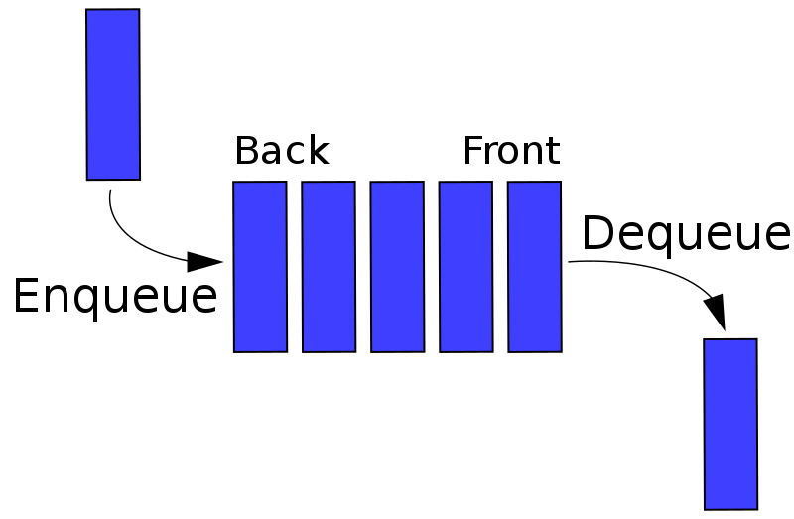
Characteristics of Queue:
Queue can handle multiple data.
We can access both ends.
They are fast and flexible.
Queue Representation:
Like stacks, Queues can also be represented in an array: In this representation, the Queue is implemented using the array. Variables used in this case are
Queue: the name of the array storing queue elements.
Front: the index where the first element is stored in the array representing the queue.
Rear: the index where the last element is stored in an array representing the queue.

Slide 8
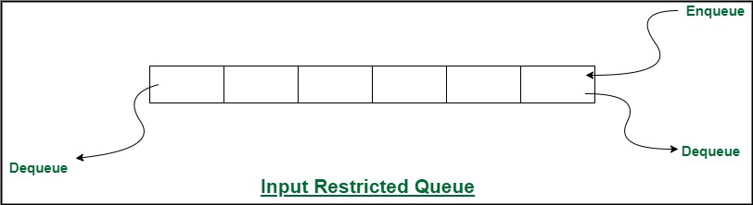
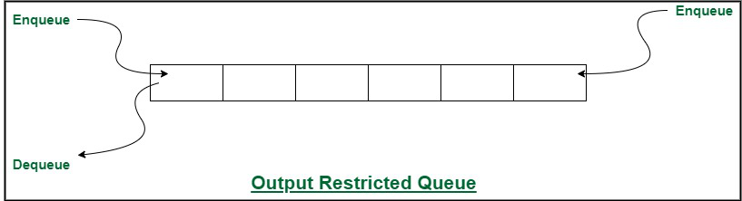
There are different types of queue:
Input Restricted Queue
This is a simple queue. In this type of queue, the input can be taken from only one end but deletion can be done from any of the ends.
Output Restricted Queue
This is also a simple queue. In this type of queue, the input can be taken from both ends but deletion can be done from only one end.

Slide 9
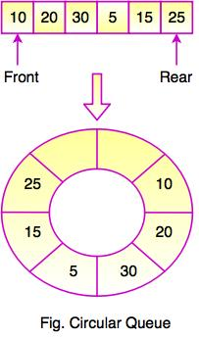
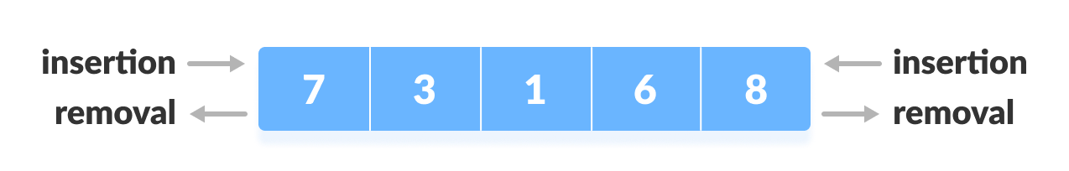
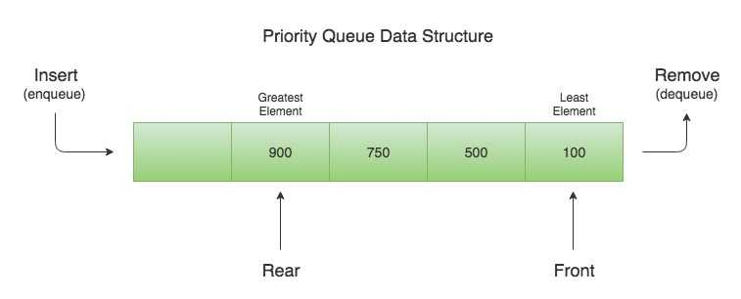
There are different types of queue:
Circular Queue
This is a special type of queue where the last position is connected back to the first position. Here also the operations are performed in FIFO order.
Double-Ended Queue (Dequeue)
In a double-ended queue the insertion and deletion operations, both can be performed from both ends.
Priority Queue
A priority queue is a special queue where the elements are accessed based on the priority assigned to them.

Slide 10
Enqueue and Dequeue

Slide 11
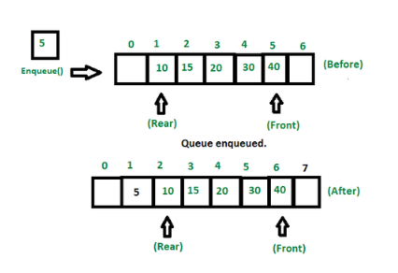
Enqueue():
Adds (or stores) an element to the end of the queue.
The following steps should be taken to enqueue (insert) data into a queue:
Step 1: Check if the queue is full.
Step 2: If the queue is full, return overflow error and exit.
Step 3: If the queue is not full, increment the rear pointer to point to the next empty space.
Step 4: Add the data element to the queue location, where the rear is pointing.
Step 5: return success.

Slide 12
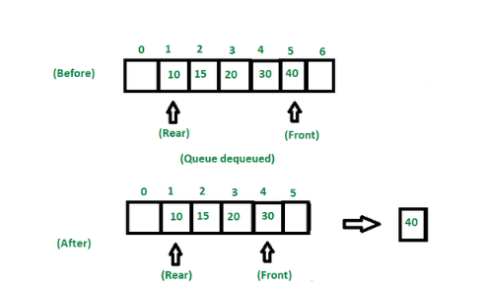
Dequeue():
Removes (or access) the first element from the queue.
The following steps are taken to perform the dequeue operation:
Step 1: Check if the queue is empty.
Step 2: If the queue is empty, return the underflow error and exit.
Step 3: If the queue is not empty, access the data where the front is pointing.
Step 4: Increment the front pointer to point to the next available data element.
Step 5: The Return success.

Slide 13
Basic Operations of Queue:

Slide 14
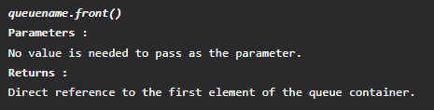
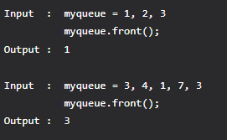
Basic Operations of Queue:
There are few supporting operations (auxiliary operations):
front():
This operation returns the element at the front end without removing it.
queue::front()
This function is used to reference the first or the oldest element of the queue container. This function can be used to fetch the first element of a queue.
Syntax
Example:

Slide 15
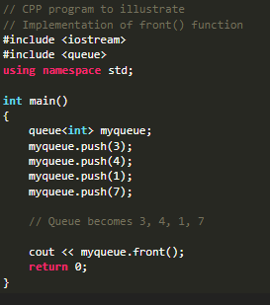
Errors and Exceptions
If the queue container is empty, it causes undefined behavior
It has a no exception throw guarantee if the queue is not empty

Slide 16
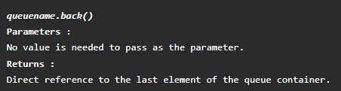
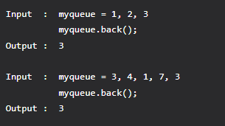
Basic Operations of Queue:
There are few supporting operations (auxiliary operations):
rear():
This operation returns the element at the rear end without removing it.
queue::back()
This function is used to reference the last or the newest element of the queue container. This function can be used to fetch the first element from the back of a queue.
Syntax :
Example:

Slide 17
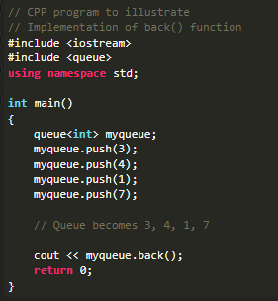
Errors and Exceptions
If the queue container is empty, it causes undefined behavior
It has a no exception throw guarantee if the queue is not empty

Slide 18
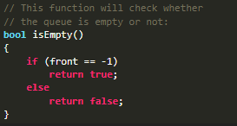
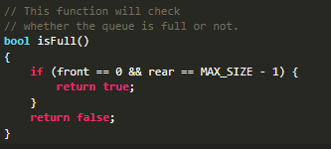
Basic Operations of Queue:
There are few supporting operations (auxiliary operations):
isEmpty():
This operation returns a boolean value that indicates whether the queue is empty or not.
isFull():
This operation returns a boolean value that indicates whether the queue is full or not.

Slide 19

Application :
Given an empty queue of integers, add numbers to the queue, then print the difference between the first and the last element.
Algorithm
1. Add numbers to the queue using push() function
2. Compare the first and the last element.
3. If first element is larger, subtract last element from it and print it.
4. Else subtract first element from the last element and print it.

Slide 20
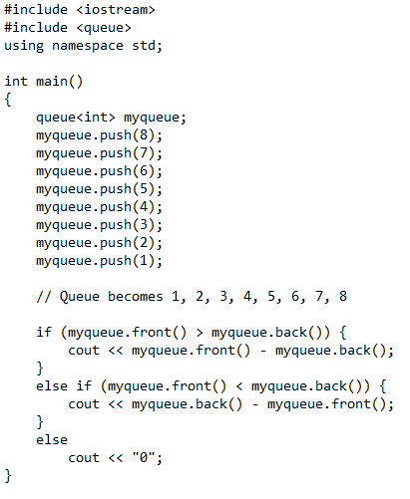
Output: 7

Slide 21
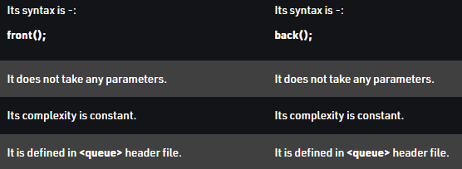
The differences in a tabular form -
queue::front()
queue::back()

Slide 22
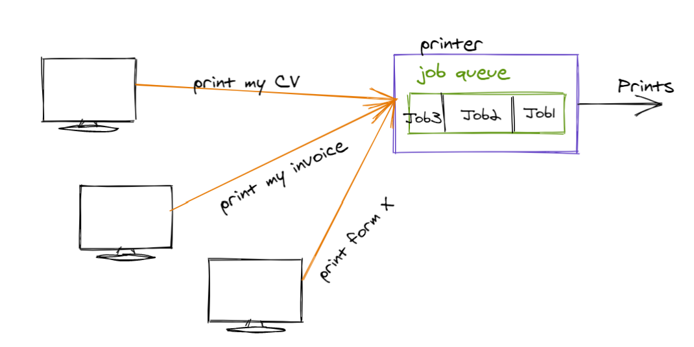
Applications of Queue:
Application of queue is common.
In a computer system, there may be queues of tasks waiting for the printer, for access to disk storage, or even in a time-sharing system, for use of the CPU.
Within a single program, there may be multiple requests to be kept in a queue, or one task may create other tasks, which must be done in turn by keeping them in a queue.
Conclusion:
A Queue is a sequential data structure that follows the FIFO (First In First Out) approach.
A Static stack is implemented using an array, whereas a dynamic stack is implemented using lists.
Enqueue and Dequeue are two main operations of a queue, the others being Peek, isEmpty, isFull.

Slide 23
Non Linear Data Structure

Slide 24
A non-linear data structure is another important type in which data elements are not arranged sequentially; mainly, data elements are arranged in random order without forming a linear structure.
Data elements are present at the multilevel, for example, tree.
In trees, the data elements are arranged in the hierarchical form, whereas in graphs, the data elements are arranged in random order, using the edges and vertex.
Multiple runs are required to traverse through all the elements completely. Traversing in a single run is impossible to traverse the whole data structure.
Each element can have multiple paths to reach another element.
The data structure where data items are not organized sequentially is called a non-linear data structure. In other words, data elements of the non-linear data structure could be connected to more than one element to reflect a special relationship among them.

Slide 25
Tree:
The tree is a non-linear data structure that is comprised of various nodes. The nodes in the tree data structure are arranged in hierarchical order.
It consists of a root node corresponding to its various child nodes, present at the next level. The tree grows on a level basis, and root nodes have limited child nodes depending on the order of the tree.
For example, in the binary tree, the order of the root node is 2, which means it can have at most 2 children per node, not more than it.
The tree itself is a very broad data structure and is divided into various categories like Binary tree, Binary search tree, AVL trees, Heap, max Heap, min-heap, etc.
All the types of trees mentioned above differ based on their properties.

Slide 26
What is Tree Data structure?
Trees: Unlike Arrays, Stack, Linked Lists, and queues, which are linear data structures, trees are hierarchical.
A tree data structure is a collection of objects or entities known as nodes linked together to represent or simulate hierarchy.
This data is not arranged in a sequential contiguous location like as we have observed in an array, the homogeneous data elements are placed at the contiguous memory location so that the retrieval of data elements is simpler.
A tree data structure is non-linear because it does not store sequentially. It is a hierarchical structure as elements in a Tree are arranged in multiple levels.
The topmost node in the Tree data structure is known as a root node. Each node contains some data, and data can be of any type. The node contains the employee's name in the tree structure, so the data type would be a string.
Each node contains some data and the link or reference of other nodes that can be called children.

Slide 27
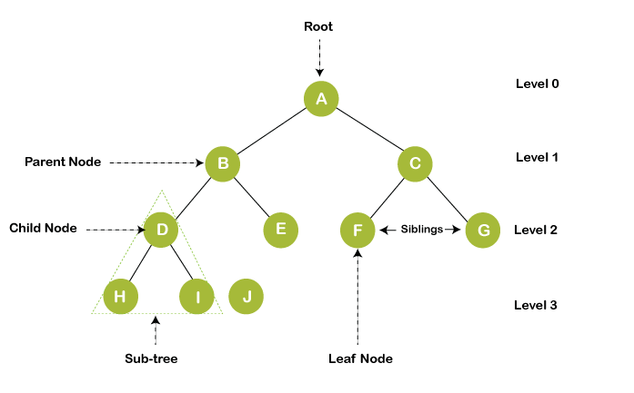

Slide 28
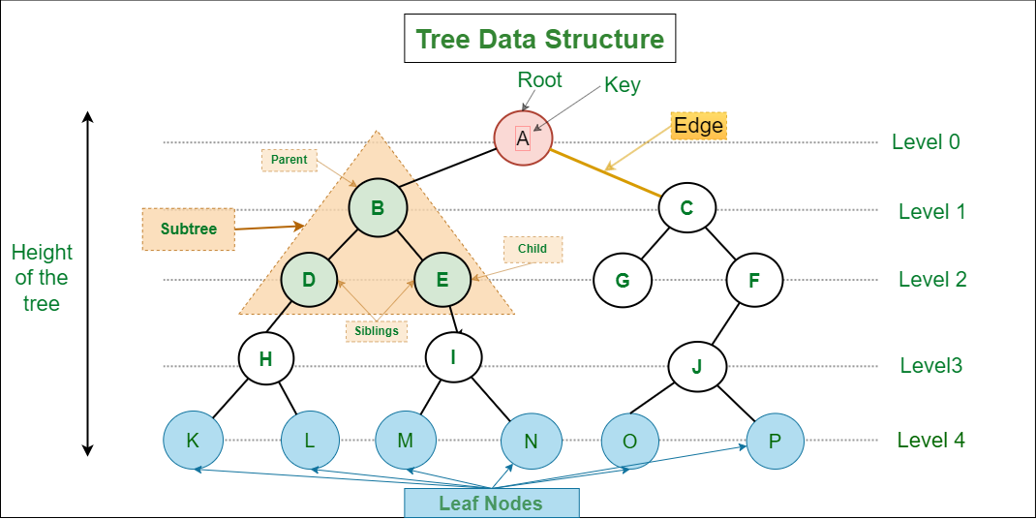

Slide 29
Terminologies used in tree:
Root node: The tree consists of a root node; it is the starting node of the tree from which any tree grows. The root node is present at level 0 in any tree. Depending on the order of the tree, it can hold that much of child nodes. For example, if in a tree the order is 3, then it can have at most three child nodes, and minimum, it can have 0 child nodes.
Child node: The child node is the node that comes after the root node, which has a parent node and has some ancestors. It is the node present at the next level of its parent node. For example, if any node is present at level 5, it is sure that its parent node is present at level 4, just above its level.
Edge: Edges are nothing but the link between the parent node, and the children node is called the link or edge connectivity between two nodes.
Siblings: The nodes having the same parent node is called siblings of each other. Same ancestors are not siblings, and only the parent node must be the same, defined as siblings. For example, if node A has two child nodes, B and C, B and C are called siblings.

Slide 30
Leaf node: The leaf node is the node that does not have any child nodes. It is the termination point of any tree. It is also known as External nodes.
Internal nodes: Internal nodes are non-leaf nodes, having at least one child node with child nodes.
Degree of a node: The degree of a node is defined as the number of children nodes. The degree of the leaf node is always 0 because it does not have any children, and the internal node always has atleast one degree, as it contains atleast one child node.
Height of the tree: The tree's height is defined as the distance of the root node to the leaf node present at the last level is called the height of the tree. In other words, height is the maximum level upto which the tree is extended.

Slide 31
Types of trees
Trees are divided into various categories as follows mentioned below:
Simple Tree
Binary tree
Complete Binary tree
Full Binary tree
Binary search tree
AVL Trees
B -Tree
B+ Tree

Slide 32
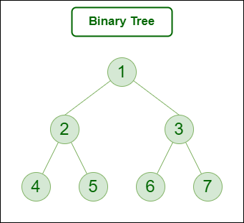
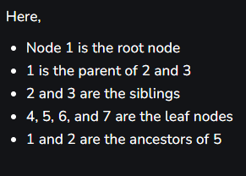
Binary Tree

Slide 33
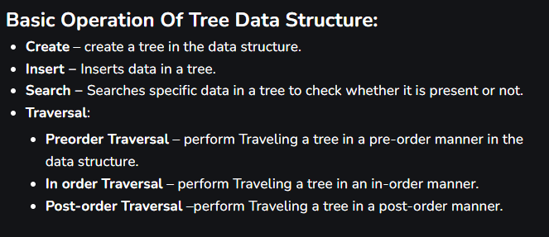

Slide 34
Types of trees
Trees are divided into various categories as follows mentioned below:
Simple Tree
Binary tree
Complete Binary tree
Full Binary tree
Binary search tree
AVL Trees
B -Tree
B+ Tree
ASSIGNMENT. 1 Whole
Select only 5 of your OWN choice. Define, explain and provide example of each tree categories.

Slide 35
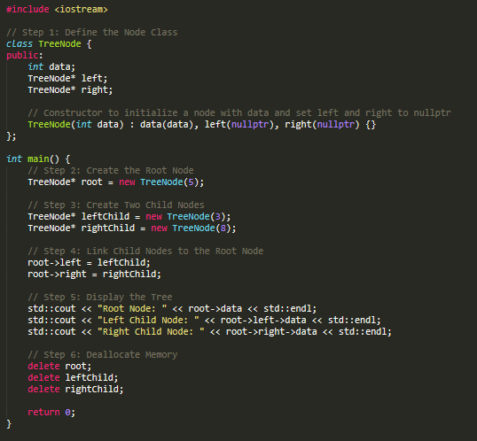
Online compiler to be used for simple activities
https://www.onlinegdb.com/online_c++_compiler

