Slide 1
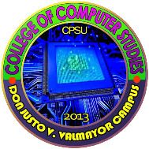
Human computer interaction 1
Ms. Deliza Grace T. Delgado
Central Philippines State University
San Carlos Campus

Slide 2
This chapter aims to:
Identify the development of human abilities and limitations in interactions towards computer generations.
Identify and compare the good and poor design.

Slide 3
INTRODUCTION
Interacting with the technology nowadays has become an essential part of everyday lives of majority of the people. The average user of computer system is now less likely to understand the technology since there are different types of technology existing this days. Therefore, computer systems should be easy to use, easy to learn, and with no errors. As you finish this module, the major concern of Human-Computer Interaction (HCI) is for you to be able to identify its origin, development and the comparison of good and bad designs.
Hence, this chapter will introduce you to an in-depth discussion of the following lessons:
History of Human-Computer Interaction
HCI Definitions
Challenges and Goals of HCI
Usability
Good and Bad Designs

Slide 4
Lesson 1.1 A Brief History of Human-Computer Interaction

Slide 5
A Brief History of Human-Computer Interaction
Human-computer interaction (HCI) is initially as a specialty area in computer science embracing cognitive science and human factors engineering. It is an area of research and practice that emerged in the early 1980s. HCI is an academic discipline that mostly think as of User-Interface Design. It focuses on the way that interactions between human beings and computers interact to ever increasing levels of both complexity and simplicity. HCI has expanded rapidly and steadily for three decades, attracting professionals from many other disciplines and incorporating diverse concepts and approaches

Slide 6
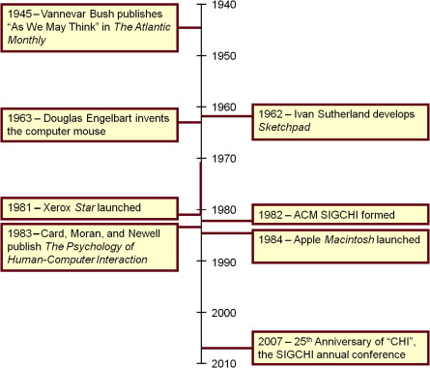
A Brief History of Human-Computer Interaction

Slide 7
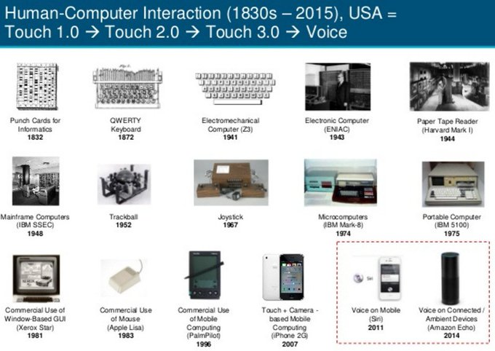
Timeline of a few notable events leading to the birth and emergence of HCI as a field of study, beginning in the 1940s.

Slide 8
Lesson 1.2 What is HCI?

Slide 9
What is HCI?
Human-computer interaction (HCI): “is a discipline concerned with the design, evaluation and implementation of interactive systems for human use and with study of major phenomena surrounding them.” - (ACM SIGCHI, 1992, p. 6)

Slide 10
The three parts of HCI are:
Human: could be an individual user or a group of users. They are limited in their capacity to process all information as well as their emotions that will affect their interactions towards technology. They might have common capabilities but they are individuals with differences which should not be ignored in the study of HCI.
Computer: could be any technology ranging from a small computer gadget to large scale of computer system. It comprises various elements, each of which affects the user of the system; the input devices, output display devices, memory, and the processing system
Interaction: any direct or indirect communication between a human and computer. This interaction framework has four parts.
User
Input
System
Output

Slide 11
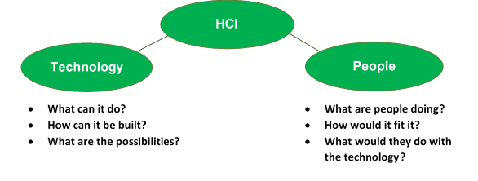
The HCI Challenge and Goals

Slide 12
HCI is not about – - making the interface looks pretty; - only for desktop computers; -something that would be nice to do but usually there’s no time for it.
HCI is about –
understanding the users;
understanding the user’s task;
understanding the user’s environment;
GUI requirements, gathering and analysis;
designing prototypes;
evaluating the system.

Slide 13
The Goals of HCI
HCI aims to develop or improve the safety, usability, utility, efficiency and effectiveness of the system that involves computers. In order to fulfil these goals, developers must attempt to:
understand how people use technology;
build suitable systems;
achieve effective, efficient and safe interaction;
put people first.
People needs, capabilities and preferences should come first. People should not have to change the way that they use a system. Instead, the system should be designed to match their requirements

Slide 14
Guidelines in HCI
Ben Shneiderman, an American computer scientist consolidated some implicit facts about designing and came up with the following eight general guidelines:
Strive for Consistency.
Cater to Universal Usability.
Offer Informative feedback.
Design Dialogs to yield closure.
Prevent Errors.
Permit easy reversal of actions.
Support internal locus of control.
Reduce short term memory load

Slide 15
Lesson 1.2 Usability: Good and Bad Design

Slide 16
Usability: Good and Bad Design
“ Easy to learn, easy to use” is the slogan in which the concept of the usability originally articulated.
Usability was and is the original and abiding focus of Human-Computer Interaction.
This helps to improve and enhance system facilities and satisfy users’ needs and necessities.
Usability is an emergent quality that reflects the grasp and the reach of HCI. Contemporary users wants more from a system than merely “ease of use”.

Slide 17
Three Major Components of Usability
Effectiveness- the completeness with which users achieve their goals
Efficiency- the competence used in using the resources to effectively achieve the goals.
Satisfaction- the ease of the work system to its users.

Slide 18
Importance of Usability
A good user-interface can:
earn a company billions;
increase users loyalty;
increase users trust;
satisfies the users.
A bad user-interface can:
be annoying, frustrating, embarrassing and even deadly;
increase mistakes in data entry and system operation;
system failure because of users rejection;
makes functions become completely inaccessible.

Slide 19
Good and Bad Designs
Basic misconception of designing a product:
if I (the developer) can use it, everyone can use it;
if non-technical people can use it, everyone can;
good user-interface can be only applied by common sense;
if all style guidelines are met it is already usable.

Slide 20
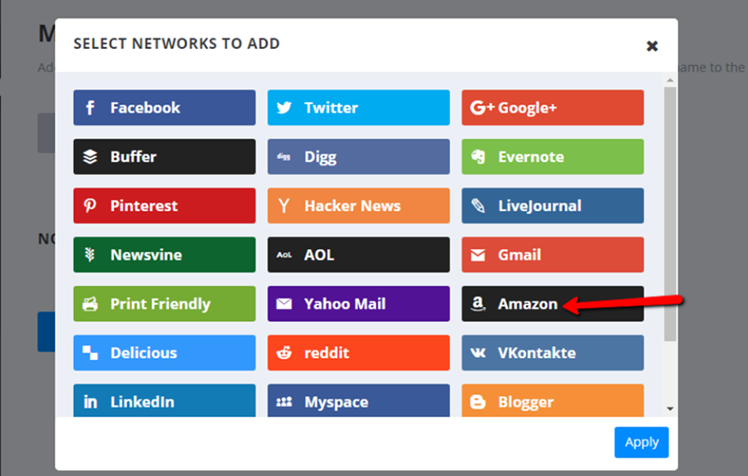
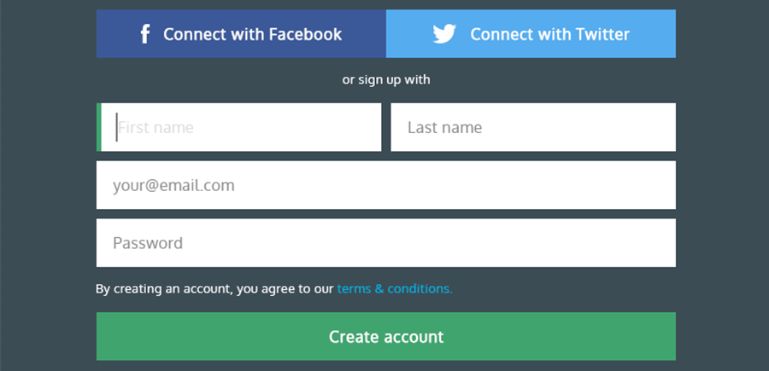
Examples of Good and Bad User Interface Design
These are examples of good UI designs that are well-organized, easy to navigate, understand and use.

Slide 21
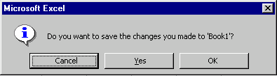
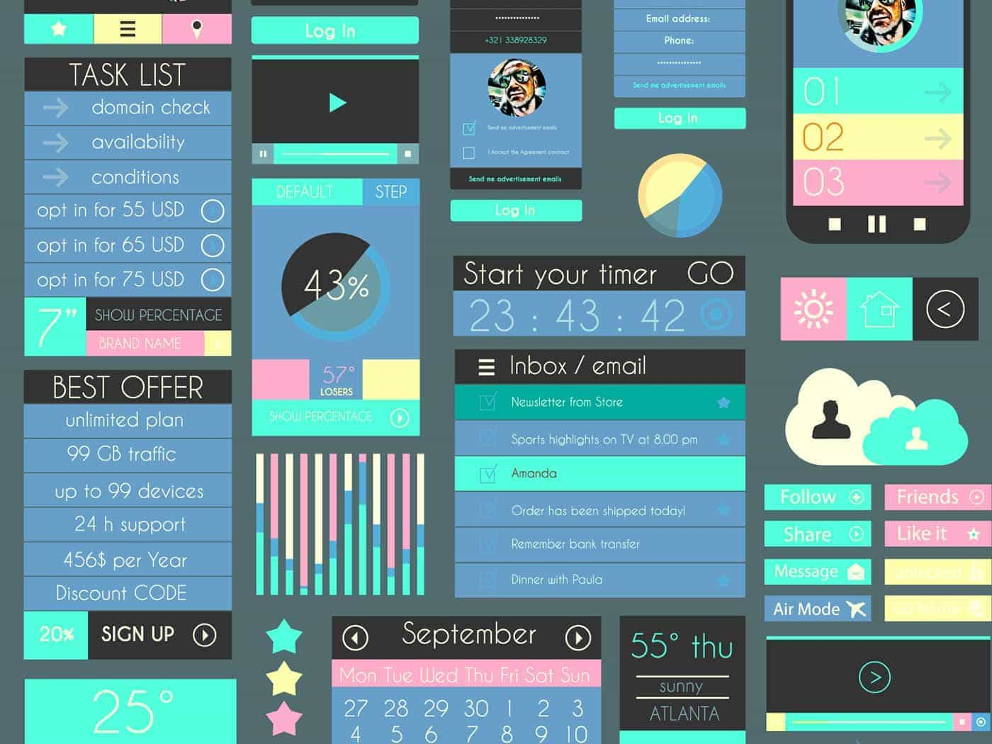
Examples of Good and Bad User Interface Design
These are examples of bad UI designs that are confusing and not user-friendly.

