Slide 1


Prototype
PharmaPlus
Sales Inventory System with Android Support
Login Page
Logo
Admin & Employee Login Page
Username & Password Input
Login Button

Slide 2
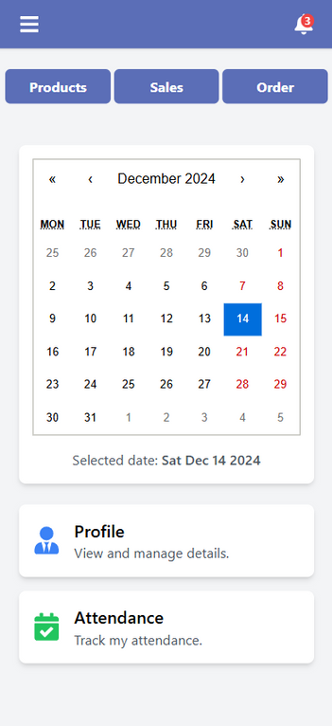
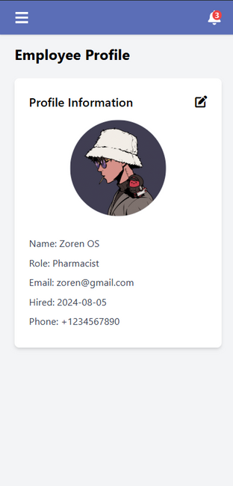
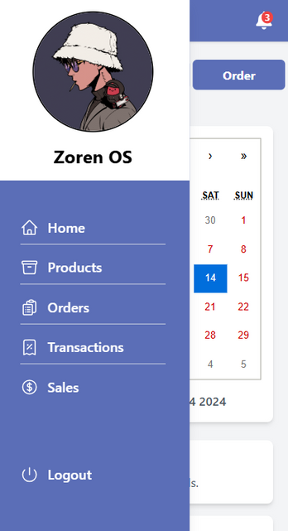
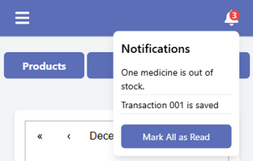
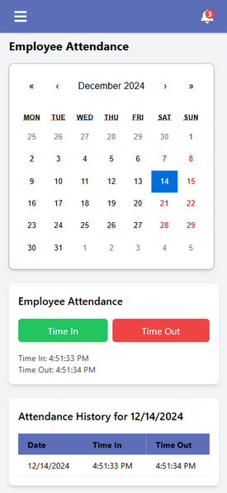
Employee Homepage
Menu / Navigation Components
Allow employees to easily navigate to different pages.
Notification
Get notified every time there's a relevant unread update.
Built-in Calendar
Profile Management
Allow an employee to view and edit their profile information
Attendance
Allow an employee to manage and track their attendance.

Slide 3
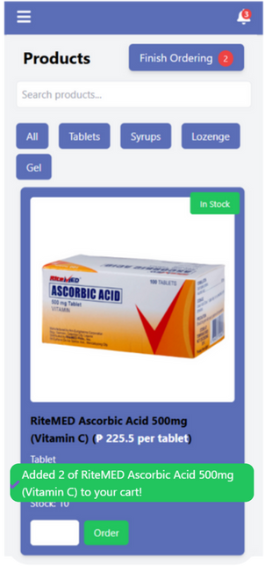
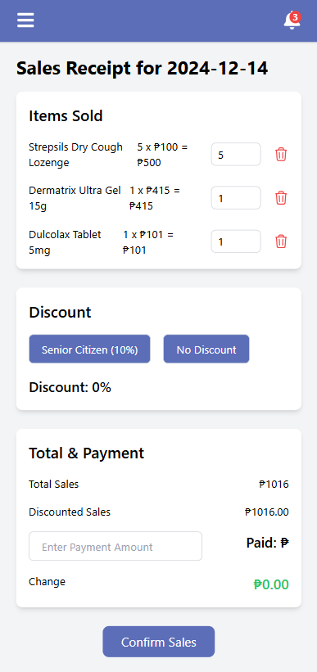
Products Page
Order Page
Finish Ordering Button
When all products are ordered, it will notify here and will direct to the order page when clicked.
This page will show the summary of order and the employee can edit and delete mistaken order. Provide discounts and the total price and payment.
Categories & Search Bar
Allow employees to easily search specific products.
Status Display
This will show the products availability if it’s in stock, out of stock and expired.
Products Display
Display the product’s price, image manufacturer and other details.
2
Order Button & Order Confirmation Message

Slide 4
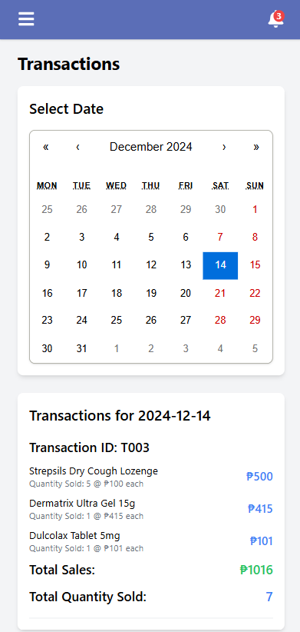
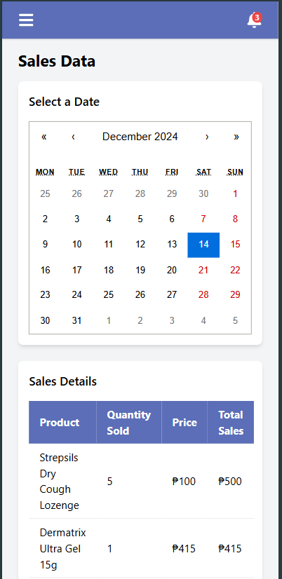
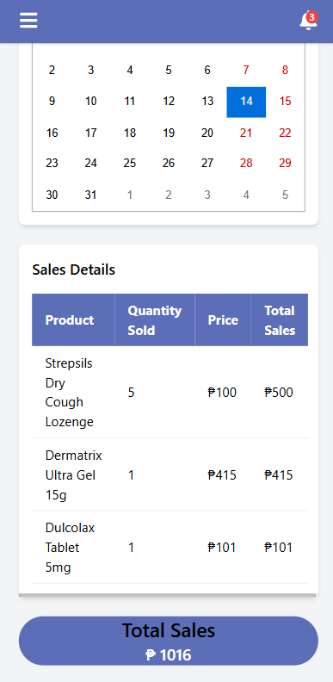
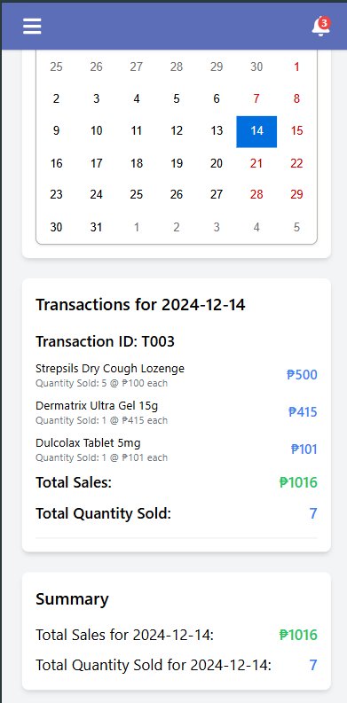
Transaction Page
Sales Page
Same for the previous page, this sales page also have a built in calendar. If you click on a specific date, it will show the overall quantity of a particular product sold on that day and the total amount of sales also.
This page have a built in calendar, if you click a specific day it will show the transactions happened at that day. It also have a summary, to know the total amount and the total quantity sold.

Slide 5
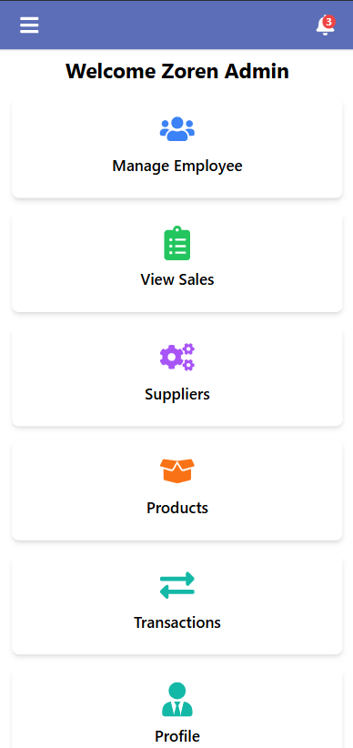
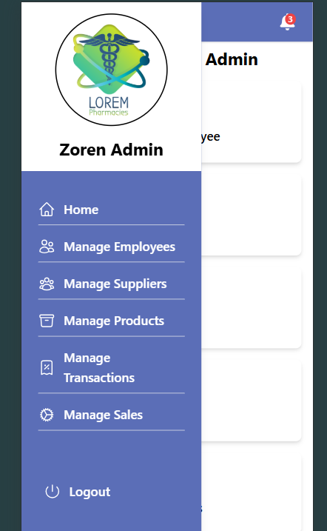
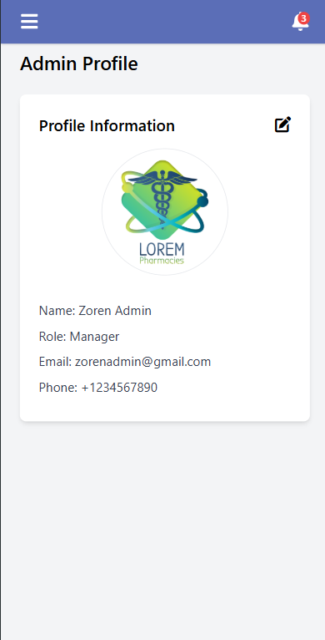
Admin Homepage
Menu / Navigation Components
Allow the admin to easily navigate to different pages.
Notification
Get notified every time there's a relevant unread update.
Profile Management
Allow the admin to view and edit their profile information

Slide 6
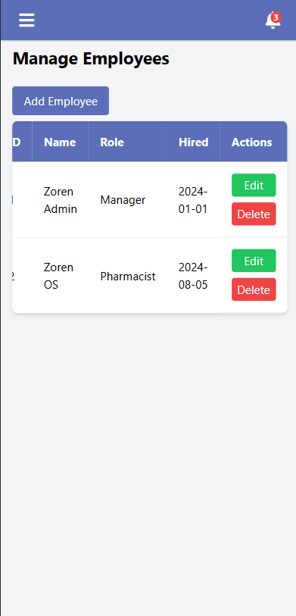
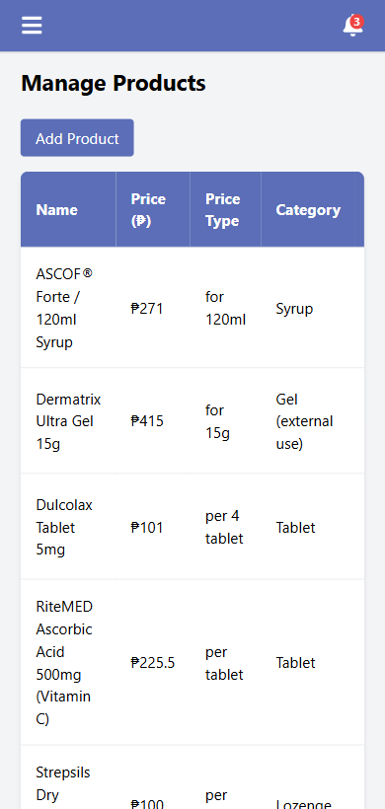
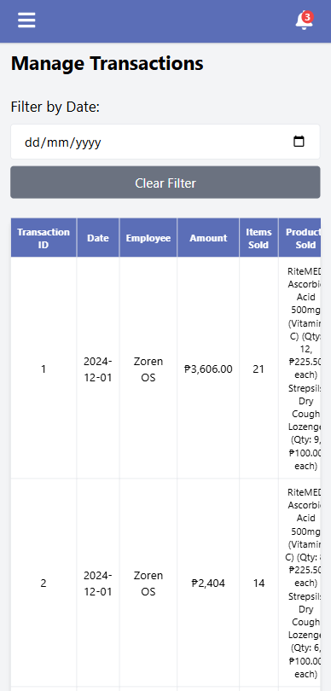
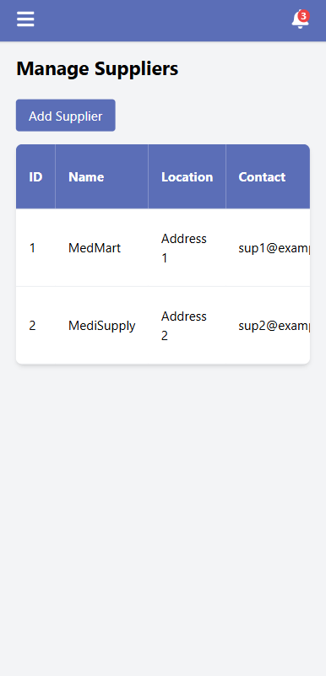
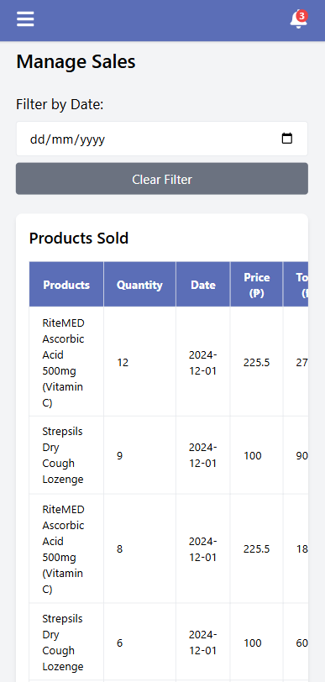
Admin Feautures
Manage Employee
View Sales
Suppliers
Products
Transactions

