Slide 1
Computing project
Hybrid Algorithm-Based 3D
Container Loading Optimisation
30 held-out cases with 150 ms per method
1 / 7
Notes:
Open the frozen protocol and introduce the box-packing problem. Source: data/heldout_protocol.json and docs/heldout.md.

Slide 2
Both methods had the same deadline
First-Fit
Try the largest boxes first, then try different box orders and rotations.
Hybrid
Build placement choices, score conflicts and payload, then search with compound moves.
Shared checks
Check boundaries, overlap, duplicate boxes, rotations and the payload limit.
Comparison
Average three trials per case, then compare the 30 case averages.
2 / 7
Notes:
Sources: baseline.py, hybrid.py and data/heldout_protocol.json. Follow the demonstration guide to validate both recorded layouts.

Slide 3
The overall result was close
Case group
First-Fit
Hybrid
Gap (points)
Hybrid W/T/L
All
69.41%
68.89%
−0.52
13/9/8
Geometry
98.72%
95.24%
−3.48
1/3/6
Payload
27.71%
28.02%
+0.31
4/6/0
Mixed
81.80%
83.41%
+1.61
8/0/2
Overall 95% interval: −1.89 to +0.61 points
Mean attempts at 150 ms: 260.7 First-Fit and 3.0 hybrid
3 / 7
Notes:
Source: results/heldout/heldout.json, brief summaries. Differences are hybrid minus First-Fit. The interval includes zero.

Slide 4
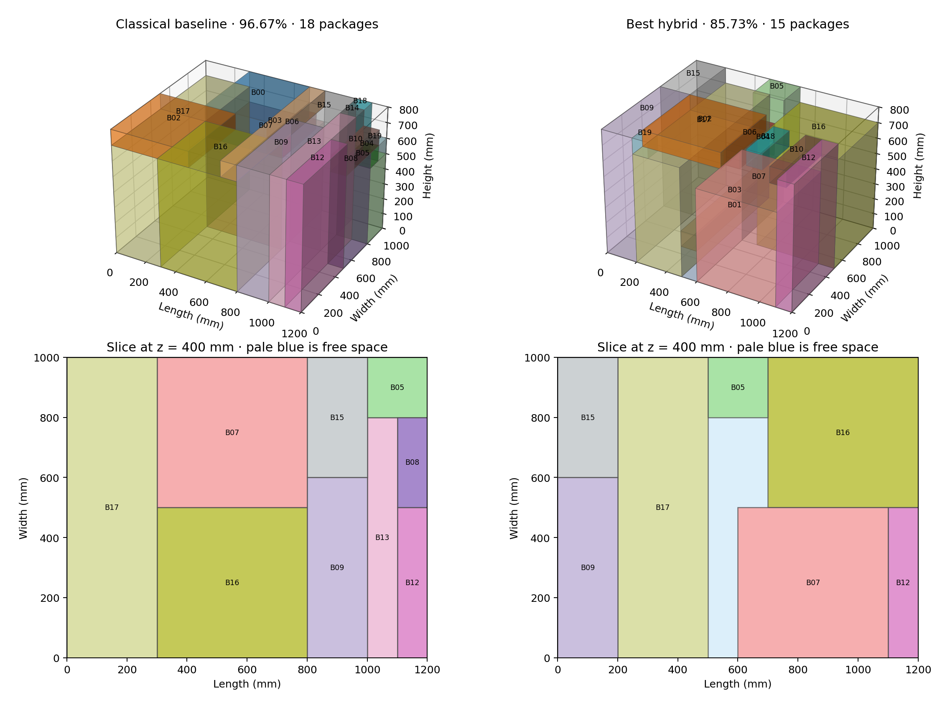
Geometry example 4108
4 / 7
Notes:
Source: results/heldout/heldout.json, case 4108, trial 301. Point out the labels and pale-blue unused space. These scores are from one recorded pair.

Slide 5
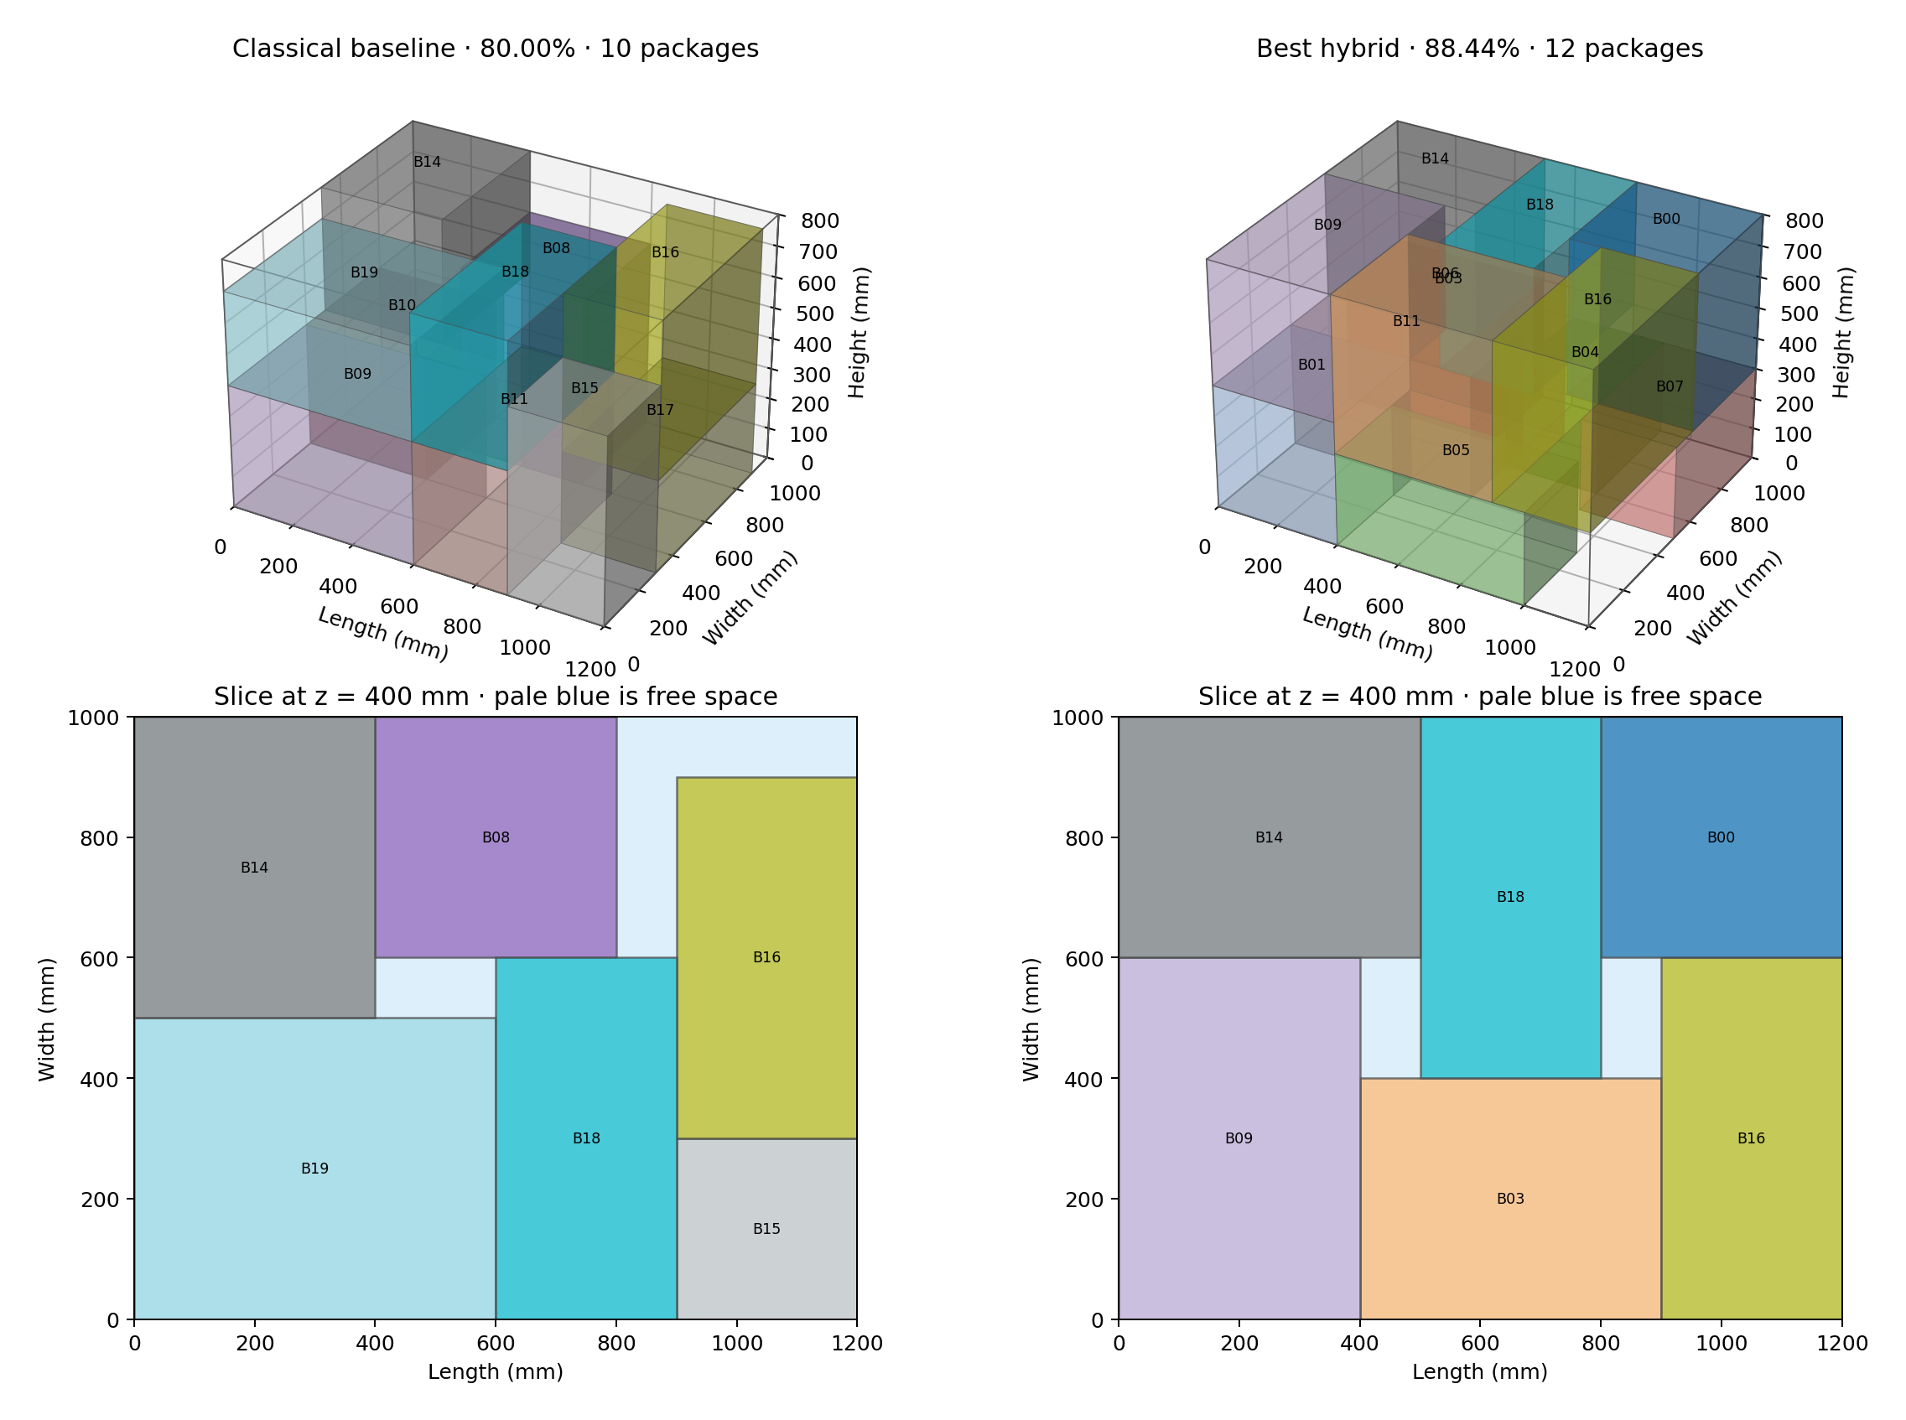
Mixed example 4302
5 / 7
Notes:
Source: results/heldout/heldout.json, case 4302, trial 301. Point out the labels and pale-blue unused space. These scores are from one recorded pair.

Slide 6
Coverage explains most of the geometry gap
Candidate coverage
The gap from a full tiling to the best packing available in the pool averaged 4.55 points.
Search within the pool
The gap from the pool optimum to the recorded hybrid result averaged 0.21 points.
Support during search
The hybrid averaged 66.30% with full support enforced during search. First-Fit averaged 67.96%.
Next test
Improve placement coverage, then compare on new cases at several fixed deadlines.
6 / 7
Notes:
Sources: results/heldout/geometry_pool_check.csv and results/support_search/heldout.json. All 30 fixed-pool solutions were proven. Discuss the study limits and next test.

Slide 7
What changes with the attempt limit?
Budget or cap
Cases
First-Fit
Hybrid
Mean attempts FF / H
Up to 4 attempts
30
67.17%
69.26%
3.5 / 3.7
150 ms
30
69.11%
68.94%
258.9 / 3.1
500 ms
30
69.78%
70.25%
863.1 / 11.0
1.5 s
30
70.32%
70.69%
2603.6 / 32.5
5 s subset
9
71.82%
72.14%
7833.9 / 100.2
An attempt costs more for the hybrid. The four-attempt cap makes scores repeatable.
7 / 7
Notes:
Source: results/effort/summary.csv. The 5-second row uses nine cases. The production compound search stays conflict-free and analytically minimizes slack. The neal reference sampled the explicit QUBO separately.

