Slide 1

GROUP 17
Probabilistic Adaptive Traffic Signal Control in Intelligent Transport Systems (ITS)
Hiya Soni AU2440084
Jay Daftari AU2440271
Arya Patel AU2440250
Swayam Prajapati AU2440087
Ahladita Chaudhary AU2440243

Slide 2
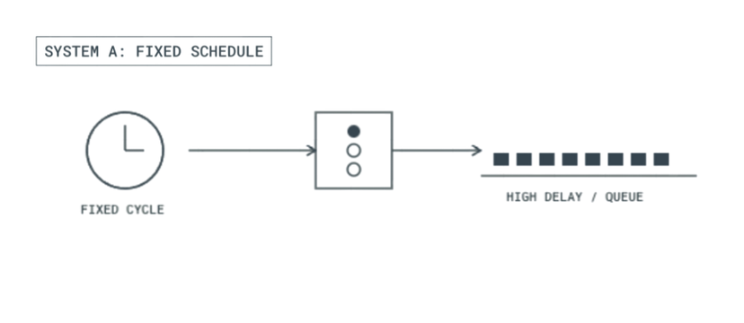
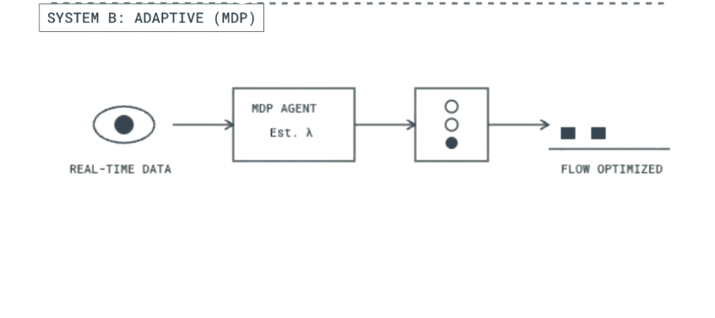


Project Context and Motivation
Probabilistic Adaptive Traffic Signal Control in Intelligent Transport Systems
  Urban traffic signals typically operate on fixed schedules
  Real-world traffic demand fluctuates continuously
  Vehicle arrivals are inherently stochastic
| 2

Slide 3
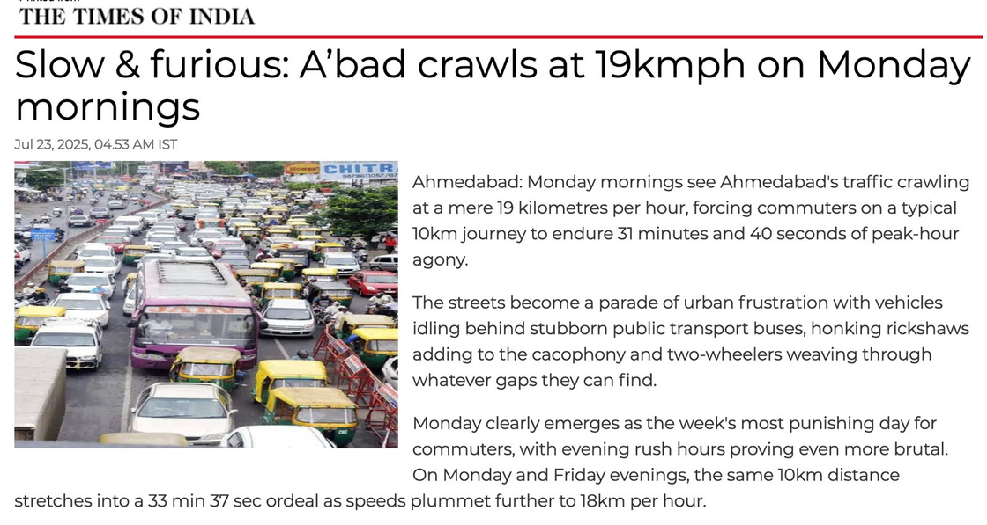
Objective:
To minimize the expected vehicle waiting time and queue length
Scopes:
  Single isolated intersection
with multi-phase control.
  Real-time adaptive signal control using Markov Decision Processes (MDP)
Estimated: The current traffic congestion state
Decided: Optimal signal phase at each time step

Slide 4
Overview
Traffic sensing → State estimation → Probabilistic decision → Signal actuation
The major components are
  Traffic sensors and detectors.
  State estimation module.
  Decision module based on Markov Decision Process
Data Flow
Observed traffic data is converted into state information for control decisions.
| 4

Slide 5
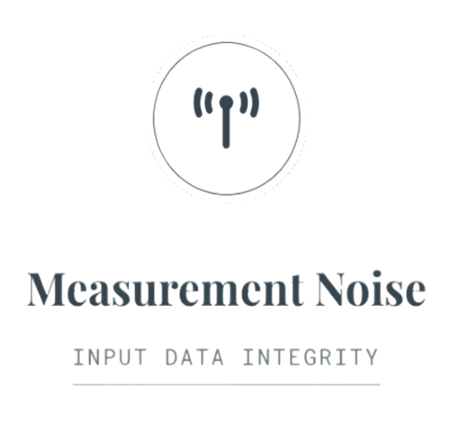
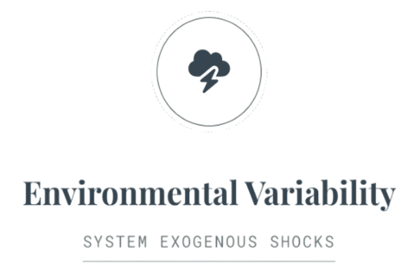
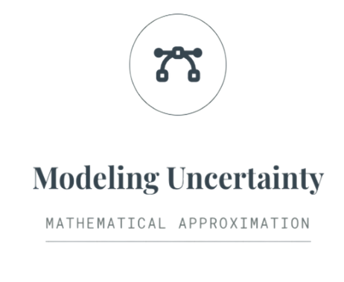
Sources of uncertainty
  Sensor errors
  missed detections
  Delayed readings.
  Weather changes, Accidents
  Road disturbances.
  Simplified representations of complex traffic dynamics
  Limited observability
| 5

Slide 6
Key Random Variables and Their Roles
Vehicles arrive randomly in each time interval Δt
Arrival rate(λ) changes with time due to traffic fluctuations
Input Flow qᵢₙ(k) at time step k varies
Output Flow qₒᵤₜ(k) depends on signal timing and queue size
Congestion State: Traffic is congested if queue > threshold
Congestion state changes are uncertain and probabilistic
Role in the Project: Capture arrival randomness, system condition, and delay reduction effectiveness.
| 6

Slide 7
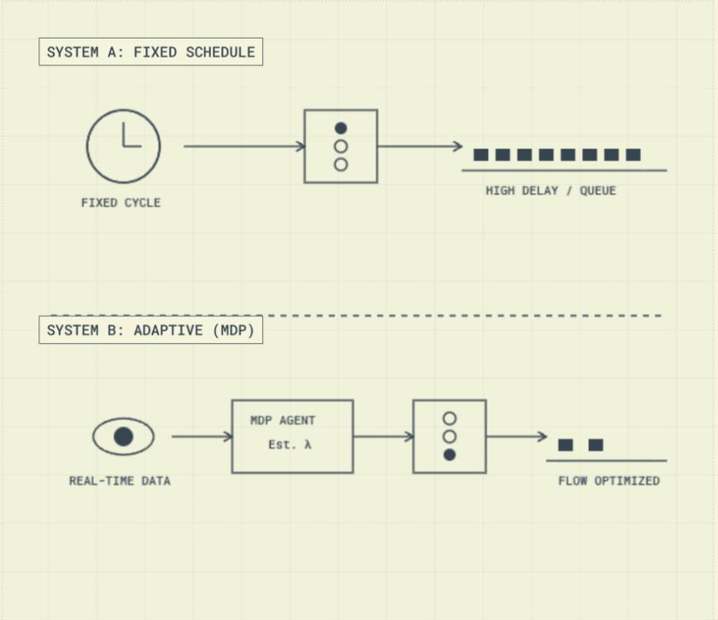
Probabilistic Models and Assumptions
Two models used
  Poisson distribution models vehicle arrivals.
  Markov Decision Process models sequential signal control
Key Assumptions
  Future state depends only on current state and chosen action.
Justification
  Traffic arrivals exhibit random and near memoryless behavior at short timescales.
| 7

Slide 8
Probabilistic Reasoning and Inference Logic
Uncertainty Propagation:
  Random arrivals lead to uncertain queue lengths and traffic states.
Role of Probabilistic Reasoning:
  Evaluate signal actions using expected outcomes rather than deterministic values.
Conceptual Reasoning Path:
  Observe current state → Compute expected reward → Select optimal action
| 8

Slide 9
Operationalizing Probabilistic Reasoning
Realization in Practice
  Simulation of stochastic traffic arrival processes.
  Repeated evaluation of state–action transitions.
Evaluation Metrics
  Expected waiting time.
  Expected queue length.
Simplified Assumption:
  Discrete time steps and limited state space for feasibility.
| 9

Slide 10
Current Limitations and Conceptual Gaps
Known Weaknesses
  Simplified view of traffic states.
  Strong reliance on sensing quality.
Unverified Assumptions
  Arrivals treated as independent.
  Traffic flow assumed steady over short periods.
Conceptual Gaps
  Limited support for large networks.
  Gaps in extreme‑congestion modeling.
| 10

Slide 11
Planned Refinements and Role Coordination
Next Milestone Evolution:
  Finer-grained traffic state modeling.
  More realistic arrival and departure patterns
Tasks Ahead:
  Model refinement and extended simulations.
Role Coordination:
  Reviewer validates assumptions and logic.
  GitHub manager handles version control and integration.
| 11

Slide 12
Conclusion
Stochastic Nature of Traffic
Limits of Deterministic Control
Probabilistic Control Approach
• Traffic flow is inherently uncertain
• Vehicle arrivals are random
• Congestion evolves probabilistically
  Fixed schedules ignore variability
  Deterministic control lacks adaptability
  Performance degrades under randomness
  Decisions based on expected outcomes
  Adaptive signal timing under uncertainty
  Markov Decision Processes enable principled control
| 12

