Slide 1
S
By Your Name
May - 2025

Slide 2

Key Concepts
UNDERSTANDING SIGNIFICANCE
S
The letter S is multifaceted; in mathematics, it might denote summation, while in branding, it can symbolize strength and security. Understanding its various implications can enhance comprehension across disciplines, illustrating the importance of context in communication. This awareness is crucial for deeper learning and application of concepts in practical scenarios.

Slide 3
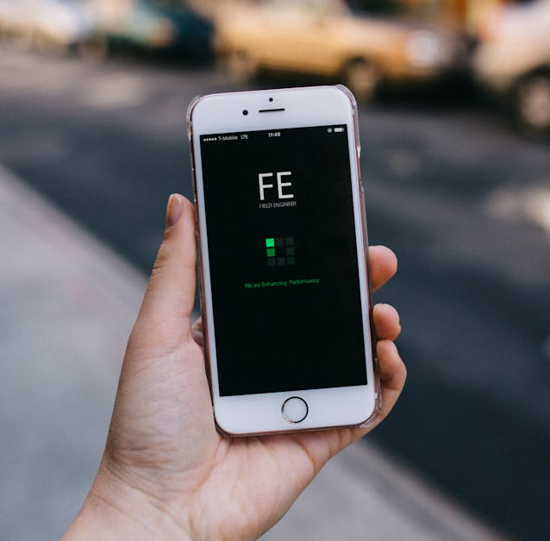

Important Applications
BRANDING AND MARKETING
In branding, 'S' signifies strength and stability. Companies utilize it in logos and campaigns to evoke reliability and efficiency, making it a powerful marketing tool.
S
MATHEMATICS AND SCIENCE
In modern mathematics and science, 'S' can symbolize a variety of entities, such as a set of values or a function, showcasing its multifunctional role across numerous disciplines.

