Slide 1

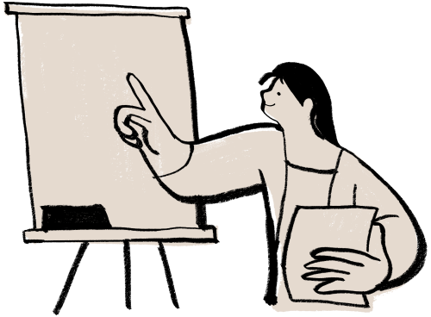
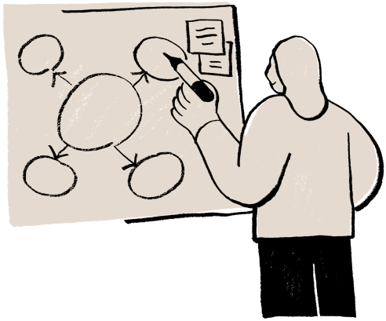
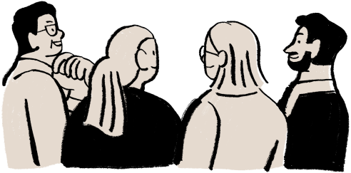
  طبِ نجات • Zindigi Prize | Ahmad · Sachin · Uzair
TIB-E-NIJAT
  Camera Vitals Screening for Every Neighborhood Pharmacy

Slide 2
S
U
M
M
A
R
Y
<280,000 doctors for 240M Pakistanis. A basic vitals check takes hours of travel and waiting. Tib-e-Nijat provides a 30-second tablet camera screening at neighborhood pharmacies.
30s camera rPPG measures pulse, HRV & breathing — Traffic-Light result: Normal, Monitor, or See a Doctor.
Screening tool that sends patients to a doctor (doesn't replace one). Face video is never stored.
~50 PKR per scan (40% pharmacy / 60% us) = ~30,000 PKR/month per store at 20 scans/day.

Slide 3

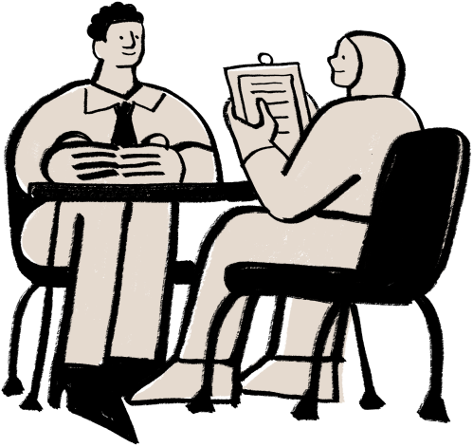

CORE VITALS
Heart Rate & HRV
Clinical Triage
Camera rPPG picks up skin micro-color changes; accuracy target within 2 BPM of ECG in hospital trial.
Simple Traffic-Light result (Normal, Monitor, See a Doctor) refers patients to doctors early.
Breathing & Stress
Confidence Meter prompts a retake in poor light; Fingertip + Flash mode handles dark rooms.

Slide 4
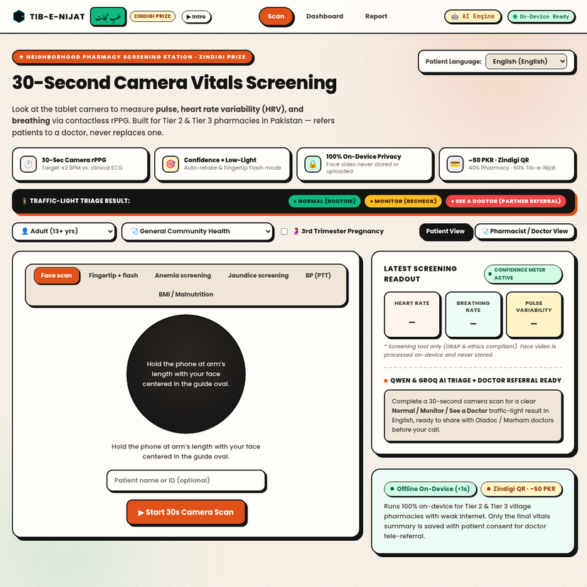
Demographics
  Target
  Locations
  Income
: Native Villages First
: Tier 2 & 3 Cities
: Pharmacy Counters
Psychographics
Families in Tier 2 & 3 towns wanting a quick 50 PKR check without hours of hospital travel & waiting.
Buyer Persona
Pharmacy owners earning ~40% revenue share & extra walk-ins; starting in our own native villages.
TARGET MARKET

Slide 5


COMPETITIVE
Key Competitors
  BP & Oximeters (1 metric)
  Oladoc / Marham (Partners)
  ECG Carts
Unique Value Proposition
  Gives partner doctors vitals before the call
  DRAP screening classification + Ethics trial
Strategic Analysis
  Strength
  Challenge
  On-device privacy: face video is never stored
  Requires normal room lighting
  Opportunity
  Mitigation
  50,000+ retail pharmacies
  Fingertip + Flash mode & Confidence Retake
ANALYSIS

Slide 6
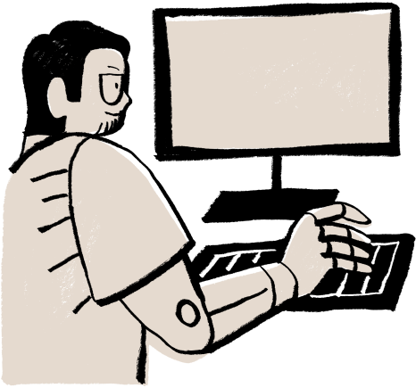
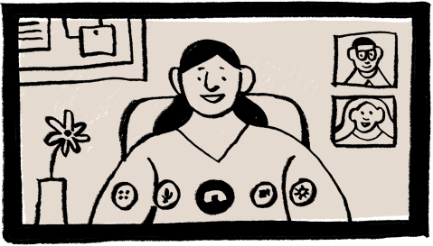
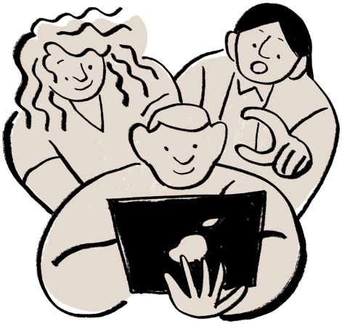
1. Now: Pharmacies
2. Next: Doctor Apps
3. Later: Zindigi Wallet
Begin in our own native villages to learn from honest feedback, then scale tablet stations.
Connect with Oladoc & Marham as partners so doctors see patient vitals before the call.
Digital wallets like Zindigi offer health-check micro-insurance, subject to SECP approval.
ROLLOUT STRATEGY

Slide 7
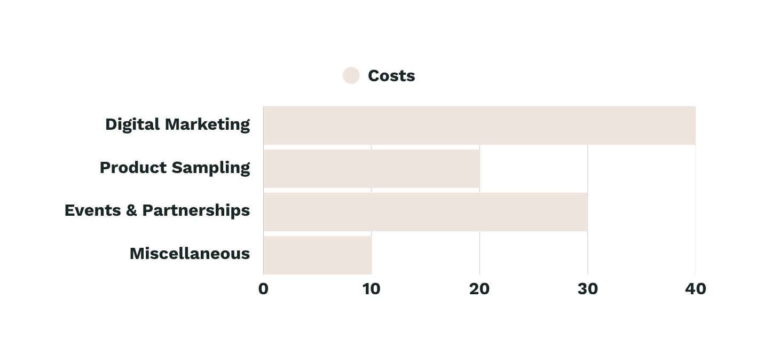
F
I
N
A
N
C
E
~50 PKR (Zindigi QR)
40% Pharmacy (~20 PKR)
~30K PKR/mo (20/day)
60% Tib-e-Nijat (~30 PKR)

Slide 8
ROADMAP
MONTH | ACTIVITY | OUTCOME
M 1-3 | Ethics Approval & ECG Trial | 100-200 patients tested vs. clinical ECG (target ±2 BPM)
M 4-6 | Native Village Pharmacy Trial | App trial in our native villages (no stations yet, real results)
M 7-12 | Nearby Towns & Partner Scale | First stations live in nearby towns; 1-2 doctor apps & Zindigi

Slide 9
OUR ASK: 2M PKR
Asking for 2,000,000 PKR: 45% (900k PKR) for first pharmacy stations (tablets, setup, training), 30% (600k PKR) for hospital ECG clinical trial & ethics approval, and 25% (500k PKR) for DRAP regulation, legal & doctor/wallet partnerships. Team: Ahmad Ali (Business), Sachin Kumar (Tech & Demo), Muhammad Uzair (Research & Validation).

Slide 10
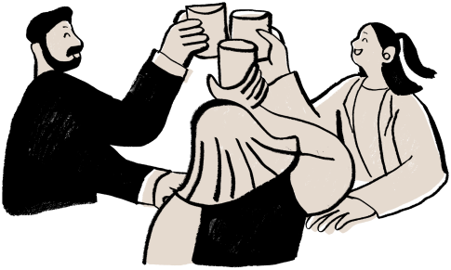
  Tib-e-Nijat (طبِ نجات) • Ahmad · Sachin · Uzair
THANK YOU
INSTANT, AFFORDABLE SCREENING AT THE NEIGHBORHOOD PHARMACY — NO SPECIAL HARDWARE, NO VIDEO STORED.

