Slide 1
UML Class Diagram

Slide 2
Class diagram
Class diagram is also known as static system modeling
It addresses the structural view of a problem.
It defines the:
classes (concepts) in the system,
their attributes,
operations,
and the relationships between these classes.

Slide 3
Associations between classes
An association defines a relationship between two or more classes, denoting a static, structural relationship between classes.
For example, Employee Works in Department, where Employee and Department are classes and Works in is an association.
Classes are named using nouns, while associations are named using verbs or verb phrases.
A link is a connection between instances of the classes (objects) and represents an instance of an association between classes.
For example, Jane Works in Manufacturing, where Jane is an instance of Employee and Manufacturing is an instance of Department.
A link can exist between two objects if, and only if, there is an association between their corresponding classes.

Slide 4
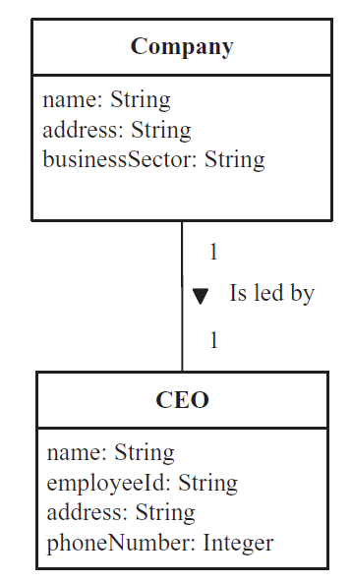
Associations..2
On class diagrams, an association is shown as an arc joining the two class boxes, with the name of the association next to the arc.
In class diagrams, association names usually read from left to right and top to bottom.
However, on a large class diagram with many classes, classes are usually in different positions relative to each other.
To avoid ambiguity when reading UML class diagrams, COMET uses the UML arrowhead notation to point in the direction

Slide 5
Multiplicity of associations
The multiplicity of an association specifies how many instances of one class can
relate to a single instance of another class.
The multiplicity of an association can be as follows:
One-to-one association.
One-to-many association
Numerically specified association
Optional association: In an optional association, there might not always be a link from an object in one class to an object in the other class.
Many to many associations

Slide 6
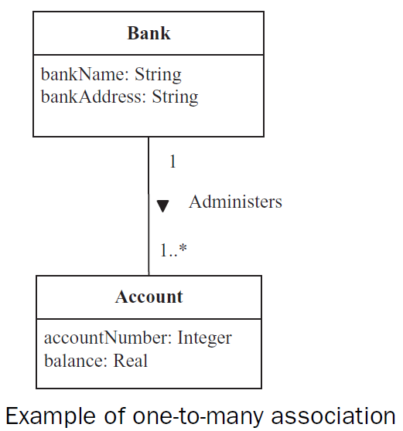
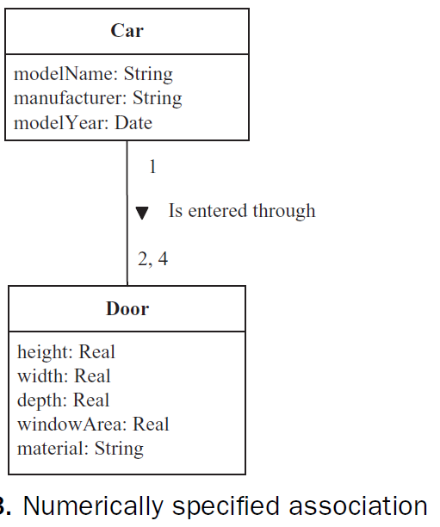
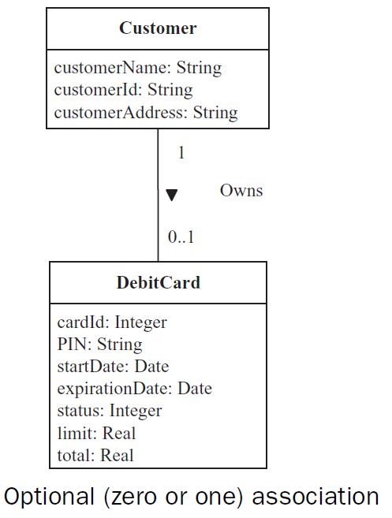
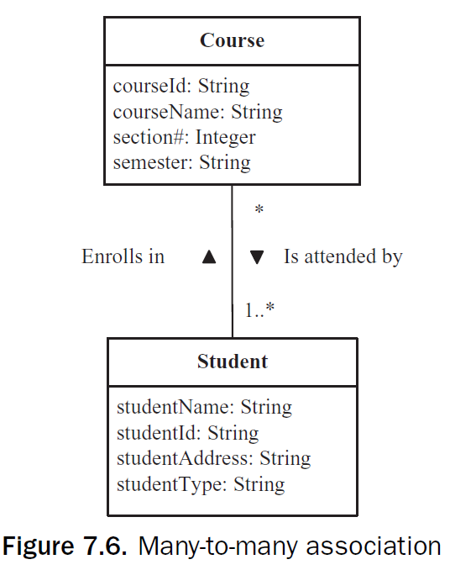
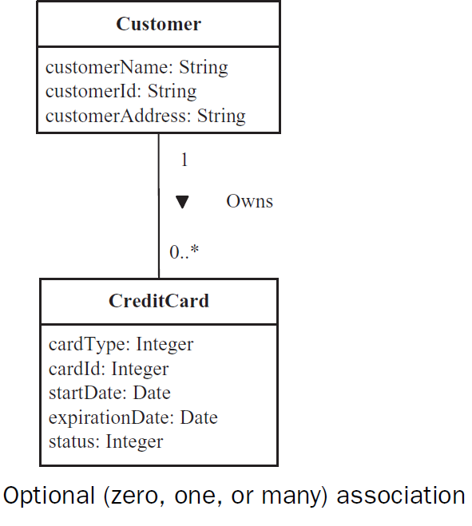

Slide 7
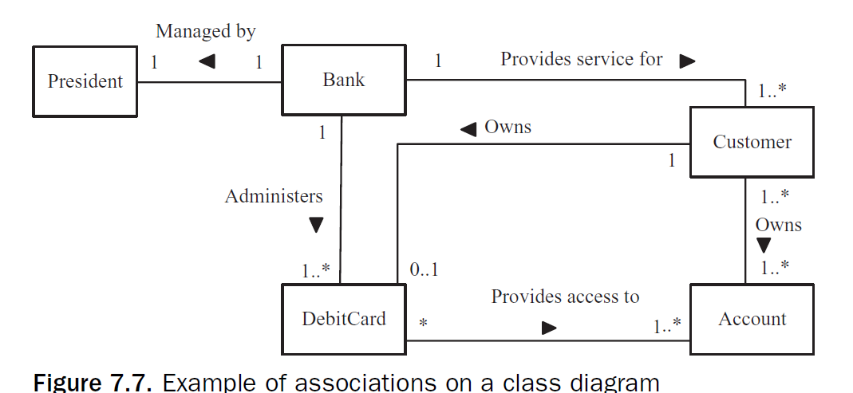
Example class diagram

Slide 8
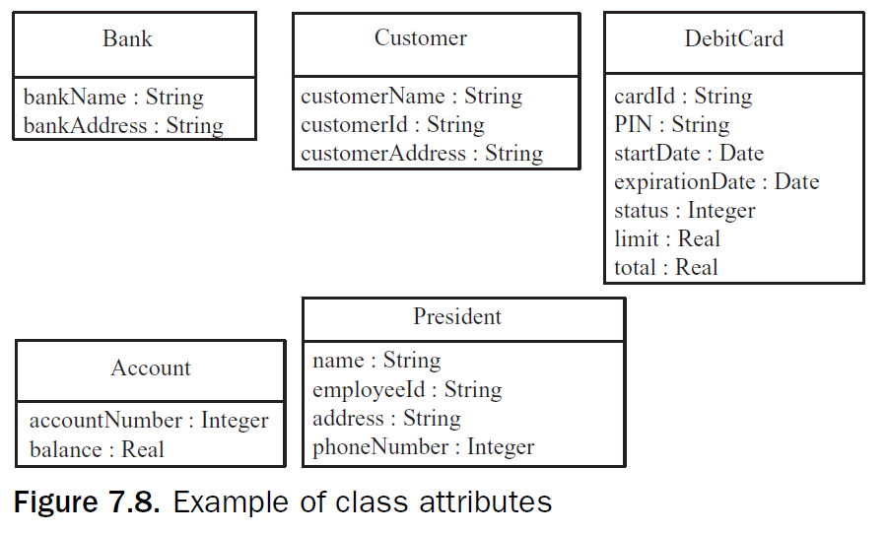
Example attributes

Slide 9
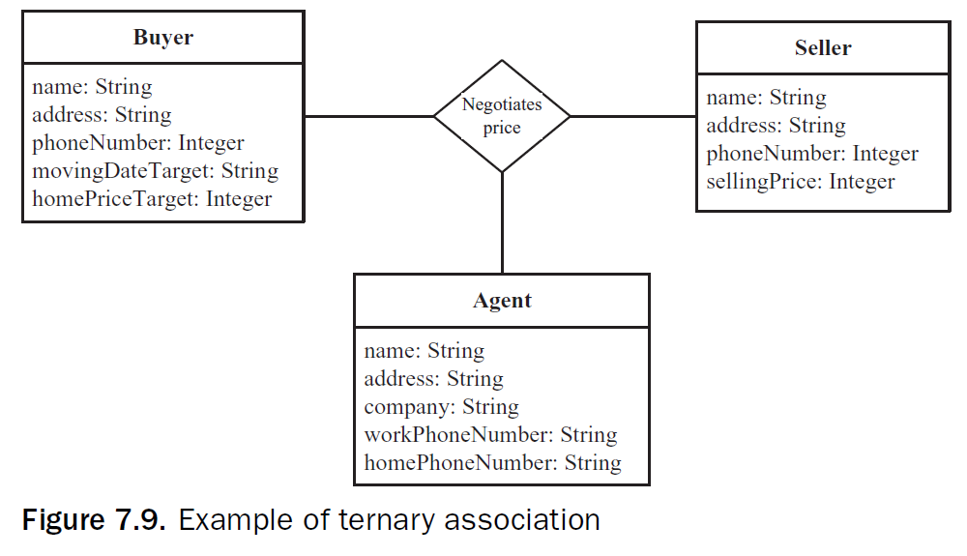
Trinary association
A ternary association is a three-way association among classes.
An example of a ternary association is among the classes Buyer, Seller, and Agent.
The association is that the Buyer negotiates a price with the Seller through an Agent.

Slide 10
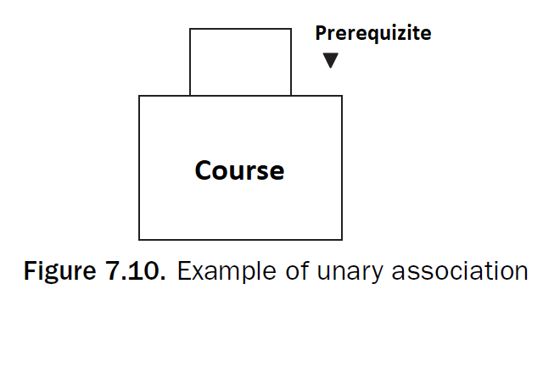
Unary associations
A unary association, also referred to as a self-association, is an association between an object of one class and another object in the same class

Slide 11
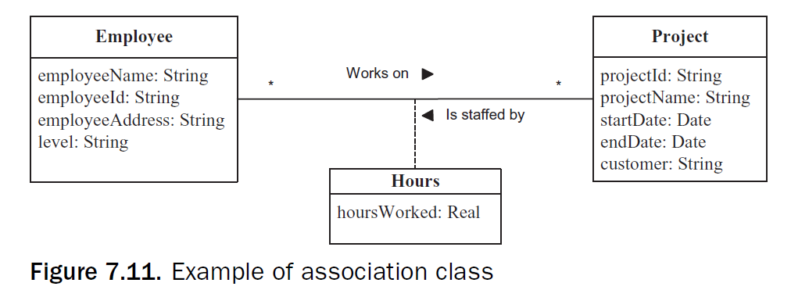
Association Classes
An association class is a class that models an association between two or more
classes.
The attributes of the association class are the attributes of the association.

Slide 12
Composition and aggregation
Both composition and aggregation hierarchies address a class that is made up of other classes.
Composition and aggregations are special forms of a relationship in which classes are connected by the whole/part relationship.
In both cases, the relationship between the parts and the whole is an Is part of relationship>
A composition is a stronger relationship than an aggregation, and an aggregation is a stronger relationship than an association.
Thus, the part objects are created, live, and die together with the whole.
The part object can belong to only one whole.
The aggregation hierarchy is a weaker form of whole/part relationship.
In an aggregation, part instances can be added to and removed from the aggregate whole.
In addition, a part could belong to more than one aggregation

Slide 13
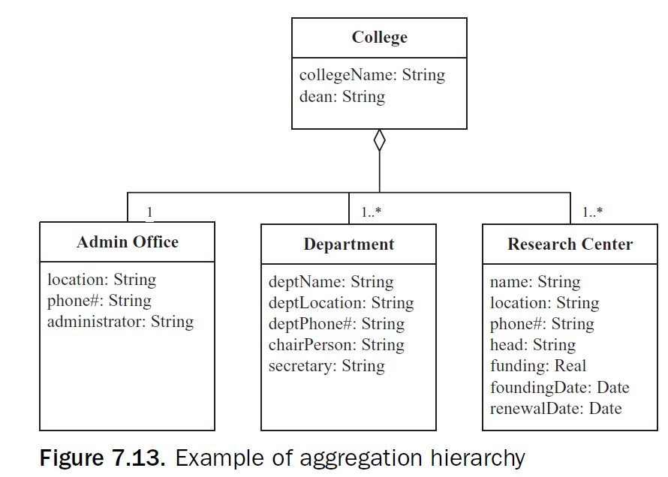
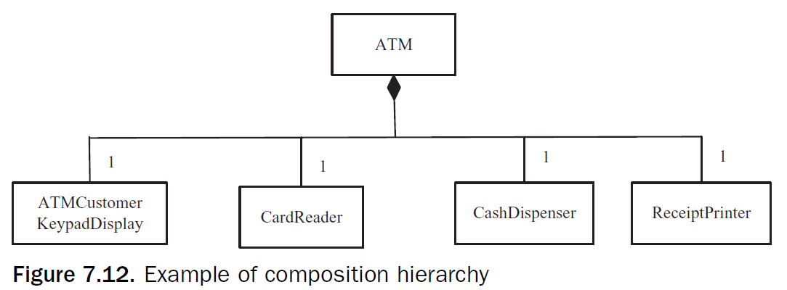
Composition and Aggregation

Slide 14
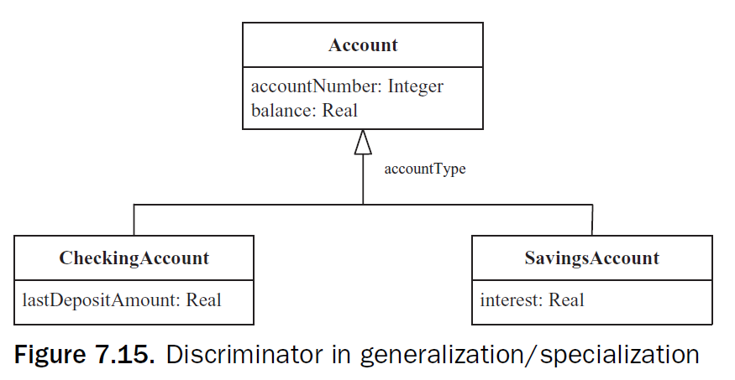
Generalization/specialization hierarchy
Some classes are similar but not identical.
They have some attributes in common and others that are different.
In a generalization/specialization hierarchy, common attributes are abstracted into a generalized class, which is referred to as a superclass.
The different attributes are properties of the specialized class, which is referred to as a subclass.
There is an Is a relationship between the subclass and the superclass.
The superclass is also referred to as a parent class or ancestor class.
The subclass is also referred to as a child class or descendent class

