Slide 1
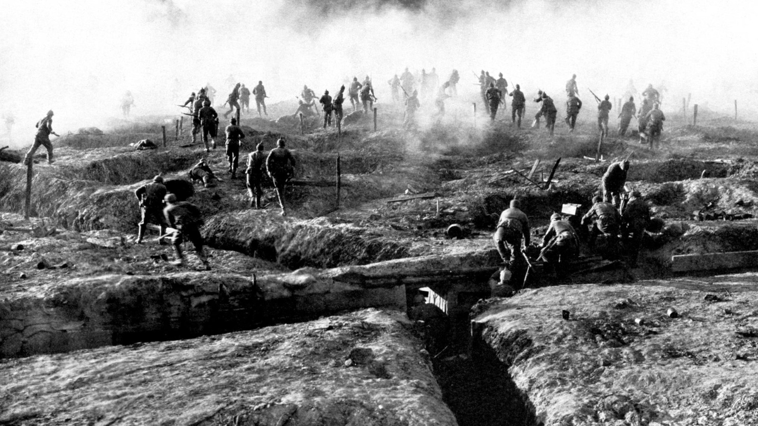

Slide 2
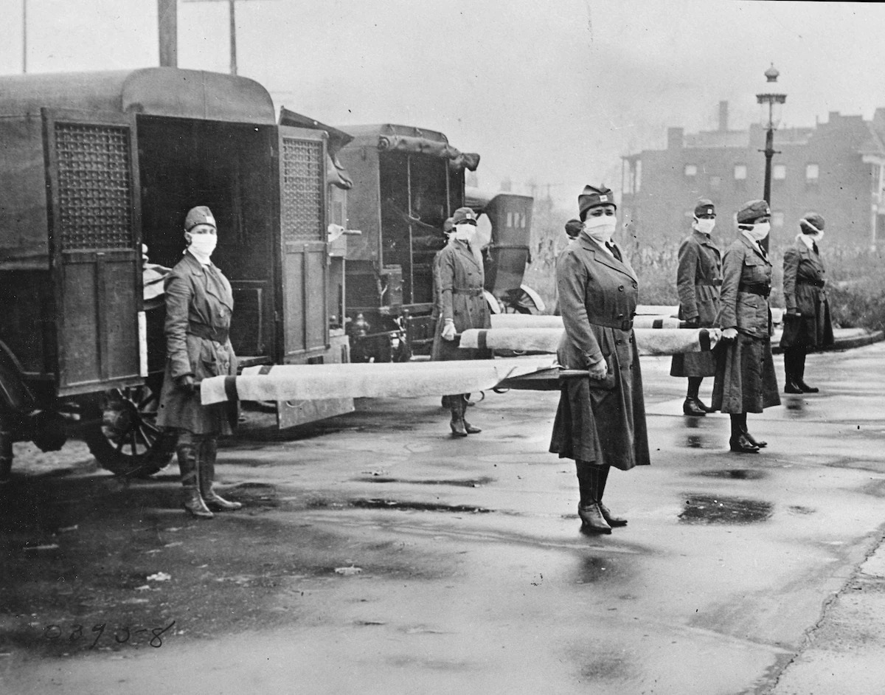

Slide 3
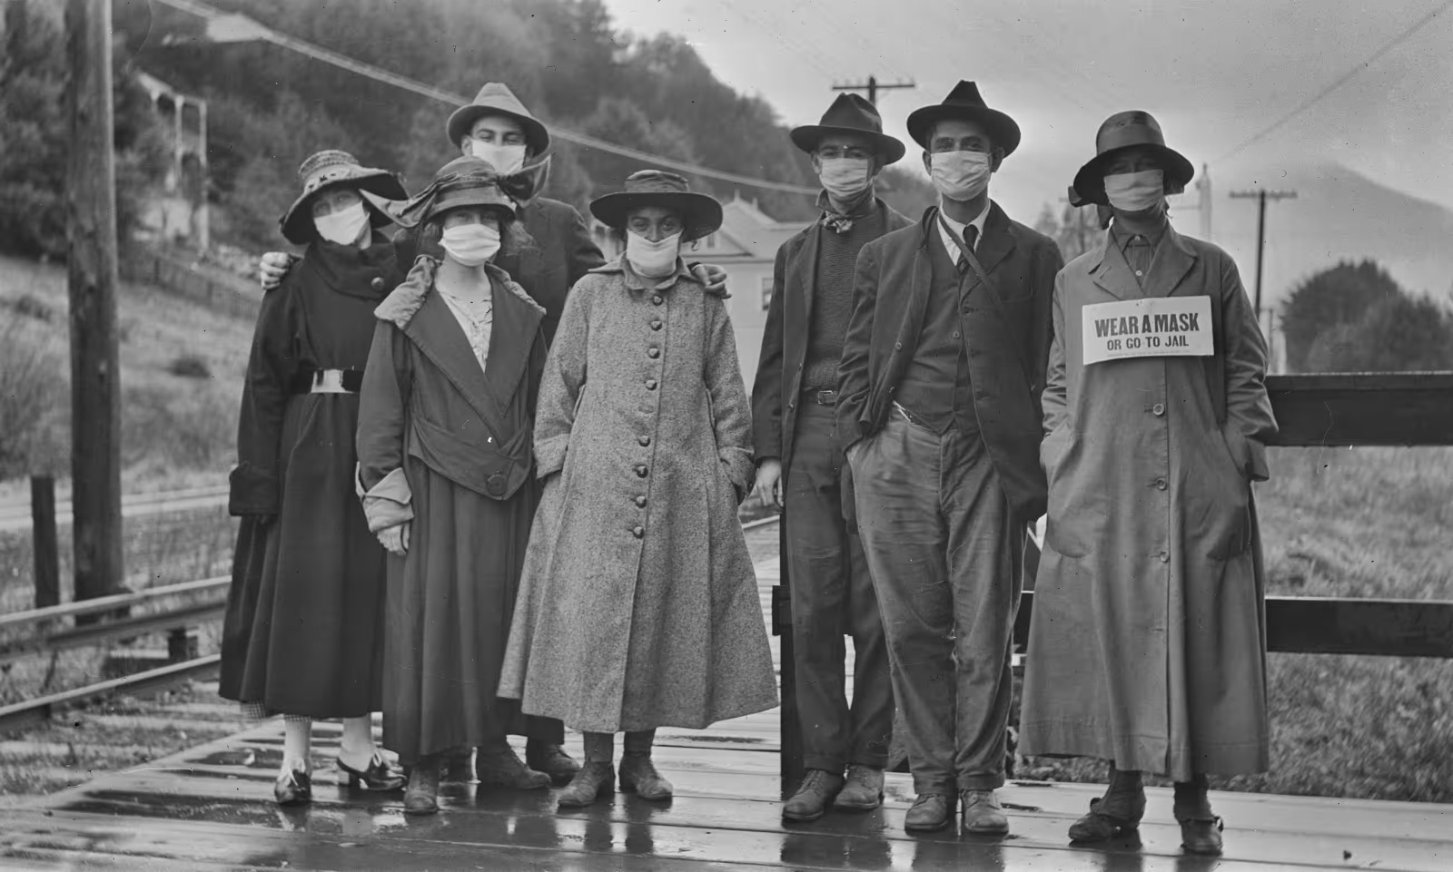

Slide 4
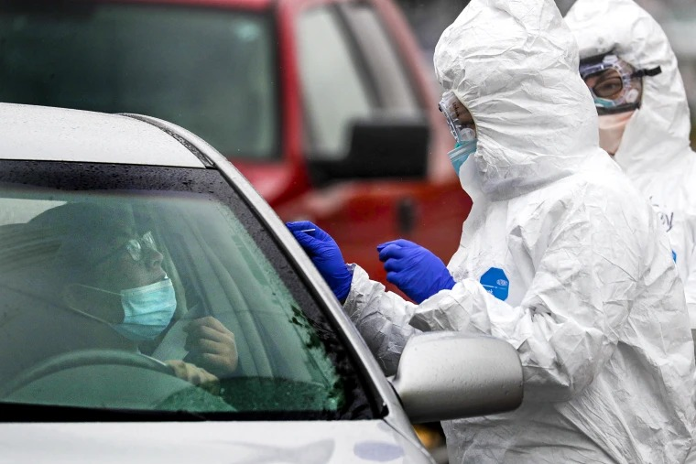

Slide 5
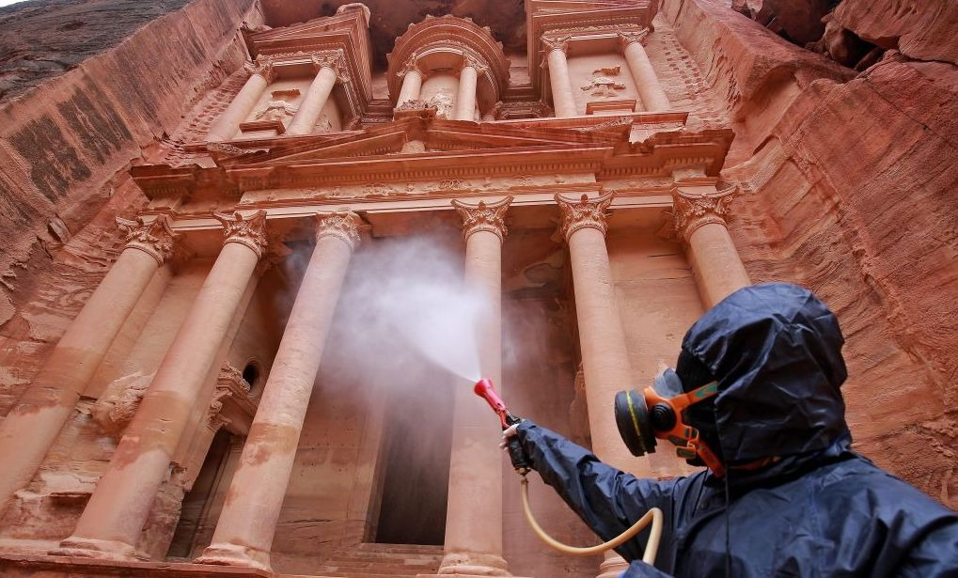

Slide 6

COVID-19 mRNA Vaccine Degradation
2023

Slide 7
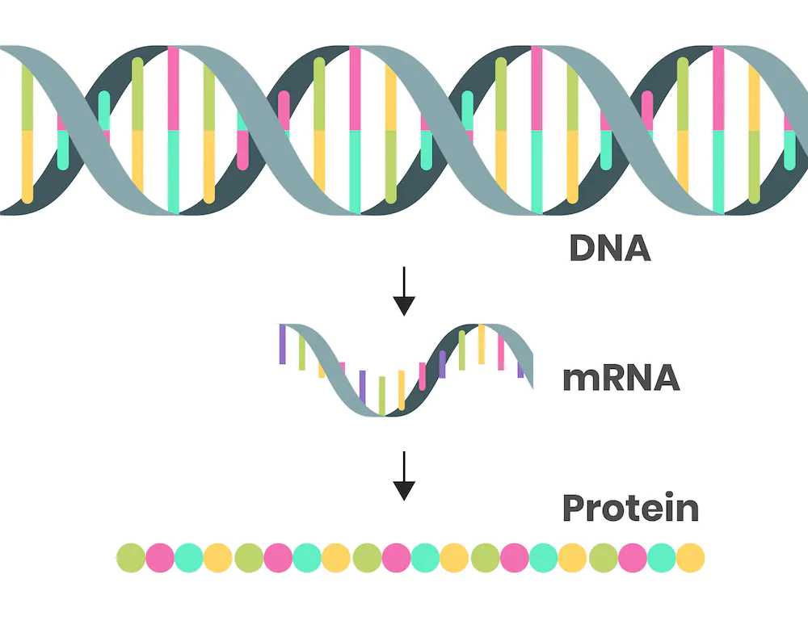
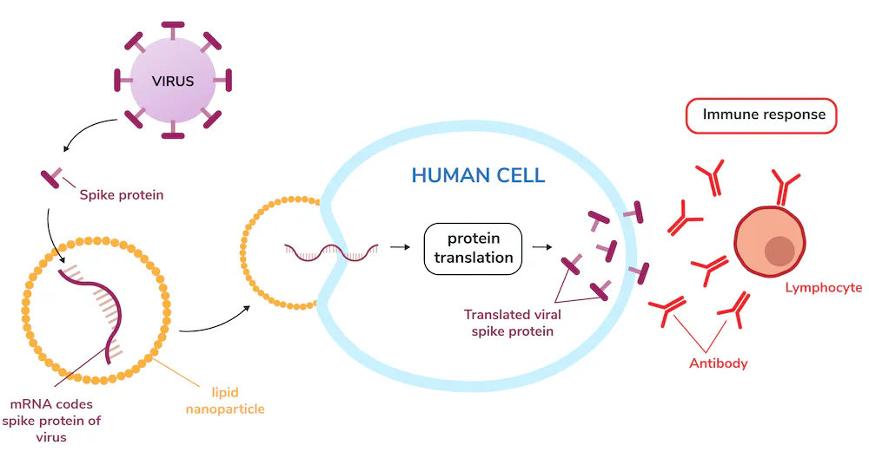
Problem Statement
what is M-RNA?
Why do they use spike proteins?

Slide 8
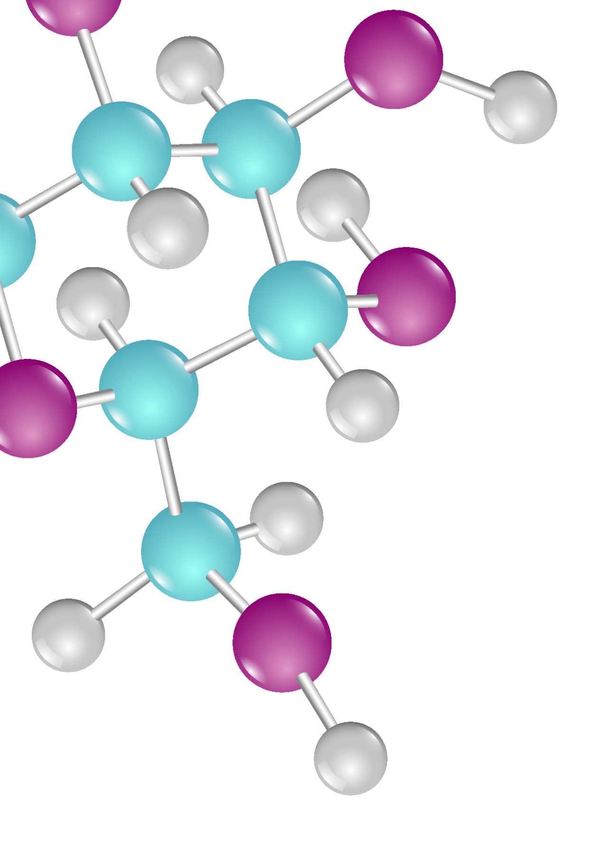
categorical features
we have 33 categorical features some of these features :
2023
1-sequence:
A 47922
G 34975
C 24678
U 22985
2- structure:
. 66648
( 31956
) 31956
3-predicted_loop_type
S 63912
E 28225
H 15240
I 9729
X 6372
M 4651
B 2431

Slide 9
Explain of Categorical fearures
we have 33 categorical features some of these features :
2023
3-predicted_loop_type
S: paired “Stem”
M: Multiloop
I: Internal loop
B: Bulge
H: Hairpin loop
E: dangling End
X: eXternal loop
1-sequence :
A: adenine
C: cytosine
G: guanine
U: uracil
2-structure
( bases are paired
) bases are unpaired
. base is without pair

Slide 10
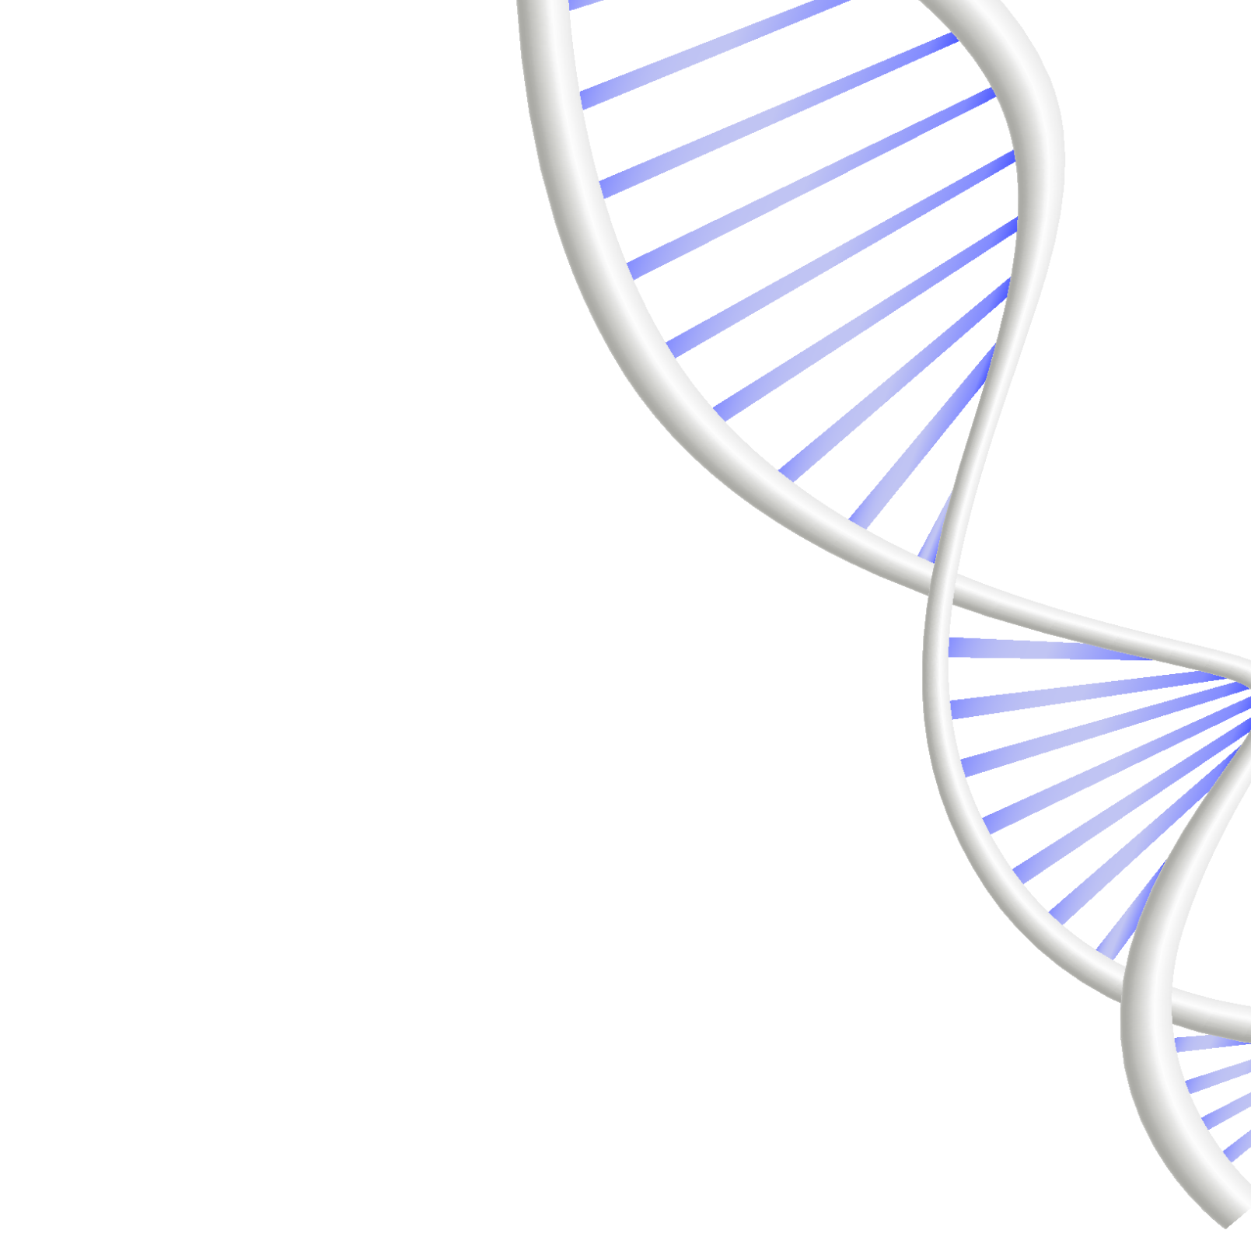
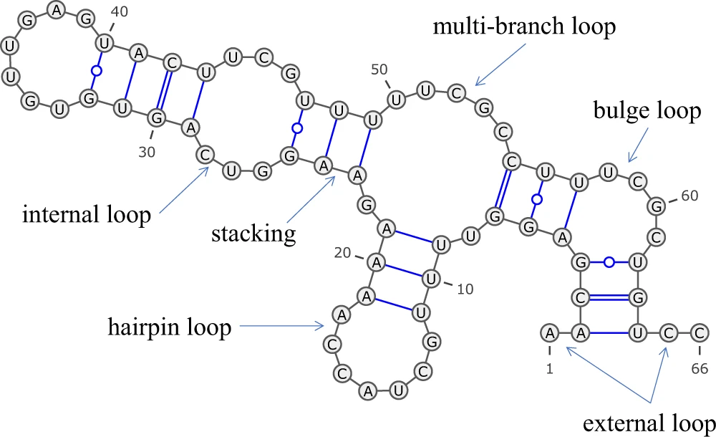
Predicted Loop Type
2023

Slide 11


Numerical Features
Number of numerical variables: 7
reactivity_error
deg_error_Mg_pH10
deg_pH10
deg_error_pH10
deg_error_Mg_50C
deg_50C
deg_error_50C
2022

Slide 12
Target Features
In this problem we have multi output features(multi output regression problem)
'reactivity’ , 'deg_Mg_pH10’ , 'deg_Mg_50C'
2023

Slide 13

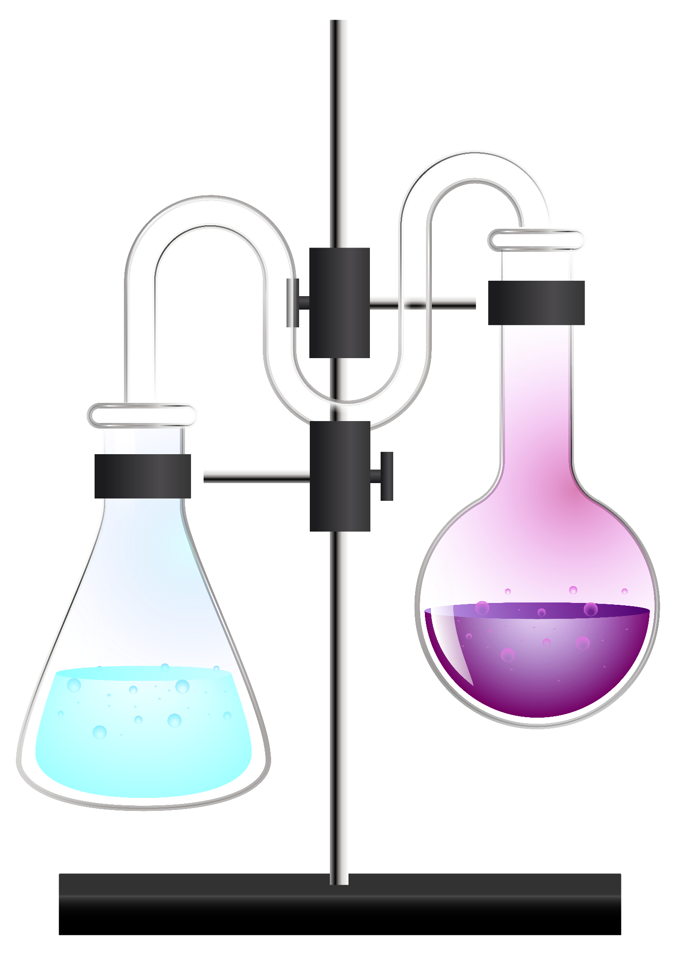
Click here for watching dashboard
Dashboard
2023

Slide 14
Models
The model | mcrmse
GradientBoostingRegressor | 0.48788903096873354
lasso_regressor | 0.7471217518134537
ridge_regressor | 0.6122783780265372
knn_regressor | 0.6181408002879986
elastic_net_regressor | 0.739450184000339
decision_tree_regressor | 0.6146255799331644
BayesianRidge | 0.6122713640026967
HuberRegressor | 0.7541795018880778
2023

Slide 15
AdaBoostRegressor | 1.2580065262562607
RidgeCV | 0.6124309671160654
LassoCV | 0.7471111868473069
OrthogonalMatchingPursuit(OMP) | 0.6279786589556227
TweedieRegressor | 0.6272364329347443
CatBoostRegressor | 0.5134073085738203
HistGradientBoostingRegressor | 0.5303554132938008
LGBMRegressor | 0.5046534268233877
XGBRegressor | 0.3667763870228275
RandomForestRegressor | 0.4528004997265309
2023

Slide 16
Hyperparameter Tuning
2023
# parameters = {
# 'estimator__n_estimators': [ 800, 900, 1000],
# 'estimator__learning_rate': [0.1, 0.25, 0.30],
# 'estimator__max_depth': [3, 4, 5]
# }
The best parameters
{'estimator__learning_rate': 0.1, 'estimator__max_depth': 3,
'estimator__n_estimators': 1000}

Slide 17
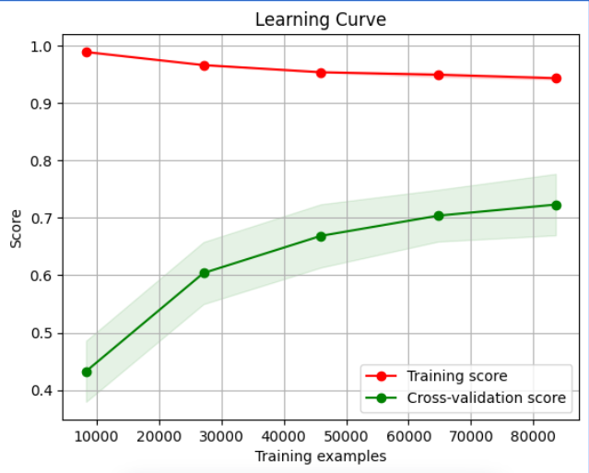
The Best parameters for XGBRegressor
max_depth | 6
learning_rate | 0.1
colsample_bytree | 0.9
reg_alpha | 5
reg_lambda | 6
min_child_weight | 2
n_estimators | 1500

Slide 18
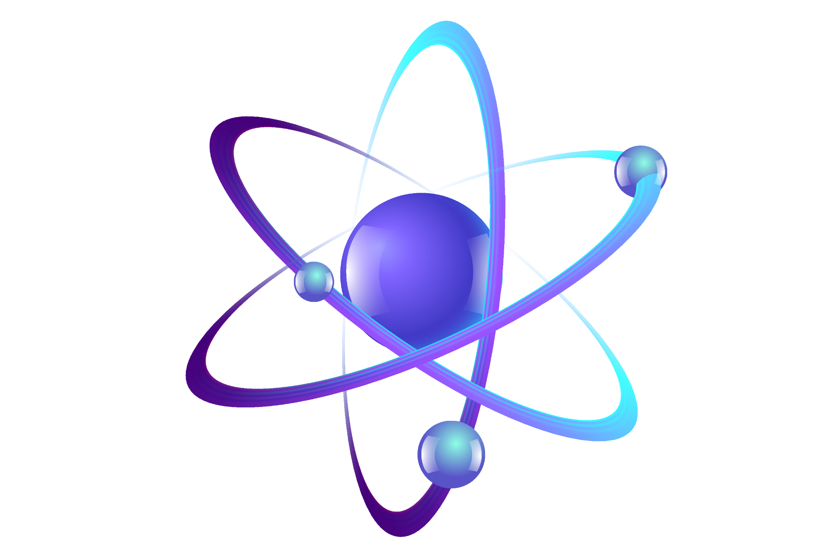
Error Analysis

Slide 19
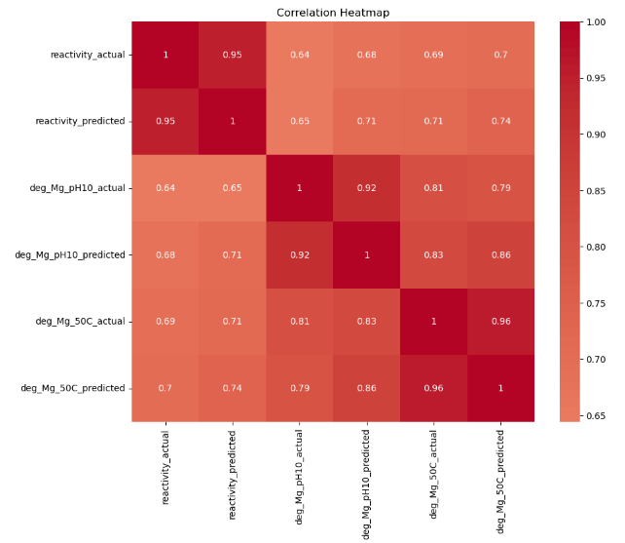
After trying all the hyperparameter tunings, we were out of trials to optimize our model performance. So we headed into ERROR ANALYSIS.
notice that deg_Mg_50C has the least correlation and probably we are going to work on it

Slide 20
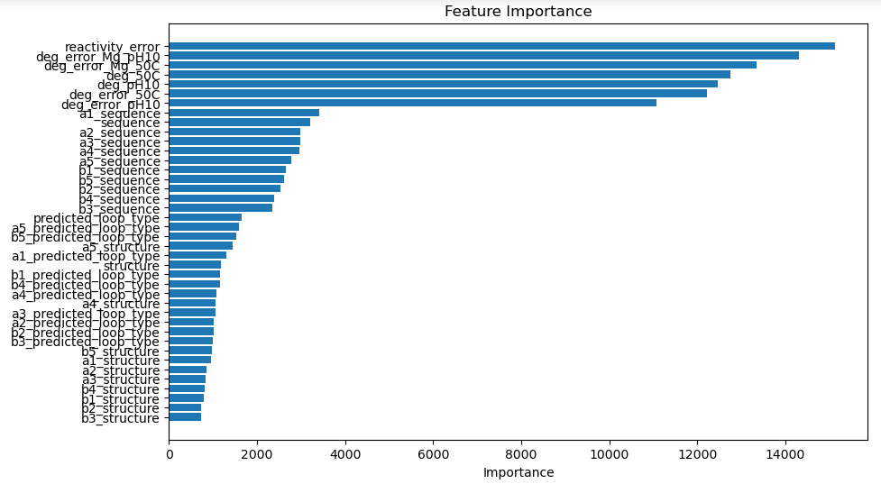
Surprisingly, as we see : for some reason; b’s_structure have the least importance of the model prediction. Maybe we need to drop some of them. We will see.

Slide 21
id | reactivity | Reactivity predicted | b’s_structure
123798 | 2.3348 | 1.860940 | -1
107764 | 0.6137 | 0.485101 | -1
122605 | 1.2227 | 0.931426 | -1
120551 | 0.9191 | 0.713176 | -1
Notice the biggest differences between the actual and the predicted, one pattern we can observe is the existence of number (-1) in b’s_structure, that could indicates that the idea of the beginning and the ending of the sequence was not delivered well to the model.

Slide 22
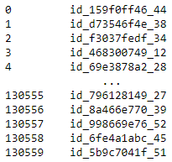
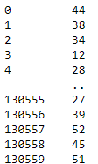
One approach we have done to solve this problem is :
1- extracting the last 2 numbers of id_seqpos, (represents the position of the sequence).
2- dropping b5_structure, b4_structure and b3_structure as they are the less importance
before
after

Slide 23
Final Result
Our error decreased from 0.386 to 0.382 on Leaderboard

Slide 24
Conclusion and Future Works
mRNA vaccines, the fastest COVID-19 candidates, face degradation issues. Our study predicted degradation-prone segments using sequence models. We used hand and label encoding methods and found the first one performed better, achieving a 0.382 score via MCRMSE on Leaderboard. Error analysis needs more time and work to find more hidden patterns and solve the deg_Mg_pH10 correlation problem .
Our future recommendation involves a hybrid model with CNNs and sequence models, potentially improved by integrating graph convolutional networks (GCNs) for deeper evaluation of mRNA degradation.

Slide 25
Referances
1- He, S., Gao, B., Sabnis, R., & Sun, Q. (2023). RNAdegformer: accurate prediction of mRNA degradation at nucleotide resolution with deep learning. Briefings in Bioinformatics, 24(1), bbac581.
2- Chze, O. N., & Abdullah, A. A. (2022, November). COVID-19 mRNA Vaccine Degradation Prediction By Using Deep Learning Algorithms. In 2022 International Conference on Innovation and Intelligence for Informatics, Computing, and Technologies (3ICT) (pp. 444-450). IEEE.
3- Wayment-Steele, H. K., Kladwang, W., Watkins, A. M., Kim, D. S., Tunguz, B., Reade, W., ... & Das, R. (2022). Deep learning models for predicting RNA degradation via dual crowdsourcing. Nature Machine Intelligence, 1-11.
4- Ing, S. H., Abdullah, A. A., Harun, N. H., & Kanaya, S. (2021, August). COVID-19 mRNA Vaccine Degradation Prediction Using LR and LGBM Algorithms. In Journal of Physics: Conference Series (Vol. 1997, No. 1, p. 012005). IOP Publishing.
5- Qaid, T. S., Mazaar, H., Alqahtani, M. S., Raweh, A. A., & Alakwaa, W. (2021). Deep sequence modelling for predicting COVID-19 mRNA vaccine degradation. PeerJ Computer Science, 7, e597.
6-https://www.analyticsvidhya.com/blog/2021/09/deep-learning-model-to-predict-mrna-degradation/
7-https://www.nebraskamed.com/COVID/where-mrna-vaccines-and-spike-proteins-go

