Slide 1

KING’S COUNTY
HOUSES PRICING PLAN
Data Science Graduation Project/ Orange Coding Academy
1

Slide 2




OUR COMPANY:
K: Khansaa’ Mahmoud
D: Diala Abdalqader
A: Ahmad Amierah
2

Slide 3
CONTENTS OF OUR PRESENTATION:
Problem statement and Objective.
Dealing with the extracted features.
Feature selection, Columns and variables we studied and fitted our model to.
Models we used.
Random Forest and Gradient Boosting for modeling.
Hyperparameter tuning
Best Model Evaluation.
User facing webPage.
3

Slide 4
1. OUR BUSINESS STATEMENT (FROM “PURCHASE POWER” TO “PRICE”)
Purchase
Power
Regression
Model
Price
We had first studied the “purchase power” which we measured by the time interval between building a house and selling it, and how all the factors and variables affected that time interval.
But as we studied the data further, we were facing some issues like the lack of some important features and information we need to create our predection model (the date when the house was sold for the first time), because -as we all know- this data is created for the study purpose and it is just expiremental.
So, we changed our study and model, to be house’s price predection, based on a dataset of about 20,000 of houses in the United States, King county. Depending on various features.
4

Slide 5
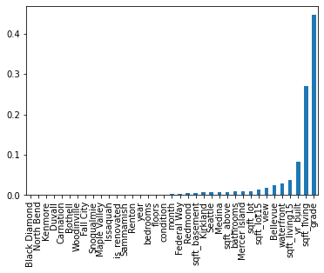
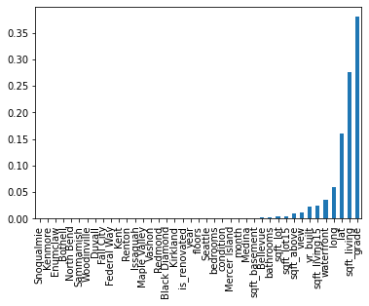
2. DEALING WITH THE EXTRACTED FEATURES:
Through the first part of data studying and analysis, we excluded the features of latitude and longitude, replacing them and the ZIP code, by the city name.
But at the step of feature selection and model fitting we found out that the data frame with latitude and longitude is more efficient in the prediction model.
SELECTED FEATURES (USING RF)
SELECTED FEATURES (USING RF)
5

Slide 6
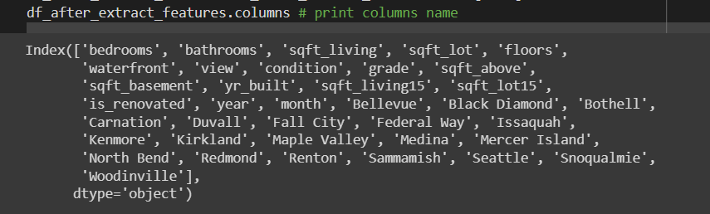
3. A. FEATURE SELECTION (USING BACKWARD ELIMINATION)
Using backward elimination, first and main process of feature selection showed that all columns and features were related to the price –as shown below-.
1
2
3
4
5
Selecting a significance level
(P-value) of 0.05, to stay in the
model.
Fitting the model with all possible predicts.
Considering the predictor with highest P-value.
Iterating the process, until all predicts are under the significance level.
Removing the predictor
6

Slide 7
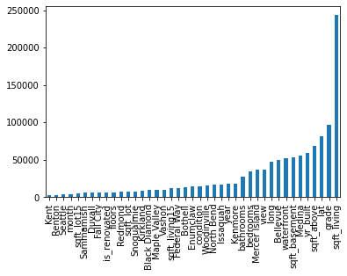
3. B. FEATURE SELECTION (USING LASSO)
SELECTED FEATURES (USING LASSO)
To assure the result we got, we used “LASSO” to double check the related features, ignoring the coefficient which shrinks to zero, and we also had the result of relation between the price and all other features.
COEFFIECIENTS
FEATURES
7

Slide 8
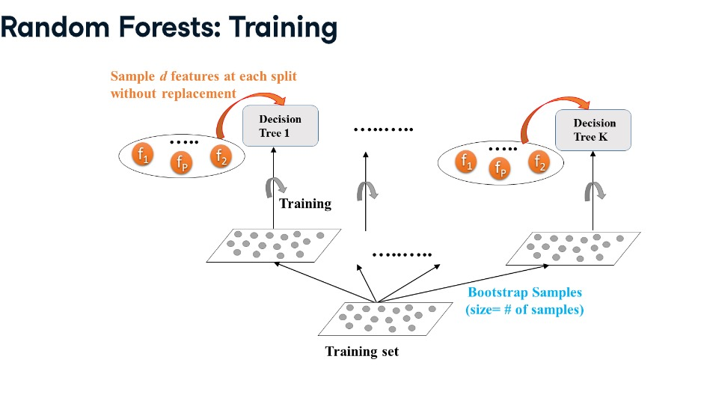
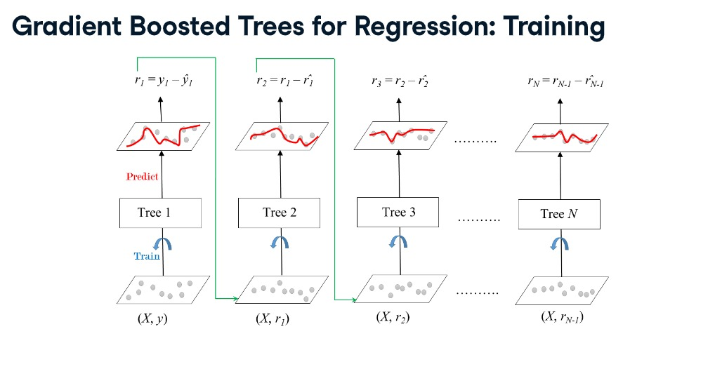
4. MODELS WE USED:
8

Slide 9



5. A. RANDOM FOREST & GRADIENT BOOSTING FOR MODELING (PRIMARY MODELING) :
RandomForest
GradientBoosting
Train ACCURACY
Train ACCURACY
Test ACCURACY
Test ACCURACY
There is a problem of high overfitting, because as we can see, there is more than 0.05 variation between train accuracy and test accuracy. In other word, our model will work good in the seen data, but badly in unseen data.
9

Slide 10
6. A. HYPERPARAMETER TUNING:
RANDOM FOREST
GRADIENTBOOSTING
n_estimators (number of trees)
max_depth (branching)
min_samples_leaf
Step 1- (gradient-wise)
Constant learning rate
Selecting n_estimators
Step 2- (tree-wise)
max_depth (branching)
min_samples_leaf
OPPORTUNITIES
10

Slide 11

5. B. RANDOM FOREST & GRADIENT BOOSTING FOR MODELING (Tuned Hyperparameters) :
RandomForest
GradientBoosting
Train ACCURACY
Train ACCURACY
Test ACCURACY
Test ACCURACY
When we worked on hyperparameters tuning, we almost solved the overfitting problem. And the best model was the GradientBoosting.
11

Slide 12
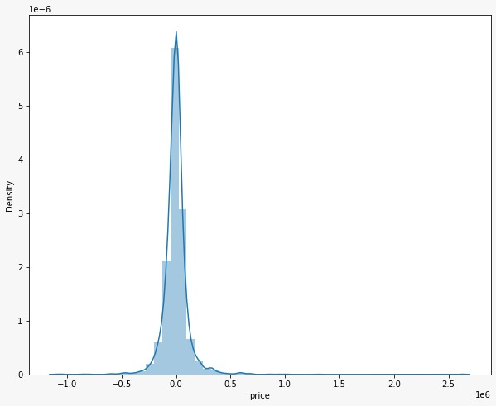
7. Best Model Evaluation:
Distribution of price variation (between actual and prediction)
This graph shows that our model works well,
because all the residual values are around Zero,
which means that there
is no big difference between the actual price
and what our model predicted.
residual
12

Slide 13
8. USER FACING PAGE:
USER INTERFACE PAGE:
Using (Stramlit) we created an user interface page, to help the user estimate a price for the real estate.
13

Slide 14
THANKS
Does anyone have any questions?
Reach to us through our Social Media Accounts !
14

