Slide 1

Combining Data from Multiple Sources
Muhammad Ahmad

Slide 2
Introduction
Combining data from multiple sources is crucial in today's data-driven world. Organizations collect data from various sources such as databases, spreadsheets, web applications, and cloud services.
SQL (Structured Query Language) and Power BI are two powerful tools for data integration

Slide 3
integrating two tables
Data Types Compatibility
Primary and Foreign Key Relationships
Data Consistency
Null Handling
Join Conditions

Slide 4
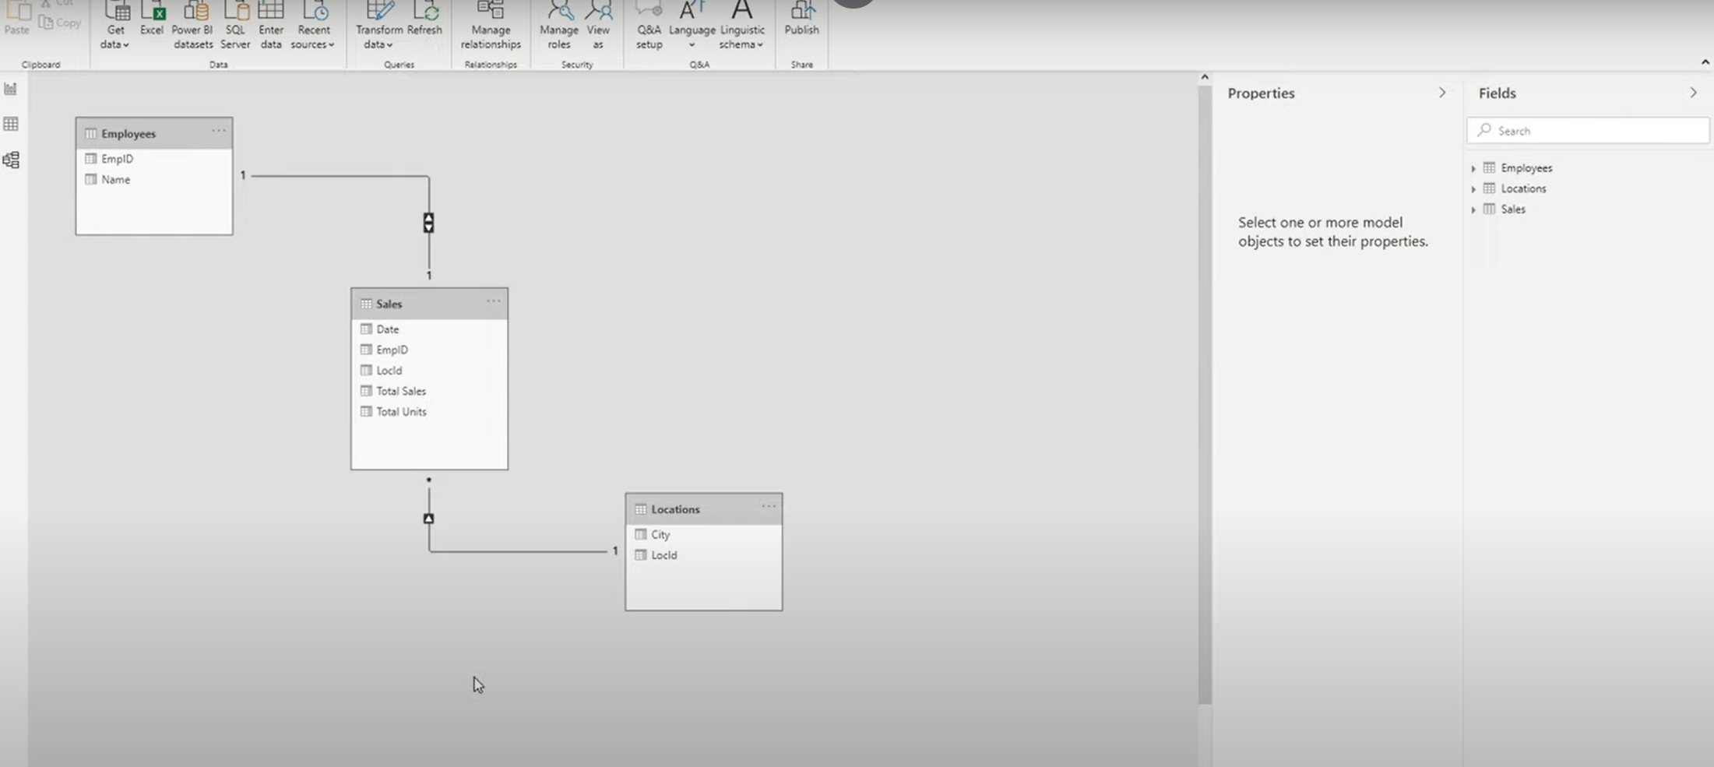


Slide 5


Slide 6
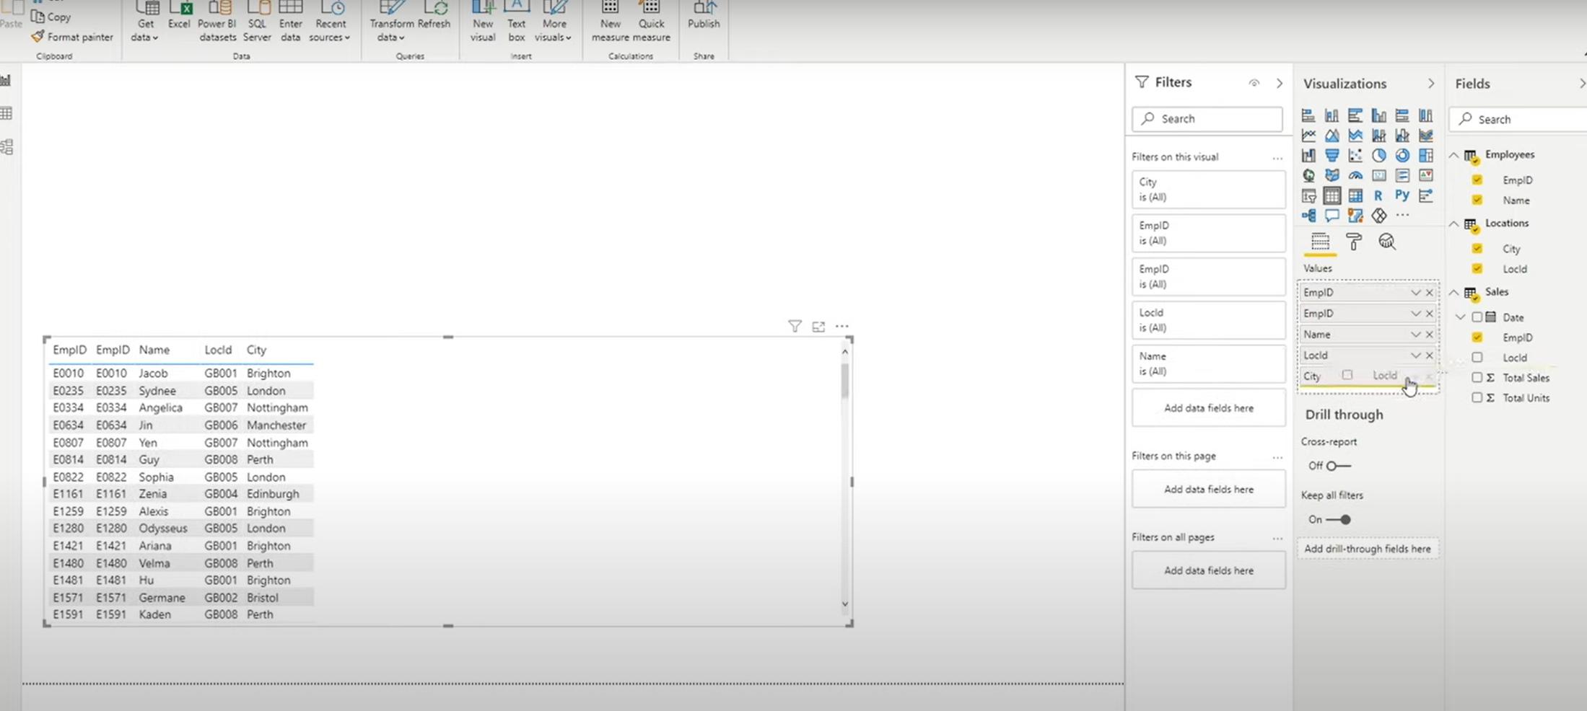

Power BI

Slide 7
SQL JOIN
To join two tables in SQL, you typically use the JOIN clause along with the appropriate join condition
INNER JOIN
LEFT JOIN (or LEFT OUTER JOIN)
RIGHT JOIN (or RIGHT OUTER JOIN)
FULL JOIN (or FULL OUTER JOIN)

Slide 8
SQL Join
SELECT Orders.OrderID, Customers.CustomerName, Orders.OrderDate
FROM Orders
INNER JOIN Customers ON Orders.CustomerID=Customers.CustomerID;

