Slide 1

Airplane Crashes Analysis
Muhammad Ahmad

Slide 2
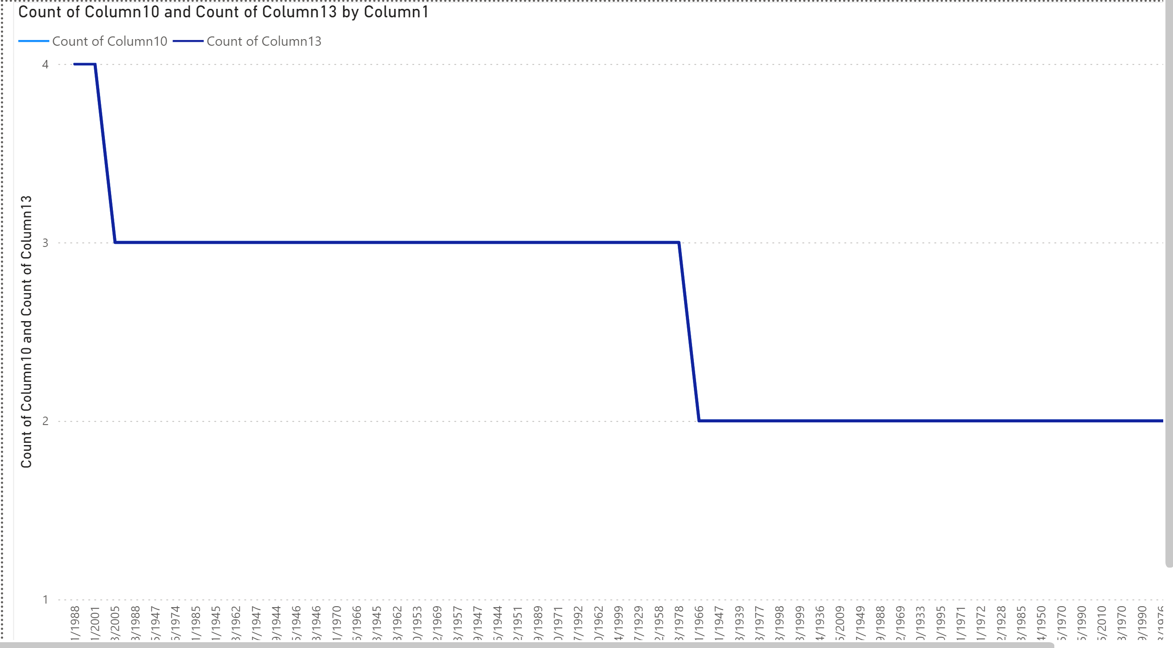
Task_1

Slide 3
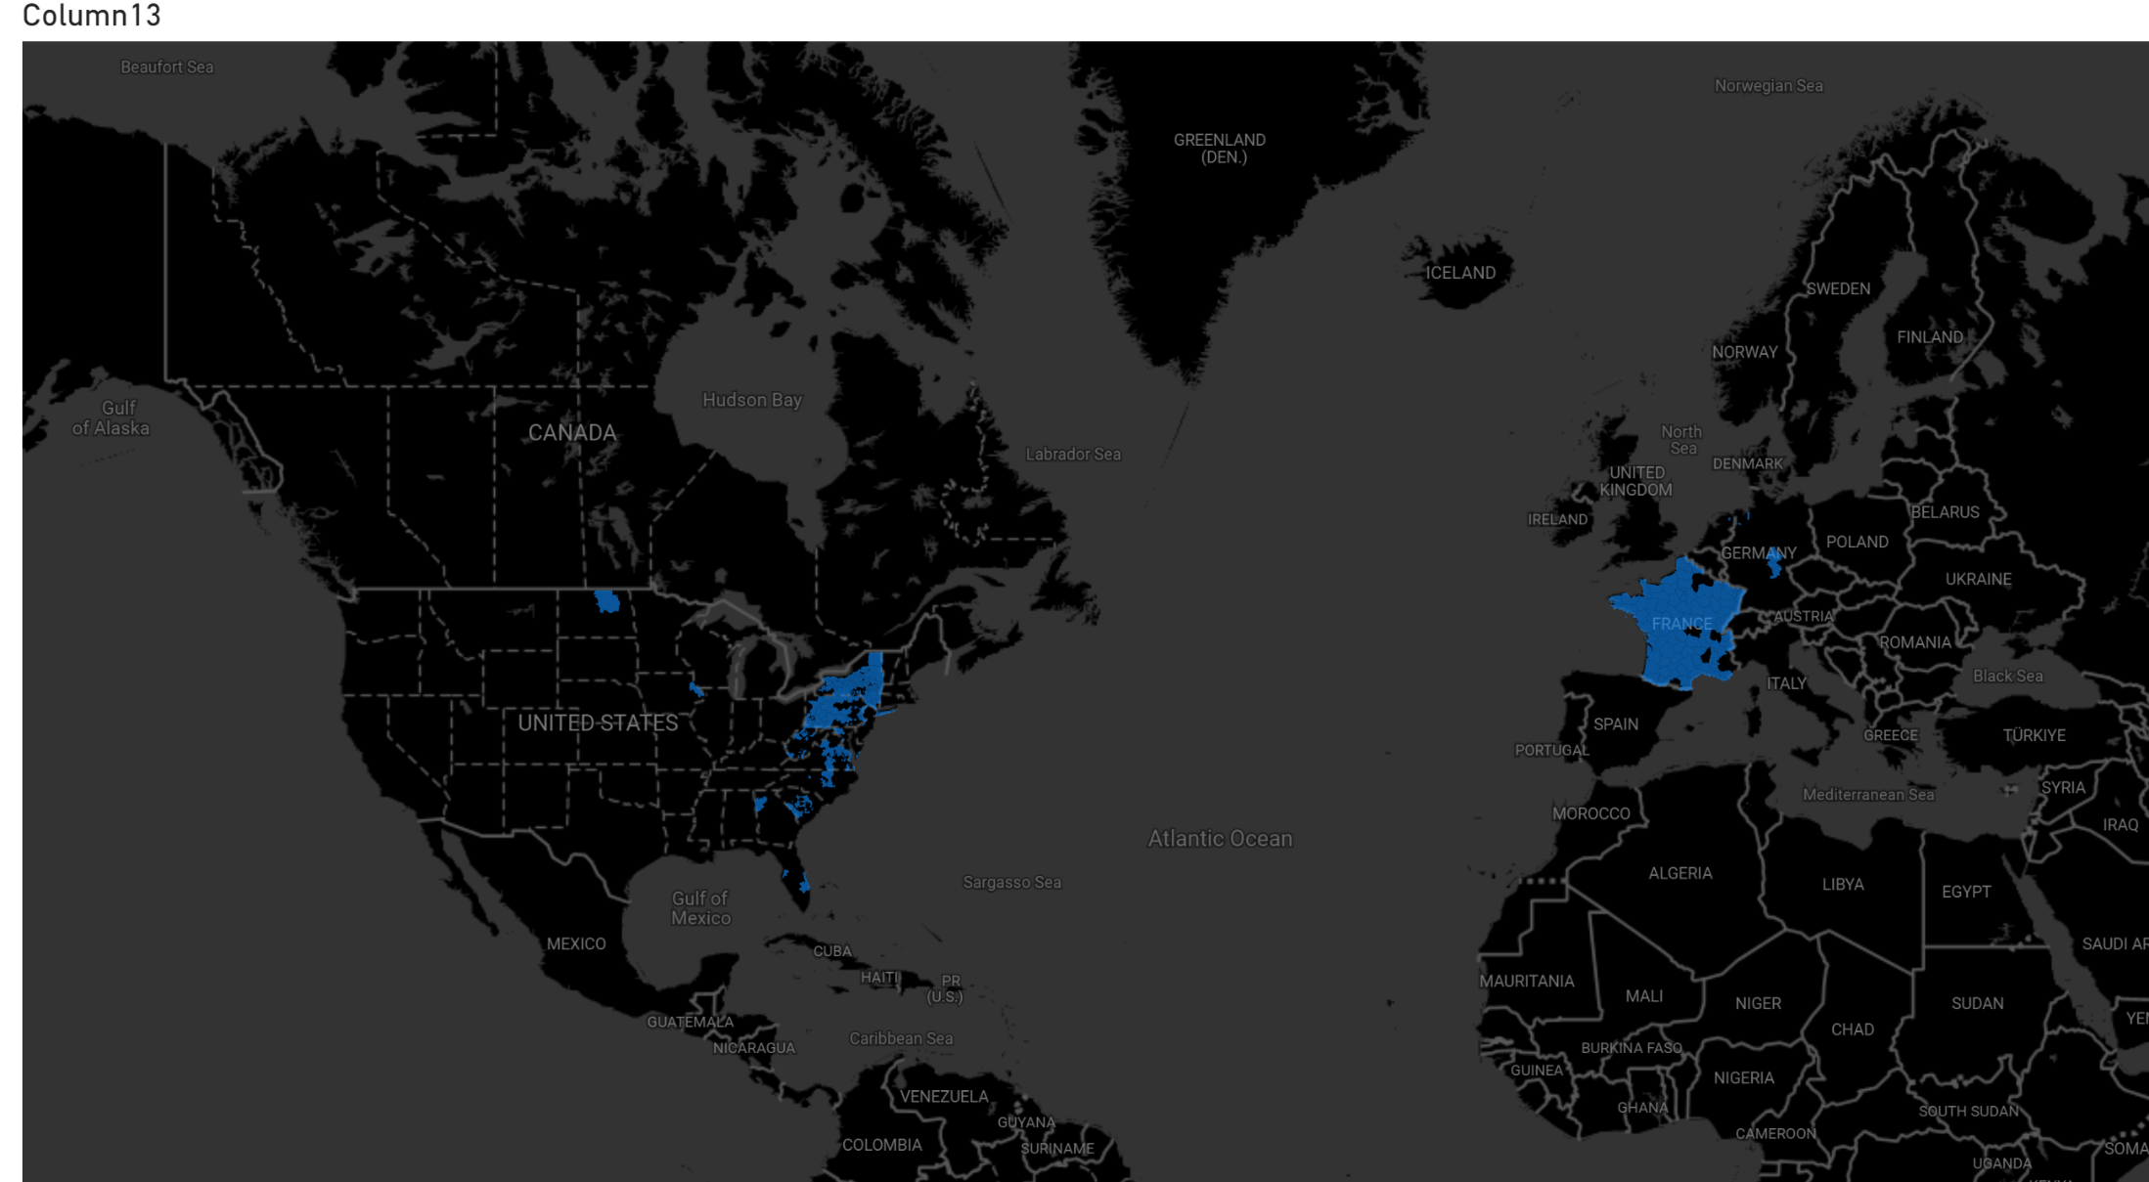
Task_2

Slide 4
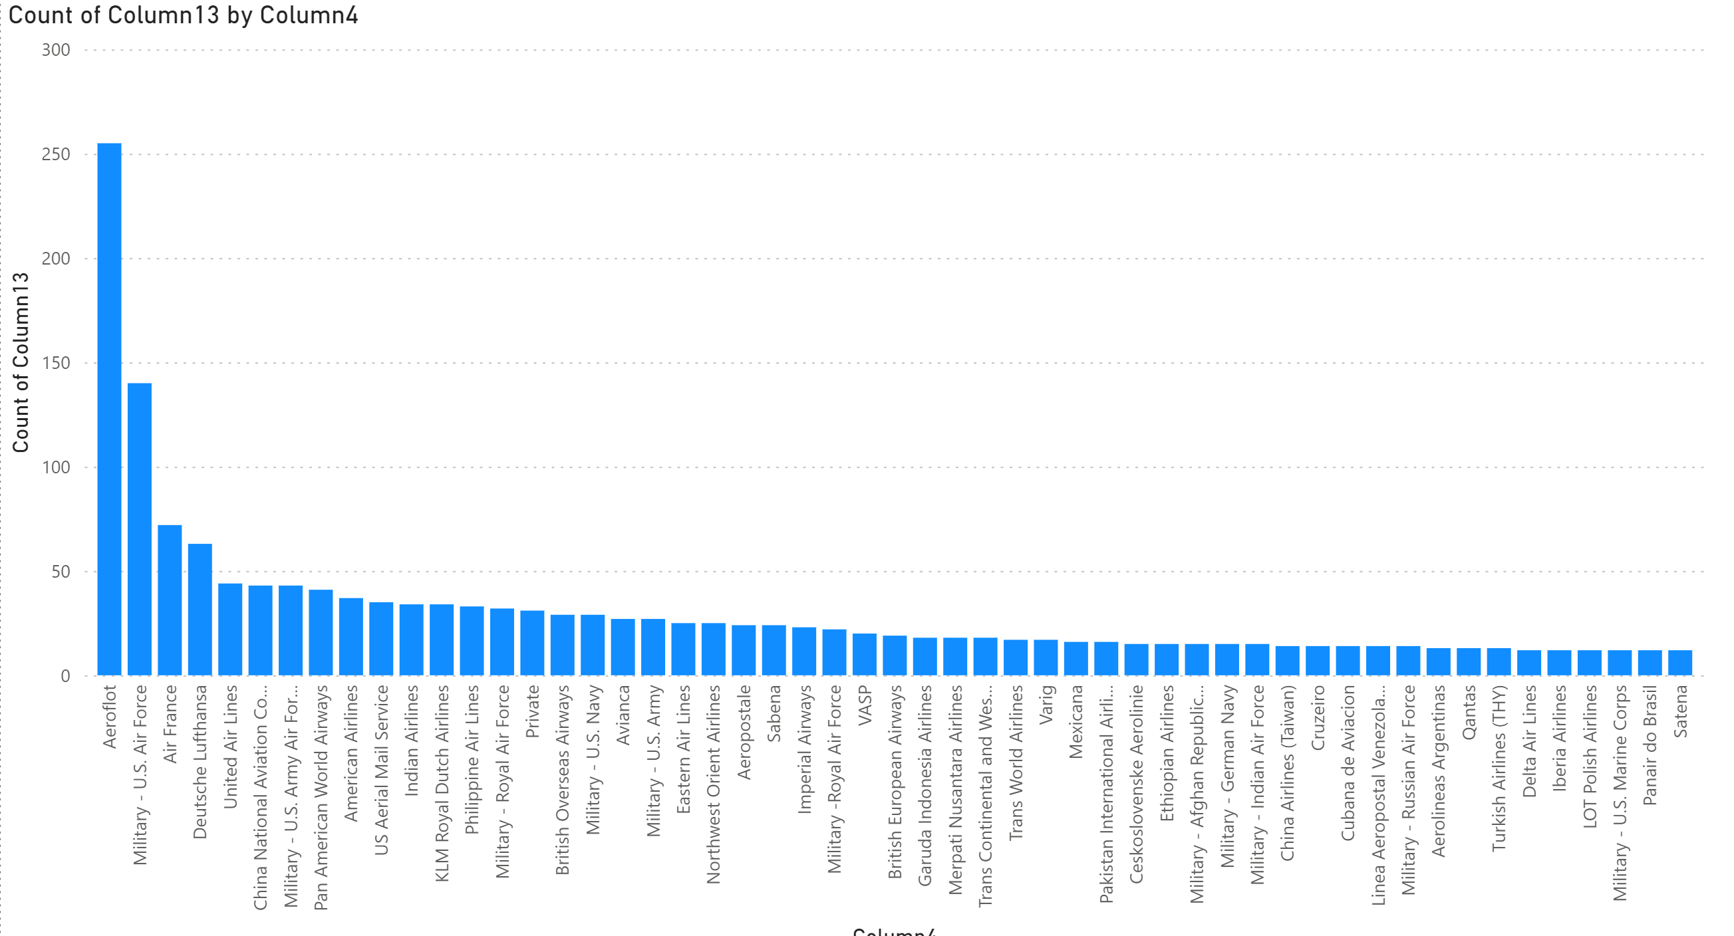
Task_3

Slide 5
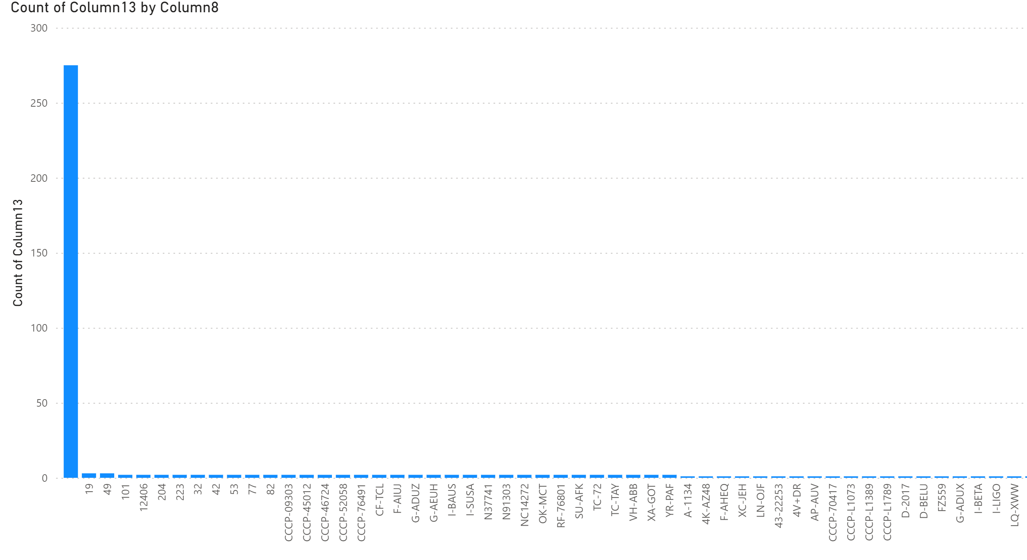
Task_4

Slide 6
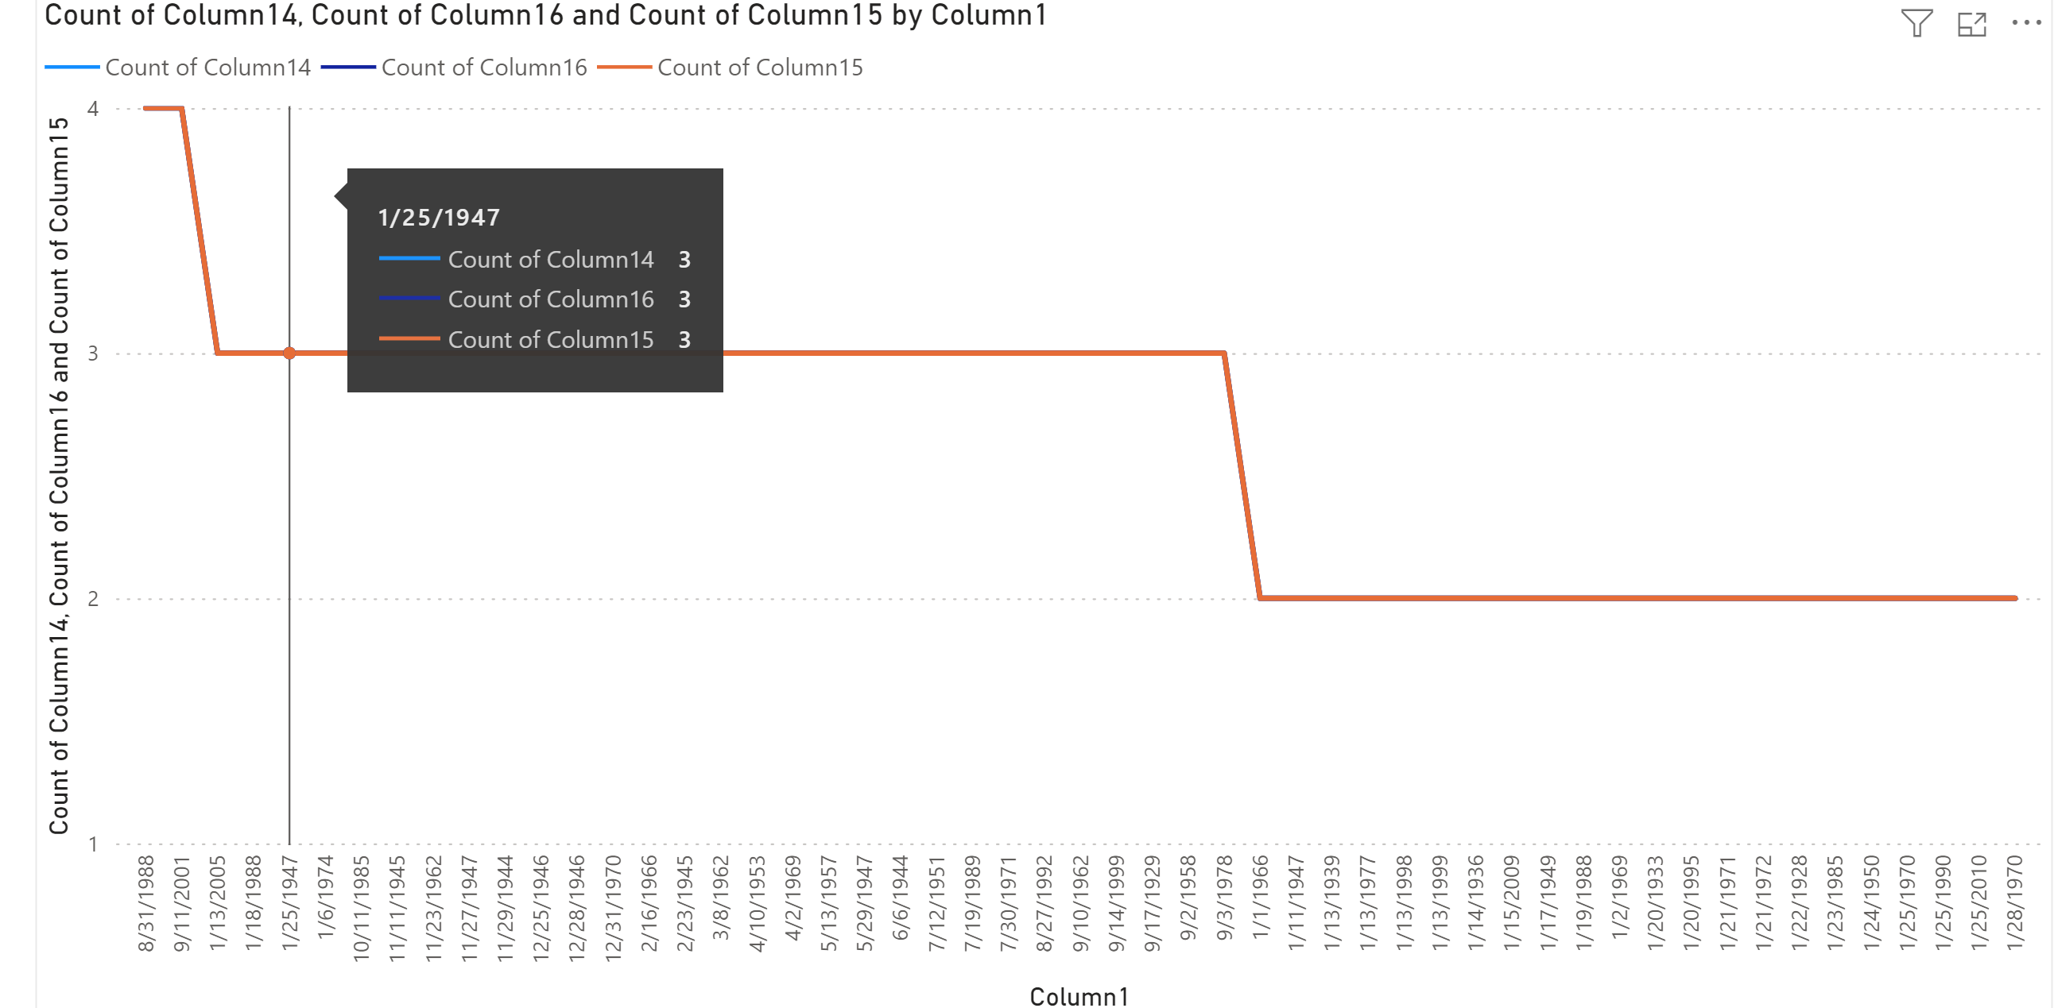
Task_5

Slide 7
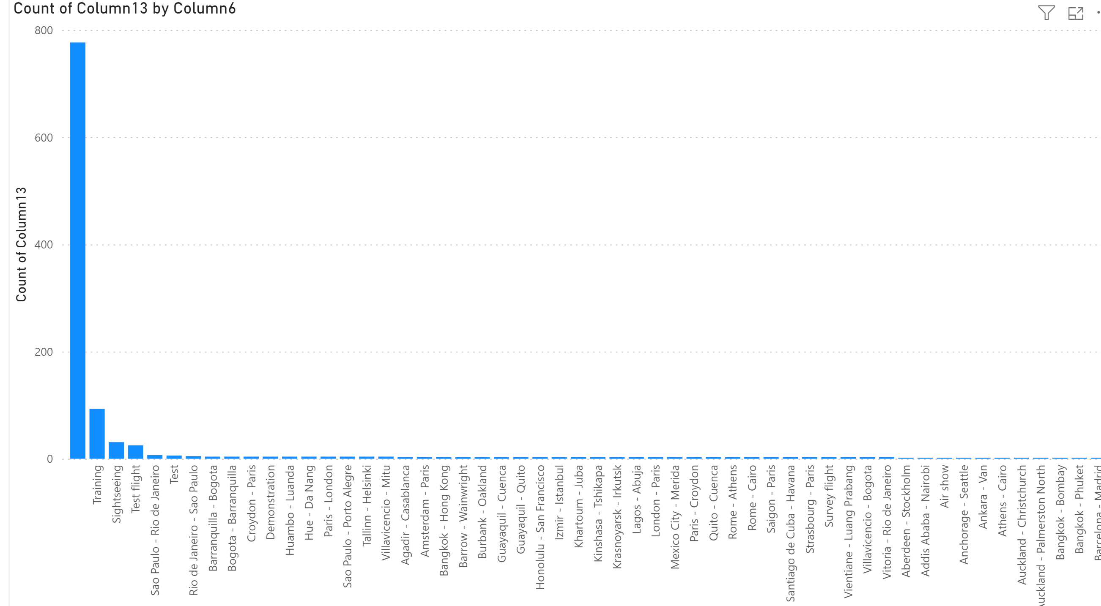
Task_6

