Slide 1
Project : Snake Ludo
Relive your childhood

Slide 2
Created By:
Rishad-ID 160041053
Ahmad-ID 160041054
Mashrur-ID 160041056

Slide 3
Reasons to make snake ludo
These days, many classical games are being remade on the digital platform. As such, games like ludo, monopoly, chess, solitaire, etc have been popularized on the global stage once more. We’re here to present our implementation of the lesser known spin-off of the widely popular ludo, the “Snake ludo” – a game which is rather entertaining in its own right.

Slide 4
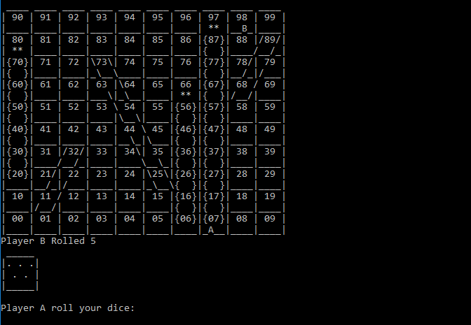
Snake Ludo

Slide 5
Features of Snake Ludo:
It’s a two player game with a definitive winner
Randomly rolls dice to avoid tampering with rolling dice
the players move around the board corresponding to their dice rolls
There is a system to store the highest score of the user

Slide 6
Improvements
We are glad to present our implementation of this traditional board game using the programming knowledge we were taught in our labs. If there are ways to improve or add new features, feel free to let us know so that we can update our game and provide players with an even better playing experience.

Slide 7
Thank You!!!

