Slide 1
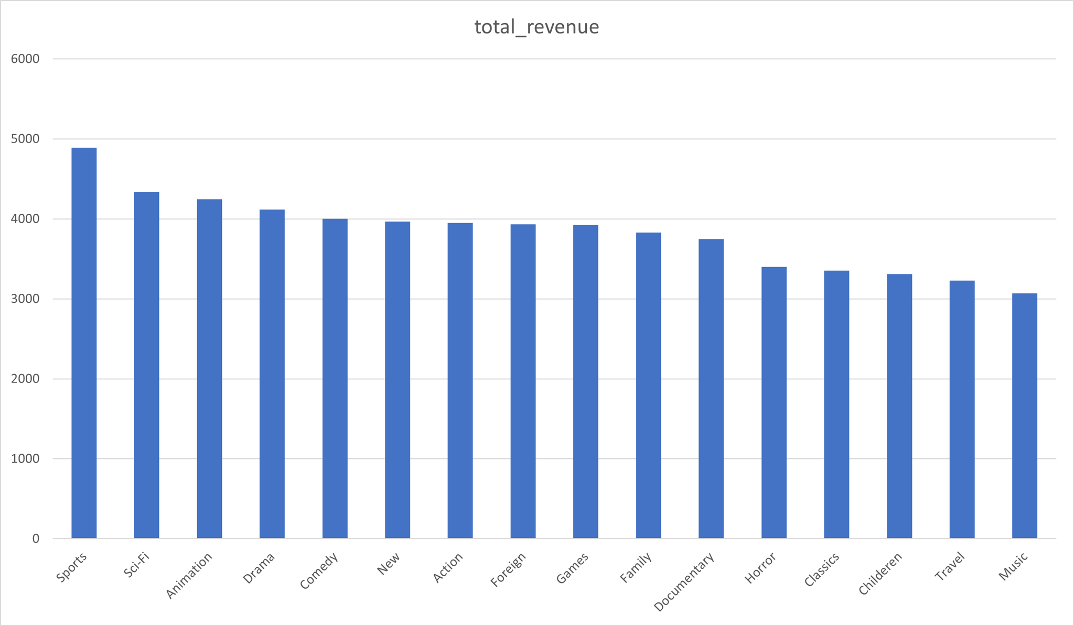
Q1: How does the rental duration vary across different film categories?
The chart shows the total revenue generated by various film categories, with each bar representing a category and its height indicating the revenue amount. "Sports" films lead with the highest revenue, followed by "Sci-Fi" and "Animation." Mid-range categories include "Drama," "Comedy," and "Action," while genres like "Travel" and "Music" earn the least. This reveals that mainstream categories are more popular, bringing in more revenue compared to niche ones, which suggests that audience preferences tend towards well-known genres.

Slide 2
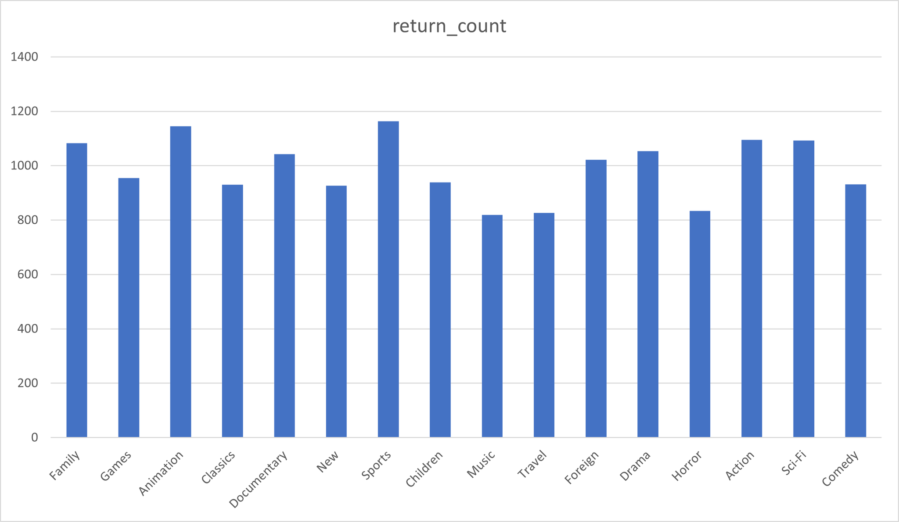
Q2: What is the return rate of rented items by category?
The chart illustrates the number of returned items across different film categories. Each bar represents a category, with its height indicating the return count. The "Sports" category leads with the highest return count of 1,164, followed closely by "Animation" with 1,145 returns, and "Family" with 1,083. "Action" and "Sci-Fi" categories also show high return rates, with 1,095 and 1,093 respectively. Mid-range return counts are seen in categories like "Drama," "Documentary," and "Foreign," each having around 1,000 returns. Lower return counts are observed in "Music" and "Travel," with 819 and 827 returns respectively, indicating they are less frequently rented. This chart suggests that categories with higher rental volumes, such as "Sports" and "Animation," also tend to have higher return rates, reflecting their popularity and frequent use.

Slide 3
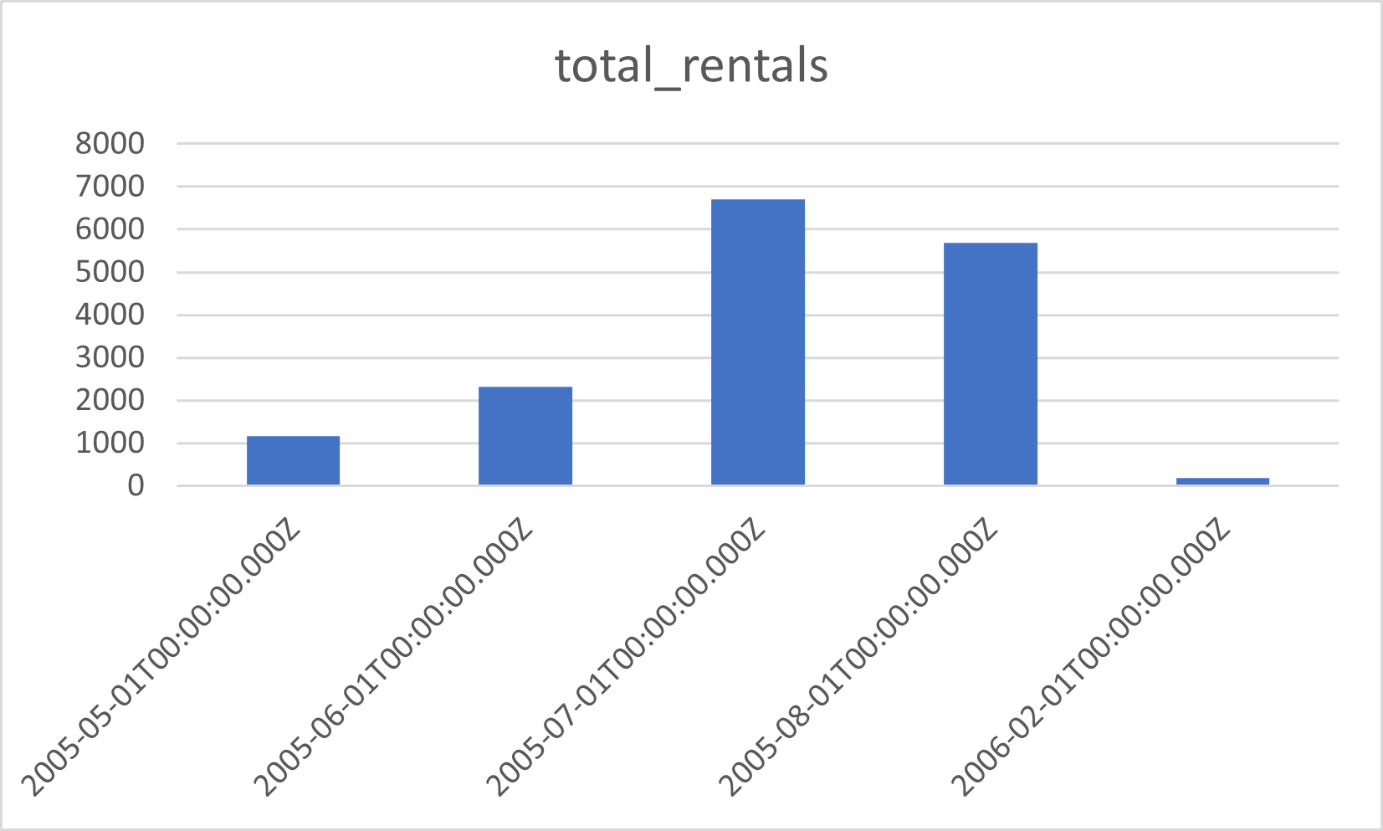
Q3: How do rental counts vary by month?
The data depicts the variation in rental counts over different months. In May 2005, there were 1,156 rentals, which doubled in June 2005, reaching 2,311 rentals. July 2005 witnessed a significant surge in rentals, escalating to 6,709, the highest count among the listed months. August 2005 sustained a relatively high rental count with 5,686 rentals. However, there was a noticeable drop in February 2006, recording only 182 rentals. This data suggests a fluctuating pattern in rental counts over the specified time period, with July 2005 being the peak month for rentals.

Slide 4
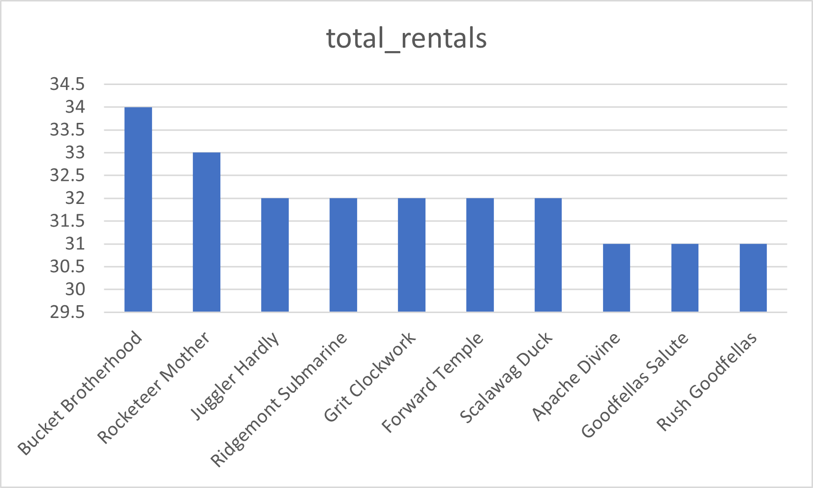
Q4: Which films are the most popular among our customers?
The data indicates the popularity of films based on their total rental counts among customers. "Bucket Brotherhood" emerges as the most popular film with 34 total rentals, closely followed by "Rocketeer Mother" with 33 rentals. "Juggler Hardly," "Ridgemont Submarine," "Grit Clockwork," "Forward Temple," and "Scalawag Duck" share the next position with 32 rentals each. "Apache Divine," "Goodfellas Salute," and "Rush Goodfellas" round up the list with 31 rentals each. These films seem to resonate well with customers, as evidenced by their high rental counts, making them the most sought-after titles among the available options.

