Slide 1
Machine Learning Assignment #2
Qasim Batrawi - Ahmad Hamdan

Slide 2

01
Non-linear Regression

Slide 3
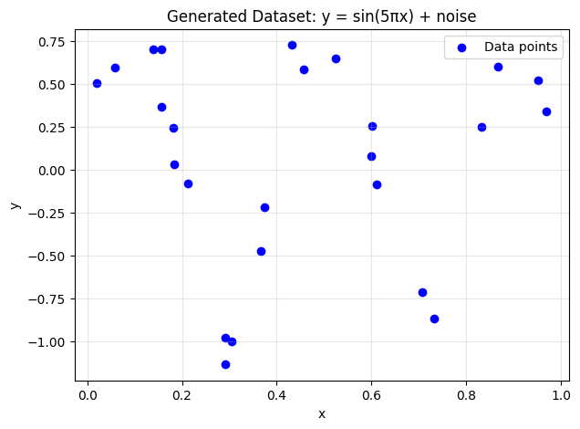
Dataset Visualization
This graph illustrates the 25 data points generated from the target function y = sin(5πx) + ε, where noise ε ∈ [−0.3,0.3] was added to each sample.
The dataset is small , making it sensitive to noise and ideal for analyzing how polynomial regression behaves under overfitting and underfitting.

Slide 4
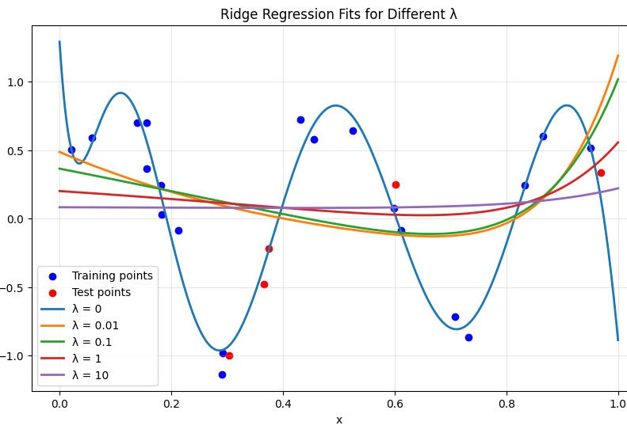
Ridge Regression: Effect of λ on Polynomial Fit
We learned that:
Small λ values produce highly flexible curves that tend to overfit the noise.
Larger λ values produce smoother, more stable curves but may underfit the true sinusoidal shape.
But.. λ = 0 is the best?

Slide 5
Why Does λ = 0 Look Like the Best Model?
1.
The target function is sin(5πx) + ε
The curve matches a sinusoidal pattern
The model captures peaks, valleys and slope
Higher λ would..
1.
2.
3.
Force the model to be smoother Reduces required curveness Underfitting
Because the underlying function contains real oscillations and the noise is limited, a flexible model (λ = 0) achieves the best generalization in this specific problem.

Slide 6
Selecting the Best λ Using Test Error
The best lambda based on test performance is
λ = 0, with a Test MSE of 0.02387.
λ = 0 → Test MSE = 0.02387
λ = 0.01 → Test MSE = 0.37589
λ = 0.1 → Test MSE = 0.37851
λ = 1 → Test MSE = 0.34171
λ = 10 → Test MSE = 0.32244
λ = 0 achieves the lowest test error by a
large margin.
The highly curved nature of sin(5πx) requires a flexible model.
The noise level is too small to justify heavy
regularization.

Slide 7

02
Non-linear Regression

Slide 8
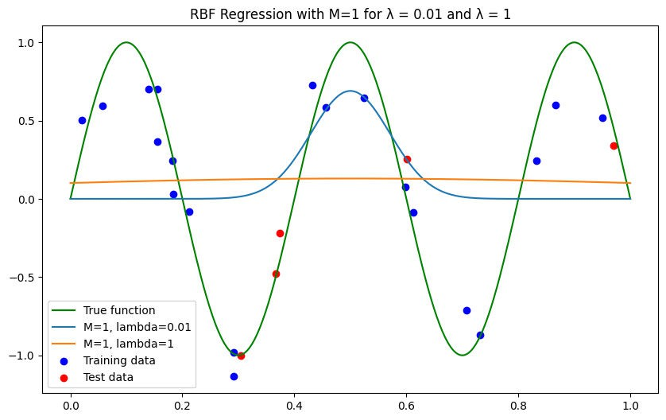
RBF Regression Results for Different Numbers of Basis Functions
M = 1 -> The model is too restrictive and cannot reproduce more than a single broad shape so it completely misses the oscillatory nature of the data.
λ = 0.01 -> A sharp localized peak at the center.
Underfits as it is being too localized.
λ = 1 -> The function becomes very broad.
Underfits as it is being too diffuse.
λ affects how local or global the single (M = 1) basis function is, but both result in underfitting.

Slide 9
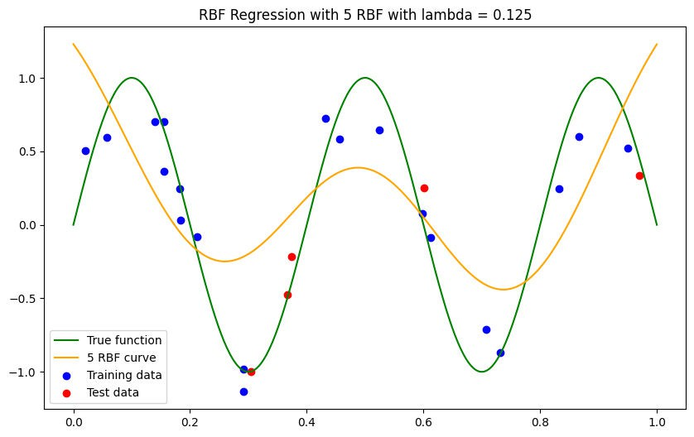
RBF Regression Results for Different Numbers of Basis Functions
M = 5 -> It can form several overlapping bumps across the domain, allowing it to follow the general shape of the true function instead of producing a single narrow or flat curve.
Even with more basis functions, the model still looks smoother than the true function because the individual RBFs are not very sharp.
λ = 0.125 -> Creates wide RBFs, which smooth out the curve and prevent it from capturing fast oscillations.

Slide 10
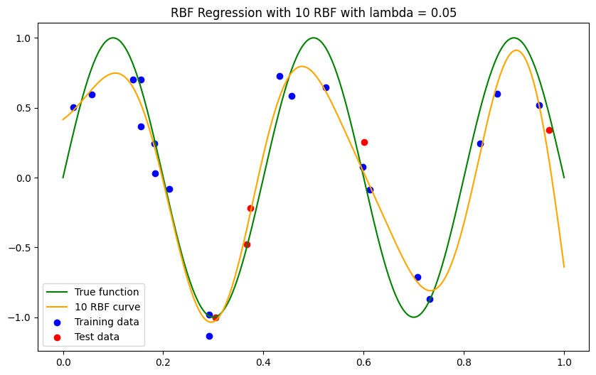
RBF Regression Results for Different Numbers of Basis Functions
M = 10 -> Gives the model more flexibility. Each RBF can create a local bump, so the curve can now follow the true function more closely and capture finer variations.
λ = 0.05 -> Makes each RBF narrower, reducing smoothing. This allows the model to respond to faster changes in the data.

Slide 11
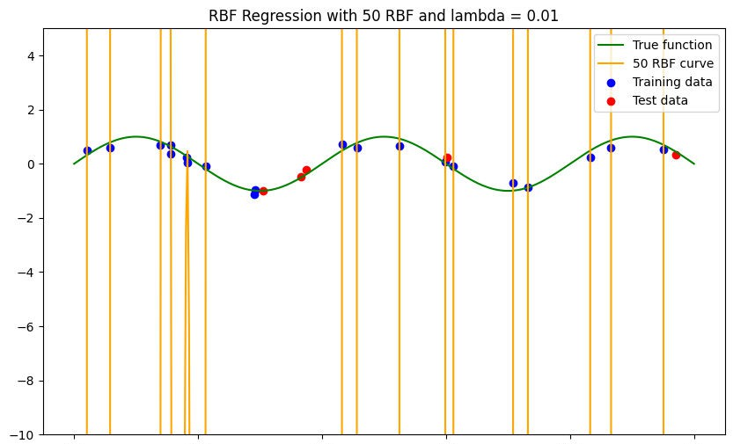
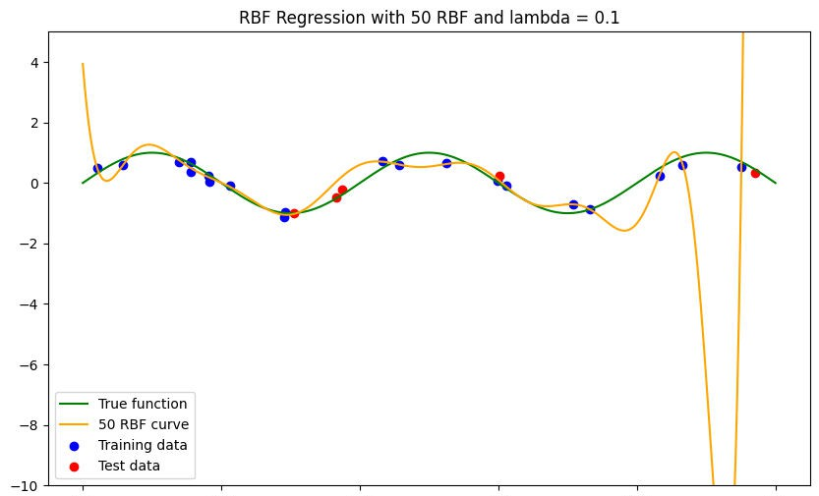
RBF Regression Results for Different Numbers of Basis Functions
M = 50 -> The curve can now follow the true function closely and capture finer variations, but this caused overfitting.
λ = 0.01 -> RBFs are very narrow. The curve overshoots drastically between points, showing extreme overfitting.
λ = 0.1 -> RBFs are moderately wide. The curve is wiggly and overfits less, with one minor undershoot.

Slide 12
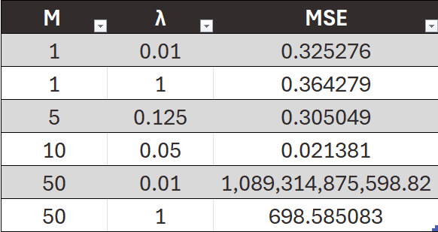
Summary of RBF Regression Results
Small M (1 or 5): Model lacks flexibility, cannot capture the true function well; Test MSE remains relatively
high.
M = 10, λ = 0.05: Best performance. Enough RBFs to model finer variations, with moderate smoothing to avoid overfitting.
High M: Too flexible. With λ = 0.01, extreme overshoots occur. With λ = 0.1, still overfits but less
severely.

Slide 13
03
Logistic Regression

Slide 14
Objective & Data Preparation
Objective: Predict Customer Churn (binary classification)
Dataset & Preprocessing:
Dataset: Customer churn dataset from Assignment #1 Preprocessing: Done in Assignment #1
Features: All columns except ChurnStatus and CustomerID Target: ChurnStatus
Data Split:
Train - 2500 Samples Validation - 500 Samples Test - 500 Samples

Slide 15
Linear Logistic Regression – Results
Train → Accuracy: 0.976, Precision: 0.796, Recall: 0.643
Validation → Accuracy: 0.978, Precision: 0.750, Recall: 0.632
Test → Accuracy: 0.980, Precision: 0.882, Recall: 0.652
The model achieves high overall accuracy, which might seem good at first glance.
However, Recall is relatively low, meaning it fails to correctly identify a significant portion of customers who actually churn.
Precision is moderate, showing that when it predicts churn, it is often correct, but not perfect.
Overall, the linear model is too simple for this problem -> it underfits the data and cannot capture non-linear patterns in customer behavior.

Slide 16
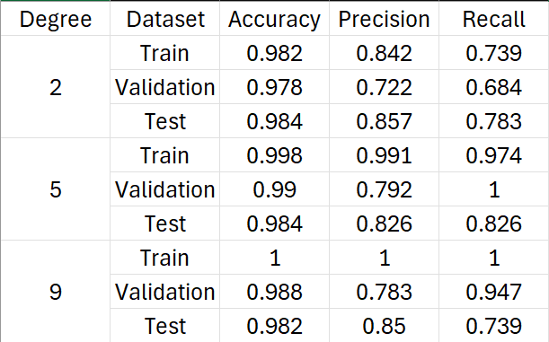
Non-linear Logistic Regression - Results
Degree 2:
Slight improvement over linear model.
Accuracy increases slightly, Recall improves modestly.
Still relatively simple -> underfitting risk is low, generalizes reasonably well.
Degree 5:
Significant improvement in Recall on the validation set. Train accuracy and precision very high -> model captures complex patterns.
Validation and test metrics show good generalization,
though precision is lower than train.
Degree 9:
Train metrics are perfect (1.0) -> overfitting.
Validation Recall still high, but precision drops slightly. Test set Recall decreases.
Too complex -> fits noise in training data, reducing
generalization.
Increasing polynomial degree -> increases model flexibility.
Too low -> underfit Too high -> overfit.
Degree 5 provides the best balance.

Slide 17
Model Selection Based on Validation Set
Priority: Minimize False Negatives -> correctly identifying customers who will churn is critical.
The Degree-5 polynomial logistic regression achieves 100% Recall on the validation set, meaning it correctly identifies all churners.
Linear Logistic Regression F1 Score: 0.6857142857142857 Degree 2 Logistic Regression F1 Score: 0.7027027027027027 Degree 5 Logistic Regression F1 Score: 0.8837209302325582 Degree 9 Logistic Regression F1 Score: 0.8571428571428571
The Degree-5 model is the best choice whether the priority is solely Recall or a balanced performance between Precision and Recall.

Slide 18
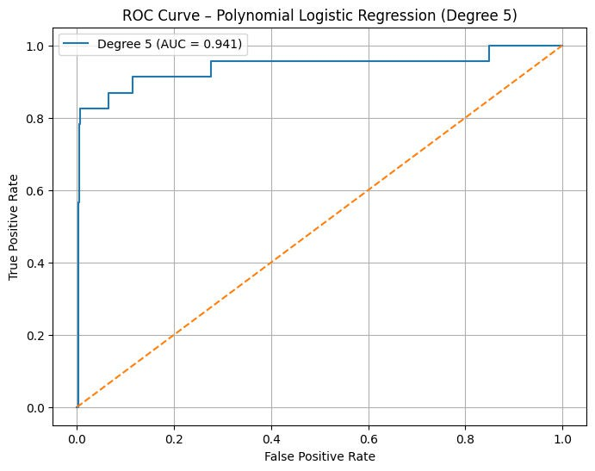
ROC Curve: Degree-5 Polynomial Logistic Regression
The ROC curve plots the True Positive Rate (Recall) against the False Positive Rate at different thresholds.
AUC value is high (= 0.941), confirming the model effectively separates churners from non-churners.
Confirms that the Degree-5 polynomial logistic regression generalizes well to the test set.

