Slide 1
USB Sandbox
An Overview

Slide 2
Objectives
Introducing sandboxing
An overview on USB attacks
Introducing some features

Slide 3
Agenda
Basic Definitions
Sandboxing
General Concept
Defenses Layers
Features

Slide 4
Agenda
Basic Definitions
Sandboxing
General Concept
Defenses Layers
Features

Slide 5
Basic Definitions
Information security's primary focus is the balanced protection of the confidentiality, integrity and availability of data (also known as the CIA triad) while maintaining a focus on efficient policy implementation.
Confidentiality
Integrity
Data Availability
Middleware

Slide 6
Agenda
Basic Definitions
Sandboxing
General Concept
Defenses Layers
Features

Slide 7
Sandboxing
Isolation concept
Extra layer of security
Prevention of malware or harmful applications

Slide 8


Slide 9
Agenda
Basic Definitions
Sandboxing
General Concept
USB Attacks
Features

Slide 10
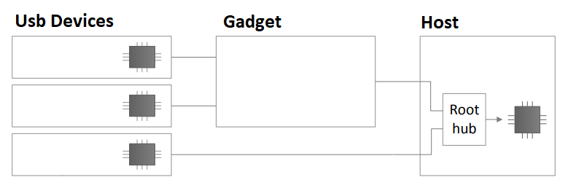
General Concept
By using a middleware between the untrusted USB device and the Host, Adding a layer of isolation by emulating the USB device on Raspberry PI.

Slide 11
Agenda
Basic Definitions
Sandboxing
General Concept
USB Attacks
Features

Slide 12
USB Attacks
USB Hardware
A
C
Programmable Microcontrollers
B
Electrical
USB Peripherals
Rubber Ducky - 2010
USB Killer
B.1
B.2
Maliciously Re-programmed Peripherals
Not Re-programmed Peripherals
DNS Override by modified USB firmware - 2014
.LINK Stuxnet
Virtual machine break-out - 2014

Slide 13
USB Attacks
Reprogrammable microcontroller USB attacks
By reprogramming the USB device's internal microcontroller. The device looks like a USB device (e.g.: charger) but carries out the operations of another (e.g.: keyboard —injects keystrokes).
B1. Maliciously reprogrammed USB peripheral firmware
By reprogramming the USB device's firmware to execute malicious actions (such as malware downloading, data exfiltration, etc.). B2. Attacks based on unprogrammed USB devices
By not reprogramming USB device firmware but leveraging flaws in how operating systems normally interact with USB protocols/standards. C. USB-based electrical attacks.

Slide 14
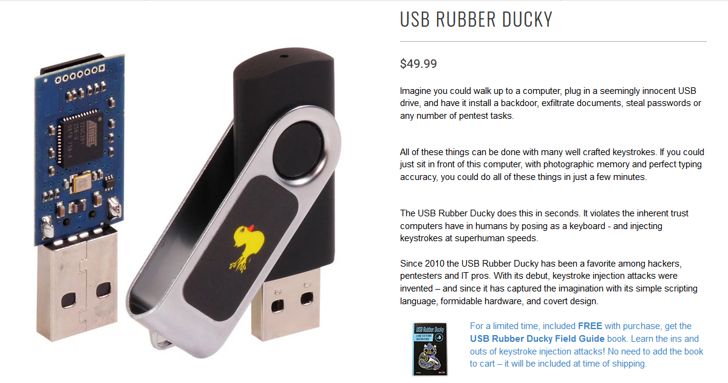

Slide 15
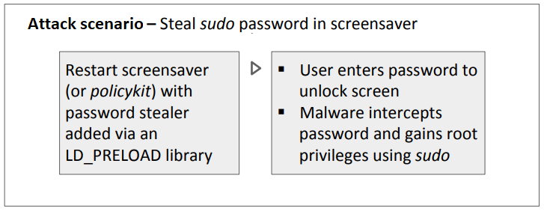
Keyboard emulation attacks
Keyboard emulation is enough for infection and privilege escalation.Example is The USB Rubber Ducky is programmed using Ducky Script, which is simple and in all caps. Each command is on a new line, and commands like ALT and CTRL are familiar. To write in Ducky Script, you simply imagine you were sitting in front of the keyboard and needed to accomplish a task using only the keyboard. Using key shortcuts and terminal commands, it's possible to achieve specific actions with relatively little code.

Slide 16
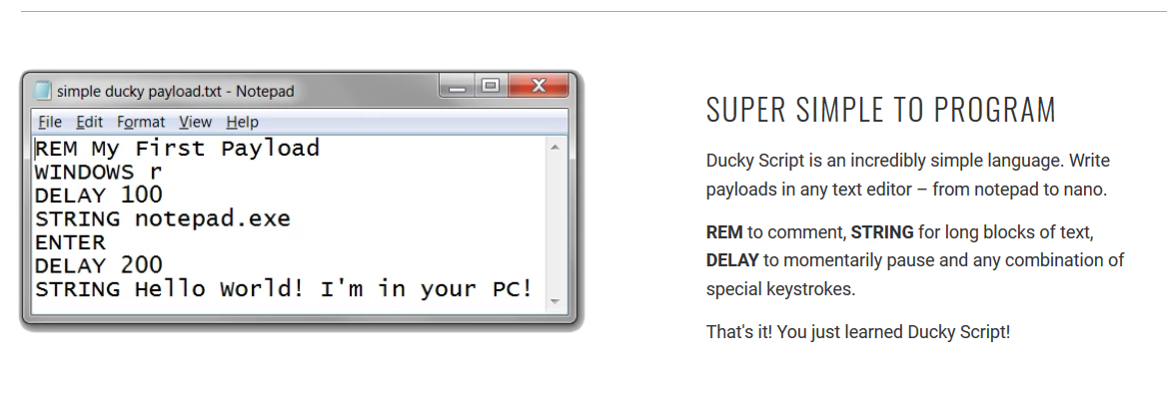

Slide 17
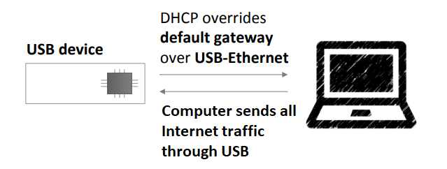
USB Attacks
Default gateway override by Modified USB Firmware

Slide 18
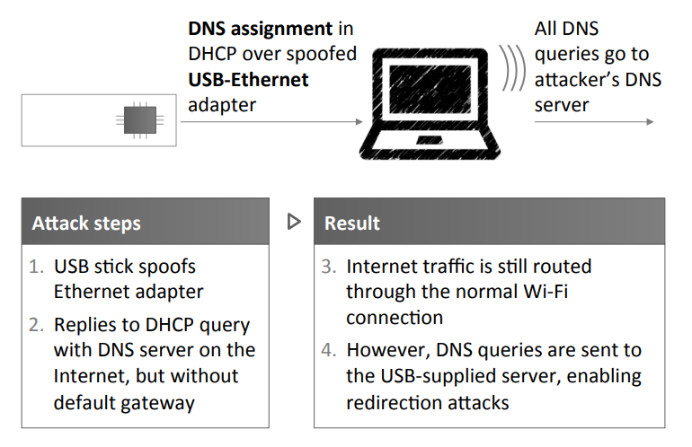
DNS override by Modified USB Firmware

Slide 19
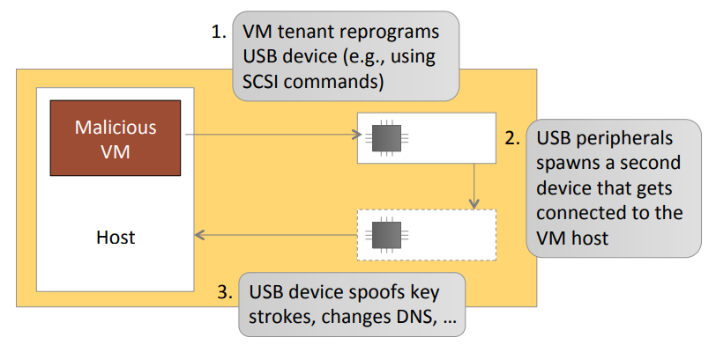
Virtual Machine Breakout

Slide 20
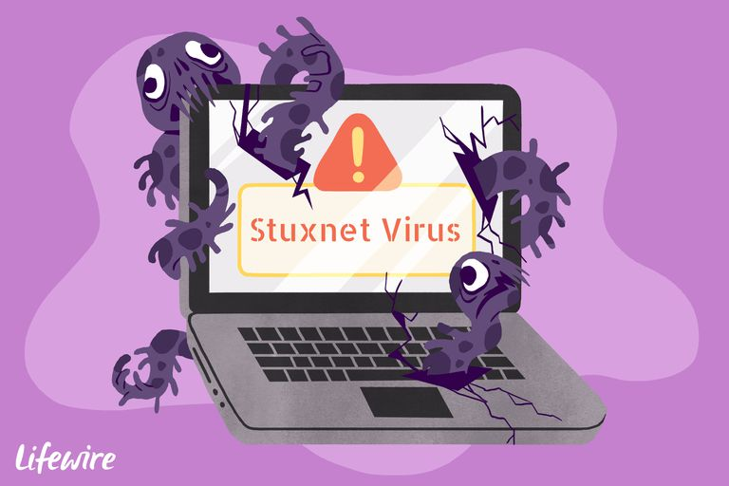
Stuxnet
Stuxnet is a malicious computer worm, first uncovered in 2010, thought to have been in development since at least 2005.
Stuxnet targets SCADA systems and is believed to be responsible for causing substantial damage to Iran's nuclear program.

Slide 21
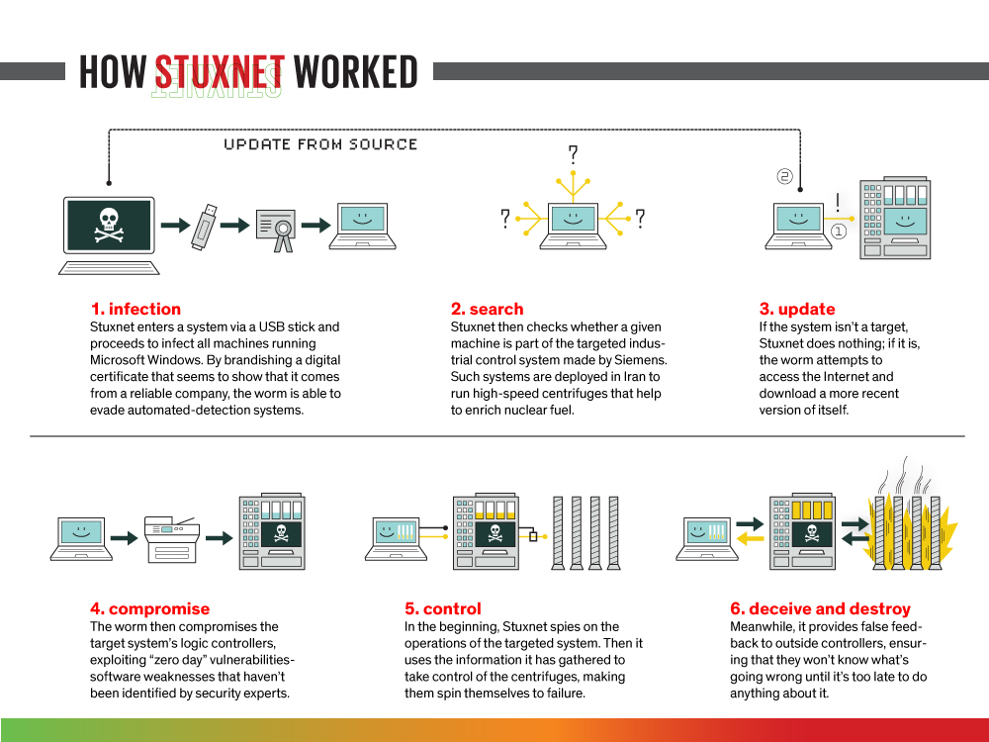

Slide 22
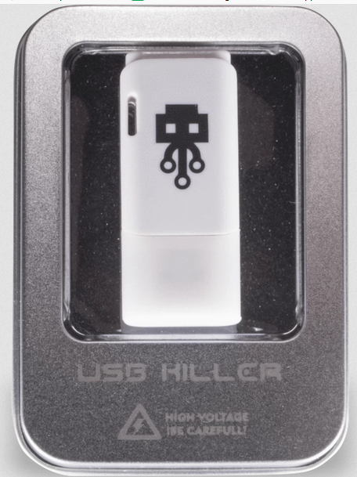
USB Killer
According to USBKill.com, a company based in Hong Kong that designed the device, USB Killer 2.0 works by collecting power from the USB power lines (5V, 1 - 3A) until it reaches ~ -240V. It then begins discharging its stored voltage multiple times per second.
The recharge/discharge cycle lasts if USB Killer 2.0 is connected to a USB port. Indeed, it will continue until it can't discharge any longer, that is, when the device has damaged its host's circuitry.

Slide 23
Agenda
Basic Definitions
Sandboxing
General Concept
USB Attacks
Features

Slide 24
Features
Integrity Checking
Storing calculated encrypted hash of files on the USB in order to check the authenticity of data in transport layer
Authentication & Encryption
Both header and file names are going to be encrypted so no one can edit them which ensures the confidentiality of data.
USB Information Profiling
All the information of the USB (Brand, HID … etc.) will be collected and analyzed for suspected attacks
Device Blacklisting
Harmful devices identifiers will be saved into the gadget and it will be automatically denied in future.

Slide 25
Features (Cont’d)
Payload Matching
Matching all types of evil code and detect them.
USB Policy
Extra USB policies will be enforced to ensure maximum protection for the host.
Cloud Signature-Based Defenses
A series of defensive mechanisms are layered in order to protect data and information.
Driver Vulnerabilities Defense
Realtime defense against vulnerabilities.
Platform Independent
The project will be able to work on all types of operating systems.
Price
The project will be available in a cheaper price than the existing solutions.

Slide 26
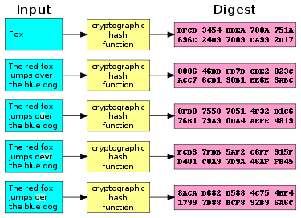

Slide 27
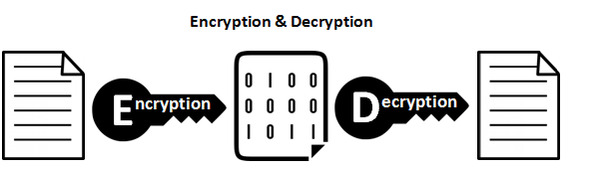
Hash Sum of files
Encrypted data
Hash Sum of files to be compared in another gadget
Hardcoded keys in code

Slide 28
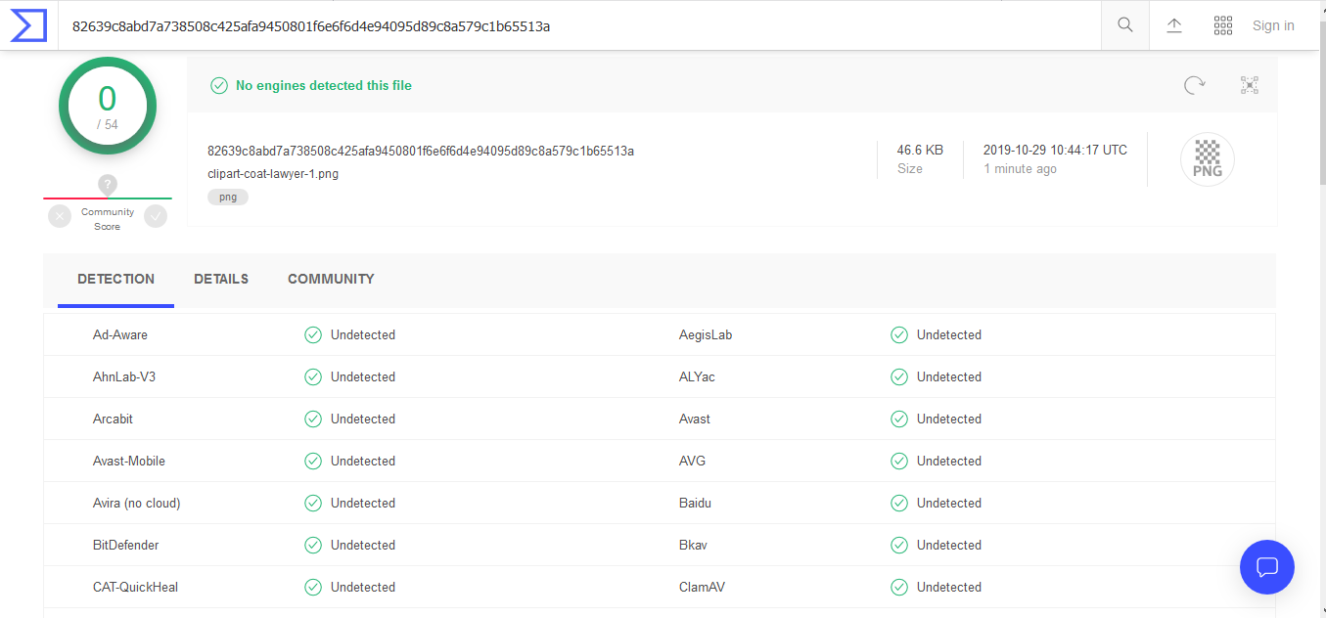


Slide 29
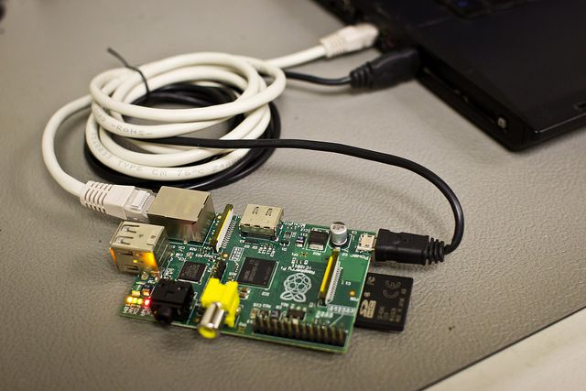
Raspberry Pi 2

Slide 30
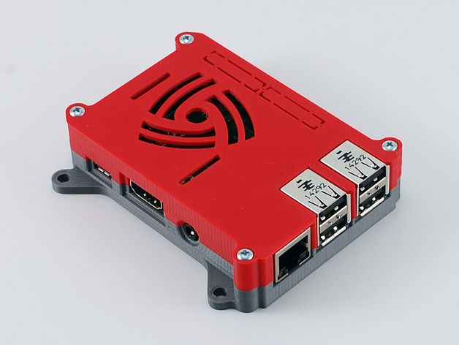
Cover for the Raspberry Pi 2

Slide 31
References
Andress, J. (2014). The Basics of Information Security: Understanding the Fundamentals of InfoSec in Theory and Practice. Syngress. p. 240. ISBN 9780128008126.
J. Tian, N. Scaife, D. Kumar, M. Bailey, A. Bates, K. Butler, "SoK: “plug pray” today - understanding USB insecurity in versions 1 through c", Security and Privacy, 2018.
E. L. Loe, H.-C. Hsiao, T. H.-J. Kim, S.-C. Lee, and S.-M. Cheng, “SandUSB: An installation-free sandbox for USB peripherals,” in IEEE 3rd World Forum on Internet of Things (WF-IoT), Dec 2016, pp.621–626.
shop.hak5.org/products/USB-rubber-ducky-deluxe

