Slide 1
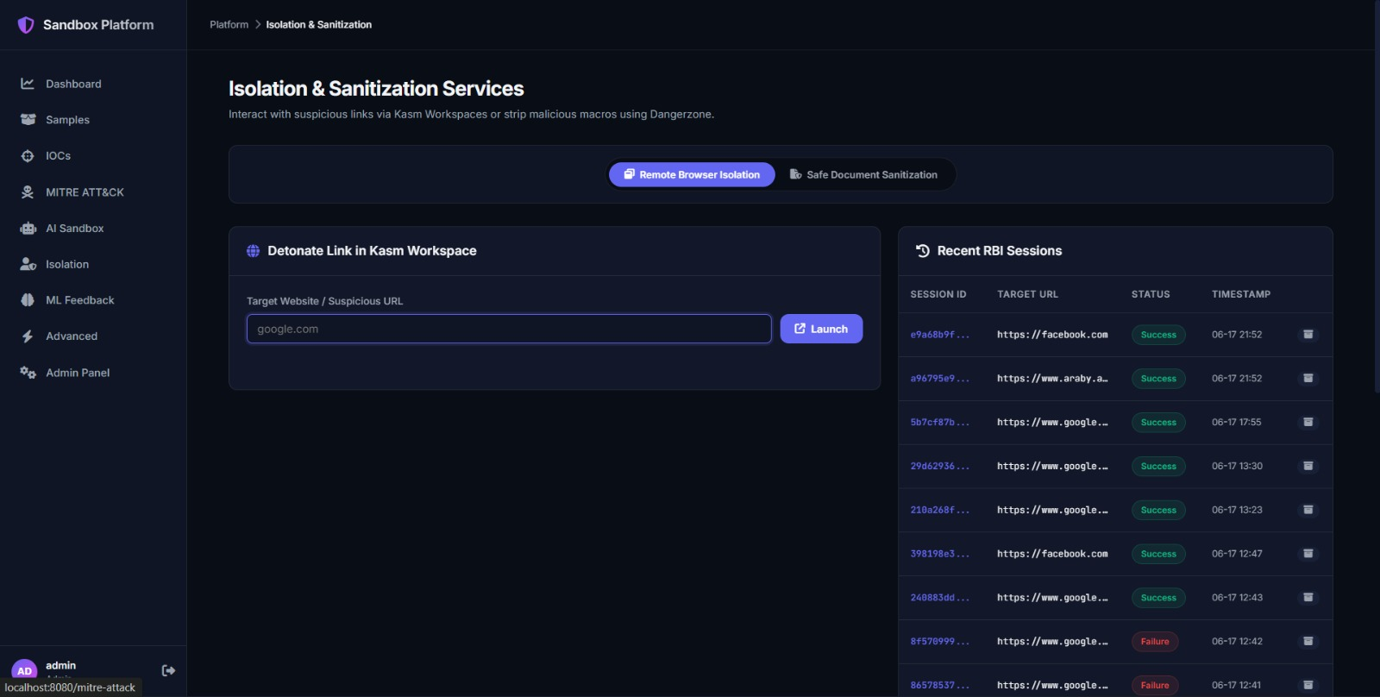
INTRODUCTION
ARCHITECTURE
ANALYSIS
ML & INTEL
ISOLATION
ADVANCED
AI Agent Code Sandbox
Secure Code Execution
Run untrusted Python payloads in isolated E2B microVMs hardened via gVisor container runtime.
Features
● Built-in Python code editor
● Real-time execution terminal
● Historic detonation runs log
● Execution telemetry access
● ~2000ms average runtime
Python 3.10 Ready
AI Agent Code Execution Sandbox — Python Editor with gVisor MicroVM
Use Case: Security analysts can write custom scripts to unpack malware, test suspicious code snippets, or validate detection logic without risking their local workstation.
26

Slide 2
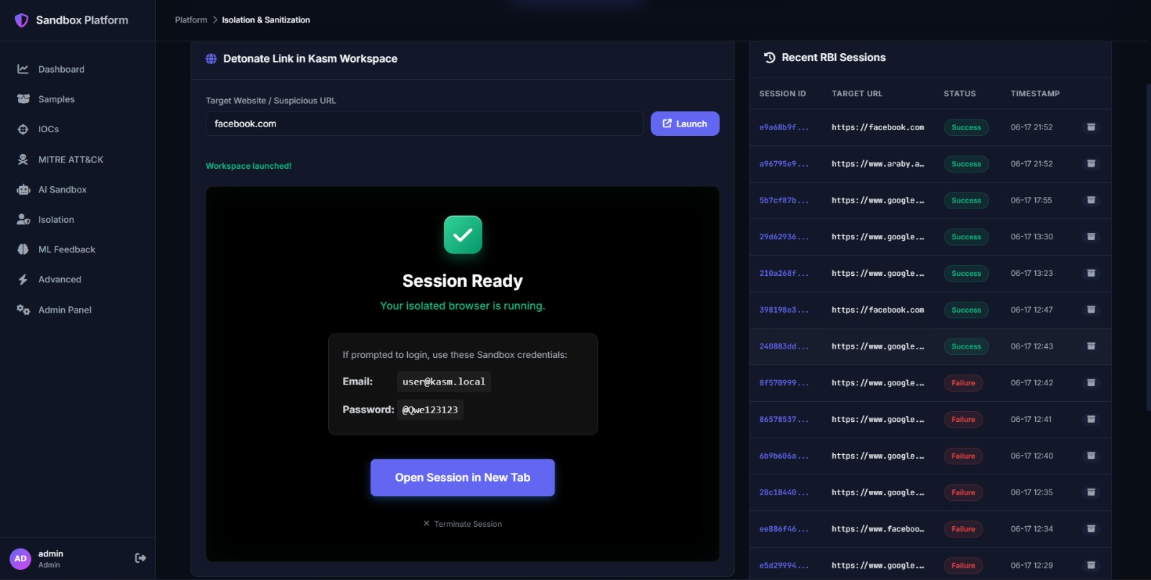
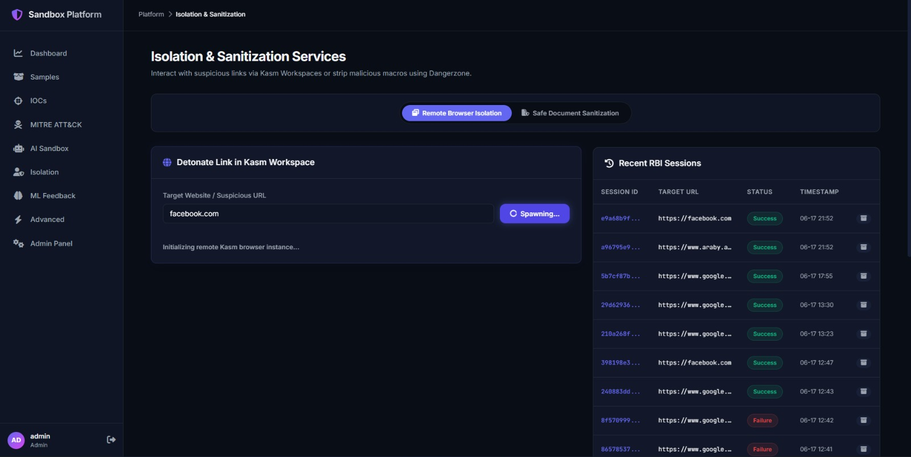
INTRODUCTION
ARCHITECTURE
ANALYSIS
ML & INTEL
ISOLATION
ADVANCED
Remote Browser Isolation
Isolation & Sanitization Services — Kasm Workspace Integration
Facebook Running in Isolated Kasm Chrome Container
Isolation Workflow
Enter Suspicious URL
Kasm API Request
Spawn Container
WebRTC Streaming
Safe Investigation
Active web scripts, exploits, and drive-by downloads execute only in the remote container — the analyst's endpoint remains completely safe.
27

Slide 3
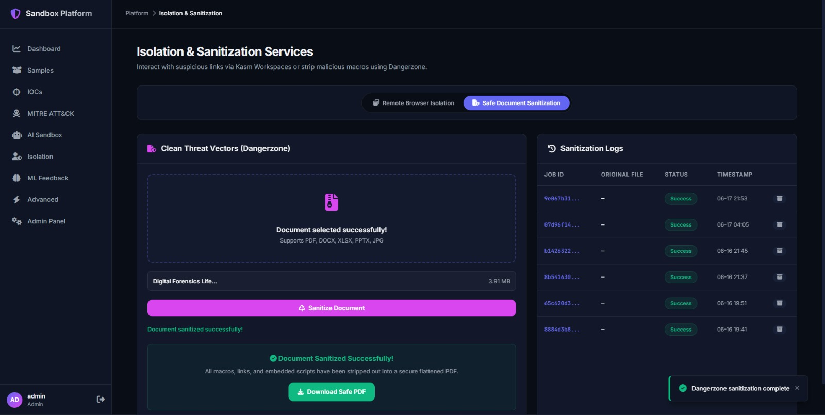
INTRODUCTION
ARCHITECTURE
ANALYSIS
ML & INTEL
ISOLATION
ADVANCED
Document Sanitization
Dangerzone Engine
Eliminates weaponized documents by converting them to safe, flattened PDFs.
Sanitization Process
1. Upload suspicious PDF, DOCX, or XLSX file
2. Spin up isolated Dangerzone container
3. Convert each page to raw pixels
4. Render back to clean, safe PDF
Macros, JS, Links Removed
Clean Threat Vectors (Dangerzone) — Document Upload & Sanitization
Result: The analyst safely downloads a completely sanitized, fully functional copy of the document with all malicious active content stripped out.
28

Slide 4
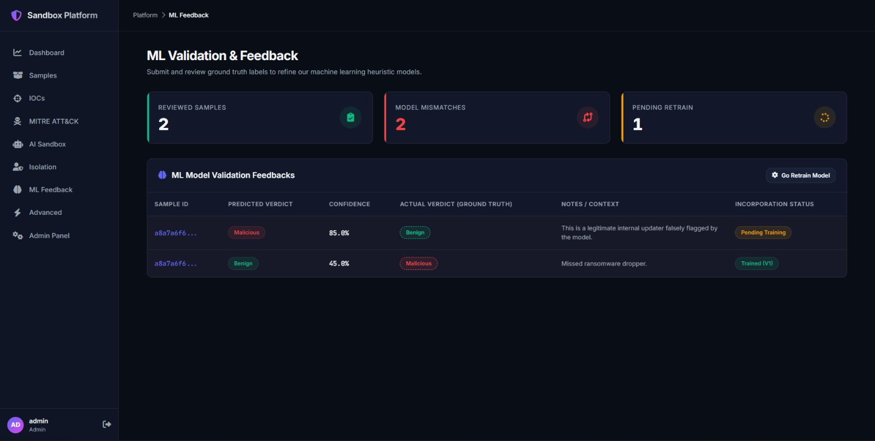
INTRODUCTION
ARCHITECTURE
ANALYSIS
ML & INTEL
ISOLATION
ADVANCED
Advanced Sandbox Instrumentation
DRAKVUF Hypervisor Introspection
Agentless VMI for deep kernel page table modifications and memory dumps via Xen hypervisor
Cowrie Honeypot Ingestion
Real-time simulation of attacks, logins, and downloads captured on public Cowrie honeypots
MITRE Heuristic Engine
Static and behavioral signature mappings matching techniques against execution telemetry
Advanced Features — DRAKVUF VMI, Cowrie Honeypot, MITRE Heuristic Engine
Future Work
macOS/Linux detonation targets · Real-time YARA scanning · Hardware-nested Xen hosts · Enhanced memory forensics
29

