Slide 1

King Fahd University of Petroleum & Minerals
OPERATIONAL TECHNOLOGY FORENSICS
Reconstructing an Unauthorized PLC Parameter Change
SEC 524 · Computer and Network Forensics · Coursework Presentation
[Student 1] · [Student 2] | October 2026
WORKING DRAFT — EXPERIMENT AND FINDINGS PENDING
Notes:
Time allocation: 30 seconds. Introduce the narrow investigation and explain that the practical work and results will be inserted after the team completes the experiment.

Slide 2
1. The forensic problem
A specific OT command needs to be reconstructed — not merely detected.
Suspected event
Investigative question
Unexpected holding-register write via Modbus/TCP, observed outside an authorised maintenance window.
What was transmitted, accepted and changed — and what can the evidence say about responsibility?
MITRE ATT&CK for ICS: T0836 · Modify Parameter
KFUPM · SEC 524 · OT digital forensics
2
Notes:
Approx. 60 seconds. The alert is a suspected out-of-window change to a PLC register using Modbus/TCP. We must establish message transmission, controller acceptance, process state, and attribution using distinct sources. Emphasize all scenario details are hypothetical until the laboratory test is performed.

Slide 3
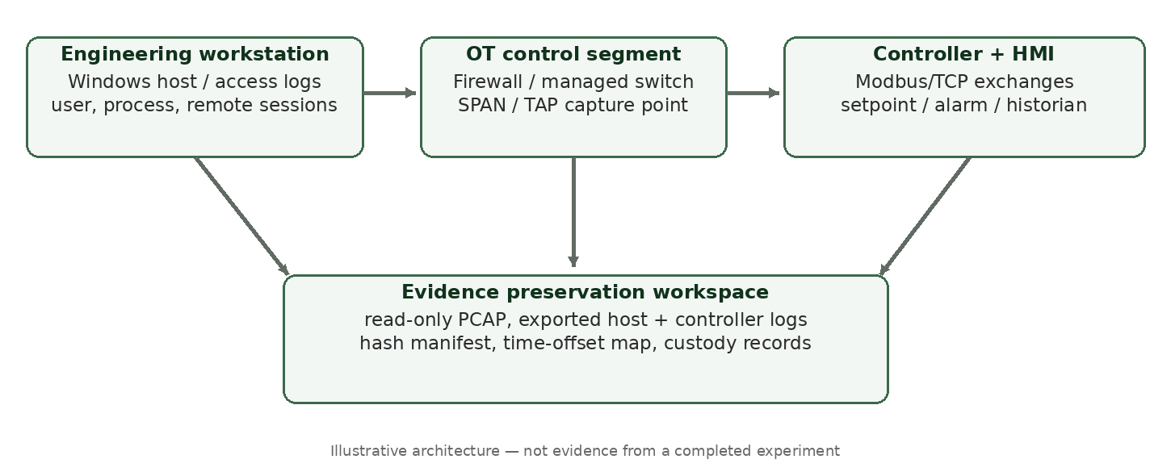
2. OT architecture and evidence paths
Illustrative laboratory topology — not a measured incident.
Never infer a physical process change from packet bytes alone.
KFUPM · SEC 524 · OT digital forensics
3
Notes:
Approx. 60 seconds. Introduce the engineering workstation, switch, PLC, HMI and optional historian. Each produces different records. The passive capture point is chosen to reduce intrusion. Explain why register maps are needed to convert bytes to physical meaning.

Slide 4
3. Evidence sources and evidential meaning
Corroboration across layers is central to the investigation.
Network PCAP
Engineering host
Command, function code, endpoints, transaction time
Session, account, tool and process activity
PLC/controller
HMI / historian
Device audit, write acceptance and configuration
Alarms, trends and possible physical effects
KFUPM · SEC 524 · OT digital forensics
4
Notes:
Approx. 65 seconds. Differentiate observing a request, verifying a response, seeing workstation activity and measuring process effects. Identify data retention constraints and missing logging as sources of uncertainty.

Slide 5
4. OT forensic constraints
Preservation choices are constrained by plant safety and device capabilities.
Safety and availability may prohibit invasive acquisition.
SPAN/TAP visibility is bounded by placement and packet loss.
Controller logs may be proprietary, ephemeral or absent.
Clock offsets, shared accounts and NAT weaken attribution.
Hash integrity is necessary, not proof of truthful source data.
KFUPM · SEC 524 · OT digital forensics
5
Notes:
Approx. 55 seconds. Operational technology differs from IT because shutdown, scanning, live collection or installing agents can affect physical processes. Digital evidence may be volatile, clocks can drift, captures incomplete, and device logs proprietary. Explain impact on confidence and admissibility.

Slide 6
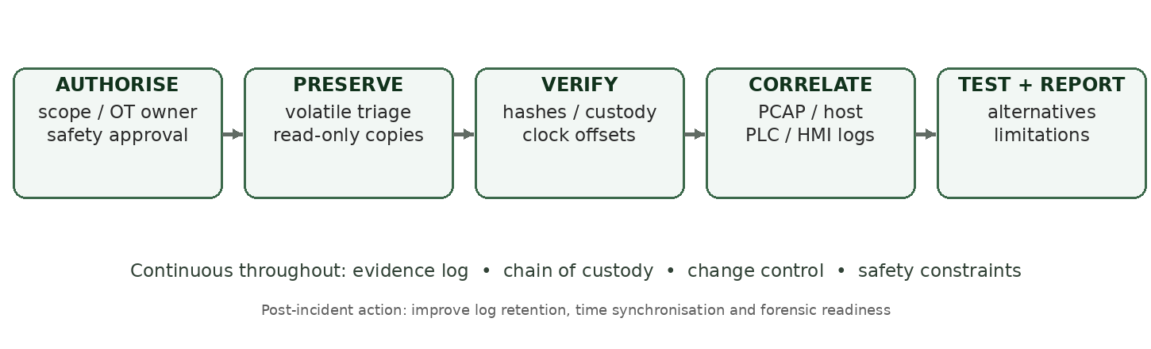
5. Proposed OT-adapted forensic framework
NIST forensic stages + SEC 524 OSCAR + OT-specific controls.
New OT-specific gates: safety approval · passive first · controller semantics · clock uncertainty
KFUPM · SEC 524 · OT digital forensics
6
Notes:
Approx. 80 seconds. Describe the authorisation/safety gate, prioritised evidence, integrity verification, timeline and competing hypotheses. Explicitly state added features relative to conventional process models: vendor-safe exports, physical-state interpretation, clock uncertainty and OT-owner sign-off.

Slide 7
6. Planned experiment — student execution pending
Controlled virtual OT lab; no production control equipment.
Document isolated simulator, workstation, network and tools.
Capture baseline reads and a controlled FC06 register write.
Export controller and host logs; hash every original file.
Reconstruct a cross-source timeline, with clock offsets.
Run benign control; independently validate material findings.
Actual commands, timestamps, digests and file names must be inserted after testing.
KFUPM · SEC 524 · OT digital forensics
7
Notes:
Approx. 65 seconds. Do not present any of these as performed yet. Describe the proposed test: baseline read-only Modbus traffic, one approved FC06 write, export logs, preserve and hash artefacts, compare a negative control and clock-offset variant. Replace with actual environment details after execution.

Slide 8
7. Findings — reserved for verified evidence
Replace each placeholder with exhibit IDs and actual results.
H1 | Command observation
H2 | State confirmation
[PCAP frame, timestamp, FC06, register/value]
[PLC or historian corroboration / missing data]
H3 | Attribution
H4 | Alternative causes
[user sessions, host and maintenance records]
[benign baseline, automation, clock uncertainty]
KFUPM · SEC 524 · OT digital forensics
8
Notes:
Approx. 65 seconds after completion. This entire slide is pending evidence. Explain which trace and exact frame prove the command, which logs confirm process state, and whether source host activity can be connected to a named operator. Identify contradictory evidence and ambiguity.

Slide 9
8. Legal and ethical boundaries
Saudi legal obligations and safety governance shape collection.
Lawful scope and explicit authorisation before collection.
PDPL controls where personal or employee logs are involved.
NCA OTCC applicability depends on organisational scope.
Complete custody records, hashes and restricted evidence access.
OT owner approves any potentially disruptive live interaction.
KFUPM · SEC 524 · OT digital forensics
9
Notes:
Approx. 60 seconds. Summarise the Anti-Cyber Crime Law, PDPL where personal data is processed, and applicable NCA OTCC requirements. Scope and applicability depend on the environment. Document chain of custody and access controls. No unauthorised active scans or production writes.

Slide 10
9. Conclusions and next steps
Claim only what the collected artefacts can independently support.
Network, device and process artefacts answer different questions.
Source IP ≠ authenticated operator ≠ physical causation.
Proposed framework: conservative collection and explicit uncertainty.
Final report needs real exhibits, validated findings and review.
Key references: NIST SP 800-82r3; SP 800-86; ISO/IEC 27037; MITRE ATT&CK for ICS; NCA OTCC.
KFUPM · SEC 524 · OT digital forensics
10
Notes:
Approx. 45 seconds. Explain that correlation across protocol, host and process data is required. The framework is proposed; it has not yet been empirically evaluated. The final presentation must include real dataset provenance, hashes, reproducible steps, verified findings and uncertainty before submission.

