Slide 1

COVID19
Big Data Technologies Course Project
Supervised By: Professor Mrudula Mukadam
Team Member:
Ahmed Nour
Saher Nassereddine
Jialei Zhang

Slide 2

contents
Project idea
Architecture & Technologies
Data Visualization
Project Demo

Slide 3
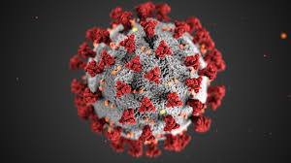
Project idea
As the corona virus influence the life of everyone in the world, we want to know more about the virus by data.

Slide 4








Architecture
Data Source → Produce → kafka → Spark → Hive → Jupyter

Slide 5

Architecture under testing
Data Source → Produce → kafka → Spark → HBase → Hive → Jupyter

Slide 6
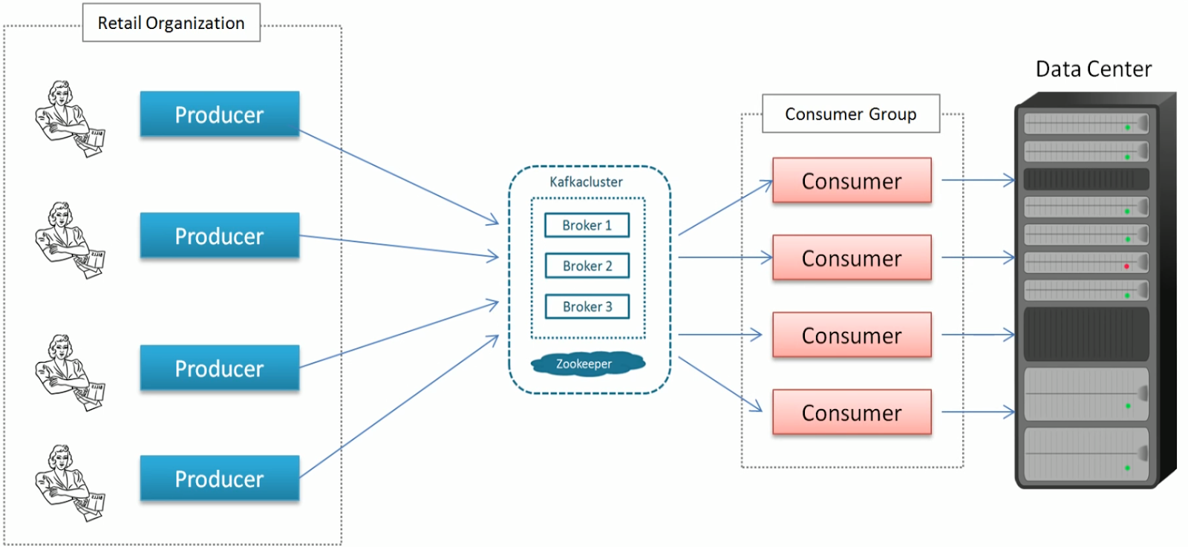
Kafka Cluster

Slide 7
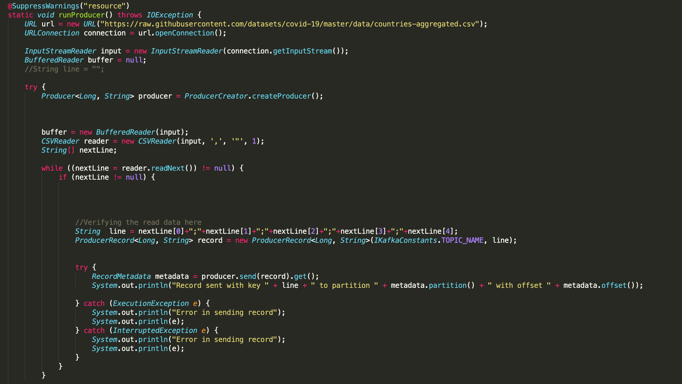
Kafka-producer

Slide 8
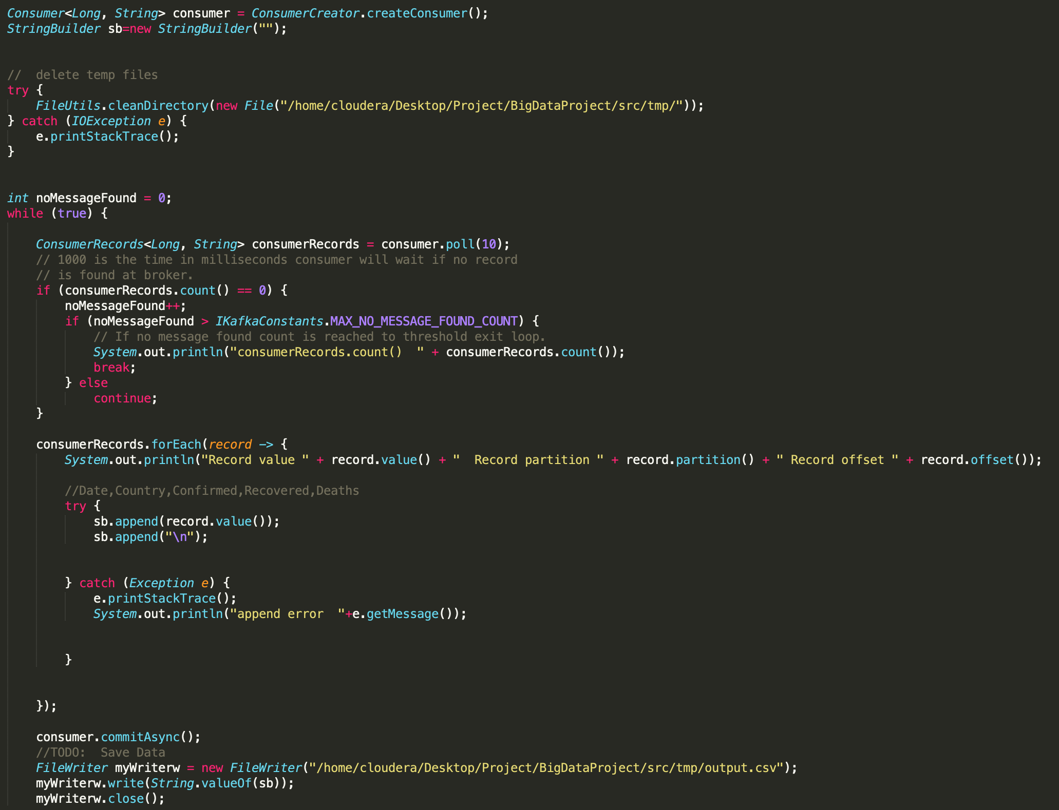
Kafka-consumer

Slide 9
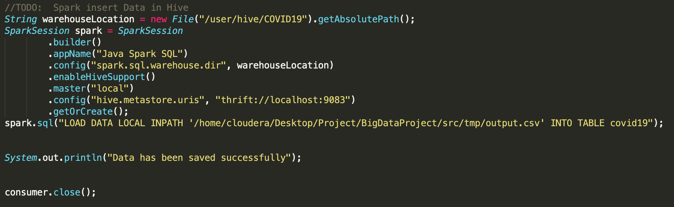
Kafka-consumer

Slide 10
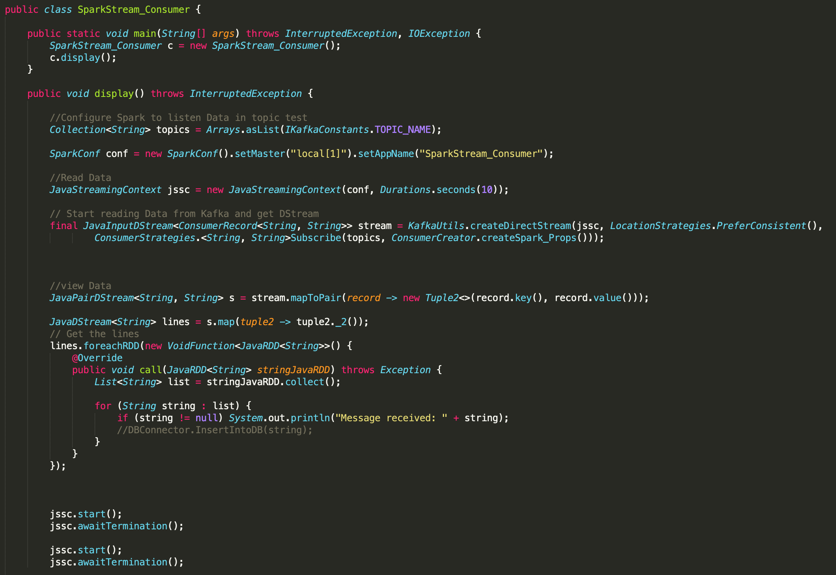
Sparkstream-consumer

Slide 11
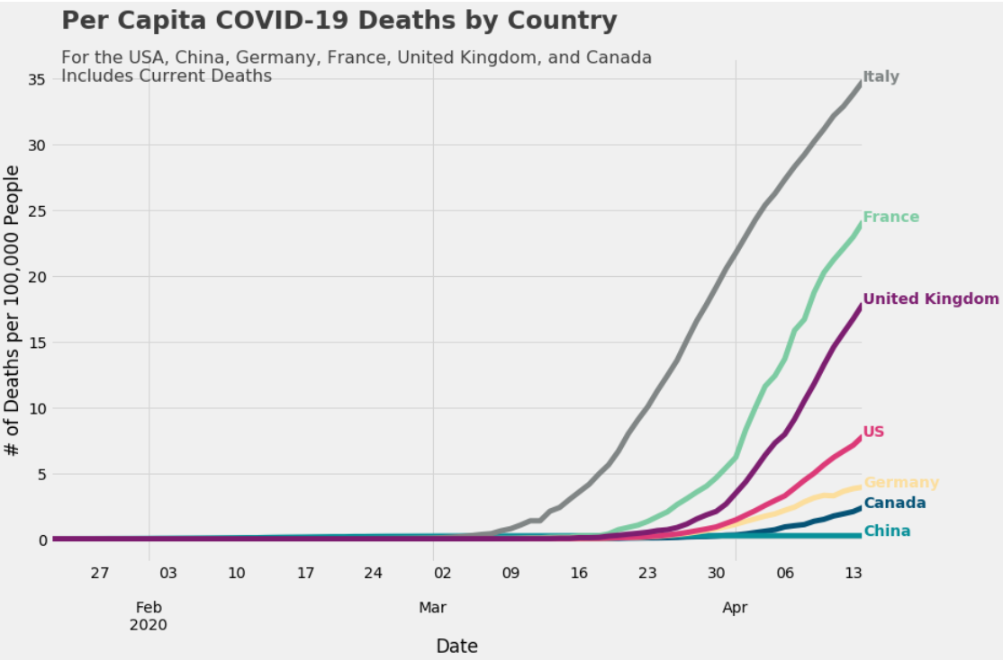
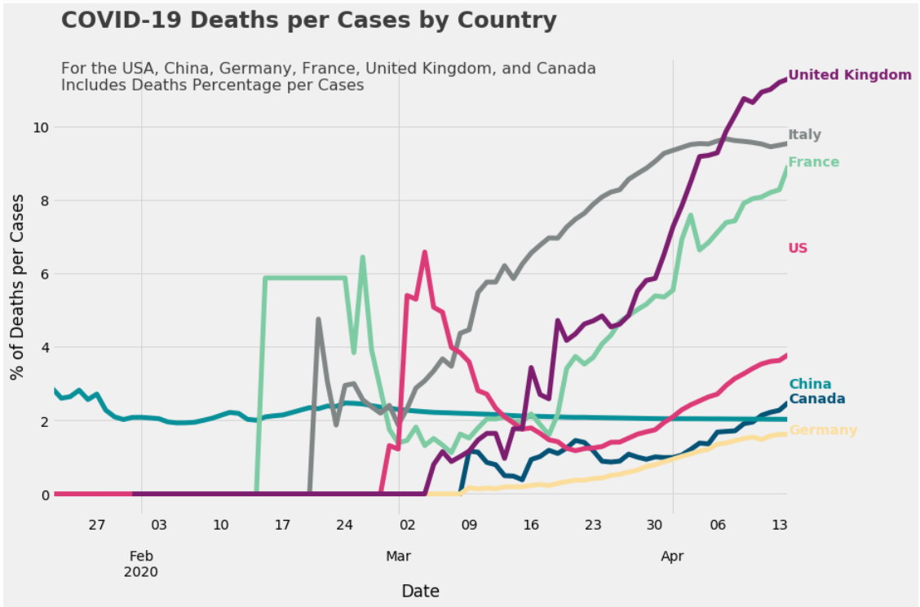
Data Visualization using python

Slide 12
Demo

Slide 13
Future work
Complete Hbase
Add Thread (Load Data & Save Data)
Apply Machine Learning
Add more Sources

Slide 14
Thank you ☺

