Slide 1
project: books recommender system
Wendy Navarrete November 2019

Slide 2
CONTENT
Introduction
Information of Data
Business Question
The Process
Recommender Systems
Models & Results
Practical Uses
Opportunities to improve
Q&A

Slide 3

Introduction
This document contains the development and findings of a Data Science Project, which objective is to recommend books.

Slide 4
Information of data
Dataset is composed by three csv files: books.csv, ratings.csv and to_red.csv
It came from github repository
It was obtained by downloading .csv files from website mentioned above

Slide 5
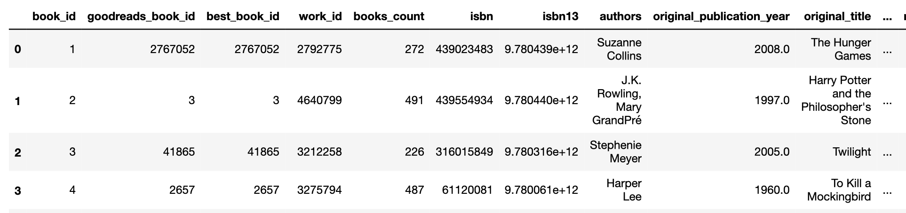
Attributes
Books.csv with metadata for each book. It includes book id, title, author, number of editions, publication year, language, average rating and others

Slide 6
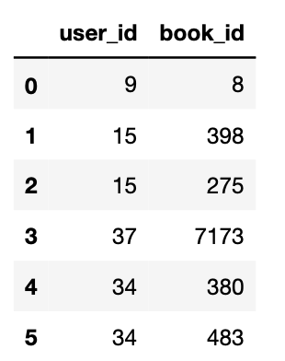
Attributes
To_read.csv, is the file that provides user IDs and the book IDs that the user has already read.

Slide 7
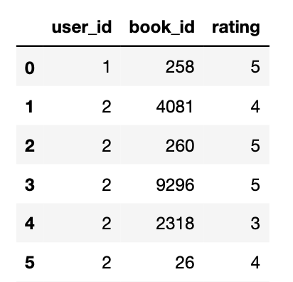
Attributes
Ratings.csv contains the most important variables for this project, user id, book id and rating for books. All these variables are integers, specifically the given rating is into a range from 1 to 5, being 1 for the lowest rates and 5 for the highest rates for a book.

Slide 8

what book to read?
Nowadays, in this global world there is a vast number of things to select, where people might be lost. That is the case at the moment of choosing the next book to read.

Slide 9
The Process
Data Loading
Data Exploration
Modeling
Model Selection
Evaluation
Cost Function
Definition
MSE
Dataset Reducing

Slide 10
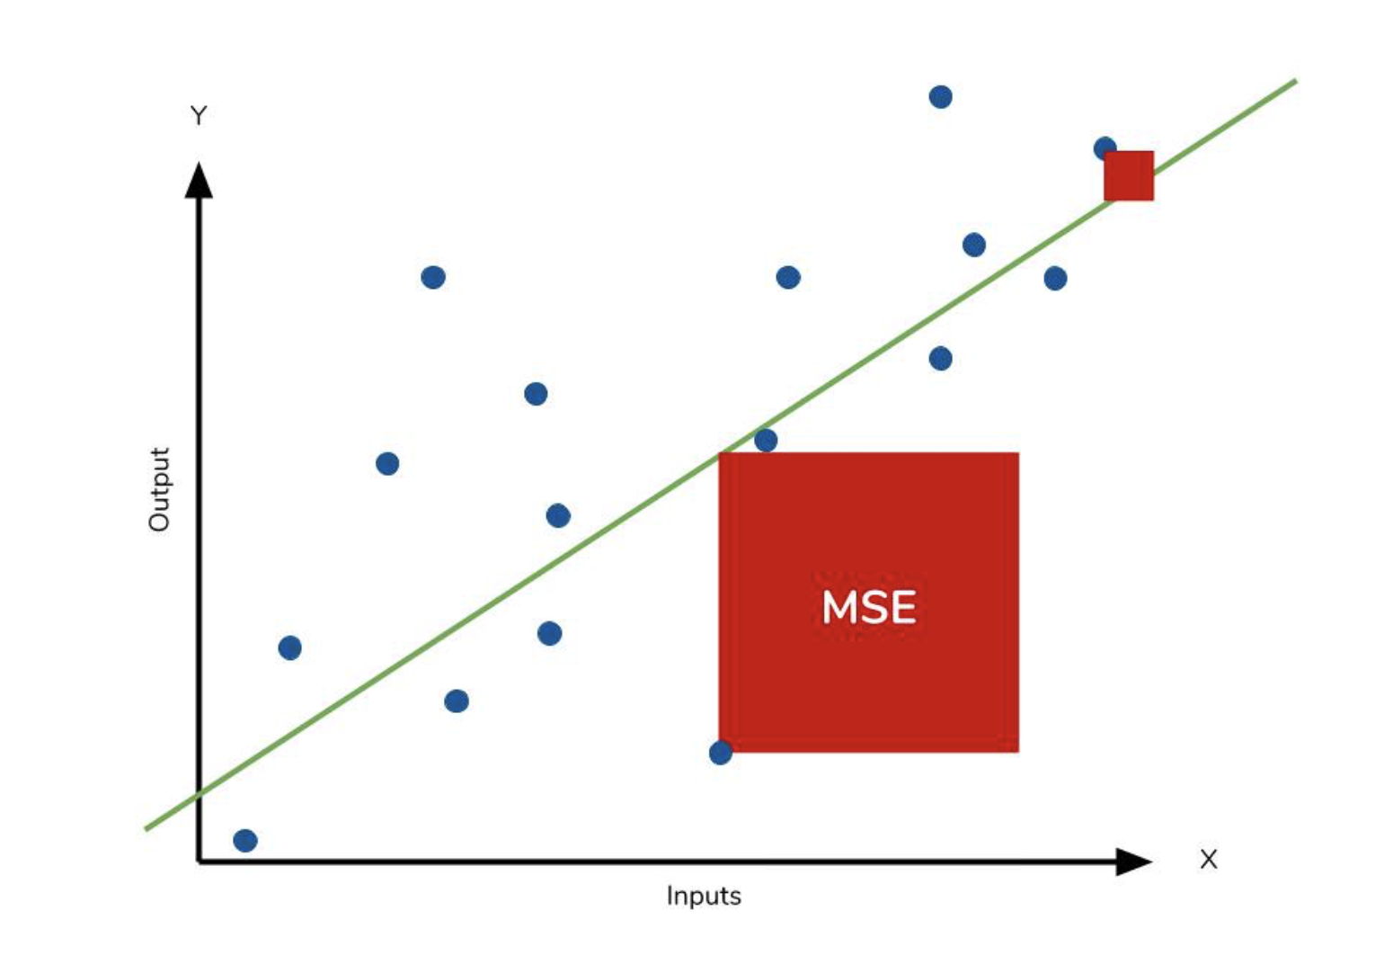
cost function definition
Mean Squared Error
One of the simple cost function.
Measures the averaged square error between the predicted and actual values

Slide 11
Recommender Systems
Two major categories:
Collaborative Filtering: Based on user’s past behavior and those of other users to which the user is similar to.
Content-Based Filtering: Based on learning the distinct properties of an item to recommend additional items with similar properties

Slide 12
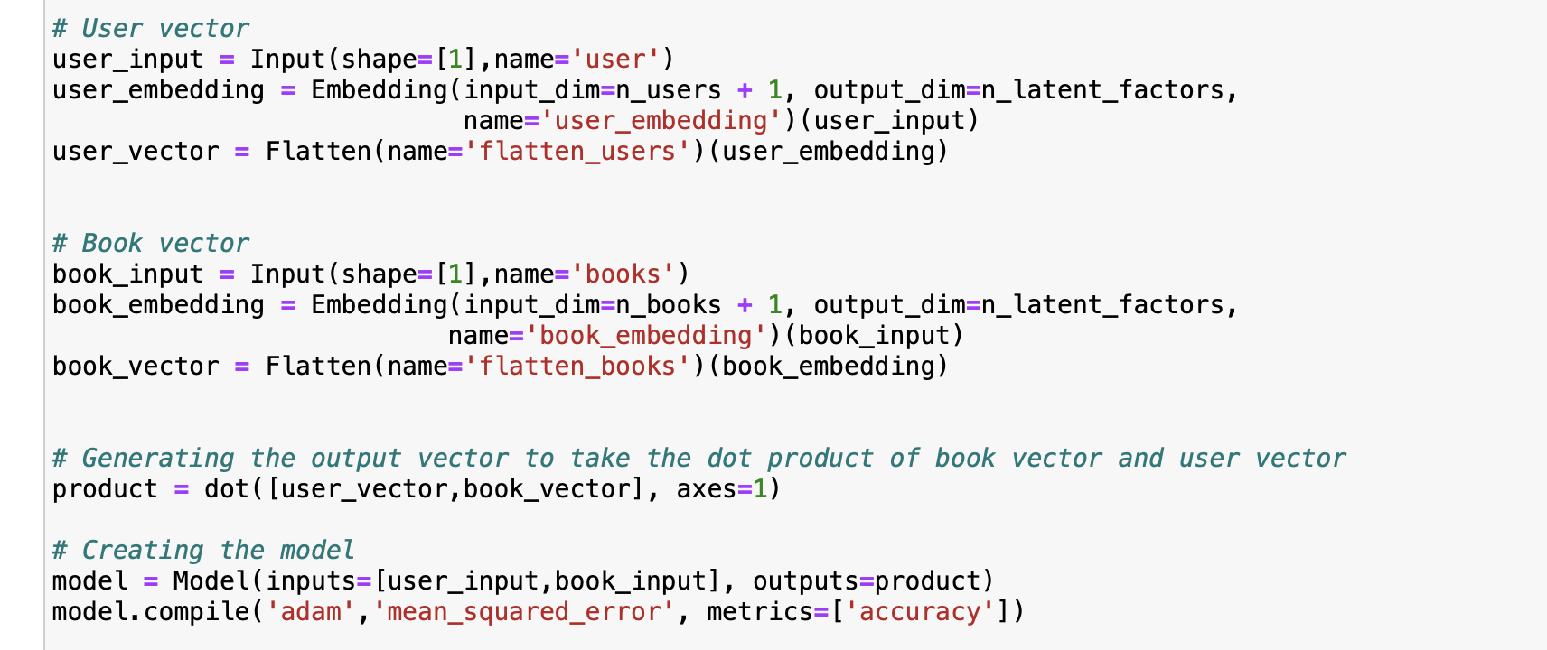
models
Latent Factor Based or Matrix Factorization (Embedding Model) has the following structure
Input for both books and users
Embeddings for books and users
Combines embeddings using a dot product

Slide 13
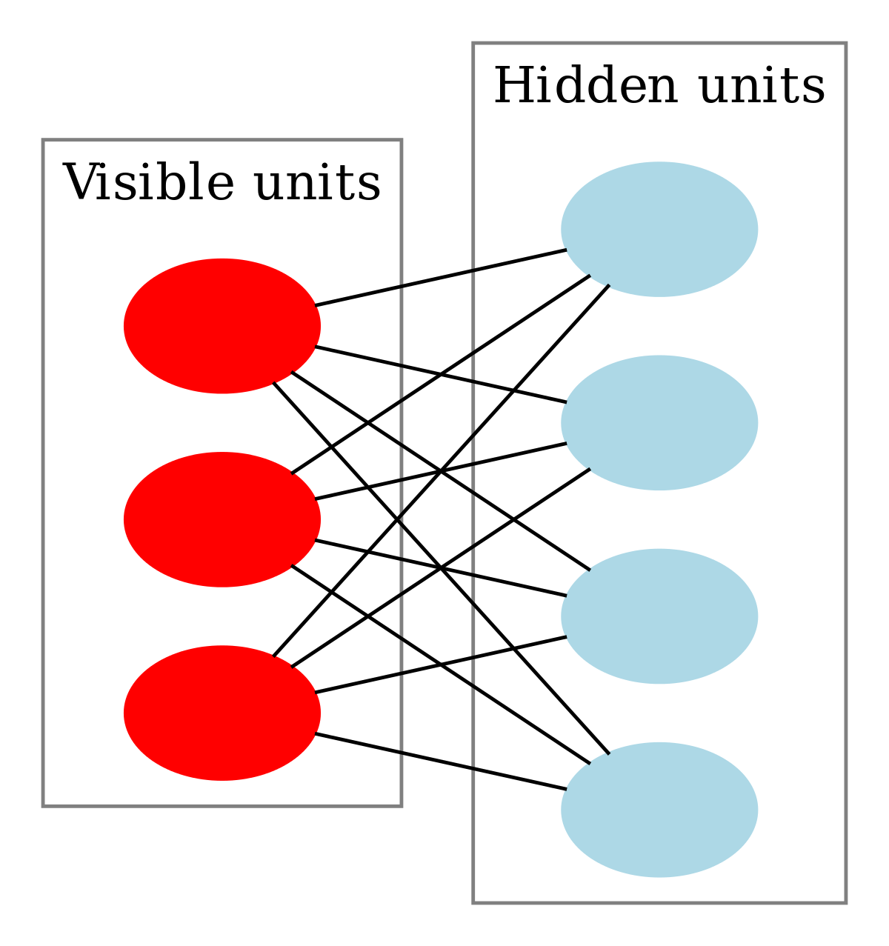
models
Restricted Boltzmann Machines
Using two layers
Communication in both directions, not between neurons in the same layer
Learned of the probability of distribution of book ratings

Slide 14
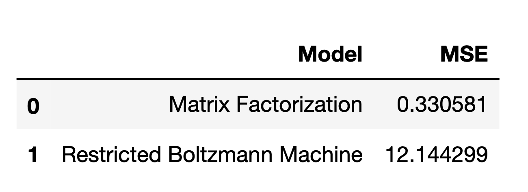
Results

Slide 15
practical uses
Because this model objective is to provide recommendations, this model can be used for multiple purposes in the sense of recommending various things to users. For example, some of them might fall in the categories below:
Some retail products
Movies, music, videos, articles
Jobs
Connections / friends

Slide 16

Opportunities to improve
This model was compared with just two other models
Consider books already read by user in all models
Dataset size
Provide an user interface

Slide 17
Q & A

Slide 18
THANKS
Wendy Navarrete
navarrete.wen@gmail.com

