Slide 1
Stack
Data Structure

Slide 2

What is Data Structure?
Notes:
Download more minimal templates here: https://crmrkt.com/GK9Dwa

Slide 3
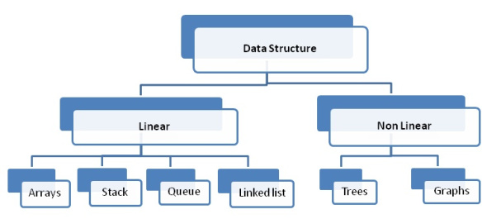
Notes:
Download more minimal templates here: https://crmrkt.com/GK9Dwa

Slide 4
Stack
Data Structure

Slide 5
What is a Stack?
Last In First Out ( LIFO).
A special area of computer's memory.
Variables are declared, stored and initialized during runtime (temporary storage memory).
Linear data structure.
Notes:
Download more minimal templates here: https://crmrkt.com/GK9Dwa

Slide 6

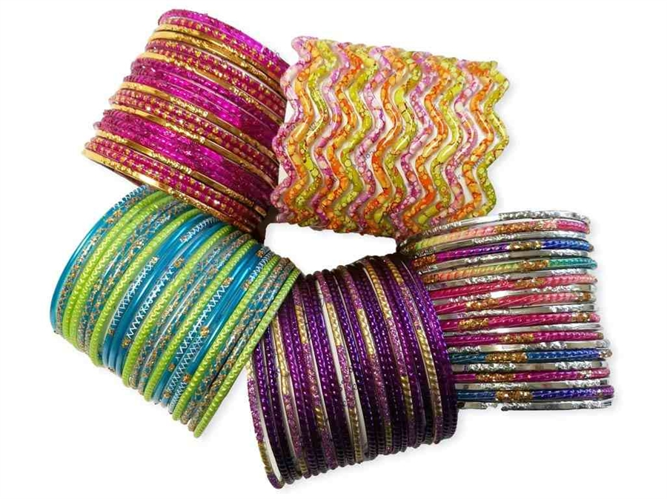
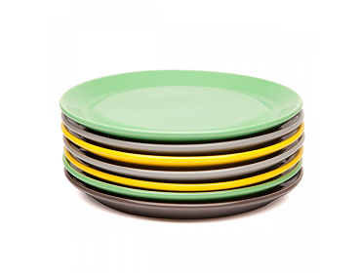
Real Life Applications of Stack
Books piled on top of each other
stack of plates
Wearing/Removing Bangles
Notes:
Download more minimal templates here: https://crmrkt.com/GK9Dwa

Slide 7
Stack Operations
Push
PoP
Peek
isEmpty
Notes:
Download more minimal templates here: https://crmrkt.com/GK9Dwa

Slide 8
Stack Operations
PUSH: Inserting an element in the stack, the new element is inserted at the top of the stack.
POP: Remove an element. Again, since we only have access to the element at the top of the stack, We just remove the top of the stack. Note: We can also choose to return the value of the popped element back, its completely at the choice of the programmer to implement this.
PEEK: Allows the user to see the element on the top of the stack. The stack is not modified in any manner in this operation.
isEmpty: Check if stack is empty or not.
Notes:
Download more minimal templates here: https://crmrkt.com/GK9Dwa

Slide 9
Notes:
Download more minimal templates here: https://crmrkt.com/GK9Dwa

Slide 10
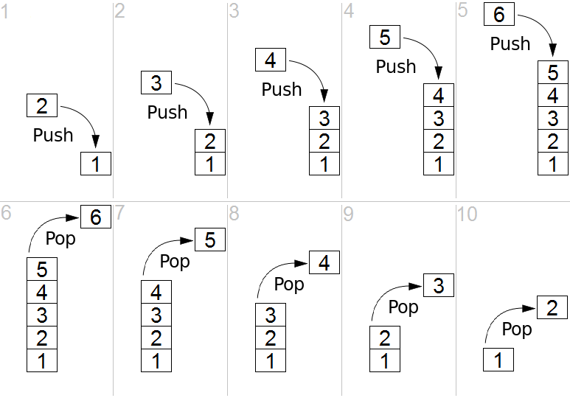
Notes:
Download more minimal templates here: https://crmrkt.com/GK9Dwa

Slide 11
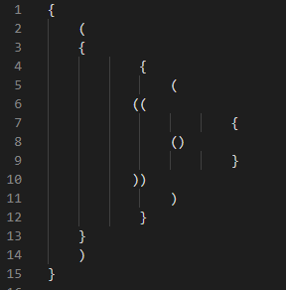
Applications
Parenthesis Checking
Stack is used to check the proper opening and closing of parenthesis.
Notes:
Download more minimal templates here: https://crmrkt.com/GK9Dwa

Slide 12
So What!
When a function is called the local variables are stored in a stack, and it is automatically destroyed once returned
Stack automatically cleans up the object.
A stack is used when a variable is not used outside that function.
High-speed access.
Not easily corrupted
Notes:
Download more minimal templates here: https://crmrkt.com/GK9Dwa

