Slide 1
DastiCrafts
Art, Design and Culture

Slide 2
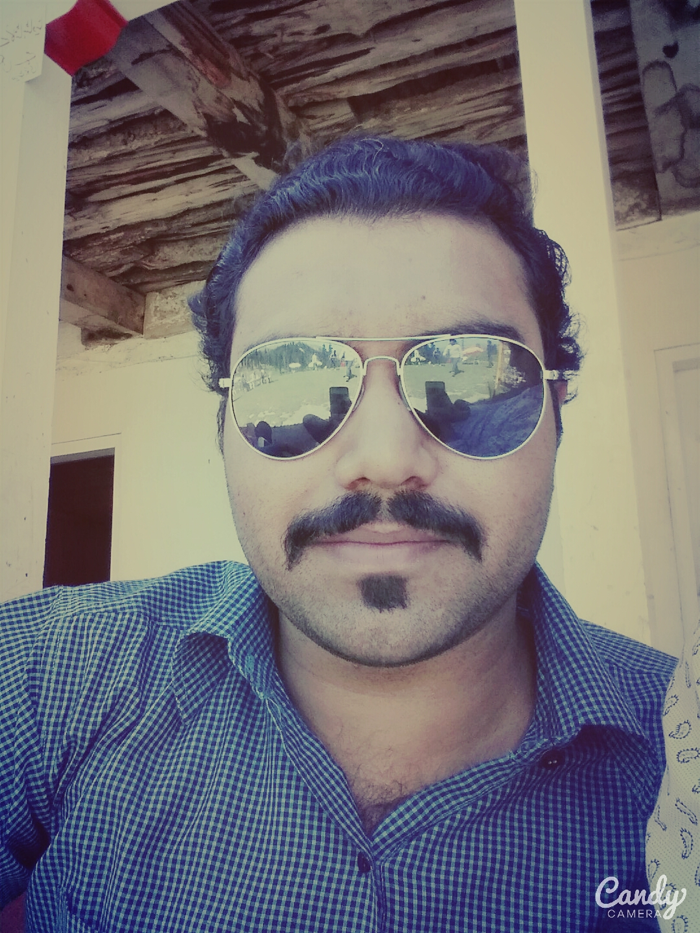
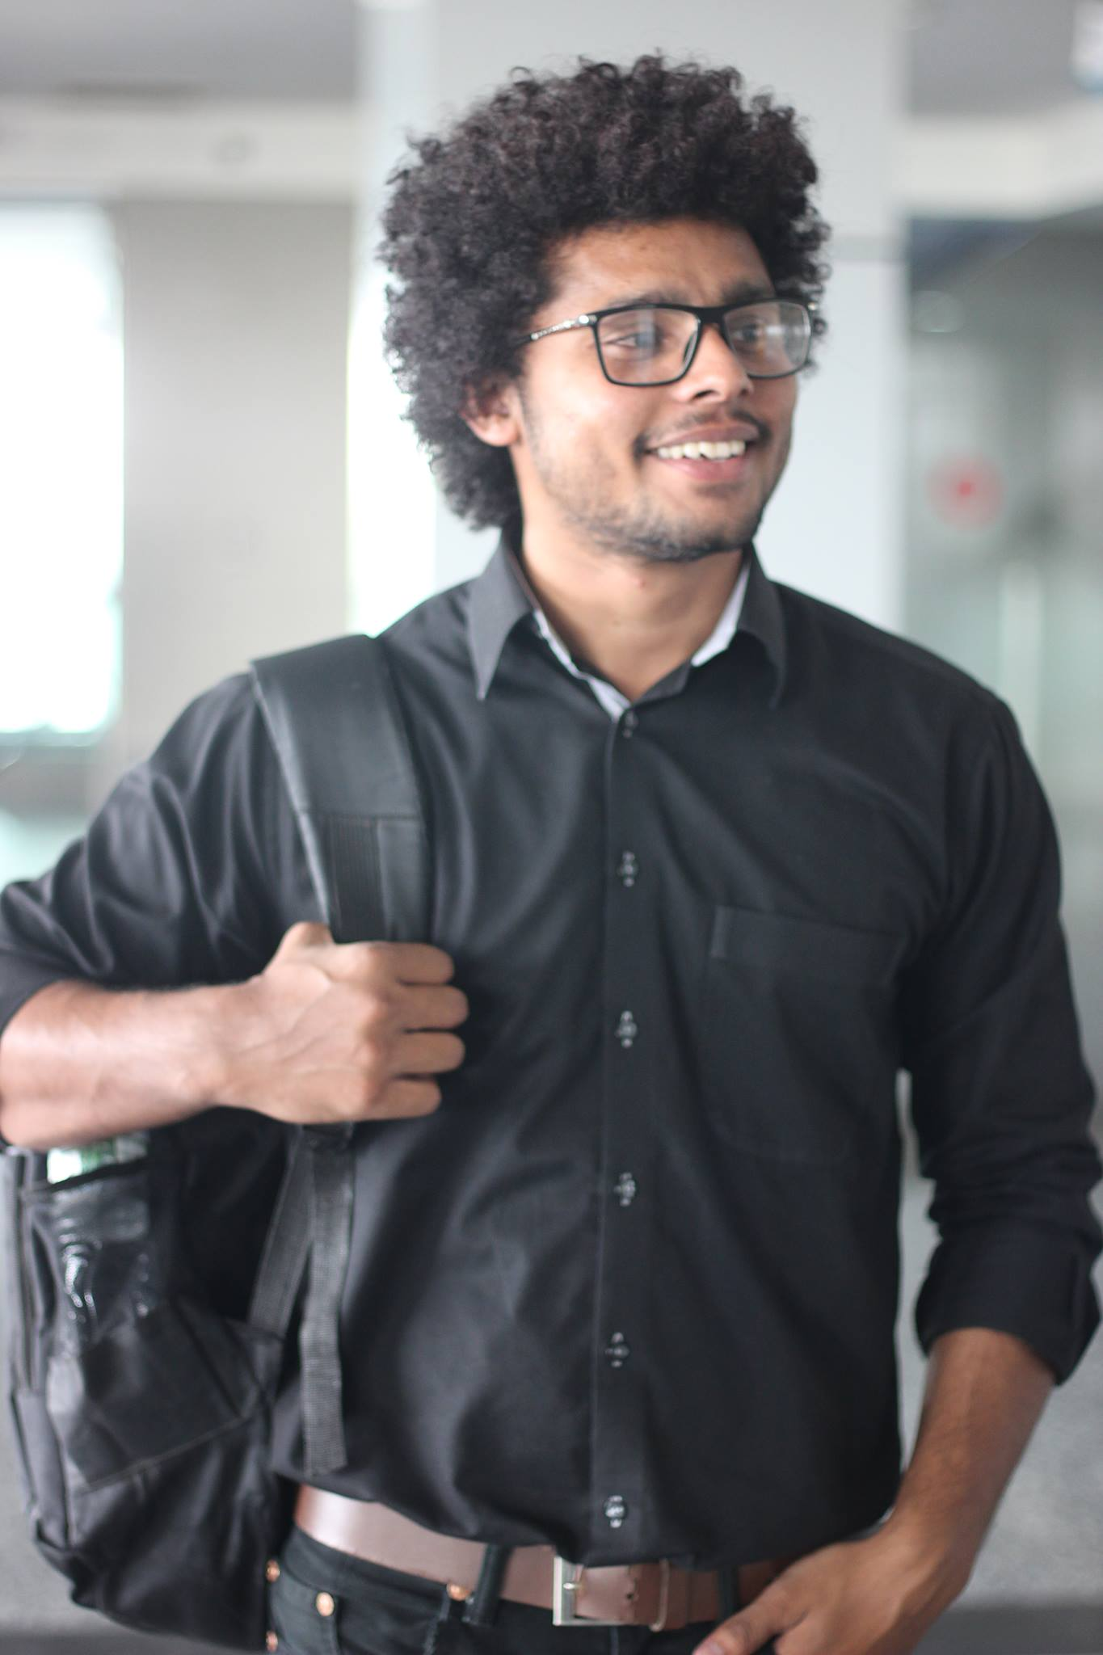
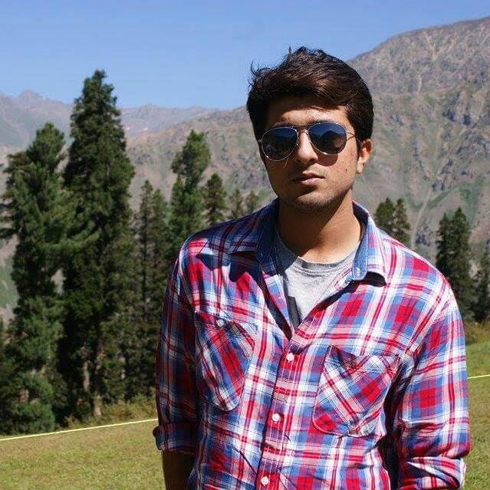
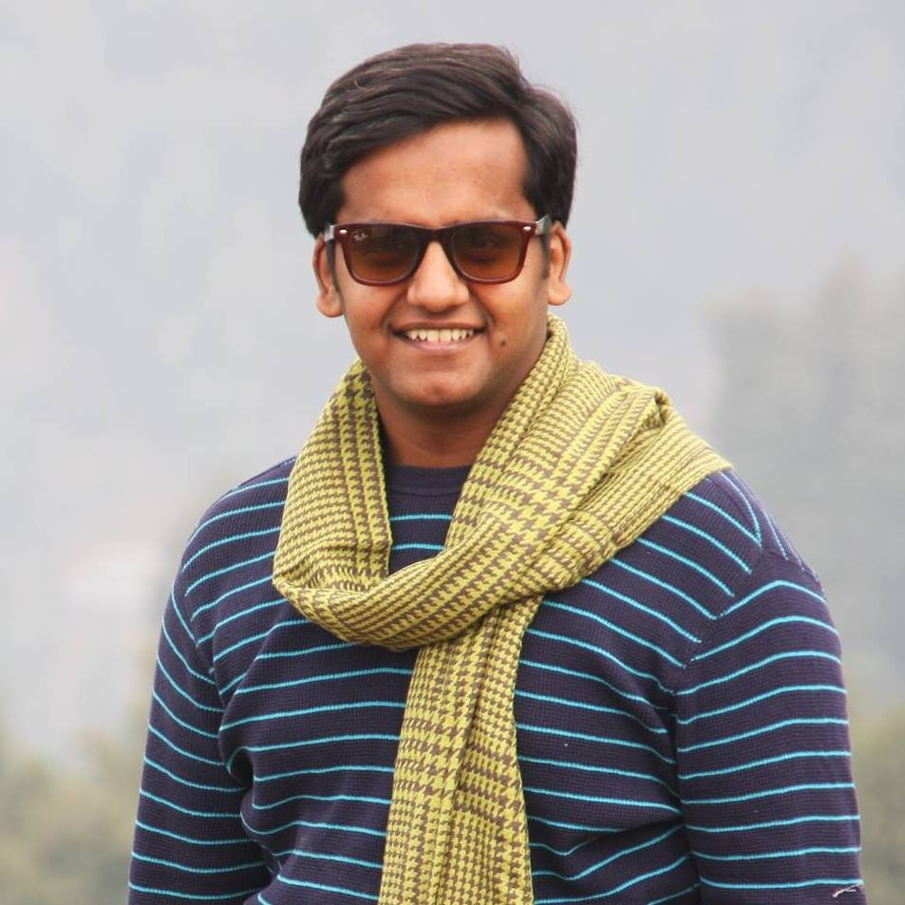
Group Members
Ahmad Yousaf Faisal Noor Saqib Javaid Umer Ahmed

Slide 3
POV-1
We met Ms. Ayesha and we were amazed to realize that there is no proper platform where people can buy variety of handicrafts.
It would be the game changing to provide such a platform where people can easily find and get handmade products.

Slide 4
POV-2
We met Mr. Riaz and we were amazed to realize that the income of artisan is too low when we compared their work with income.
It would be game changing to provide such a platform in which they can generate more income from their products.

Slide 5
POV-3
We met Hamza we were amazed to realize that It is difficult to find a desired design of different handicrafts.
It would be game changing if we provide them with the desired design of different handicrafts.

Slide 6
Three best HMW's
1.How might we take orders and deliver it to the customers?
2.How might we help increase the profit of artisans?
3.How might we make a better user interface for getting orders for customized products?

Slide 7
Three Best Solutions
1. We can make a web application where customers can contact and place their orders.
2. Increasing profit by giving them more orders.
3. Customer will provide us with the desired design of product he/she wants to have by sending us an image of the product or will give us details about the desired product .

Slide 8
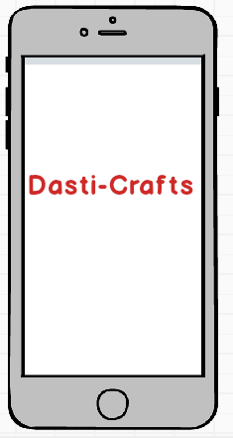
Prototype

Slide 9
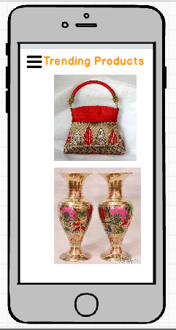

Slide 10
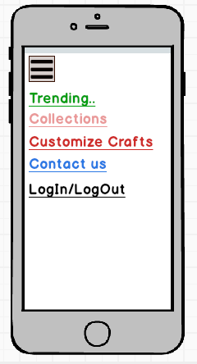

Slide 11
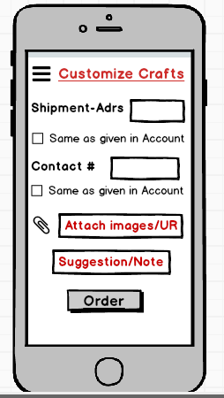

Slide 12
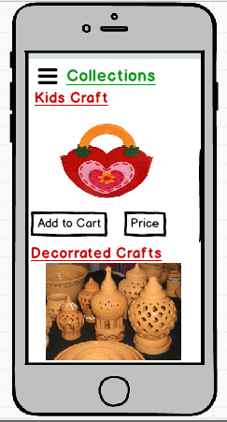

Slide 13
Thank You

