Slide 1

Design Experiments for the FPGA Vision Remote Lab
Prof. Dr. Marco Winzker, Bonn-Rhein-Sieg University, 2018
Competencies and Learning Objectives
With the lecture you can experience product development from algorithm to circuit implementation. Investigate different tasks in this process with design experiments.
Information about the experiments is also available as a video lecture: https://youtu.be/KMoczJ_p7Gc
Content of these Slides
Overview
Access to the lecture
Ideas for experiments
Feel free to use this material for your needs
Version: 23. August 2018
This work by Marco Winzker, Hochschule Bonn-Rhein-Sieg is licensed under a Creative Commons Attribution 4.0 International License.

Slide 2
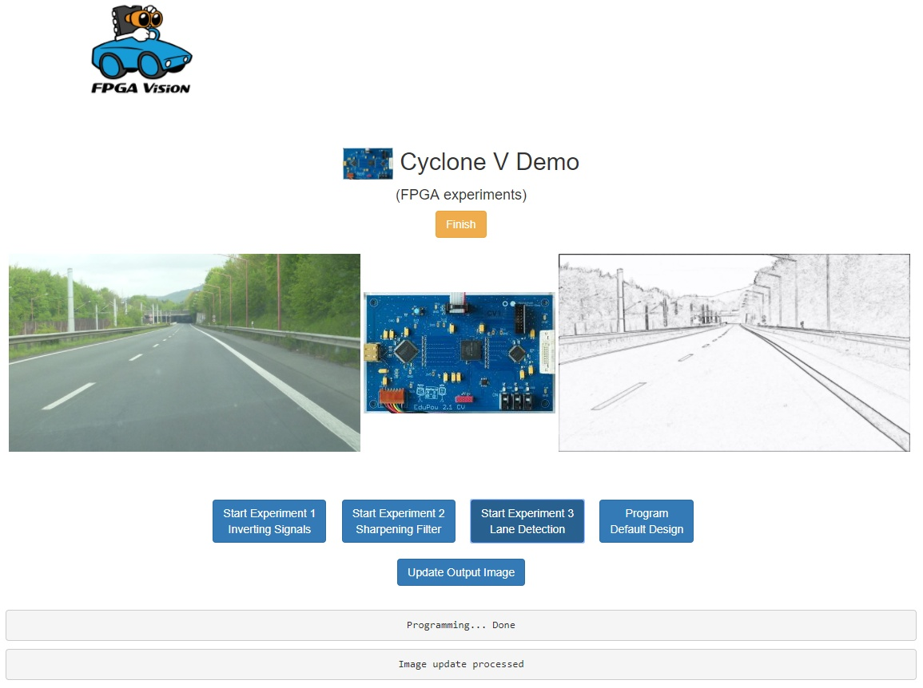
Overview
The lecture covers the design of a lane detection algorithm for cars and its implementation on an FPGA.
Choose your learning goals
Signal processing: Understand and optimize the image processing algorithm
Digital design: Modify the FPGA design and reduce FPGA resources and power consumption
Microelectronics: Compare power consumption for different CMOS technologies
input image
FPGA board
output image

Slide 3
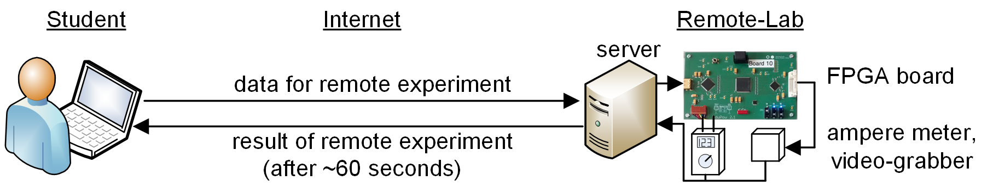
Access to the Lecture
All material can be accessed from the project page http://www.h-brs.de/fpga-vision-lab
The lecture provides:
Seven lecture videos
Access to remote-lab with FPGA
Altera/Intel Cyclone V
Altera/Intel Cyclone IV for comparison of CMOS technologies
Source code: C and VHDL

Slide 4
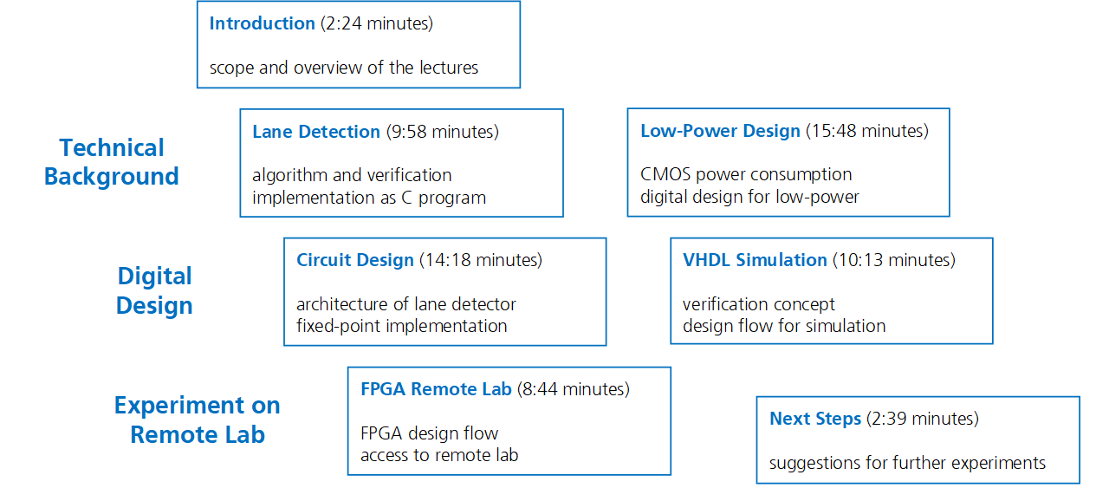
Lecture Videos
Subtitles in English, Arabic, Spanish
Select which videos are of interest for you

Slide 5
Set-Up of Design-Flow
Learning goal:
Understand the design-flow of FPGA design and remote-lab usage
This experiment should be done as a preparation for all other experiments
Level of difficulty: Easy
Experiment:
Install the Intel/Altera Quartus design software and device files for Cyclone V on your computer
Download the source files for FPGA design and perform FPGA synthesis
Upload the bitfile (filetype: sof) to the remote-lab and perform the experiment
The remote-lab should detect the edges of the input image as shown in the video lectures.

Slide 6
Optimize Position of RGB-to-Y Conversion (1/2)
Learning goal:
Working with the VHDL files
Understanding the structure of the circuit design
Level of difficulty: Moderate
Experiment:
The RGB (red, green, blue) input pixel need 24 bit and are stored in two line memories for vertical edge detection. For processing they are converted to luminance (Y) with 12 bit resolution.
It is better to first convert RGB to Y and only store 12 bit to save memory. Also this reduces resources for processing, as only one conversion is required and not several instances.

Slide 7
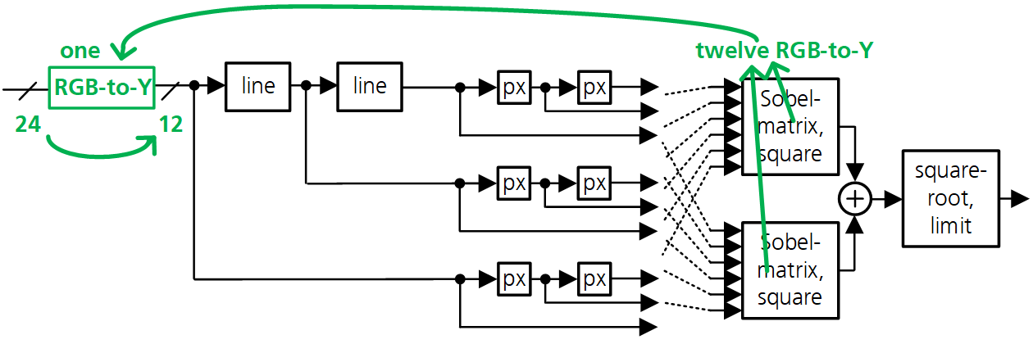
Optimize Position of RGB-to-Y Conversion (2/2)
Change the VHDL code to perform RGB-to-Y before the line memories
Simulate the new VHDL code to verify the changes
The output of the modified code should be identical to the original design
Perform FPGA synthesis and compare resource usage with original design
Upload the bitfile to the remote-lab, check the functionality and compare power dissipation with original design

Slide 8
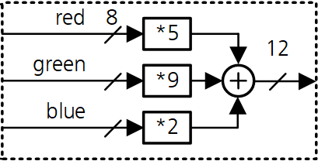
Reduce Word Width of Luminance Values (1/3)
Learning goal:
Optimization of the signal processing algorithm
Design verification with C-program and simulation
Level of difficulty: Advanced
Experiment:
An input pixel has three components (red, green, blue), each with 8 bit. They are converted to 12 bit luminance values. Reduce the word width of luminance values to save resources.
Reducing word width can be done by discarding the lower bits of the 12 bit luminance value after adding red, green and blues components

Slide 9
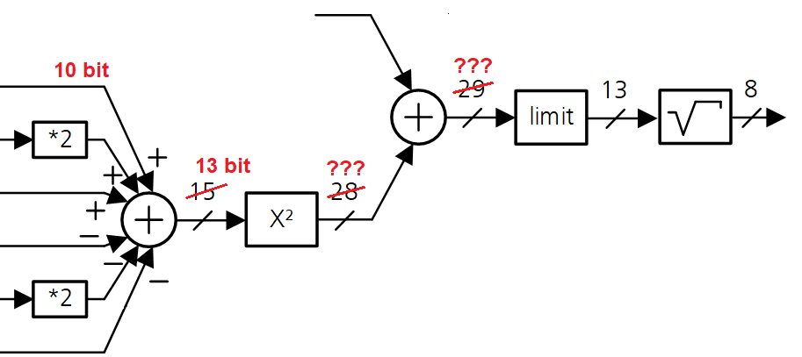
Reduce Word Width of Luminance Values (2/3)
Please note that reducing the word width of luminance values also reduces the word width of the consecutive processing steps (see diagram for an example).
Reduce the word width of luminance in the C code to 10 bit, 8 bit or other word width and check if the output image still has acceptable quality
Change the VHDL code accordingly and verify the changes by simulation
NOTE: The output of the design is not identical to the original design. Use the modified C code to generate new expected values for the testbench.
Perform FPGA synthesis and compare resource usage to original design
Use the remote-lab to check functionality and compare power dissipation

Slide 10
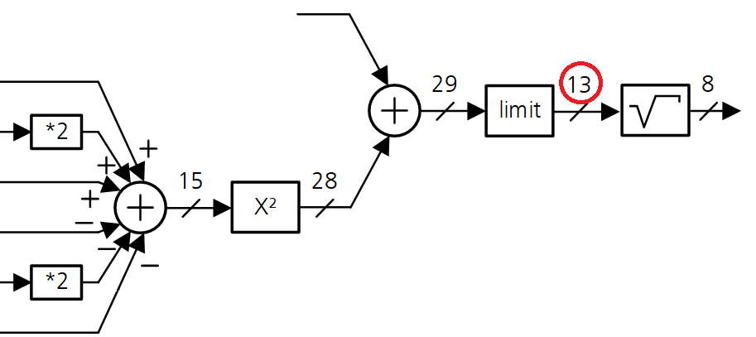
Reduce Word Width of Luminance Values (3/3)
Also the input of the square-root function can be changed from 13 to 10 bit or 8 bit.
Change C code and VHDL code
Verify the design and compare it with other versions of the design
These optimization steps can be done on their own or combined with each other.
They can also be combined with the experiment “interchanging the order of RGB-to-Y conversion and line memories”.

Slide 11
Power Consumption of different FPGAs
Learning goal:
Understand the influence of CMOS technology for power consumption
Level of difficulty: Moderate
Experiment:
Implement a design on two different FPGAs and compare resource usage and power consumption.
Check the data sheet of Altera/Intel Cyclone IV and Cyclone V FPGAs. Which CMOS technology do they use?
Implement a design for both FPGAs. Different constraints files for pin locations are provided.
Check resource usage and compare the power consumption
Compare other circuit designs, e.g. a filter or shift register (see next section)
See video lecture “Comparing CMOS Technologies with FPGA Experiments”
https://youtu.be/7hSjqMc742A

Slide 12
Reduce Power Consumption by “Sleep Mode” (1/2)
Learning goal:
Optimization of power consumption
Understand sleep modes which disabling a circuit for certain times
Level of difficulty: Advanced
Experiment:
Lane detection is active for the complete image. However, lanes are not present in the top region of the image (see diagram).
Therefore processing can be switched off for the top of the image. Consequently, there is no valid output for this region.
invalid

Slide 13
Reduce Power Consumption by “Sleep Mode” (2/2)
Look at test images to determine, how many lines of the image you want to skip. The image has 720 lines and, as an example, processing can be disabled for one third of the image, which is 240 lines.
Different techniques for such a “sleep mode” are possible:
Set input pixel to a fixed value. This will reduce switching activity.
Disable all flip-flops in the signal processing by a “sleep-signal”.
Switch of the clock for the signal processing circuit. Please note:
You need two clock signals: One for generating the sync signals and counting lines. The other is for signal processing and can be disabled.
The FPGA has predefined routing for clock signal, so you will drive two clock networks. Find out if you save power or if the overhead increases power consumption.
Modify the design and simulate it. Modify the testbench to ignore undefined output lines.
Perform FPGA synthesis and compare resource usage to original design
Use the remote-lab to check functionality and compare power dissipation

Slide 14
General Image Processing Experiments
You can also use the remote lab for general experiment about image processing.
The following experiments are not specific for lane detection.

Slide 15
Inverting the Input Image
Learning goal:
Understand input and output signals of the VHDL code
Understand design-flow of FPGA design and remote-lab usage
Level of difficulty: Easy
Experiment:
Invert the color of every pixel.
Check the existing VHDL code to understand the input and output signals
Invert the values of RGB (red, green, blue) for all pixel
Optional:
Use the input switches to select which color component is inverted
The switches connect to the input port enable_in(2 downto 0)
Convert the image to black and white by calculating luminance and output this value on the red, green and blue channel

Slide 16
Image Enhancement with Sharpening Filter
Learning goal:
Signal processing with an FPGA
Level of difficulty: Advanced
Experiment:
Improve the perceived image quality by sharpening the image with an FIR filter. Research literature about sharpening filter.
Develop an algorithm using C code
Implement the algorithm with VHDL, simulate it and check functionality on the remote-lab
To see the output image in full resolution click on the image
Different filter functions are possible. For example you can implement the filter function h = [1;0;-9;48;-9;0;1]∙1/32 in vertical and horizontal direction.
Develop a filter that has good quality with low effort.
Make sure the output values stay in the range of 0 to 255. Don’t forget limiting.

Slide 17
Power Consumption of Shift Register (1/2)
Learning goal:
Understand power consumption in digital circuits
Compare static and dynamic power consumption
Level of difficulty: Moderate
Experiment:
Implement a shift register with different numbers of flip-flops. Delay red, green, blue pixel of the input image but do not delay sync signals.
The image content is shifted by the number of delay stages.
Implement a shift register for the image signal. You need to delay 24 bit for RGB data. Check resource usage.
Compare the power consumption for 100, 200 and 300 clock cycles delay. How much delay can you implement?
To measure static power consumption, disable the clock signal with a switch.
The switches connect to the input port enable_in(2 downto 0)

Slide 18
Power Consumption of Shift Register (2/2)
The FPGA synthesis will try to implement a shift register with block-RAMs. To observe power consumption of flip-flops, specify an array with the code in the box.
This experiment is also explained in the video lecture “Comparing CMOS Technologies with FPGA Experiments”
https://youtu.be/7hSjqMc742A
Further option for this experiment:
Remove the “attribute ramstyle” to implement the circuit with block-RAMs. Compare resource usage and power consumption.
[...]
type delay_array is array (0 to 100) of std_logic_vector(23 downto 0);
signal delay : delay_array;
attribute ramstyle : string;
attribute ramstyle of delay : signal is "logic";
[...]

Slide 19
Brightness Adjustment
Learning goal:
Signal processing with an FPGA
Level of difficulty: Complex
Experiment:
When you have images that are dark or bright, it can be useful to adjust the brightness. Also the contrast can be enhanced. Research literature on this topic.
The FPGA board does not provide a frame memory, so you can analyze one image, for example with a histogram of signal values. The result can then be used to optimize the next image.
Develop an algorithm using C code
Implement the algorithm with VHDL, simulate it and check functionality on the remote-lab

Slide 20
Complex Image Processing Experiment
And you can use the remote lab for a very complex image processing experiment.
This experiment can take several weeks or a complete semester.

Slide 21
Further Steps in Lane Detection (1/2)
Learning goal:
Development of image processing algorithms
Level of difficulty: Very complex
Experiment:
The current design detects edges in the input image. Next step in a lane detection system are identification of lane boundaries from the edges, tracking of lanes and warning when a vehicle crosses lanes.
In the output image you can superimpose the lane boundaries on the original image or the edge detection image.

Slide 22
Further Steps in Lane Detection (2/2)
Research literature about lane detection and lane departure warning
Good starting points are http://scholar.google.de/ and http://ieeexplore.ieee.org/
Often a Hough transform is proposed
Develop an algorithm using the C code
Implement the algorithm with VHDL, simulate it and check functionality on the remote-lab
The FPGA board does not provide a frame memory, so you can calculate lanes for one image and superimpose the result on the next image.
You can also generate a warning for leaving a lane and indicate it by a red box in the image.

