Slide 1

Prof . Hussein Omran Eng . Islam
Gear Factory System
-Ahmed hesham
-Ahmed fouad
-MohamedTarek
-Karemm said
-Mahmoud Nabil
_Mosaab

Slide 2
Requirements:
User Requirement:
The system provide for user manipulation with data such as (add, search, update, remove) helps you to get on time information of (customers, employees ...etc.) and this information helping for produce reports.

Slide 3
System Requirement:
The system should have forms that provides the following
1-registration (sign in) form to going into system and form for who want to make new account (sign up) for sign up there is some constraints.

Slide 4
*First you cannot let the text boxes empty and make register and then you cannot make new account with (Username, Password) which is already exist in the database and checking the textbox for confirm password with password textbox if they are same or not.

Slide 5
2-from registration user must going to form which is a menu have the ability to enter all other forms in the system you can from menu sign out and going back to sign in form.
3-each form in the menu is a form for which can interact directly with database and provide the following (add, search, update, remove, back to menu, close).

Slide 6
4-in the database we need tables for (customers, orders, suppliers, raw material, employees, department, work schedule, gears, machines, gear knifes, shippers) the attributes and relationships for the tables are discussed later.

Slide 7
Functional Requirements:
*Each user: can join in the system but with authorized name and pass and looking for all information he/her needed and also can modify or remove on this data.
*The system: have to check the registration for all users want join in the system and if the user want to make new account the system have to check that his username and password are not inserted before.
*The manager: have to see the date and time of the sign in for all users in the system.

Slide 8
Non-Functional Requirements:
Product requirement:
The Gear-Factory System shall be available to all users during normal working hours (Sat–wed, 08:30 – 17:30). Downtime within normal working hours shall not exceed five seconds in any one day.
Organizational requirement: Users of the Gear-Factory System shall authenticate themselves using their usernames and passwords.
External requirement: The system shall implement privacy for users that only the staff in the company can enter the system.

Slide 9
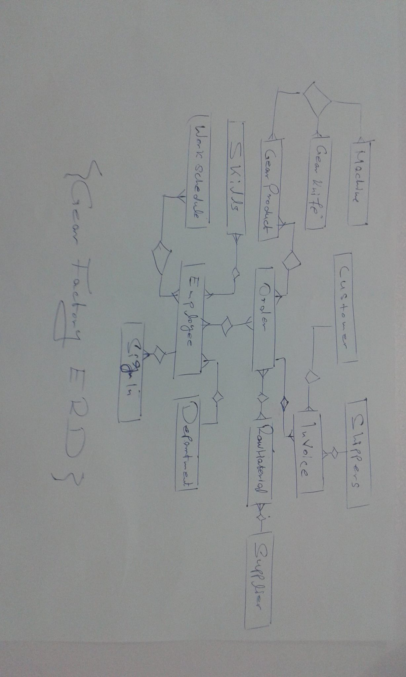
ERD(Gear Factory)
ERD its aim to show the relation between the different entitites of the system in our system

Slide 10
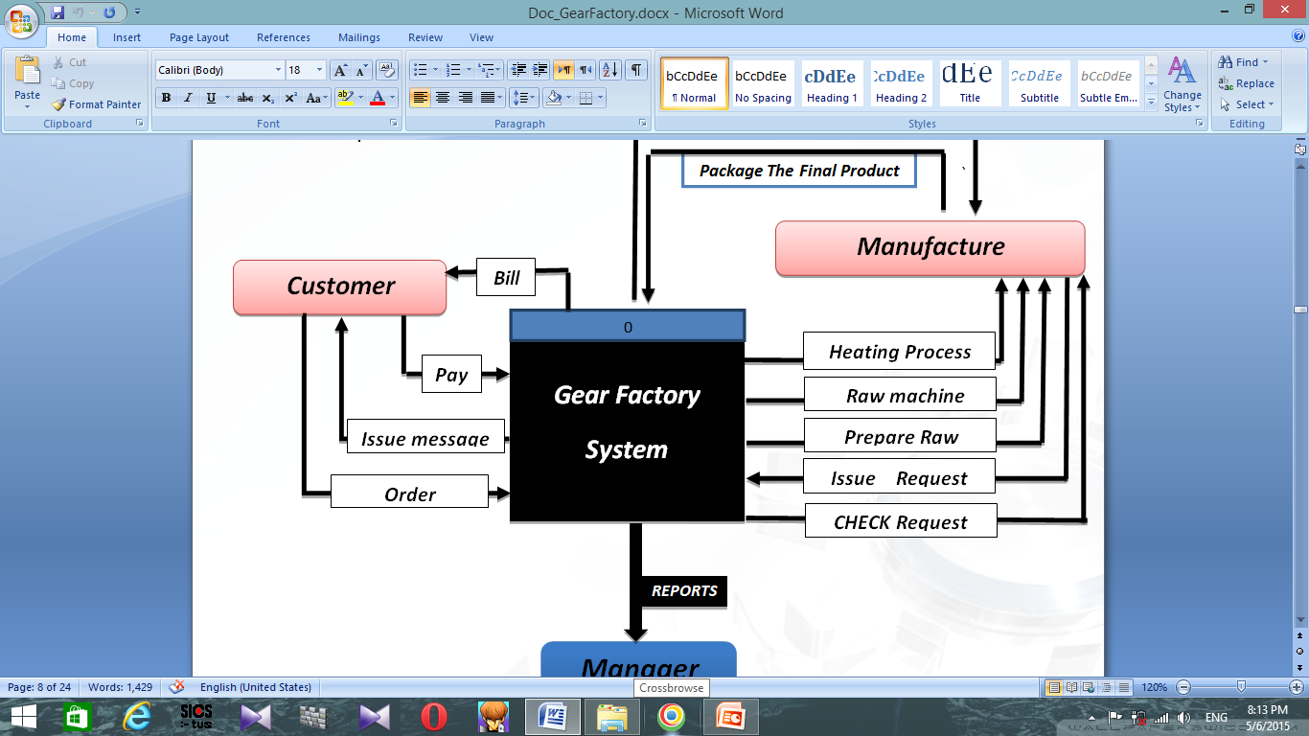
Context Diagram(Level 0):

Slide 11
Context Diagram(Level 0):
-in our context diagram (level 0) we have three main entities (customer-manufacteur-manager)and the gear system which will interact with the entities

Slide 12
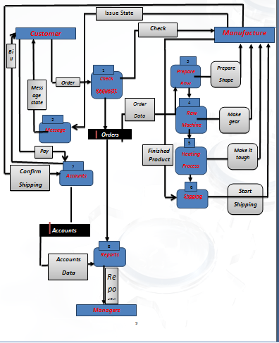
DFD(Gear Factory)

Slide 13
DFD(Gear Factory)
*In the data flow diagram (level 1) we discuss more details about the system which include the three main entities (customer-manufacteur-manager) ,processes,and data store .

Slide 14
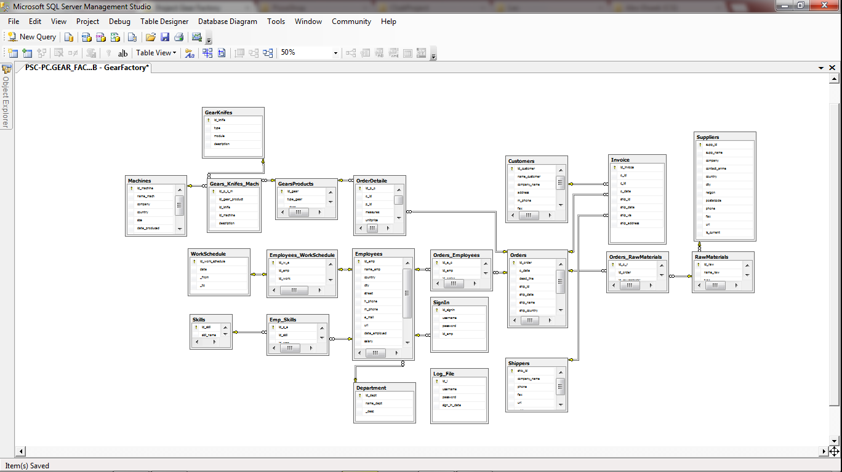
SQL Schema:

Slide 15
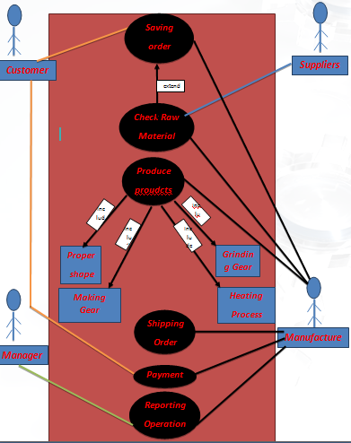
Use case (Gear factory)

Slide 16
Use case (Gear factory)
*in use case diagram consists from several actors and cases for each actor , in our system our main actors customer,manager,manufacteur,and suppliers

