Slide 1


AI Personal Productivity Agent
AMULATE HACKATHON 2025
Team Name: Team Forcus
Presenter Names: Ahmad Zakariya
Challenge: BMW - Develop an AI assistant that helps users plan their day or manage tasks by integrating reasoning with tools
December 30, 2025
1

Slide 2





Agenda
The problem we are trying to solve and why it matters
Our idea: U-Dot AI, an agentic productivity assistant
How the productivity agent works (architecture & reasoning)
Live demo: U-Dot AI in action
Conclusion, impact, and future scopes
2
Notes:
2

Slide 3


Problem Statement and Motivation
What is the Problem and Why are we solving it?
Problem
Motivation
Knowledge workers juggle multiple tasks and context switches daily
Most productivity tools rely on static to-do lists
Real-world constraints like time, effort, and priority are ignored
Users must manually decide what to do next
This leads to poor prioritization and overloaded schedules
Productivity should be guided by reasoning, not just reminders
Users should interact using natural language
Planning must consider time, priorities, and constraints
The system should act using tools, not just reply with text
Goal: build a true agent, not another to-do app
3

Slide 4





Solution Overview
Key Features
Deterministic Scheduling with Constraints
Task scheduling is handled by deterministic logic, ensuring transparency and reliability in how time blocks are allocated.
Agentic Day Planning
U-Dot AI reasons about tasks, priorities, and available time to create a realistic daily plan instead of a static task list.
Natural Language Task & Preference Understanding
Users can interact naturally, and the agent extracts intent, effort, and constraints.
Stateful Memory Across Interactions
Users can interact naturally (e.g., “Add a 2-hour coding session after lunch”), and the agent extracts intent, effort, and constraints.
Self-Aware Agent Execution Flow
The agent explicitly goes through reasoning, execution, and completion states, reinforcing trust and explainability.
4

Slide 5
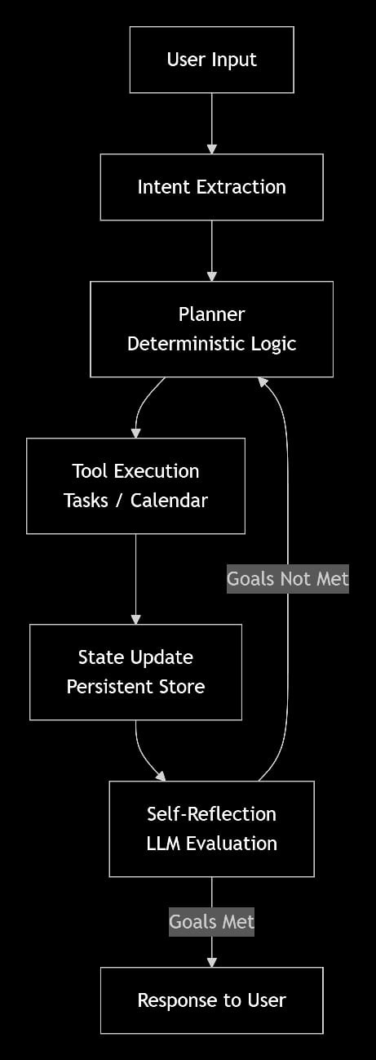
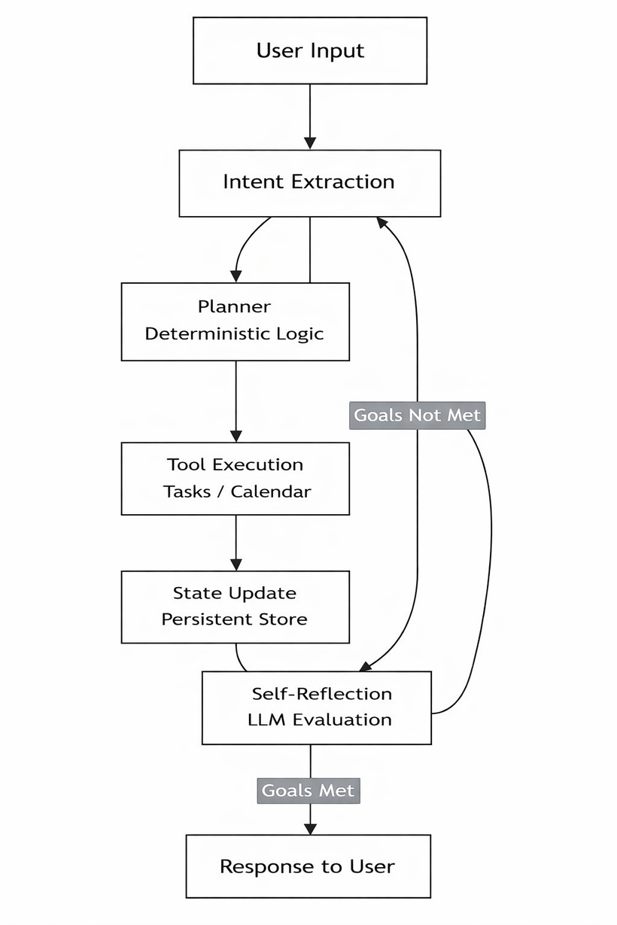
Solution Deep-Dive
Architecture
How the agent works behind the scenes:
User Interface (Web App)
Intent & Reasoning Layer (LLM)
Agent Orchestration (LangGraph)
Deterministic Tools & State
Scheduling, task updates, and constraint handling are implemented using deterministic Python logic to ensure transparency and reliability.
Persistent Agent State
The agent maintains:
Tasks and priorities
Calendar events
User preferences
Last action summary
User interacts with U-Dot AI using natural language
Simple web-based interface
A Large Language Model is used strictly for:
Intent extraction
Effort and constraint understanding
Summarization and reflection
The LLM does not directly modify state.
The agent follows an explicit reasoning loop with well-defined states:
Parse intent
Plan actions
Execute tools
Update state
Self-reflect
Respond to user
5

Slide 6
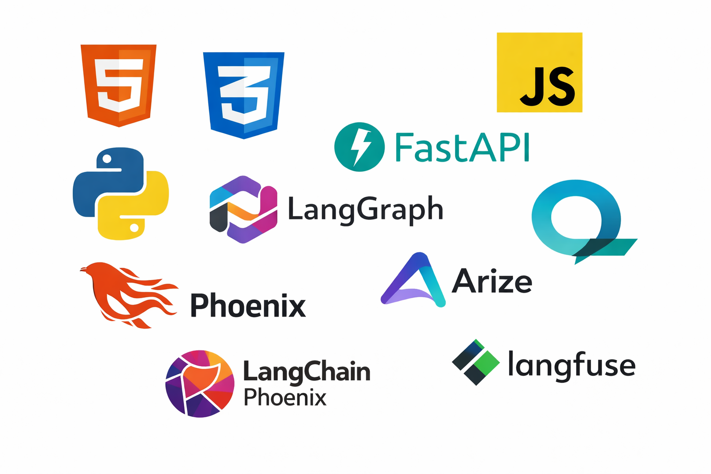
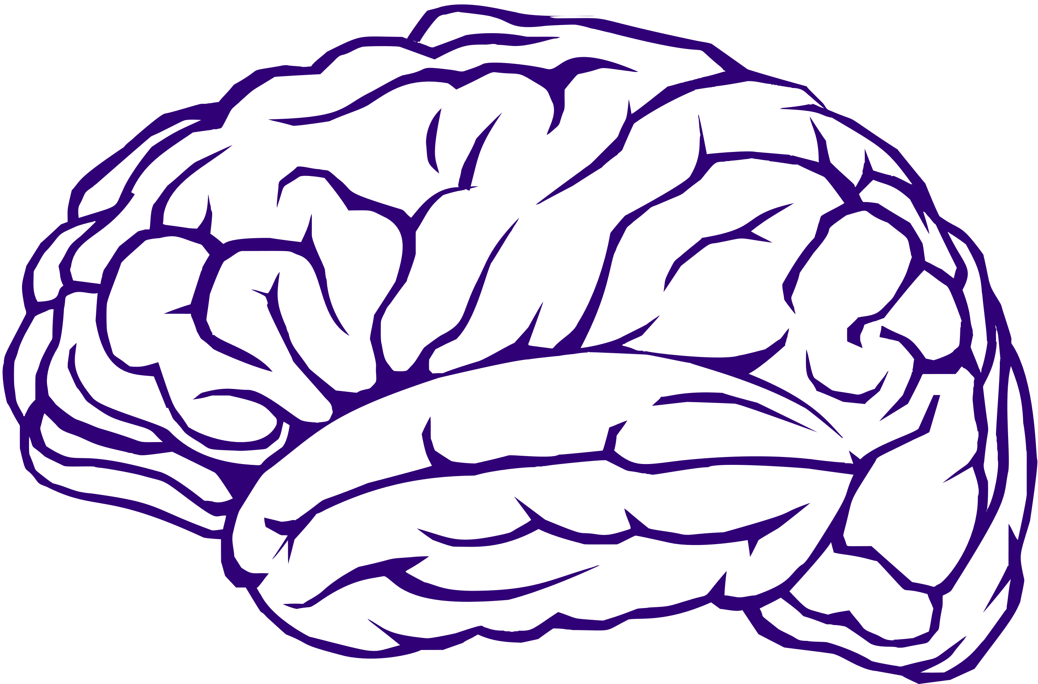


Solution Deep-Dive
Implementation Details
Agent Logic
Tools Used
State-driven agent
Maintains tasks, calendar events, preferences, and history
Explicit reasoning loop (LangGraph)
Parse intent
Plan actions
Execute tools
Update state
Self-reflect
Respond to user
Clear LLM boundaries
LLM used only for understanding and reasoning
All scheduling logic remains deterministic
Self-reflection step
Verifies execution success before responding
Frontend: HTML, CSS, JavaScript (custom UI for agent interaction)
Backend: Python, FastAPI
Agent Framework: LangGraph (explicit agent state transitions)
LLM Provider:Google Vertex AI (Gemini models)
State & Scheduling: Deterministic Python logic (task prioritization, time blocking)
Observability (Planned): Arize Phoenix / Langfuse for tracing reasoning and tool usag
6

Slide 7

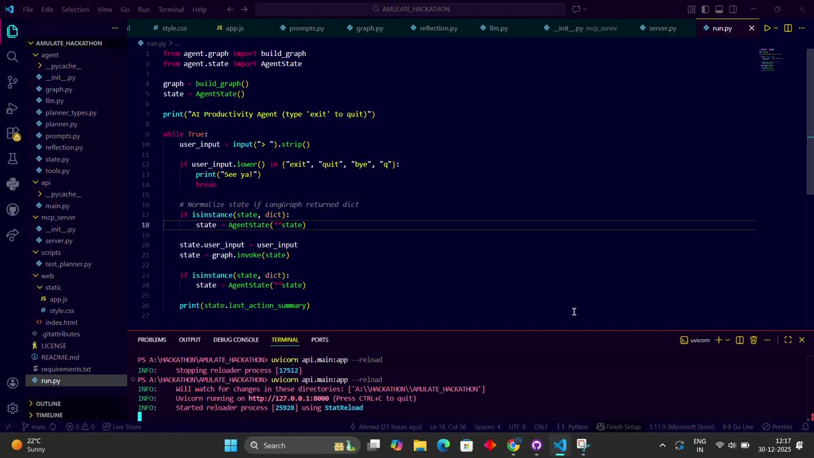
Demo
Video Demo
Watch the agent plan a real day in seconds
7

Slide 8
Conclusions and Future Evolutions
Conclusion
Future Scopes
We built U-Dot AI, a true agentic productivity assistant that goes beyond task listing to reason, plan, and act
The system combines:
Natural language understanding
Deterministic scheduling logic
Explicit agent reasoning loops
By separating reasoning from execution, U-Dot AI is:
Transparent
Predictable
Trustworthy
The project demonstrates how modern AI systems can be designed as agents, not chatbots
Calendar Integration : Integrate with real calendar APIs (e.g., Google Calendar) for live scheduling and updates
Advanced Self-Reflection & Feedback : Enhance the agent’s ability to explain decisions and learn from user feedback
Observability & Monitoring : Add full tracing using tools like Arize Phoenix or Langfuse for reasoning transparency
User Support : Extend U-Dot AI to support different user personas such as product managers or team leads
Long-Term Memory & Optimization : Enable the agent to learn productivity patterns and optimize plans over time
8

