Slide 1






import pandas as pd import numpy as np import seaborn as sb
import matplotlib.pyplot as plt plt.rcParams['figure.figsize'] = (10, 7) plt.style.use('ggplot')
import pandas as pd
data = {'Candy Variety':['Chocolate Hearts','Sour Jelly','Candy Canes','Sour Jelly', 'Fruit Drops'],
'Date and Time':['9-02-2020 14:05','24-10-2020 18:00','18-12-2020 20:13','25-10-2020 10:00' ,'18-10-202
'Day' :['Sunday','Saturday' ,'Friday','Sunday' ,'Sunday'], 'Length':[1, 3.5, 3.5, 3.5, 8],
'Breadth':[1,2,2.5,2,6],
'Price':[7.5, 7.6, 8, 7.6, 14]}
dfa = pd.DataFrame(data) dfa
Candy Variety | Date and Time | Day | Length | Breadth | Price
0 Chocolate Hearts | 9-02-2020 14:05 | Sunday | 1.0 | 1.0 | 7.5
1 Sour Jelly | 24-10-2020 18:00 | Saturday | 3.5 | 2.0 | 7.6
2 Candy Canes | 18-12-2020 20:13 | Friday | 3.5 | 2.5 | 8.0
3 Sour Jelly | 25-10-2020 10:00 | Sunday | 3.5 | 2.0 | 7.6
4 Fruit Drops | 18-10-2020 15:46 | Sunday | 8.0 | 6.0 | 14.0
##converting the data and time to datatime format
dfa['Date and Time'] = pd.to_datetime(dfa['Date and Time'], format="%d-%m-%Y %H:%M") dfa
Candy Variety | Date and Time | Day | Length | Breadth | Price
0 Chocolate Hearts | 2020-02-09 14:05:00 | Sunday | 1.0 | 1.0 | 7.5
1 Sour Jelly | 2020-10-24 18:00:00 | Saturday | 3.5 | 2.0 | 7.6
2 Candy Canes | 2020-12-18 20:13:00 | Friday | 3.5 | 2.5 | 8.0
3 Sour Jelly | 2020-10-25 10:00:00 | Sunday | 3.5 | 2.0 | 7.6
4 Fruit Drops | 2020-10-18 15:46:00 | Sunday | 8.0 | 6.0 | 14.0
##Creating new feature data from the existing feature data ##Creating Date and Time from the Date and Time attribute dfa['Date'] = dfa['Date and Time'].dt.date
dfa['Time'] = dfa['Date and Time'].dt.time dfa
Candy Variety | Date and Time | Day | Length | Breadth | Price | Date | Time
0 Chocolate Hearts | 2020-02-09 14:05:00 | Sunday | 1.0 | 1.0 | 7.5 | 2020-02-09 | 14:05:00
1 Sour Jelly | 2020-10-24 18:00:00 | Saturday | 3.5 | 2.0 | 7.6 | 2020-10-24 | 18:00:00
2 Candy Canes | 2020-12-18 20:13:00 | Friday | 3.5 | 2.5 | 8.0 | 2020-12-18 | 20:13:00
3 Sour Jelly | 2020-10-25 10:00:00 | Sunday | 3.5 | 2.0 | 7.6 | 2020-10-25 | 10:00:00
4 Fruit Drops | 2020-10-18 15:46:00 | Sunday | 8.0 | 6.0 | 14.0 | 2020-10-18 | 15:46:00
# If you wanted to know more about the weekend and weekday sale trends, in particular, you could # categorize the days of the week in a feature called Weekend with 1=True and 0=False
dfa['weekend'] = np.where(dfa['Day'].isin(['Saturday', 'Sunday']), 1, 0) dfa
Candy Variety | Date and Time | Day | Length | Breadth | Price | Date | Time | weekend
0 Chocolate Hearts | 2020-02-09 14:05:00 | Sunday | 1.0 | 1.0 | 7.5 | 2020-02-09 | 14:05:00 | 1
1 Sour Jelly | 2020-10-24 18:00:00 | Saturday | 3.5 | 2.0 | 7.6 | 2020-10-24 | 18:00:00 | 1
2 Candy Canes | 2020-12-18 20:13:00 | Friday | 3.5 | 2.5 | 8.0 | 2020-12-18 | 20:13:00 | 0
3 Sour Jelly | 2020-10-25 10:00:00 | Sunday | 3.5 | 2.0 | 7.6 | 2020-10-25 | 10:00:00 | 1
4 Fruit Drops | 2020-10-18 15:46:00 | Sunday | 8.0 | 6.0 | 14.0 | 2020-10-18 | 15:46:00 | 1
1)Imputation:

Slide 2


---Dealing with the missing values
-----Either delete the record OR fill with mean
Categories:
Categorical Imputation: Missing categorical values replaced with most commonly occuring values
Numerical Imputation: Missing numerical values are replaced with mean of corresponding values
dfb = pd.DataFrame(data)
dfb['Date and Time'] = pd.to_datetime(dfb['Date and Time'], format="%d-%m-%Y %H:%M")
##Appending the new row with missing values
dfb.loc[len(dfb.index)] = [np.NaN, "22-10-2020 17:24:00","Thursday", 3.5, 2, np.NaN] dfb
Candy Variety | Date and Time | Day | Length | Breadth | Price
0 Chocolate Hearts | 2020-02-09 14:05:00 | Sunday | 1.0 | 1.0 | 7.5
1 Sour Jelly | 2020-10-24 18:00:00 | Saturday | 3.5 | 2.0 | 7.6
2 Candy Canes | 2020-12-18 20:13:00 | Friday | 3.5 | 2.5 | 8.0
3 Sour Jelly | 2020-10-25 10:00:00 | Sunday | 3.5 | 2.0 | 7.6
4 Fruit Drops | 2020-10-18 15:46:00 | Sunday | 8.0 | 6.0 | 14.0
5 NaN | 22-10-2020 17:24:00 | Thursday | 3.5 | 2.0 | NaN
##Filling the categorical with most occuring value dfb['Candy Variety'] = dfb['Candy Variety'].fillna(dfb['Candy V #In dfb['Candy Variety'].mode() calculate mode with most freque #In .mode()[0] select the first value from mode result, bcz mod ##Filling the numerical value with the mean dfb['Price'] = dfb['Price'].fillna(dfb['Price'].mean()) |  |  |  |  |  | ariety'].mode()[0]) nt observation e returns series of objects
dfb
Candy Variety | Date and Time | Day | Length | Breadth | Price
0 Chocolate Hearts | 2020-02-09 14:05:00 | Sunday | 1.0 | 1.0 | 7.50
1 Sour Jelly | 2020-10-24 18:00:00 | Saturday | 3.5 | 2.0 | 7.60
2 Candy Canes | 2020-12-18 20:13:00 | Friday | 3.5 | 2.5 | 8.00
3 Sour Jelly | 2020-10-25 10:00:00 | Sunday | 3.5 | 2.0 | 7.60
4 Fruit Drops | 2020-10-18 15:46:00 | Sunday | 8.0 | 6.0 | 14.00
5 Sour Jelly | 22-10-2020 17:24:00 | Thursday | 3.5 | 2.0 | 8.94
2) Descretization
It involves essentially taking a set of values of data and grouping sets of them together in some logical fashion into bins (or buckets).
Binning can be applied to numerical value and categorical value The grouping data is as follows:
Group based on equal intervals
Grouping based on equal frequencies
Grouping based on decision tree sorting(to establish relation with target)
dfb['Type of Day'] = np.where(dfb['Day'].isin(['Saturday', 'Sunday']), 'Weekend', 'Weekday') dfb
Candy Variety | Date and Time | Day | Length | Breadth | Price | Type of Day
0 Chocolate Hearts | 2020-02-09 14:05:00 | Sunday | 1.0 | 1.0 | 7.50 | Weekend
1 Sour Jelly | 2020-10-24 18:00:00 | Saturday | 3.5 | 2.0 | 7.60 | Weekend
2 Candy Canes | 2020-12-18 20:13:00 | Friday | 3.5 | 2.5 | 8.00 | Weekday
3 Sour Jelly | 2020-10-25 10:00:00 | Sunday | 3.5 | 2.0 | 7.60 | Weekend
4 Fruit Drops | 2020-10-18 15:46:00 | Sunday | 8.0 | 6.0 | 14.00 | Weekend
5 Sour Jelly | 22-10-2020 17:24:00 | Thursday | 3.5 | 2.0 | 8.94 | Weekday
3) Categorical Encoding
It is the technique used to encode categorical features into numerical values which are simpler for algorithm to understand

Slide 3



-One Hot Encoding(OHE): Popular technique for categorical encoding
-Disadvantages:
*Dramatic inrease in number of features
*Result in the creation of highly correlated features
for k in dfb['Type of Day'].unique():
dfb[k] = np.where(dfb['Type of Day']==k, 1, 0)
dfb
Candy Variety | Date and Time | Day | Length | Breadth | Price | Type of Day | Weekend | Weekday
0 Chocolate Hearts | 2020-02-09 14:05:00 | Sunday | 1.0 | 1.0 | 7.50 | Weekend | 1 | 0
1 Sour Jelly | 2020-10-24 18:00:00 | Saturday | 3.5 | 2.0 | 7.60 | Weekend | 1 | 0
2 Candy Canes | 2020-12-18 20:13:00 | Friday | 3.5 | 2.5 | 8.00 | Weekday | 0 | 1
3 Sour Jelly | 2020-10-25 10:00:00 | Sunday | 3.5 | 2.0 | 7.60 | Weekend | 1 | 0
4 Fruit Drops | 2020-10-18 15:46:00 | Sunday | 8.0 | 6.0 | 14.00 | Weekend | 1 | 0
5 Sour Jelly | 22-10-2020 17:24:00 | Thursday | 3.5 | 2.0 | 8.94 | Weekday | 0 | 1
4) Feature Splitting
Splitting features into parts can sometimes increase the value of features towards target.
dfb['Date and Time'] = pd.to_datetime(dfb['Date and Time']) dfb['Date'] = dfb['Date and Time'].dt.date
dfb['Time'] = dfb['Date and Time'].dt.time dfb
Candy Variety
Date and Time
Day Length Breadth Price
Type of
Day
Weekend
Weekday
Date
Time
0
Chocolate
Hearts
2020-02-09
14:05:00
Sunday
1.0
1.0 7.50
Weekend
1
0
2020-02-
09
14:05:00
1
Sour Jelly
2020-10-24
18:00:00
Saturday
3.5
2.0 7.60 Weekend
1
0
2020-10-
24
18:00:00
2 Candy Canes
2020-12-18
20:13:00
Friday
3.5
2.5 8.00
Weekday
0
1
2020-12-
18
20:13:00
3
Sour Jelly
2020-10-25
10:00:00
Sunday
3.5
2.0 7.60 Weekend
1
0
2020-10-
25
10:00:00
4
Fruit Drops
2020-10-18
15:46:00
Sunday
8.0
6.0 14.00
Weekend
1
0
2020-10-
18
15:46:00
5
Sour Jelly
2020-10-22
17:24:00
Thursday
3.5
2.0 8.94 Weekday
0
1
2020-10-
22
17:24:00
5) Handling Outliers
-Outliers are the data points that significantly deviate from the data. The can be the observations that are usually high or low compared to other values.
-They can adversely affect our prediction, so they should be handled properly.
Removal
Replacing values
Capping: replace the min and max vals with arbitrary values
Descritization
sb.boxplot(data=dfb[['Length', 'Breadth', 'Price']]) plt.show()

Slide 4
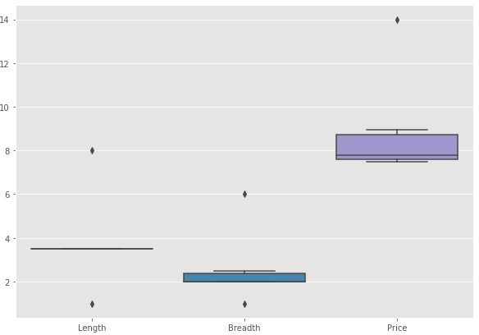



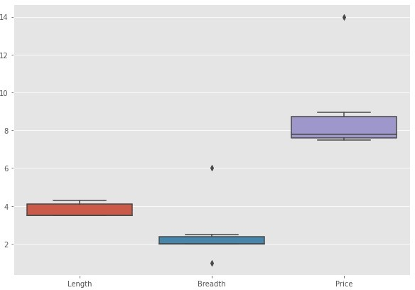

##Handling the outliers for the Length
Q1 = dfb['Length'].quantile(0.25) Q3 = dfb['Length'].quantile(0.75)
IQR = Q3-Q1
lower_extreme = Q1-1.5*IQR upper_extreme = Q3+1.5*IQR
outliers = dfb[(dfb['Length'] < lower_extreme) | (dfb['Length'] > upper_extreme)] outliers
Candy Variety Date and Time Day | Length | Breadth | Price | Type of Day | Weekend | Weekday Date Time
₀ Chocolate 2020-02-09 _{Sunday} Hearts 14:05:00 | 1.0 | 1.0 | 7.5 | Weekend | 1 | 0 ²⁰²⁰⁻⁰²⁻ 14:05:00 09
4 Fruit Drops ²⁰²⁰⁻¹⁰⁻¹⁸ Sunday 15:46:00 | 8.0 | 6.0 | 14.0 | Weekend | 1 | 0 ²⁰²⁰⁻¹⁰⁻ 15:46:00 18
dfb.loc[dfb['Length'] < lower_extreme, 'Length'] = dfb['Length'].mean() dfb.loc[dfb['Length'] > upper_extreme, 'Length'] = dfb['Length'].mean() sb.boxplot(data=dfb[['Length', 'Breadth', 'Price']])
plt.show()
##Handling the outliers for the Breadth
q1 = dfb['Breadth'].quantile(0.25) q3 = dfb['Breadth'].quantile(0.75)
IQR = q3-q1
lower_extreme = q1-1.5*IQR

Slide 5

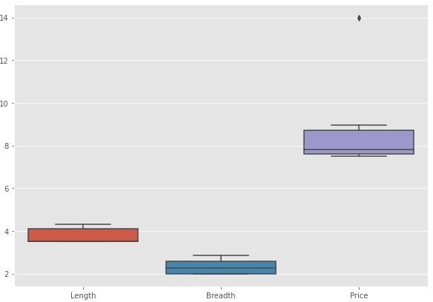


upper_extreme = q3+1.5*IQR
##Defining the outliers
outliers = dfb[(dfb['Breadth'] < lower_extreme) | (dfb['Breadth'] > upper_extreme)] outliers
Candy Variety Date and Time Day | Length | Breadth | Price | Type of Day | Weekend | Weekday Date Time
₀ Chocolate 2020-02-09 _{Sunday} Hearts 14:05:00 | 4.305556 | 1.0 | 7.5 | Weekend | 1 | 0 ²⁰²⁰⁻⁰²⁻ 14:05:00 09
4 Fruit Drops ²⁰²⁰⁻¹⁰⁻¹⁸ Sunday 15:46:00 | 4.305556 | 6.0 | 14.0 | Weekend | 1 | 0 ²⁰²⁰⁻¹⁰⁻ 15:46:00 18
##Replacing the outlier with mean()
dfb.loc[dfb['Breadth'] < lower_extreme, 'Breadth'] = dfb['Breadth'].mean() dfb.loc[dfb['Breadth'] > upper_extreme, 'Breadth'] = dfb['Breadth'].mean() sb.boxplot(data=dfb[['Length', 'Breadth', 'Price']])
plt.show()
##Handling the outlier of the Price q1 = dfb['Price'].quantile(0.25) q3 = dfb['Price'].quantile(0.75)
IQR = q3-q1
lower_extreme = q1-1.5*IQR upper_extreme = q3+1.5*IQR
##Defining the outliers
outliers = dfb[(dfb['Price'] < lower_extreme) | (dfb['Price'] > upper_extreme)] outliers
Candy Variety
Date and Time
Day Length
Breadth
Price
Type of
Day
Weekend
Weekday
Date Time
4
Fruit Drops
2020-10-18
15:46:00
Sunday
4.305556 2.847222 14.0
Weekend
1
0
2020-10-
18
15:46:00
##Replacing the outlier with mean()
dfb.loc[dfb['Price'] < lower_extreme, 'Price'] = dfb['Price'].mean() dfb.loc[dfb['Price'] > upper_extreme, 'Price'] = dfb['Price'].mean() sb.boxplot(data=dfb[['Length', 'Breadth', 'Price']])
plt.show()

Slide 6
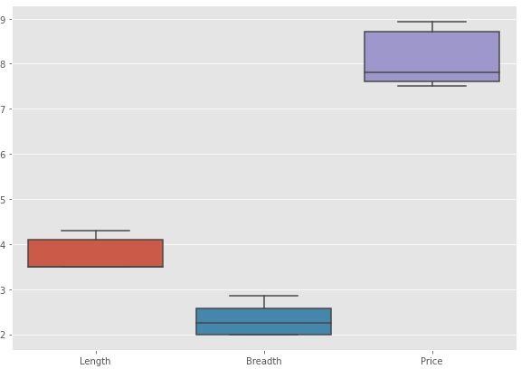



6) Variable Transformation
dfb['Area'] = dfb['Length'] * dfb['Breadth'] dfb
Candy Variety
Date and
Time
Day Length
Breadth
Price
Type of
Day
Weekend
Weekday
Date
Time
Area
0
Chocolate
Hearts
2020-02-09
14:05:00
Sunday
4.305556 2.583333 7.50 Weekend
1
0
2020-
02-09
14:05:00
11.122685
1 Sour Jelly
2020-10-24
18:00:00
Saturday 3.500000 2.000000 7.60 Weekend
1
0
2020-
10-24
18:00:00 7.000000
2
Candy Canes
2020-12-18
20:13:00
Friday
3.500000 2.500000 8.00 Weekday
0
1
2020-
12-18
20:13:00
8.750000
3 Sour Jelly
2020-10-25
10:00:00
Sunday 3.500000 2.000000 7.60 Weekend
1
0
2020-
10-25
10:00:00 7.000000
4 Fruit Drops
2020-10-18
15:46:00
Sunday
4.305556 2.847222 8.94 Weekend
1
0
2020-
10-18
15:46:00
12.258873
5 Sour Jelly
2020-10-22
17:24:00
Thursday 3.500000 2.000000 8.94 Weekday
0
1
2020-
10-22
17:24:00 7.000000
dfb['Is Sour Jelly'] = dfb['Candy Variety'].apply(lambda x:1 if x=="Sour Jelly" else 0) dfb
Candy Variety
Date and
Time
Day Length
Breadth
Price
Type of
Day
Weekend
Weekday
Date
Time
Is Area Sour
Jelly
0
Chocolate
Hearts
2020-02-
09 Sunday
14:05:00
4.305556 2.583333 7.50 Weekend
1
0
2020-
02-09
14:05:00
11.122685
0
1 Sour Jelly
2020-10-
24 Saturday 3.500000 2.000000 7.60 Weekend
18:00:00
1
0
2020-
10-24
18:00:00 7.000000
1
2
Candy Canes
2020-12-
18
20:13:00
Friday
3.500000 2.500000 8.00 Weekday
0
1
2020-
12-18
20:13:00
8.750000
0
3 Sour Jelly
2020-10-
25 Sunday 3.500000 2.000000 7.60 Weekend
10:00:00
1
0
2020-
10-25
10:00:00 7.000000
1
4 Fruit Drops
2020-10-
18 Sunday
15:46:00
4.305556 2.847222 8.94 Weekend
1
0
2020-
10-18
15:46:00
12.258873
0
5 Sour Jelly
2020-10-
22 Thursday 3.500000 2.000000 8.94 Weekday
17:24:00
0
1
2020-
10-22
17:24:00 7.000000
1
7) Scalling
Transforming the values in a dataset to a specific range or distribution
-) Scalling is needed when variables have different units, it can affect the performance

Slide 7


of certain algorithms and statistical analysis.
-) It is a common step to ensure that variables are comparible and don't ensure the bias ans distortion in the analysis.
TYPES:
Min-max scalling:
This process involves the rescaling of all values in a feature in the range 0 to 1. In other words, the minimum value in the original range will take the value 0,
the maximum value will take 1 and the rest of the values in between the two extremes will be appropriately scaled.
Standardization/variance Scalling/Z-score normalization:
All the datapoints are subtracted by their means and the result is divided by distribution's variance or standard deviation, to arrive at a distribution with a 0 mean and 1 variance.
## Min-Max Scalling
from sklearn.preprocessing import MinMaxScaler dfmm = dfb.copy()
scaler = MinMaxScaler()
numerical_columns = ["Length", "Breadth", "Price", "Area"] dfmm[numerical_columns] = scaler.fit_transform(dfmm[numerical_columns]) dfmm
Candy Variety
Date and
Time
Day Length
Breadth
Price
Type of
Day
Weekend
Weekday
Date
Time
Is Area Sour
Jelly
0
Chocolate
Hearts
2020-02-
09 Sunday
14:05:00
1.0 0.688525 0.000000 Weekend
1
0
2020-
02-09
14:05:00
0.783948
0
1 Sour Jelly
2020-10-
24 Saturday
18:00:00
0.0 0.000000 0.069444 Weekend
1
0
2020-
10-24
18:00:00 0.000000
1
2
Candy Canes
2020-12-
18
20:13:00
Friday
0.0 0.590164 0.347222 Weekday
0
1
2020-
12-18
20:13:00
0.332771
0
3 Sour Jelly
2020-10-
25 Sunday
10:00:00
0.0 0.000000 0.069444 Weekend
1
0
2020-
10-25
10:00:00 0.000000
1
4
Fruit Drops
2020-10-
18 Sunday
15:46:00
1.0 1.000000 1.000000 Weekend
1
0
2020-
10-18
15:46:00
1.000000
0
5 Sour Jelly
2020-10-
22 Thursday
17:24:00
0.0 0.000000 1.000000 Weekday
0
1
2020-
10-22
17:24:00 0.000000
1
## Standard(Z-Score Scalling)
from sklearn.preprocessing import StandardScaler dfsz = dfb.copy()
numerical_columns = ["Length", "Breadth", "Price", "Area"]
##Initializing the scalar object
##The StandardScaler scales the data by subtracting the mean and dividing by std.
scaler = StandardScaler()
##Apply scalling to the numerical columns
dfsz[numerical_columns] = scaler.fit_transform(dfsz[numerical_columns]) dfsz

Slide 8

Candy Variety
Date and Time
Day
Length
Breadth
Price
Type of
Day
Weekend
Weekday
Date
Time
Is Area Sour
Jelly
0
Chocolate
Hearts
2020-
02-09
14:05:00
Sunday 1.414214 0.773085 -0.967681 Weekend
1
0
2020-
02-09
14:05:00
1.067633
0
2020-
1 Sour Jelly 10-24 Saturday -0.707107 -0.950962 -0.805500 Weekend
18:00:00
1
0
2020-
10-24
18:00:00 -0.873562
1
2
Candy Canes
2020-
12-18
20:13:00
Friday
-0.707107
0.526792 -0.156775 Weekday
0
1
2020-
12-18
20:13:00
-0.049562
0
2020-
3 Sour Jelly 10-25
10:00:00
Sunday -0.707107 -0.950962 -0.805500 Weekend
1
0
2020-
10-25
10:00:00 -0.873562
1
4
Fruit Drops
2020-
10-18
15:46:00
Sunday 1.414214 1.553011 1.367727 Weekend
1
0
2020-
10-18
15:46:00
1.602615
0
2020-
5 Sour Jelly 10-22 Thursday -0.707107 -0.950962 1.367727 Weekday
17:24:00
0
1
2020-
10-22
17:24:00 -0.873562
1
8) Creating Features
dfb['Is Expensive'] = np.where(dfb['Price'] > dfb['Price'].mean(), 1, 0) dfb['Price Per Unit Area'] = dfb['Price']/dfb['Area']
dfb
Candy Variety
Date and Time
Day Length
Breadth
Price
Type of
Day
Weekend
Weekday
Date
Time
Is Area Sour
Jelly
Expe
0
Chocolate
Hearts
2020-
02-09
14:05:00
Sunday
4.305556 2.583333 7.50 Weekend
1
0
2020-
02-09
14:05:00
11.122685
0
2020-
1 Sour Jelly 10-24 Saturday 3.500000 2.000000 7.60 Weekend
18:00:00
1
0
2020-
10-24
18:00:00 7.000000
1
2
Candy Canes
2020-
12-18
20:13:00
Friday
3.500000 2.500000 8.00 Weekday
0
1
2020-
12-18
20:13:00
8.750000
0
2020-
3 Sour Jelly 10-25
10:00:00
Sunday 3.500000 2.000000 7.60 Weekend
1
0
2020-
10-25
10:00:00 7.000000
1
4
Fruit Drops
2020-
10-18
15:46:00
Sunday
4.305556 2.847222 8.94 Weekend
1
0
2020-
10-18
15:46:00
12.258873
0
2020-
5 Sour Jelly 10-22 Thursday 3.500000 2.000000 8.94 Weekday
17:24:00
0
1
2020-
10-22
17:24:00 7.000000
1
# Apply one-hot encoding to 'Candy Variety'
encoded_df = pd.get_dummies(dfa['Candy Variety'])
# Concatenate the encoded DataFrame with the original DataFrame
dfa_encoded = pd.concat([dfa, encoded_df], axis=1)
# Drop the original 'Candy Variety' column
dfa_encoded.drop('Candy Variety', axis=1, inplace=True)
# Print the encoded DataFrame
dfa_encoded

Slide 9

Date and Time Day Length Breadth Price Date Time | weekend | Candy Canes | Chocolate Hearts | Fruit Drops | Sour Jelly
0 ²⁰²⁰⁻⁰²⁻⁰⁹ Sunday 1.0 1.0 7.5 ²⁰²⁰⁻⁰²⁻ 14:05:00 | 1 | False | True | False | False
1 ²⁰²⁰⁻¹⁰⁻²⁴ Saturday 3.5 2.0 7.6 ²⁰²⁰⁻¹⁰⁻ 18:00:00 | 1 | False | False | False | True
2 ²⁰²⁰⁻¹²⁻¹⁸ Friday 3.5 2.5 8.0 ²⁰²⁰⁻¹²⁻ 20:13:00 | 0 | True | False | False | False
3 ²⁰²⁰⁻¹⁰⁻²⁵ Sunday 3.5 2.0 7.6 ²⁰²⁰⁻¹⁰⁻ 10:00:00 | 1 | False | False | False | True
4 ²⁰²⁰⁻¹⁰⁻¹⁸ Sunday 8.0 6.0 14.0 ²⁰²⁰⁻¹⁰⁻ 15:46:00 | 1 | False | False | True | False
14:05:00
09
18:00:00
24
20:13:00
18
10:00:00
25
15:46:00
18

