Slide 1
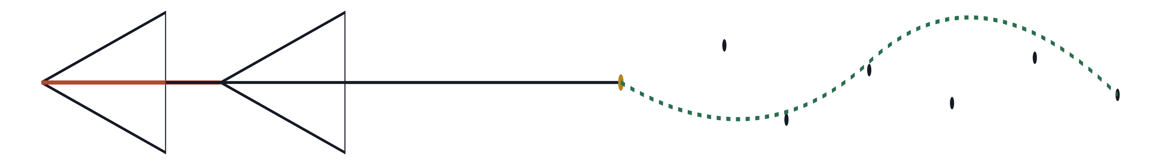
MASTER'S PROGRAMME · COMPUTER VISION AND ROBOTICS
From Monocular to Stereo Visual Odometry
Recovering metric scale on the TUM VI fisheye benchmark
AUTHORS
Ahmad Rammal
INSTITUTION
Md Tanvir Chowdhury
Université Bourgogne Europe

Slide 2
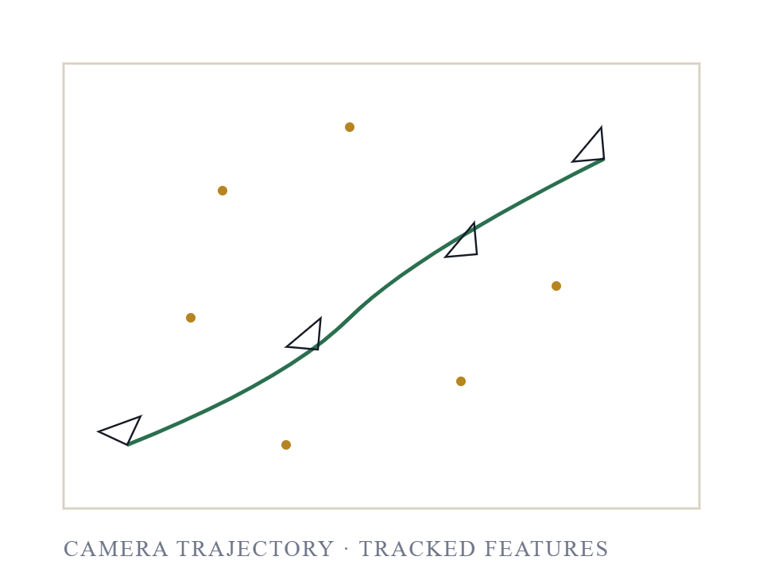
01 / MOTIVATION
The Localization Problem
Accurate localization without GPS is a fundamental problem in mobile robotics, augmented reality, and autonomous driving.
Visual odometry estimates camera motion by tracking visual features across successive frames, providing a lightweight alternative to LiDAR or IMU-based methods.
It is also the front-end of most vision-based SLAM pipelines — every globally consistent map begins with a reliable local pose stream.
From Monocular to Stereo VO · TUM VI
02 / 23

Slide 3
02 / BACKGROUND
Visual Odometry, Briefly
Visual odometry observes 2D feature correspondences between successive frames, then recovers the 3D camera motion that explains them.
01
02
03
04
Detect
Track
Estimate
Compose
Find repeatable corner features in each frame.
⟶
Match the same features across the next frame.
⟶
Recover the relative camera pose from those tracks.
⟶
Integrate per-frame motion into a full trajectory.
The geometry is identical for monocular and stereo systems — the difference is whether the recovered motion has a real-world scale, or only a relative one.
From Monocular to Stereo VO · TUM VI
03 / 23

Slide 4
03 / THE CORE PROBLEM
The Scale Ambiguity
A trajectory spanning one metre is geometrically indistinguishable from one spanning one kilometre.
~10,000×
On the Outdoors5 sequence, monocular VO integrated 4,565 m of unit-vector “path” — where the camera physically moved 0.39 m between matched-pair endpoints.
MONOCULAR SCALE ERROR · OUTDOORS5
Without scale, no downstream task that requires real-world distances is possible: no path planning, no obstacle avoidance, no metric mapping.
From Monocular to Stereo VO · TUM VI
04 / 23

Slide 5
04 / THE FIX
The Stereo Solution
A calibrated stereo rig with known baseline B resolves the ambiguity directly.
f · B
Z
=
Corresponding pixels in the left and right images encode a disparity d, and metric depth follows in closed form.
d
Every PnP pose increment is now anchored in real-world distance, and the trajectory is metric by construction — no scale post-correction required.
METRIC DEPTH FROM CALIBRATED DISPARITY
From Monocular to Stereo VO · TUM VI
05 / 23

Slide 6
05 / DATASET
The TUM VI Fisheye Benchmark
The TUM VI benchmark provides synchronised global-shutter stereo pairs, a high-rate IMU, and sub-millimetre motion-capture ground truth.
SEQUENCE
FRAMES
GT SEGMENTS
GT GAP
ENVIRONMENT
Room2
2,882
1 (full)
none
Indoor room
Corridor3
5,802
2 (start + end)
≈ 230 s
Indoor corridor
Outdoors5
17,747
2 (start + end)
≈ 749 s
Outdoor loop
RESOLUTION
512 × 512 px
Total
26,431
three sequences, indoor → outdoor difficulty
FRAME RATE
20 Hz stereo
The GT gaps on Corridor3 and Outdoors5 are not stated in the TUM VI documentation but are clearly visible in the raw mocap0/data.csv. We will return to them as Pitfall II.
FIELD OF VIEW
≈ 190° (equidistant fisheye)
BASELINE
10.11 cm
FOCAL
f_{x} = f_{y} ≈ 191.0 px
IMU
200 Hz
From Monocular to Stereo VO · TUM VI
06 / 23

Slide 7
06 / WHAT WE BUILT
Contributions
A monocular VO baseline — FAST features, pyramidal Lucas–Kanade tracking, and 5-point essential-matrix recovery, validated on three TUM VI sequences.
A metric stereo VO pipeline — fisheye-aware rectification, StereoSGBM disparity, forward–backward optical-flow consistency, 3D–2D PnP-RANSAC, motion-only bundle adjustment, and a reprojection-error confidence gate.
An honest failure-handling protocol — per-frame status logging that separates hard skips from soft flags, so no tracking failure is hidden.
Two TUM VI evaluation pitfalls , identified and corrected — the camera–IMU frame mismatch, and the multi-minute mocap blackouts on Corridor3 and Outdoors5.
Rigorous, gap-aware evaluation on 26,431 frames — per-segment ATE of 0.02–0.29 m, per-segment translational RPE of 0.018–0.040 m, with no deep learning and no loop closure.
From Monocular to Stereo VO · TUM VI
07 / 23

Slide 8
07 / METHOD
Monocular Pipeline
Classical geometry-only monocular VO — no learned components, no IMU.
01
02
03
04
05
06
Histogram equalize
FAST features
Lucas–Kanade
Undistort points
5-point essential
Compose pose
Threshold 8, NMS, target 2,000 / frame.
21 × 21 window, 3 pyramid levels.
Fisheye model, per-point (not per-image).
RANSAC, 1.0 px threshold; cheirality.
Integrate (R, t) into SE(3) trajectory.
TUM VI fisheye is dark (µ ≈ 36/255).
FAST is chosen over Shi–Tomasi because TUM VI fisheye images are very dark — FAST returns more than 2,000 keypoints per frame; Shi–Tomasi returns fewer than 200. The essential matrix defines translation only up to a unit norm: we fix ‖t‖ = 1 , which is exactly the source of the scale ambiguity we set out to solve.
From Monocular to Stereo VO · TUM VI
08 / 23

Slide 9
08 / METHOD
Stereo Pipeline
The stereo pipeline replaces 2D–2D epipolar geometry with 3D–2D PnP, anchored in real-world depth from disparity.
01
02
03
04
05
06
Rectify
SGBM disparity
Lift to 3D
FB-LK track
PnP-RANSAC
Motion-only BA
Fisheye-aware override of f_{rect}.
Indoor + outdoor presets.
Z = f·B / d for each FAST point.
Round-trip error < 1 px to next frame.
3D–2D, 2 px threshold, 200 iters.
Levenberg–Marquardt on inliers.
07
Confidence gate
Soft-flag if reprojection RMSE > 1 px.
Each component is small on its own; the combination is what produces hard-skip rates below 0.1 % on all three sequences. The next slides walk through the three components that matter most — fisheye rectification, forward–backward LK with PnP, and the refinement-plus-gating stage.
From Monocular to Stereo VO · TUM VI
09 / 23

Slide 10
09 / METHOD · DETAIL
Fisheye Rectification
The 190° field of view breaks OpenCV's automatic rectification.
OUT-OF-THE-BOX OPENCV
54 px
The automatic projection matrices shrink the focal length so aggressively that no useful disparity range remains.
Rectified focal length returned by cv2.fisheye.stereoRectify . Maximum reliable depth: f·B / 1 ≈ 5.4 m — unusable.
Our override is principled, not a hack: we keep the rotation maps that align the two epipoles, and reuse the original calibrated focal length in the new projection matrices.
OUR OVERRIDE
191 px
This gives a single, internally consistent f across rectification, disparity-to-depth, and PnP intrinsics — the most common stereo calibration bug disappears.
We retain the computed rotation maps but override the projection matrices with the original focal length. Maximum reliable depth extends to ≈ 19 m.
From Monocular to Stereo VO · TUM VI
10 / 23

Slide 11
10 / METHOD · DETAIL
Tracking and Pose — FB-LK + PnP
Two robustness ideas do most of the heavy lifting on the front end.
FORWARD–BACKWARD CONSISTENCY
‖ LK↓( LK↑ (x_{t} ) ) − x_{t} ‖ < 1.0 px
Forward–backward Lucas–Kanade. Every feature is tracked forward to the next frame and then backward to the previous one; the round-trip error must be below one pixel, otherwise the track is discarded before RANSAC ever sees it.
This single check eliminated more than ninety percent of the PnP failures we observed on early runs — bad tracks were filtered out before they could corrupt the consensus set.
PNP-RANSAC OBJECTIVE
min_{R, t} Σ_{i ∈ I} ‖ x_{i} − π( R X_{i} + t ) ‖²
3D–2D PnP-RANSAC. Surviving features carry metric 3D coordinates from the disparity map; PnP finds the pose that reprojects them onto the next image with sub-pixel error.
RANSAC THRESHOLD 2 PX · 200 ITERS · CONF 0.999
From Monocular to Stereo VO · TUM VI
11 / 23

Slide 12
11 / METHOD · DETAIL
Refinement and Depth Gating
MOTION-ONLY BUNDLE ADJUSTMENT
REPROJECTION CONFIDENCE GATE
PER-SEQUENCE DEPTH GATING
Soft-flag — never hard-skip — borderline frames.
Outdoors: disparity ≥ 1 px, depth ≤ 20 m.
Levenberg–Marquardt refinement of pose on the inlier set.
Frames with reprojection RMSE above 1 px are logged as REPROJ_LOW_CONF but kept in the trajectory. Skipping them loses real motion contribution, which empirically hurts more than absorbing some noise.
Depth error grows quadratically: δZ/Z reaches 52 % at 20 m. Including far points feels generous but injects large bias into PnP. Gating drops the Outdoors5 drift rate from 6.1 % to 4.8 %.
RANSAC produces an inlier-consistent but coarse estimate. LM minimises the reprojection residual only over the consensus inliers — the dominant per-frame noise source on long outdoor sequences.
“Seeing further” through stereo can hurt accuracy when the far points are poorly conditioned. Depth uncertainty is not a footnote — it is the failure mode.
From Monocular to Stereo VO · TUM VI
12 / 23

Slide 13
12 / EVALUATION PITFALLS
Pitfall I — Camera–IMU Frame Mismatch
TUM VI mocap reports the pose of the IMU body in the world frame. Our VO emits the pose of the camera in the world frame.
18×
The two are related by the rigid extrinsic T_{cam,imu} from the camchain — on TUM VI, this is approximately a 180° rotation.
ROTATIONAL RPE INFLATION BEFORE CORRECTION
Without converting ground truth into the camera frame, the relative-pose residual carries a similarity-transform artefact that inflates rotational RPE by roughly an order of magnitude — even when the trajectory itself is correct. ATE is unaffected because Umeyama alignment absorbs any constant offset; RPE is local, so it cannot.
RAW
CORRECTED
47°–63°
1.0°–1.7°
From Monocular to Stereo VO · TUM VI
13 / 23

Slide 14
13 / EVALUATION PITFALLS
Pitfall II — Ground-Truth Coverage Gaps
TUM VI motion capture only operates inside a fixed Vicon volume.
OUTDOORS5 · STEREO RPE-T
GAP-AWARE PROTOCOL
On Corridor3 the user leaves and re-enters the volume once, producing a 230 s mocap blackout. On Outdoors5 the user does the entire outdoor loop outside the volume — a 749 s blackout.
SINGLE UMEYAMA ACROSS GAP
0.037 m
2.90 m
⟶
A single Umeyama alignment across that gap would align two indoor pose clusters that the VO knows are separated by roughly a kilometre of outdoor walking — minutes of drift absorbed into the residual.
One non-physical relative-pose pair — last-start-frame paired with first-end-frame, 12.5 minutes apart in real time but only 10 indices apart in the matched array — was injecting ≈ 45 m of relative-translation error into the RMSE single-handedly.
Our protocol. Split matched pairs at Δt > 5 s, run Umeyama and ATE per segment, threshold RPE pairs at Δt ≤ 1 s.
From Monocular to Stereo VO · TUM VI
14 / 23

Slide 15
14 / RESULTS
Tracking Robustness
SEQUENCE
FRAMES
MONO HARD-SKIP
STEREO HARD-SKIP
STEREO SOFT-FLAG
Stereo hard-skip stays at or below 0.1 % on every sequence.
Room2
2,882
137 (4.8 %)
0 (0.0 %)
1 (0.0 %)
Monocular fails on near-pure-rotation segments where parallax is too small for the five-point essential matrix to recover translation — on Outdoors5, more than one frame in eight.
Corridor3
5,802
275 (4.7 %)
0 (0.0 %)
19 (0.3 %)
Stereo's robustness is a direct consequence of the forward–backward consistency check: bad tracks are removed before RANSAC, rather than discovered as outliers by RANSAC.
Outdoors5
17,747
2,325 (13.1 %)
9 (0.1 %)
168 (0.9 %)
Every borderline frame is auditable in a per-frame status CSV — nothing is silently absorbed.
Total
26,431
2,737 (10.4 %)
9 (0.0 %)
188 (0.7 %)
OK
REPROJ_LOW_CONF
TRACK_FAIL
PNP_FAIL
From Monocular to Stereo VO · TUM VI
15 / 23

Slide 16
15 / RESULTS
Headline Results — Gap-Aware Protocol
SEQUENCE
MODE
ATE SEG (M)
RPE-T (M)
RPE-R (°)
DRIFT (M)
DRIFT %
PATH (M)
Room2
Mono
1.23
9.83
46.57
0.70*
0.49
142.4
Stereo
0.29
0.020
1.10
1.03
0.72
142.6
Corridor3
Mono
0.72–0.77
8.03
53.61
0.50*
1.18
42.1
Stereo
0.024–0.042
0.018
1.09
5.23
1.71
306.9
Outdoors5
Mono
0.73–0.91
7.78
62.96
0.35*
0.26
135.8
Stereo
0.15–0.17
0.037
1.62
46.13
4.10
1,125.4
Stereo is metric by construction: per-segment ATE at most 0.29 m, per-segment RPE-t at most 0.04 m. Path-normalised drift is 0.72 % indoors to 4.10 % on the kilometre outdoor loop.
* Mono drift is post-Sim(3) — raw unit-vector integrated paths are 1,879 m, 707 m, and 4,565 m. Umeyama's scale parameter does the work; we look harder at this on the next slides.
From Monocular to Stereo VO · TUM VI
16 / 23

Slide 17
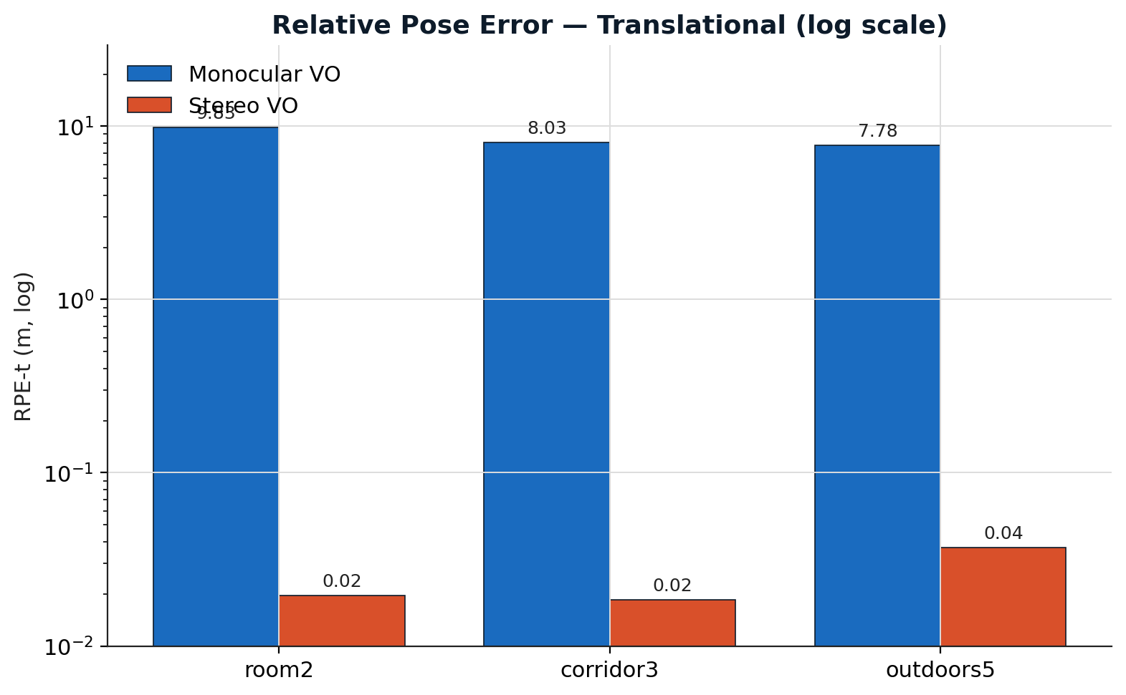
16 / RESULTS · THE HEADLINE GAP
Translational RPE — Stereo vs. Monocular
Local accuracy, on a log scale.
Monocular sits around 8 m of per-interval translational error on every sequence; stereo sits between 18 and 37 millimetres.
RPE is the honest cross-modal metric — a 210× improvement outdoors, 436× in the corridor, 502× in Room2.
From Monocular to Stereo VO · TUM VI
17 / 23

Slide 18
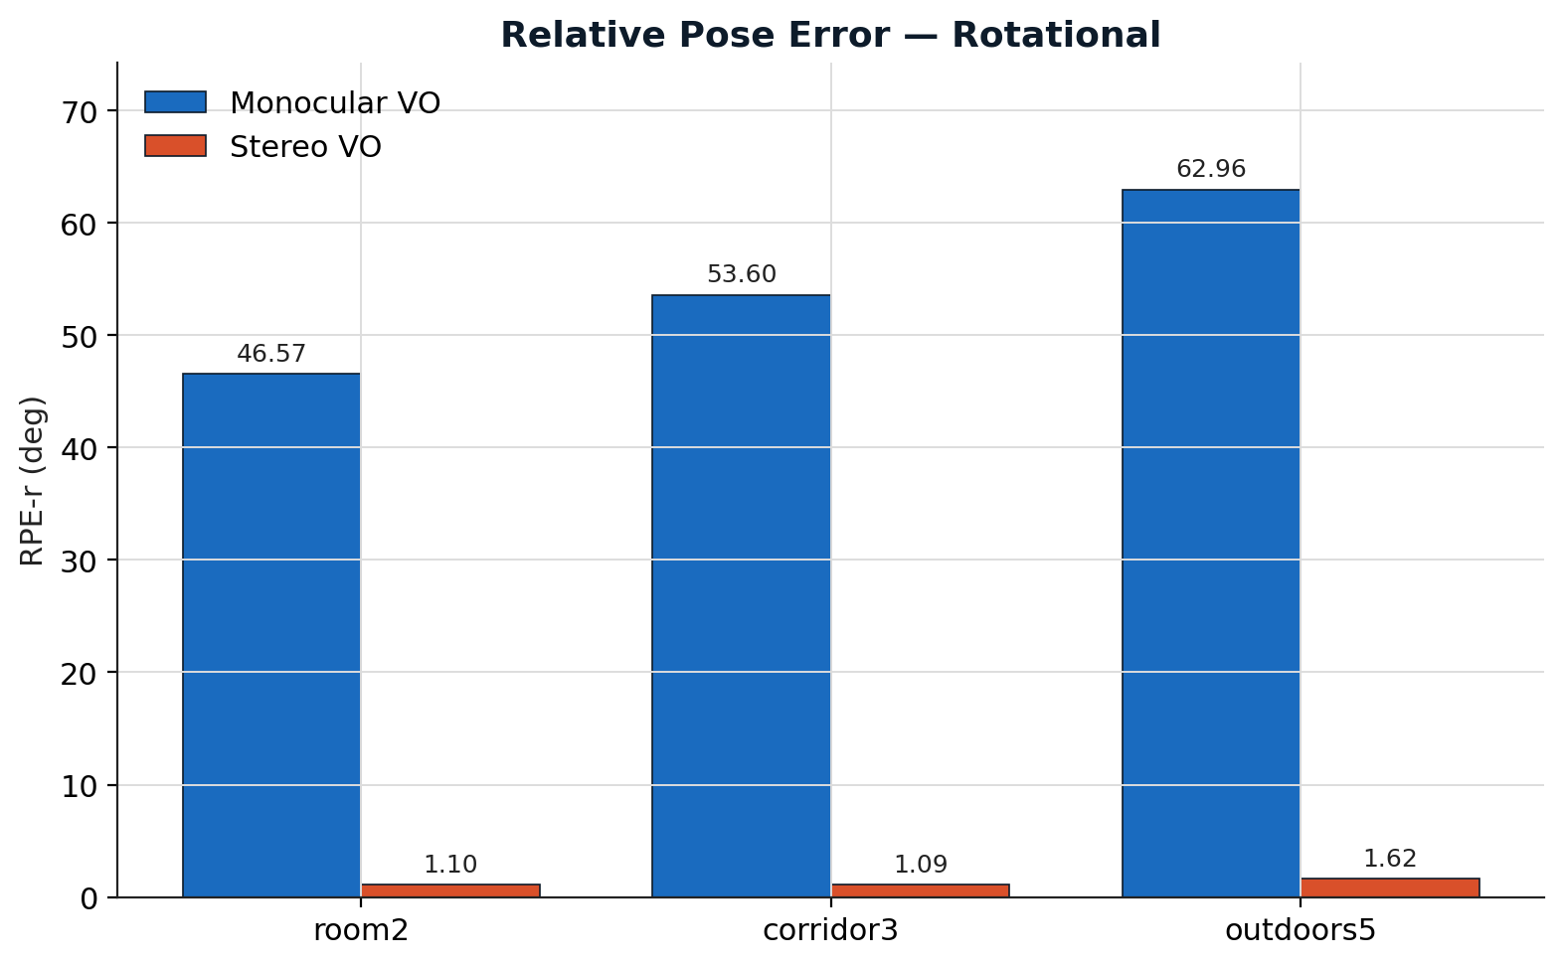
17 / RESULTS
Rotational RPE — The Pure-Rotation Failure Mode
Monocular rotational RPE reaches 47° to 63°. Stereo stays near 1°.
The 5-point essential matrix is degenerate under near-pure rotation — translation cannot be recovered from rotational image flow alone.
TUM VI's hand-held look-around motion in Room2 is the textbook worst case. Stereo grounds every PnP step in metric depth, so pure rotation stops being a failure mode.
From Monocular to Stereo VO · TUM VI
18 / 23

Slide 19
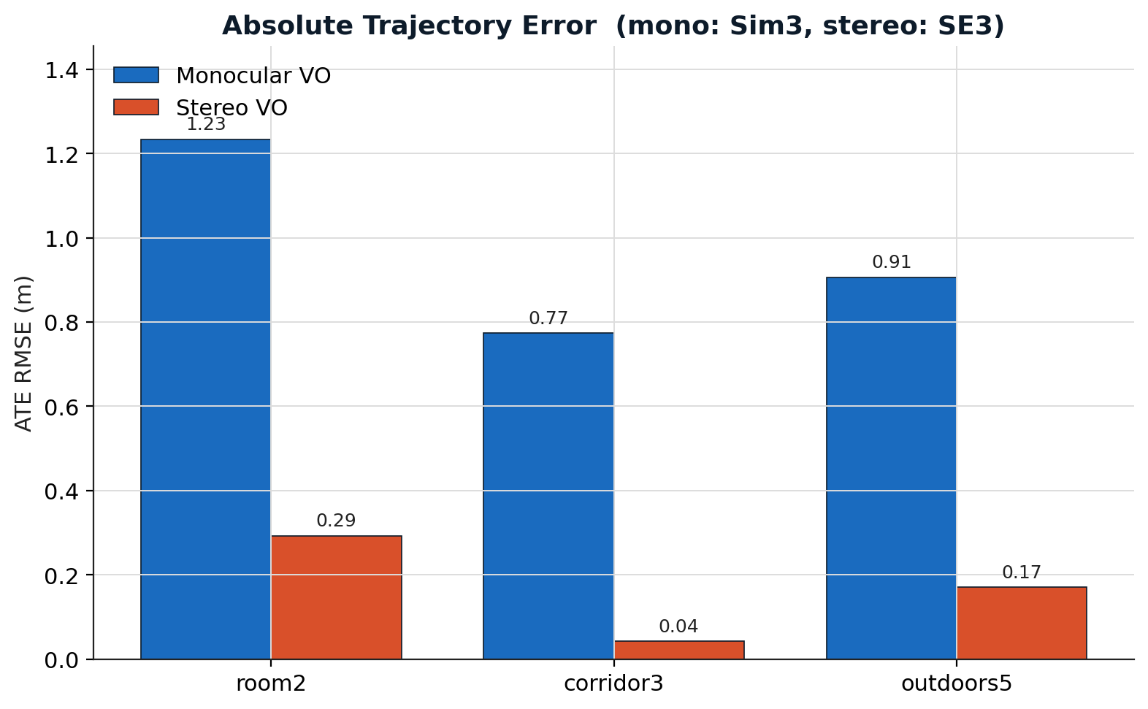
18 / RESULTS
Absolute Trajectory Error
Stereo wins on ATE — but the comparison is unfair to stereo.
Mono ATE uses Sim(3) alignment, which freely optimises scale; stereo uses SE(3) because metric scale is already recovered.
Even with that handicap, stereo is 4× better in Room2, 19× in the corridor, 5× outdoors. Mono ATE looks low only because Sim(3) hides the scale collapse.
From Monocular to Stereo VO · TUM VI
19 / 23

Slide 20
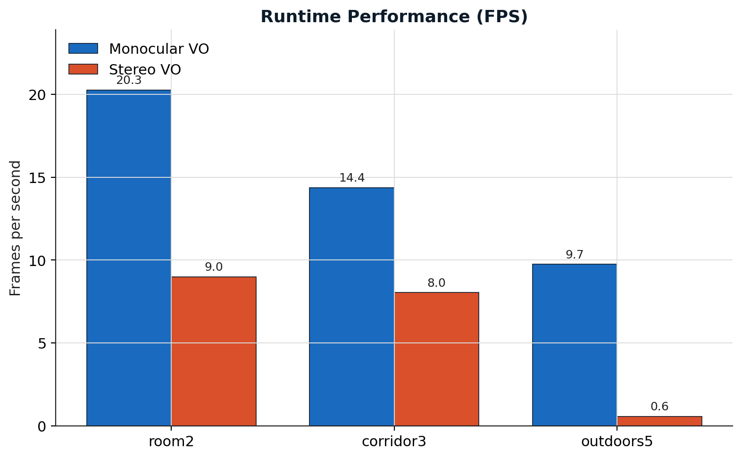
19 / RESULTS · HONEST CAVEAT
Runtime — The Cost of Metric Scale
Stereo is roughly half the speed of monocular indoors. Outdoors it collapses to 0.6 frames per second.
The dominant cost is StereoSGBM disparity — especially the outdoor preset, where the disparity search range doubles to cover textureless ground.
This is a single-thread Python prototype. A production version would move SGBM to GPU and parallelise the front-end.
From Monocular to Stereo VO · TUM VI
20 / 23

Slide 21
20 / RESULTS
Ablation — Component Contributions on Outdoors5
CUMULATIVE CONFIGURATION
ATE SEG (M)
RPE-T (M)
RPE-R (°)
DRIFT %
Each component pulls its weight — none is redundant.
Initial outdoor preset
0.59
0.075
5.49
13.31
The largest individual gain comes from the camera–IMU frame correction; on rotational RPE alone it more than halves the residual.
+ GT in camera frame
0.42
0.061
2.27
6.06
+ tighter depth gating + LM refine
0.28
0.046
1.94
4.81
+ FB-LK consistency
0.16
0.037
1.62
4.10
Tighter depth gating and LM refinement together cut per-segment ATE by a third, addressing the quadratic depth-uncertainty problem outdoors.
Forward–backward LK is the final, decisive step — per-segment ATE 0.16 m, drift rate 4.1 %.
From Monocular to Stereo VO · TUM VI
21 / 23

Slide 22
21 / CLOSING
Conclusion and Next Steps
A classical, geometry-only stereo VO pipeline reaches near-zero hard-skip rates and single-digit drift on the TUM VI fisheye benchmark — without deep learning and without loop closure.
PATH TO FULL SLAM
Local bundle adjustment over a sliding window of recent poses and map points.
DBoW2 vocabulary-tree place recognition for loop closure.
200 Hz IMU pre-integration to counter rotational drift directly.
Marginalisation-based window filter to replace per-frame PnP.
Hard-skip rate ≤ 0.1 % vs. 4.7 %–13.1 % monocular
Per-segment ATE ≤ 0.29 m on every GT-covered interval
Gap-aware RPE-t 210× to 502× improvement over monocular
Path-normalised drift 0.72 %–4.10 % over 1,575 m of trajectory
Rotational RPE ≤ 1.7° once the camera–IMU frame is corrected
From Monocular to Stereo VO · TUM VI
22 / 23

Slide 23
22 / FIN
PER-QUESTION STATUS LOGGING ENABLED
Thank you.
a per-question status code, in the spirit of slide 15
OK
any normal question.
REPROJ_LOW_CONF
"have you considered…" — suggestions in question form.
TRACK_FAIL
"what about KITTI?" — a different dataset entirely.
STEP_REJECT
"is this real-time?" — please see slide 20.
QUESTIONS?
From Monocular to Stereo VO · TUM VI
23 / 23

