Slide 1
Stem or Lemmatize Words
Python Practical

Slide 2
Stemming
Process of reducing a word to its word stem
Important in natural language understanding (NLU) and natural language processing (NLP)
Stemming is also a part of queries and Internet search engines
Example:
Words = Used, User, Using, Usable
Stem = USE

Slide 3
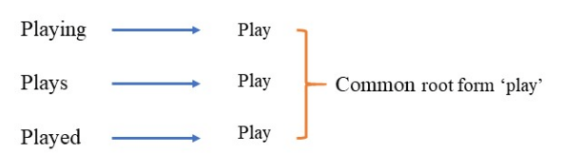

Stemming and Lemmatization
Stemming and Lemmatization are Text Normalization/Word Normalization
Used in Natural Language Processing that are used to prepare text, words, and documents for further processing

Slide 4
How to do it in Python?
Using NLTK [Natural Language Tool Kit]
Steps:
Download and Install NLTK
Stemming Words using PorterStemmer and LancasterStemmer
Stemming Sentences (with TOKENIZATION)
Stemming Documents

Slide 5
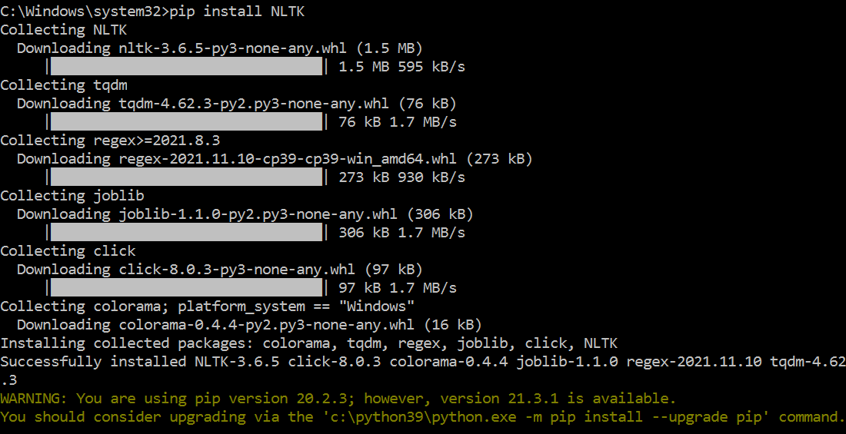
Step 1-Download and Install NLTK
NLTK stands for Natural Language Toolkit
This is a suite of libraries and programs for statistical natural language processing for English written in Python
Open command prompt as Administrator
Use command pip install NLTK in command prompt

Slide 6
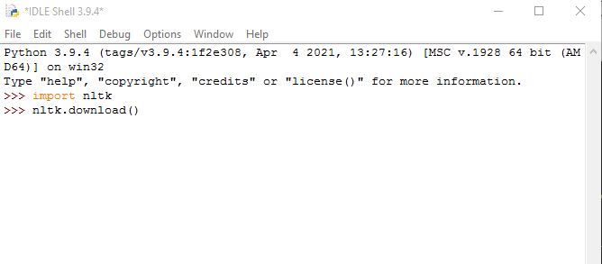
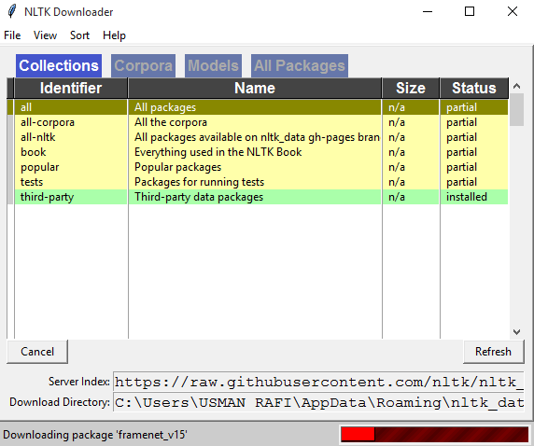
Step 1-Download and Install NLTK
Use: nltk.download() in Python Shell
Use the downloader to download packages, corpora, models

Slide 7
Step 2-Stemming Words using PorterStemmer and LancasterStemmer
PorterStemmer uses Suffix Stripping to produce stems. Notice how the PorterStemmer is giving the root (stem) of the word "cats" by simply removing the 's' after cat.
Simple and Speedy
The LancasterStemmer (Paice-Husk stemmer) is an iterative algorithm with rules saved externally
One table containing about 120 rules indexed by the last letter of a suffix
On each iteration, it tries to find an applicable rule by the last character of the word
Each rule specifies either a deletion or replacement of an ending

Slide 8


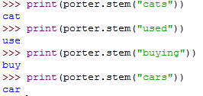
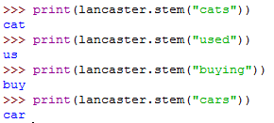
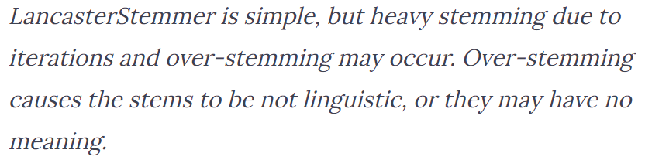
Step 2-Stemming Words using PorterStemmer and LancasterStemmer
Import Stemmers
Create Objects of Stemmers
Stemming using PorterStemmer
Stemming using LancasterStemmer

Slide 9

Step 2-Stemming Sentences (without TOKENIZATION)
Import Stemmers
Create Objects of Stemmers
Stemming using
PorterStemmer
LancasterStemmer
As you see the stemmer sees the entire sentence as a word, so it returns it as it is. We need to stem each word in the sentence and return a combined sentence. To separate the sentence into words, you can use tokenizer.

Slide 10


Step 2-Stemming Sentences (with TOKENIZATION)
Import Stemmers
Create Objects of Stemmers
Import TOKENIZER
Set the Sentence
Tokenize the Sentence &
Display TOKENS
Stem TOKENS and store
In a separate list
Join the list containing
STEM words

