Slide 2
Yagi-Uda dipole array
Antenna 1 : Results

Slide 3
Yagi-Uda dipole array
Antenna 1 : sketches, objectives and parameters

Slide 4
Antenna Structure: Antenna Parameters
Name | Description
f₀ | Centre frequency
D | Wire diameter
N | Number of elements
Lr | Reflector element length
Lde | Driven element length
Ld1 | Director 1 length
Ld2 | Director 2 length
Ld3 | Director 3 length
Ld4 | Director 4 length
Ld5 | Director 5 length

Slide 5
Antenna Structure: Antenna Parameters (2)
Name | Description
Ld6 | Director 6 length
Ld7 | Director 7 length
Ld8 | Director 8 length
Ld9 | Director 9 length
Ld10 | Director 10 length
Ld11 | Director 11 length
Ld12 | Director 12 length
Ld13 | Director 13 length
Ld14 | Director 14 length
Ld15 | Director 15 length

Slide 6
Antenna Structure: Antenna Parameters (3)
Name | Description
Ld16 | Director 16 length
Ld17 | Director 17 length
Ld18 | Director 18 length
Ld19 | Director 19 length
Ld20 | Director 20 length
Ld21 | Director 21 length
Ld22 | Director 22 length
Ld23 | Director 23 length
Ld24 | Director 24 length
Ld25 | Director 25 length

Slide 7
Antenna Structure: Antenna Parameters (4)
Name | Description
Ld26 | Director 26 length
Ld27 | Director 27 length
Ld28 | Director 28 length
Ld29 | Director 29 length
Ld30 | Director 30 length
Ld31 | Director 31 length
Ld32 | Director 32 length
Ld33 | Director 33 length
Ld34 | Director 34 length
Ld35 | Director 35 length

Slide 8
Antenna Structure: Antenna Parameters (5)
Name | Description
Ld36 | Director 36 length
Ld37 | Director 37 length
Ld38 | Director 38 length
Sr | Spacing between driven element and reflector
Sd1 | Spacing between director 1 and previous element
Sd2 | Spacing between director 2 and previous element
Sd3 | Spacing between director 3 and previous element
Sd4 | Spacing between director 4 and previous element
Sd5 | Spacing between director 5 and previous element
Sd6 | Spacing between director 6 and previous element

Slide 9
Antenna Structure: Antenna Parameters (6)
Name | Description
Sd7 | Spacing between director 7 and previous element
Sd8 | Spacing between director 8 and previous element
Sd9 | Spacing between director 9 and previous element
Sd10 | Spacing between director 10 and previous element
Sd11 | Spacing between director 11 and previous element
Sd12 | Spacing between director 12 and previous element
Sd13 | Spacing between director 13 and previous element
Sd14 | Spacing between director 14 and previous element
Sd15 | Spacing between director 15 and previous element
Sd16 | Spacing between director 16 and previous element

Slide 10
Antenna Structure: Antenna Parameters (7)
Name | Description
Sd17 | Spacing between director 17 and previous element
Sd18 | Spacing between director 18 and previous element
Sd19 | Spacing between director 19 and previous element
Sd20 | Spacing between director 20 and previous element
Sd21 | Spacing between director 21 and previous element
Sd22 | Spacing between director 22 and previous element
Sd23 | Spacing between director 23 and previous element
Sd24 | Spacing between director 24 and previous element
Sd25 | Spacing between director 25 and previous element
Sd26 | Spacing between director 26 and previous element

Slide 11
Antenna Structure: Antenna Parameters (8)
Name | Description
Sd27 | Spacing between director 27 and previous element
Sd28 | Spacing between director 28 and previous element
Sd29 | Spacing between director 29 and previous element
Sd30 | Spacing between director 30 and previous element
Sd31 | Spacing between director 31 and previous element
Sd32 | Spacing between director 32 and previous element
Sd33 | Spacing between director 33 and previous element
Sd34 | Spacing between director 34 and previous element
Sd35 | Spacing between director 35 and previous element
Sd36 | Spacing between director 36 and previous element

Slide 12
Antenna Structure: Antenna Parameters (9)
Name | Description
Sd37 | Spacing between director 37 and previous element
Sd38 | Spacing between director 38 and previous element
X | Device X-dimension
Y | Device Y-dimension
Z | Device Z-dimension

Slide 13
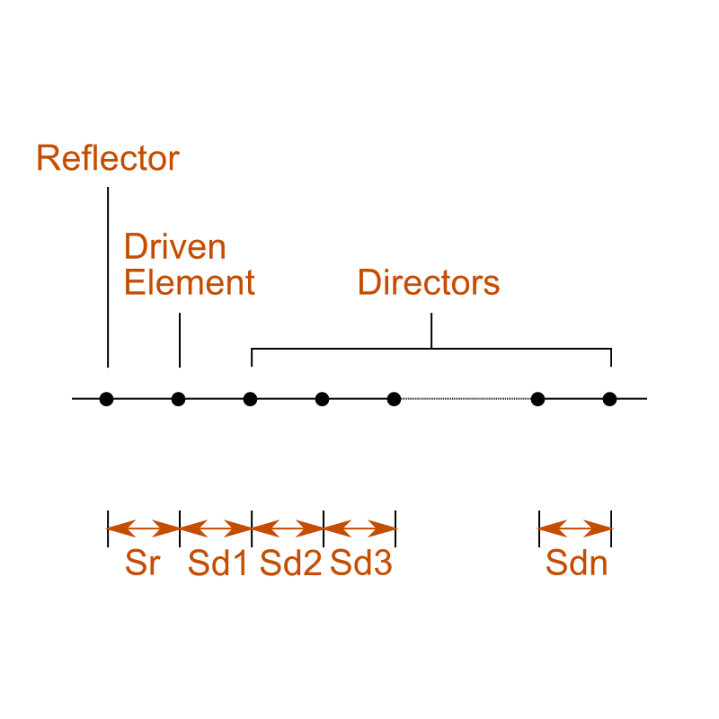
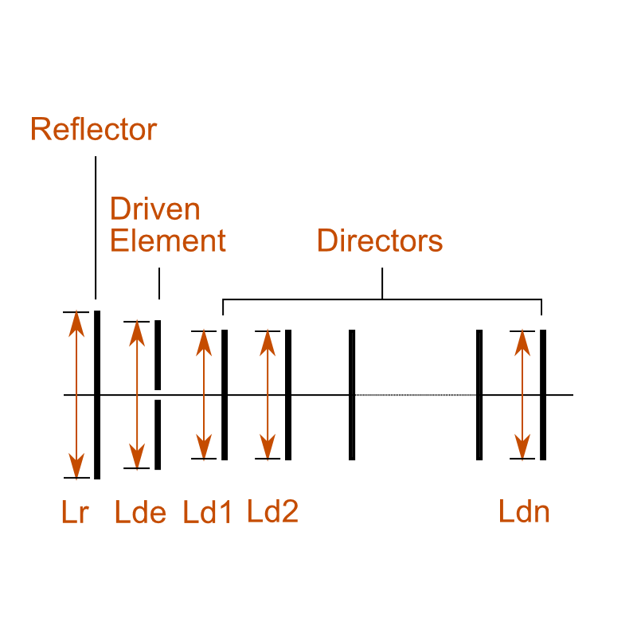
Sketches
Top view
Side view

Slide 14
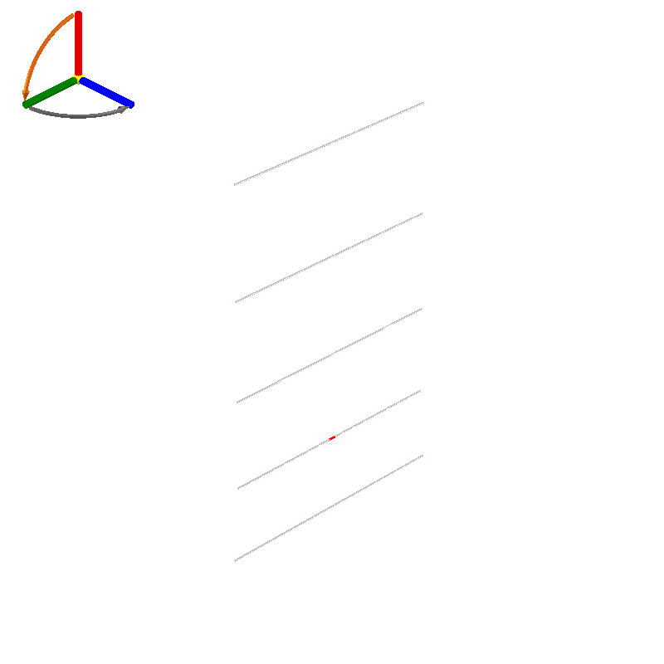
Design 1: Preview

Slide 15
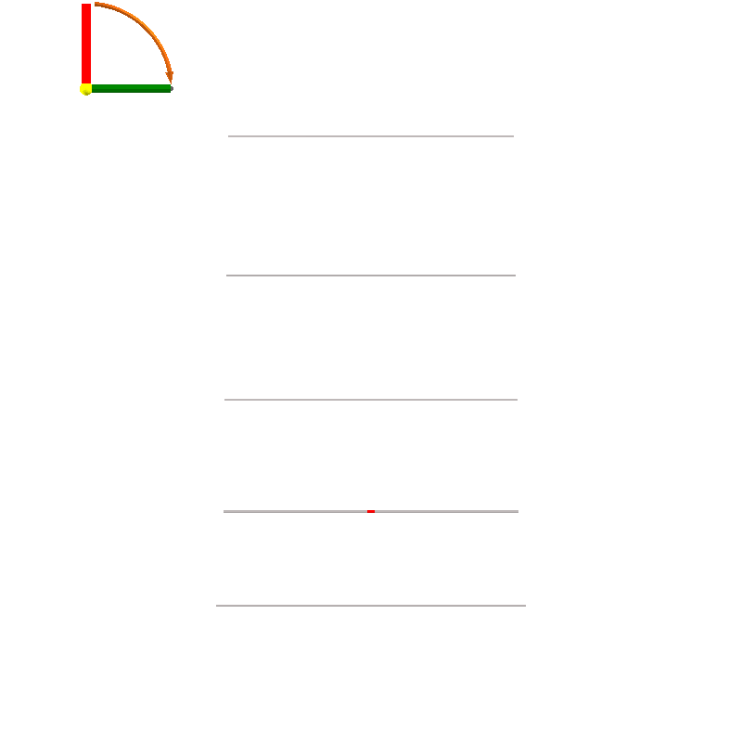
Design 1: Front Side Preview

Slide 16
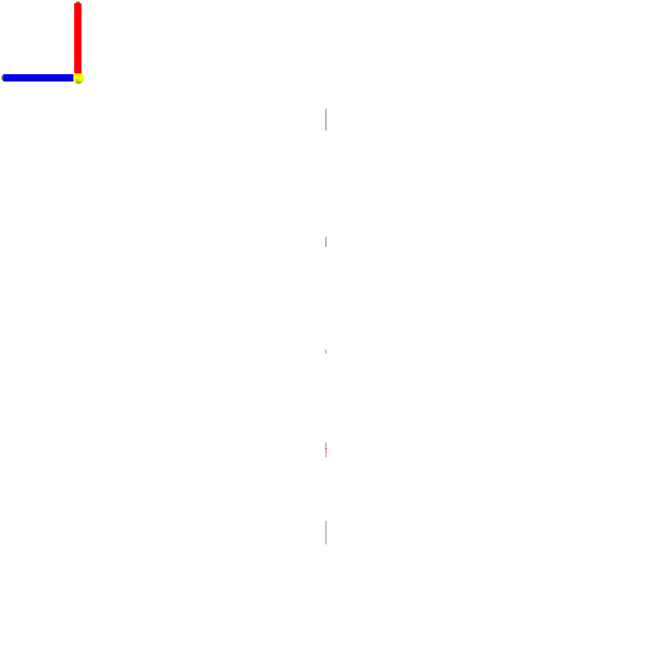
Design 1: Left Side Preview

Slide 17
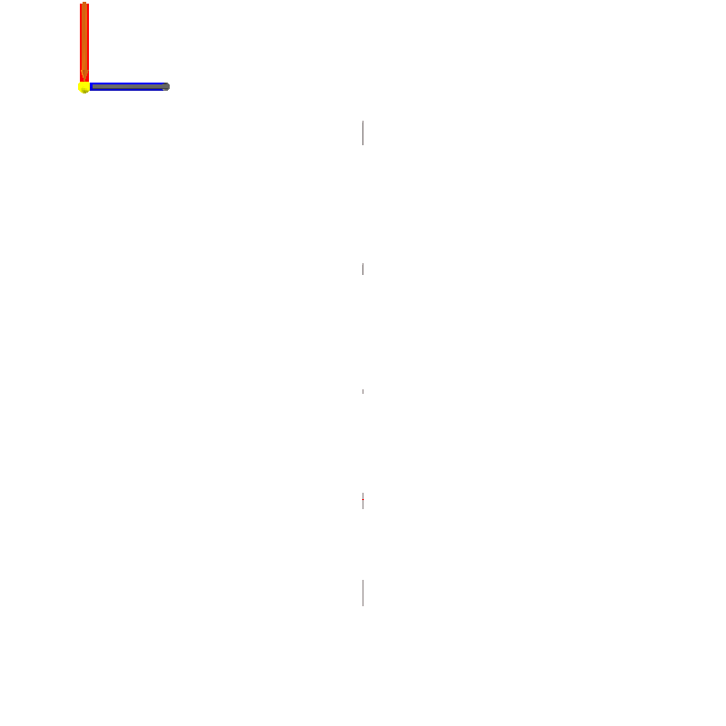
Design 1: Right Side Preview

Slide 18
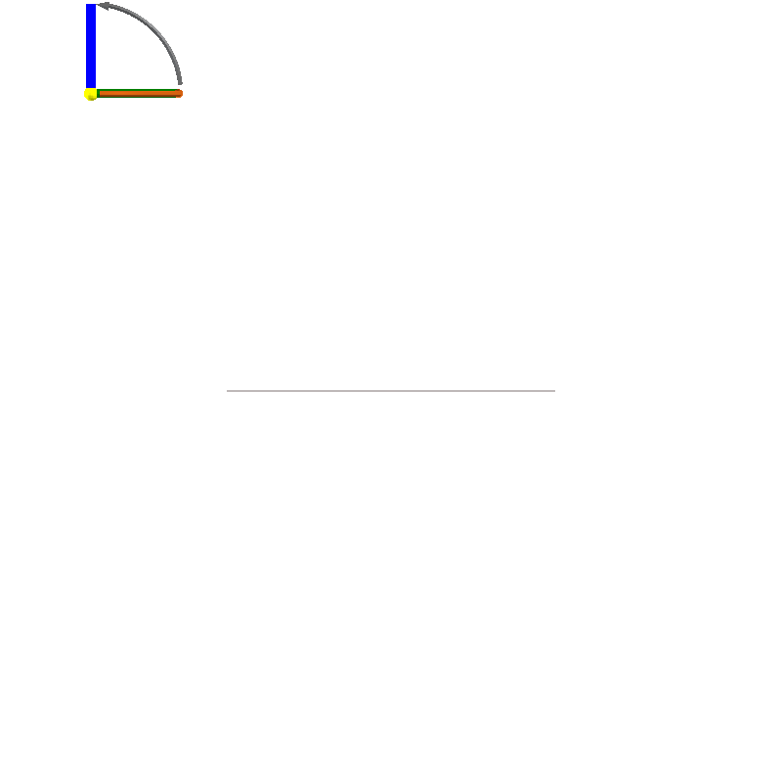
Design 1: Top Side Preview

Slide 19
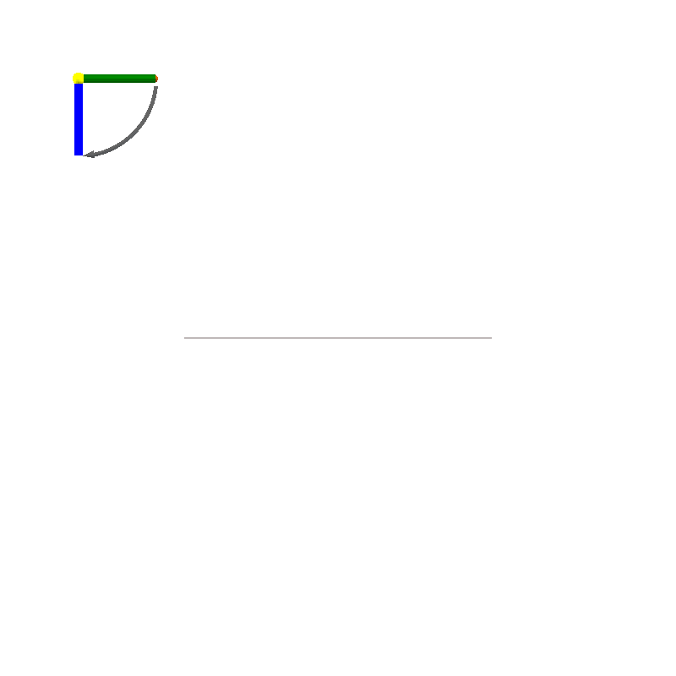
Design 1: Bottom Side Preview

Slide 20
Design 1: Design Objectives
Objective Group: gain and wire diameter
Name | Description | Value
f₀ | Centre frequency | 435.5 MHz
D | The desired wire diameter | 2.3 mm
G | Gain | 11 dBi

Slide 21
Design 1: Physical Parameters
Name | Description | Value
D | Wire diameter | 2.3 mm
N | Number of elements | 5
Lr | Reflector element length | 340.1 mm
Lde | Driven element length | 323.5 mm
Ld1 | Director 1 length | 321.6 mm
Ld2 | Director 2 length | 317.9 mm
Ld3 | Director 3 length | 314.1 mm
Ld4 | Director 4 length | 310.4 mm
Ld5 | Director 5 length | 307.5 mm
Ld6 | Director 6 length | 304.6 mm

Slide 22
Design 1: Physical Parameters (2)
Name | Description | Value
Ld7 | Director 7 length | 302.0 mm
Ld8 | Director 8 length | 299.7 mm
Ld9 | Director 9 length | 297.4 mm
Ld10 | Director 10 length | 295.2 mm
Ld11 | Director 11 length | 293.6 mm
Ld12 | Director 12 length | 292.2 mm
Ld13 | Director 13 length | 290.8 mm
Ld14 | Director 14 length | 289.4 mm
Ld15 | Director 15 length | 288.0 mm
Ld16 | Director 16 length | 286.8 mm

Slide 23
Design 1: Physical Parameters (3)
Name | Description | Value
Ld17 | Director 17 length | 285.6 mm
Ld18 | Director 18 length | 284.5 mm
Ld19 | Director 19 length | 283.3 mm
Ld20 | Director 20 length | 282.1 mm
Ld21 | Director 21 length | 280.9 mm
Ld22 | Director 22 length | 279.7 mm
Ld23 | Director 23 length | 278.9 mm
Ld24 | Director 24 length | 278.1 mm
Ld25 | Director 25 length | 277.2 mm
Ld26 | Director 26 length | 276.5 mm

Slide 24
Design 1: Physical Parameters (4)
Name | Description | Value
Ld27 | Director 27 length | 275.7 mm
Ld28 | Director 28 length | 274.8 mm
Ld29 | Director 29 length | 274.2 mm
Ld30 | Director 30 length | 273.7 mm
Ld31 | Director 31 length | 273.2 mm
Ld32 | Director 32 length | 272.7 mm
Ld33 | Director 33 length | 272.2 mm
Ld34 | Director 34 length | 271.7 mm
Ld35 | Director 35 length | 271.3 mm
Ld36 | Director 36 length | 270.7 mm

Slide 25
Design 1: Physical Parameters (5)
Name | Description | Value
Ld37 | Director 37 length | 270.2 mm
Ld38 | Director 38 length | 269.7 mm
Sr | Spacing between driven element and reflector | 103.3 mm
Sd1 | Spacing between director 1 and previous element | 122.3 mm
Sd2 | Spacing between director 2 and previous element | 137.2 mm
Sd3 | Spacing between director 3 and previous element | 152.2 mm
Sd4 | Spacing between director 4 and previous element | 166.3 mm
Sd5 | Spacing between director 5 and previous element | 178.9 mm
Sd6 | Spacing between director 6 and previous element | 191.4 mm
Sd7 | Spacing between director 7 and previous element | 203.8 mm

Slide 26
Design 1: Physical Parameters (6)
Name | Description | Value
Sd8 | Spacing between director 8 and previous element | 212.5 mm
Sd9 | Spacing between director 9 and previous element | 221.2 mm
Sd10 | Spacing between director 10 and previous element | 230.1 mm
Sd11 | Spacing between director 11 and previous element | 238.8 mm
Sd12 | Spacing between director 12 and previous element | 245.5 mm
Sd13 | Spacing between director 13 and previous element | 249.4 mm
Sd14 | Spacing between director 14 and previous element | 253.3 mm
Sd15 | Spacing between director 15 and previous element | 257.0 mm
Sd16 | Spacing between director 16 and previous element | 260.9 mm
Sd17 | Spacing between director 17 and previous element | 264.8 mm

Slide 27
Design 1: Physical Parameters (7)
Name | Description | Value
Sd18 | Spacing between director 18 and previous element | 268.5 mm
Sd19 | Spacing between director 19 and previous element | 270.7 mm
Sd20 | Spacing between director 20 and previous element | 272.7 mm
Sd21 | Spacing between director 21 and previous element | 274.7 mm
Sd22 | Spacing between director 22 and previous element | 276.8 mm
Sd23 | Spacing between director 23 and previous element | 278.6 mm
Sd24 | Spacing between director 24 and previous element | 279.3 mm
Sd25 | Spacing between director 25 and previous element | 279.9 mm
Sd26 | Spacing between director 26 and previous element | 280.6 mm
Sd27 | Spacing between director 27 and previous element | 281.3 mm

Slide 28
Design 1: Physical Parameters (8)
Name | Description | Value
Sd28 | Spacing between director 28 and previous element | 282.0 mm
Sd29 | Spacing between director 29 and previous element | 282.2 mm
Sd30 | Spacing between director 30 and previous element | 282.3 mm
Sd31 | Spacing between director 31 and previous element | 282.5 mm
Sd32 | Spacing between director 32 and previous element | 282.7 mm
Sd33 | Spacing between director 33 and previous element | 282.9 mm
Sd34 | Spacing between director 34 and previous element | 283.2 mm
Sd35 | Spacing between director 35 and previous element | 283.5 mm
Sd36 | Spacing between director 36 and previous element | 284.0 mm
Sd37 | Spacing between director 37 and previous element | 284.3 mm

Slide 29
Design 1: Physical Parameters (9)
Name | Description | Value
Sd38 | Spacing between director 38 and previous element | 284.6 mm

Slide 30
Design 1: Derived Quantities
Name | Description | Value
X | Device X-dimension | 340.1 mm
Y | Device Y-dimension | 2.3 mm
Z | Device Z-dimension | 517.2 mm

Slide 31
Yagi-Uda dipole array
Antenna 1 : estimated performance charts

Slide 32
Impedance vs Frequency

Slide 33
Impedance vs Frequency

Slide 34
Impedance vs Frequency
Reflection coefficient (20log|Γ|)
 | Design 1
Reference impedance @ port 1 | (50+0j) Ω

Slide 35
Impedance vs Frequency

Slide 36
Impedance vs Frequency
VSWR
 | Design 1
Reference impedance @ port 1 | (50+0j) Ω

Slide 37
Far Field vs Angle @ f0

Slide 38
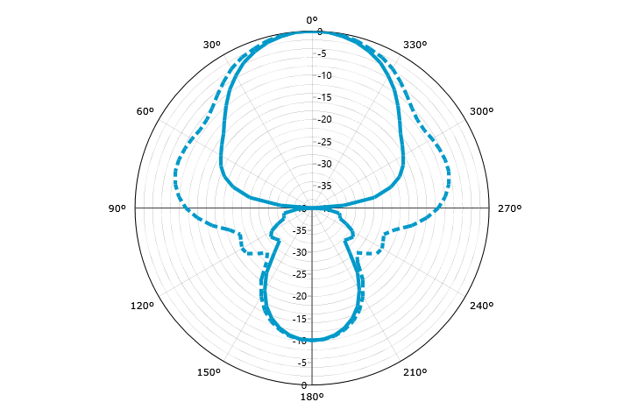
Far Field vs Angle @ f0
Gain (Total - normalised)

Slide 39
Far Field vs Angle @ f0

Slide 40
Far Field vs Angle @ f0
Gain (LHC - normalised)

Slide 41
Far Field vs Angle @ f0

Slide 42
Far Field vs Angle @ f0
Gain (RHC - normalised)

Slide 43
Far Field vs Angle @ f0

Slide 44
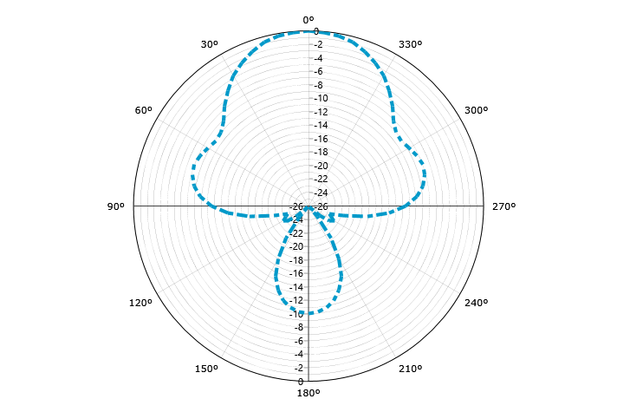
Far Field vs Angle @ f0
Gain (Horizontal - normalised)

Slide 45
Far Field vs Angle @ f0

Slide 46
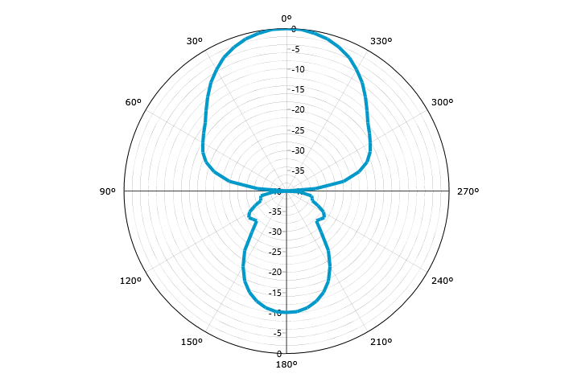
Far Field vs Angle @ f0
Gain (Vertical - normalised)

Slide 47
Far Field vs Angle @ f0

Slide 48
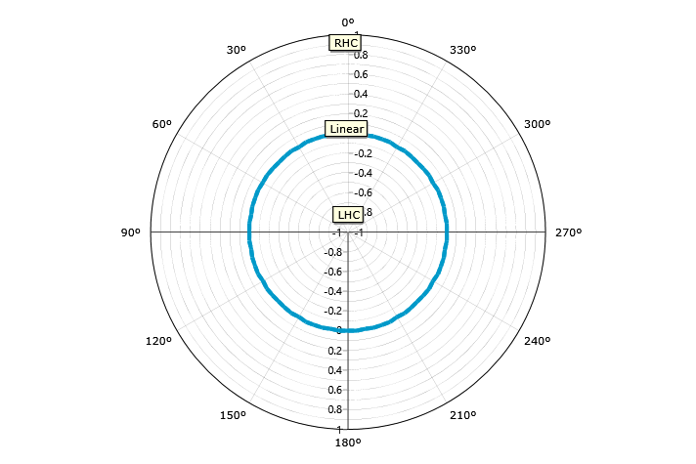
Far Field vs Angle @ f0
Axial Ratio (Handed)

Slide 49
Far Field vs Angle @ f0

Slide 50
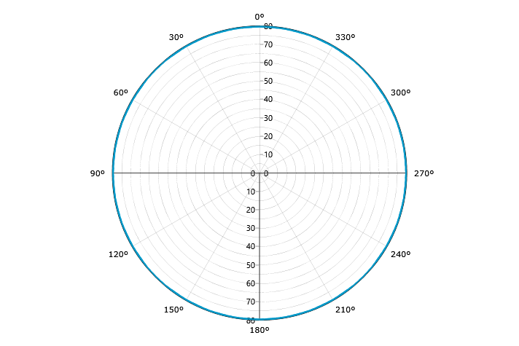
Far Field vs Angle @ f0
Axial Ratio (IEEE)

Slide 51
Far Field vs Angle @ f0

Slide 52
Far Field vs Angle @ f0
Ludwig III (Cross)

Slide 53
Far Field vs Frequency

Slide 54
Far Field vs Frequency

Slide 55
Far Field vs Frequency

Slide 56
Far Field vs Frequency

Slide 57
Far Field vs Frequency

Slide 58
Far Field vs Frequency

Slide 59
Far Field vs Frequency

