Slide 1
Semantic Web Project
Presented by Muhammad Ahmad Ali (183232)

Slide 2
Intro.
A Simple Project of Vehicle ontology.
Turtle and python(For sparql).
Use Rdf, Rdfs, and Owl.
Owl: class, Owl: sameAs, Owl: datatype, etc…

Slide 3
Prefix/namespace
@prefix owl: <http://www.w3.org/2002/07/owl#> . @prefix rdf: <http://www.w3.org/1999/02/22-rdf-syntax-ns#> . @prefix xml: <http://www.w3.org/XML/1998/namespace> . @prefix xsd: <http://www.w3.org/2001/XMLSchema#> . @prefix base: <http://www.example.org/owl/TypeOfMoterVehicle.owl#> . @prefix rdfs: <http://www.w3.org/2000/01/rdf-schema#> . @prefix : <xml:base#> .

Slide 4
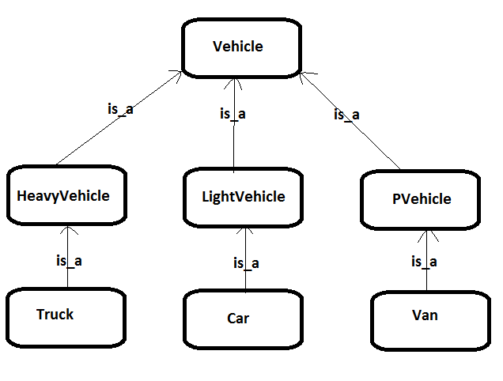
Ontology & Classes
Code:
<xml:base> rdf:type owl:Ontology . :Vehicle rdf:type owl:Class . :HeavyVehicle rdfs:subClassOf :Vehicle . :LightVehicle rdfs:subClassOf :Vehicle . :PVehicle rdfs:subClassOf :Vehicle .
:Truck rdfs:subClassOf :HeavyVehicle . :Car rdfs:subClassOf :LightVehicle . :Van rdfs:subClassOf :PVehicle .

Slide 5
Class Defination
:LightVehicle rdfs:subClassOf [ rdf:type owl:Restriction ; owl:onProperty :isFasterthan ; owl:allValuesFrom :Vehicle ; ] ; rdfs:comment "LightVehicle are those vehicles that are Faster then other types of Vehicle ."^^xsd:string .

Slide 6
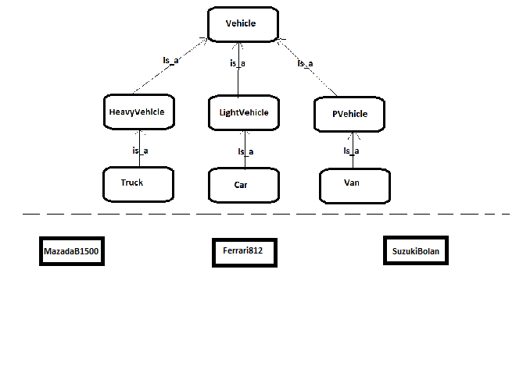
Create instance
:Ferrari812 rdf:type :Car . :MazdaB1500 rdf:type :Truck . :SuzukiBolan rdf:type :Van . :Tesla rdf:type :Car. :Ferrari rdf:type :Car.

Slide 7
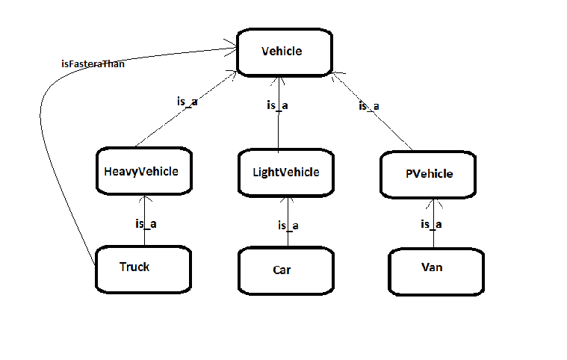
:isFasterthan
:isFasterthan rdf:type owl:ObjectProperty ; rdf:type owl:AsymmetricProperty; rdfs:domain :Vehicle ; rdfs:range :Vehicle .

Slide 8
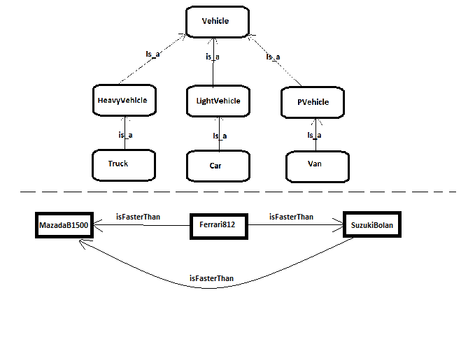
:isFasterthan
:Ferrari812 rdf:type :Car ; :isFasterthan :SuzukiBolan ; :isFasterthan :MazdaB1500 . :SuzukiBolan rdf:type :Van ; :isFasterthan :MazdaB1500 . :Tesla rdf:type :Car; :isFasterthan :MazdaB1500 ; :isFasterthan :Suzukibolan .

Slide 9
Same/Diff. classes and instance
[] rdf:type owl:AllDisjointClasses ; owl:members ( :HeavyVehicle :LightVehicle :PVehicle ) .
[] rdf:type owl:AllDifferent ; owl:distinctMembers (
:Ferrari812 :MazdaB1500
:SuzukiBolan :Tesla ) .
:Ferrari owl:sameAs :Ferrari812 .

Slide 10
:Use
ObjectProperty
Same as :isFasterthan
Vehicle Use for (personal, passenger, and Transport).
:Use rdf:type owl:ObjectProperty ; rdfs:domain :Vehicle ; rdfs:range :UseFor .

Slide 11
datatype/property
:Kmh rdf:type rdfs:Datatype ; rdfs:subClassOf xsd:integer . :inkg rdf:type rdfs:Datatype ; rdfs:subClassOf xsd:integer . :LoadCap rdf:type owl:DatatypeProperty ; rdf:type owl:FunctionalProperty; rdfs:domain :Vehicle ; rdfs:range :inkg .
:Speed rdf:type owl:DatatypeProperty ; rdf:type owl:FunctionalProperty; rdfs:domain :Vehicle ; rdfs:range :Kmh . :colour rdf:type rdfs:Datatype ; rdfs:subClassOf xsd:string . :Shade rdf:type owl:DatatypeProperty ; rdfs:domain :Car ; rdfs:range :colour . :Fuel rdf:type rdfs:Datatype ; rdfs:subClassOf xsd:string .

Slide 12
Instance details
:Ferrari812 rdf:type :Car ; :LoadCap "200"^^:inkg ; :Speed "250"^^:Kmh ; :Use :Personal ; :Shade "Red"^^:colour; :Fuel "Petrol"@en . :MazdaB1500 rdf:type :Truck ; :LoadCap "1000"^^:inkg ; :Speed "110"^^:Kmh ; :Use :Transport ; :Shade "blue"^^:colour; :Fuel "Desil"@en .
:SuzukiBolan rdf:type :Van ; :LoadCap "200"^^:inkg ; :Speed "140"^^:Kmh ; :Use :Passenger ; :Shade "White"^^:colour ; :Fuel "Petrol"@en . :Tesla rdf:type :Car ; :LoadCap "200"^^:inkg ; :Speed "250"^^:Kmh ; :Use :Personal ; :Shade "Red"^^:colour ; :Fuel "Battery"@en .

Slide 13
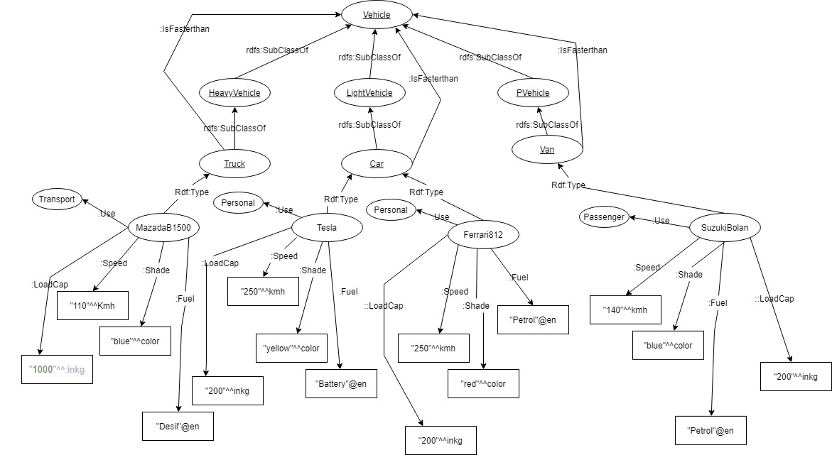

Slide 14
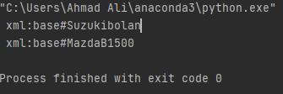
Sparql Query 1 test
PREFIX rdf: <http://www.w3.org/1999/02/22-rdf-syntax-ns#> PREFIX rdfs: <http://www.w3.org/2000/01/rdf-schema#> PREFIX owl: <http://www.w3.org/2002/07/owl#> PREFIX xsd: <http://www.w3.org/2001/XMLSchema#> PREFIX base: <http://www.example.org/owl/TypeOfMoterVehicle.owl#> PREFIX xml: <http://www.w3.org/XML/1998/namespace> SELECT ?x WHERE { :Tesla :isFasterthan ?x. }

Slide 15
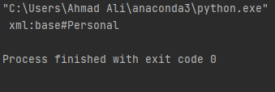
Sparql Query 2 test
PREFIX rdf: <http://www.w3.org/1999/02/22-rdf-syntax-ns#> PREFIX rdfs: <http://www.w3.org/2000/01/rdf-schema#> PREFIX owl: <http://www.w3.org/2002/07/owl#> PREFIX xsd: <http://www.w3.org/2001/XMLSchema#> PREFIX base: <http://www.example.org/owl/TypeOfMoterVehicle.owl#> PREFIX xml: <http://www.w3.org/XML/1998/namespace> SELECT ?x WHERE { :Tesla :Use ?x. }

Slide 16
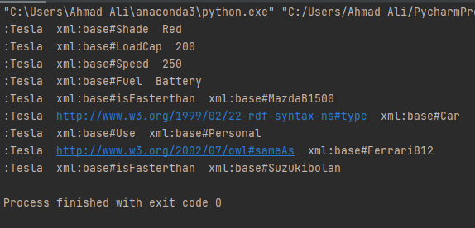
Sparql Query 3 test
PREFIX rdf: <http://www.w3.org/1999/02/22-rdf-syntax-ns#> PREFIX rdfs: <http://www.w3.org/2000/01/rdf-schema#> PREFIX owl: <http://www.w3.org/2002/07/owl#> PREFIX xsd: <http://www.w3.org/2001/XMLSchema#> PREFIX base: <http://www.example.org/owl/TypeOfMoterVehicle.owl#> PREFIX xml: <http://www.w3.org/XML/1998/namespace> SELECT ?x ?y WHERE { :Tesla ?x ?y. }

Slide 17



Thank You

