Slide 1
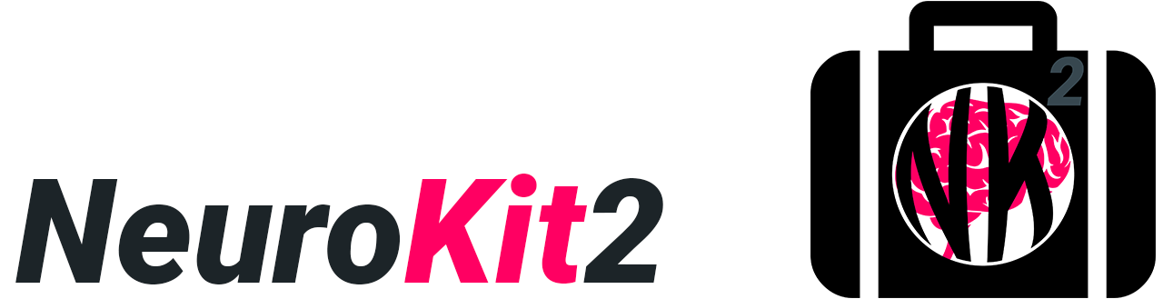
A Python Package for Physiological Signals Processing
Dominique Makowski
OHBM 2022
Notes:
Hi everybody, It’s dom here today to talk to you about NeuroKit2, a Python package to help you process and analyze physiological or bodily signal from the heart, the brain, the respiration system, muscle activity and so on.

Slide 2
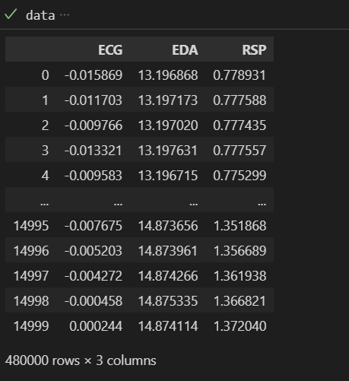
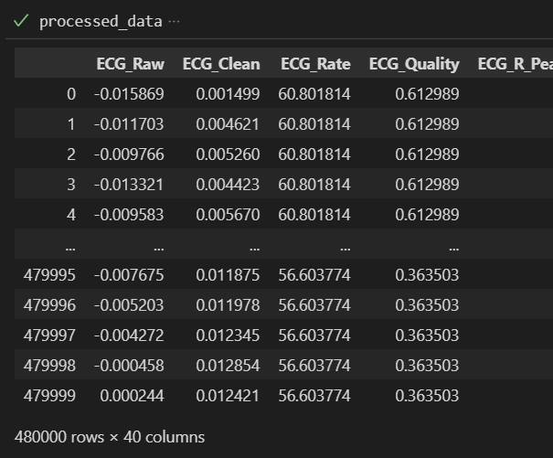
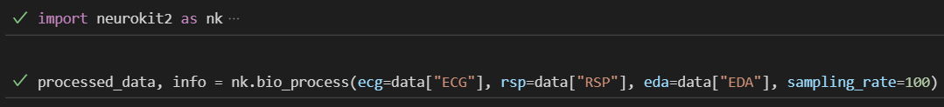
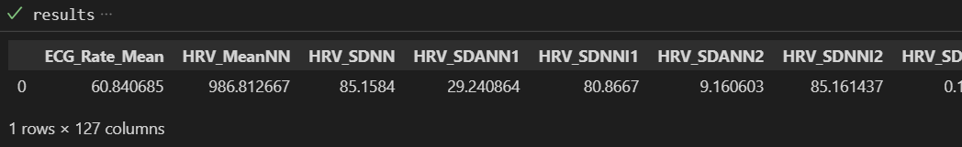
Signal processing + analysis in 2 lines of code
Notes:
It’s was designed to be quite powerful, yet very accessible, especially for users with little experience with programming and coding.
So it’s very easy to use…

Slide 3
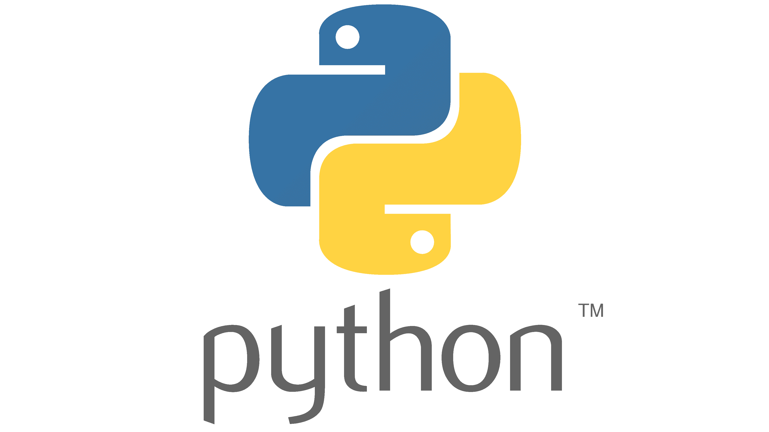

Features
Processing and Feature Extraction for ECG, PPG, RSP, EOG, EMG, EDA, EEG…
Made by neuroscientists for neuroscientists
Unique Capabilities
Fractal Physiology (Entropy, Fractal Dimensions, Chaos, …)
Heart Rate Variability (HRV)
Microstates (EEG)
Notes:
And again it supports many types of signals
It was made by neuroscientist for neurocientst
It is meant to be acessible, easy to use, with settings and tutorials that are suited for neuroscience and psychology research
And it implements some unique cutting edge features, such as the widest and most comprehensive coverage of complexity indices, Heart Rate Variability metrics, as well as EEG microstates analysis

Slide 4
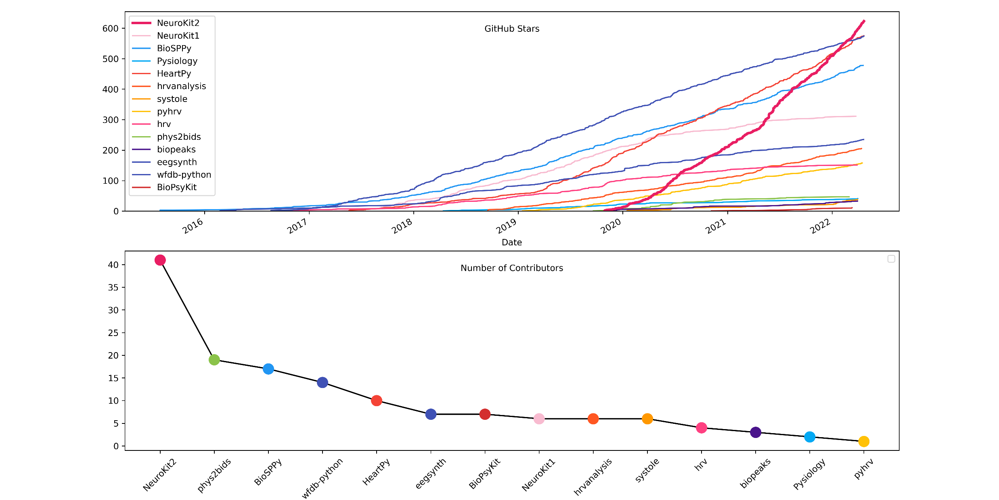


A Popular Software with a Friendly Community
Notes:
It is a recent software, that was created in 2020, and the bulk of its development happened *thanks* to the COVID lockdowns.
Considerable growht in popularity since its creation, becoming one of the most used and contributor-friendly software in psychophysiology.
Of course it’s fully open-source, so join the community

Slide 5
Join the Community!
github.com/neuropsychology/NeuroKit
Notes:
Don’t hestitate to give it a try and get in touch,
Head over to Neurokit’s Github repository at github dot com slash neuropsychology slash neurokit, for an overview with more examples and walk-throughs!
I’ll see you there!
Cheers

