Slide 1
PHISHING ATTACKS
IN CYBER SECURITY

Slide 2
WHAT IS PHISHING ATTACKS ?
Phishing attacks are a type of Cyberattack where attackers deceive individuals into providing sensitive information such as Usernames, Passwords, or Credit card details by pretending to be a Trustworthy entity.
These attacks can occur through various channels, with email and websites being the most common.
Understanding the different types of phishing attacks is crucial in protecting yourself and your organization from these threats.

Slide 3
TYPES OF PHISHING ATTACKS
Email Phishing
Spear Phishing
Whaling

Slide 4






EMAIL PHISHING One Of The Oldest and Most Common Forms of phishing
1
2
Use This User
Information
Click on The Email
5
4
Get The User Information
3
REAL WEBSITE
FAKE WEBSITE

Slide 5
EMAIL PHISHING SIGNS OF EMAIL PHISHING
Suspicious Sender Email Address
Urgent Language (e.g Your Account Will be Get Locked )
Links or Attachments You Weren’t Expected
Spelling or Grammatical Errors

Slide 6
SPEAR PHISHING
Spear phishing is a more targeted form of phishing that focuses on specific individuals or organizations.
Attackers usually gather detailed information about their target beforehand, making the attack more convincing.
Example: A company executive receives a message from someone posing as an internal employee, requesting sensitive financial documents.

Slide 7
How to Identify Spear Phishing ?
Personalization: Using your name, job title, or other personal information.
Request for sensitive or unusual information.
Email appears to come from a known contact but contains subtle inconsistencies (e.g., slight variations in the sender's email address).

Slide 8
pharming attack
An attack technique that manipulates the Domain Name System (DNS) to redirect a user's legitimate request to a fraudulent website without their knowledge.
Pharming redirects victims from legitimate websites to fake ones without their knowledge
Instead of using deceptive emails, Parming attacks exploit vulnerabilities in a computer’s DNS (Domain Name System) to reroute traffic to malicious sites.
Example: A user types in their bank’s URL and is redirected to a lookalike site that collects their login credentials.

Slide 9
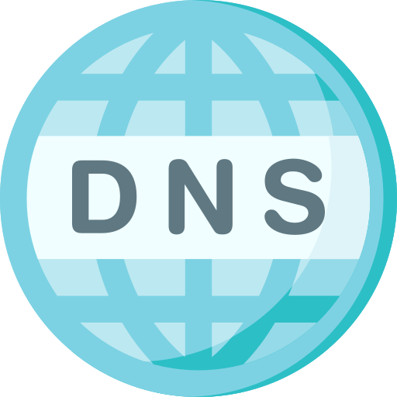
pharming attack
FAKE WEBSITE
REAL WEBSITE

Slide 10
Signs of Pharming
Website loads differently than expected.
Unusual pop-ups or requests for login information.
HTTPS padlock missing from the URL bar on trusted sites.

Slide 11
CLONE PHISHING ATTACK
Clone phishing involves attackers duplicating a previously sent legitimate email and modifying it to contain malicious content, such as a link or attachment.
This method tricks users into clicking because it mimics something they’ve already seen.
Example: An email from a service provider is cloned and resent with a new, malicious attachment or link, encouraging the victim to download malware.

Slide 12
CLONE PHISHING ATTACK
Dear Sarah,
Thank you for your recent payment. Please find the attached invoice for your records.
[Download Invoice](http://trustedcompany.com/invoice/1234.pdf)
If you have any questions, please contact our support team.
Best regards,
Your Company’s Billing Department
Dear Sarah,
We noticed an issue with your recent payment. Please review the revised invoice attached and make the necessary adjustments.
[Download Revised Invoice](http://maliciouswebsite.com/invoice/1234.pdf)
If you have any questions or need assistance, feel free to reach out.
Best regards,
Your Company’s Billing Department

Slide 13
How to Spot Clone Phishing ?
Repeated or "duplicate" email messages.
Unexpected changes in attachments or links from known senders.

Slide 14
Vishing and Smishing attack
Vishing (Voice Phishing): Attackers call and pose as legitimate entities like tech support or banks, asking for personal or financial information.
Smishing (SMS Phishing): Phishing attempts are made through text messages, often containing malicious links or urgent requests.
Example (Vishing): A user receives a call from someone claiming to be from tech support, asking them to provide their system login details to "fix" a problem.
Example (Smishing): A text message appears to come from a bank, urging the recipient to click a link to verify account activity.

Slide 15
How to Avoid Vishing/Smishing ?
Be wary of unsolicited calls or messages asking for sensitive information.
Always verify the authenticity of the message by contacting the entity directly.

Slide 16
How to Prevent Phishing Attacks ?
Be Skeptical of Unexpected Communications: If you receive an email, call, or message that seems unusual or unexpected, verify it before providing any information or clicking links.
Check URLs Carefully: Always hover over links before clicking to ensure they lead to legitimate websites. Phishers often use URLs that look very similar to real ones, but with subtle differences.
Enable Two-Factor Authentication (2FA): Adding an extra layer of security can prevent unauthorized access to accounts, even if credentials are stolen.
Use Security Software: Antivirus and anti-phishing tools can help detect and block phishing attempts before they reach you.
Educate Yourself and Your Organization: Awareness training can significantly reduce the risk of falling for phishing attacks. Regular updates on the latest phishing techniques are essential.

Slide 17
IN Conclusion
Phishing attacks continue to be one of the most effective and dangerous cyber threats. By understanding the various types of phishing and adopting best practices for prevention, individuals and organizations can significantly reduce their risk of being compromised. Staying vigilant and cautious is the best defense against these ever-evolving tactics.

