Slide 1
MANDATORY ASSIGNMENT 1
AJ Motors
• Distributed car sales · architecture and delivery strategy
• Ahmad Alkaseb · Jeppe Koch · Asger Bergøe · Laith Alkaseb
• https://github.com/AhmadAlkaseb/aj
AJ MOTORS / Technical review · 12 November 2026
01
Notes:
Current design presentation prepared from the implemented repository. Do not claim it documents the original classroom presentation.
Repository: https://github.com/AhmadAlkaseb/aj

Slide 2
MANDATORY ASSIGNMENT 1
Problem and acceptance criteria
• Coordinate customer, vehicle, order and manual payment ownership.
• One car must not be reserved by two buyers.
• Frontend consumes GraphQL catalogue queries and REST commands.
• Latency, durability and access boundaries need explicit tests.
AJ MOTORS / Technical review · 12 November 2026
02
Notes:
Report 1.1–1.2. Manual payment records an outcome; no money transfer or Stripe integration.
Repository: https://github.com/AhmadAlkaseb/aj

Slide 3
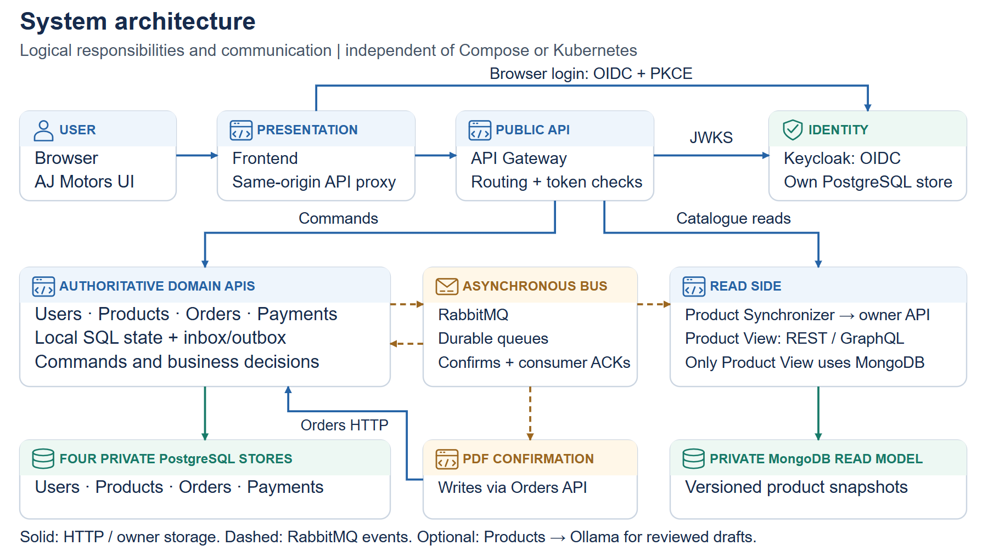
MANDATORY ASSIGNMENT 1
System architecture
• Five domain APIs; synchronizer and confirmation processor are additional workers.
AJ MOTORS / Technical review · 12 November 2026
03
Notes:
Report 2.1–2.3. Databases, broker, frontend and gateway are not counted among the five domain microservices.
Repository: https://github.com/AhmadAlkaseb/aj

Slide 4
MANDATORY ASSIGNMENT 1
Why these technologies?
• Java 17/Javalin/Maven: consistent backend and build tooling.
• PostgreSQL: owner constraints and transactions; MongoDB: catalogue snapshots.
• RabbitMQ: asynchronous delivery; REST + GraphQL: commands and queries.
• Compose locally; kind, Calico, HPA and KEDA for the production-like demo.
AJ MOTORS / Technical review · 12 November 2026
04
Notes:
Report 1.3. Technology choice is a trade-off, not proof of scalability.
Repository: https://github.com/AhmadAlkaseb/aj

Slide 5
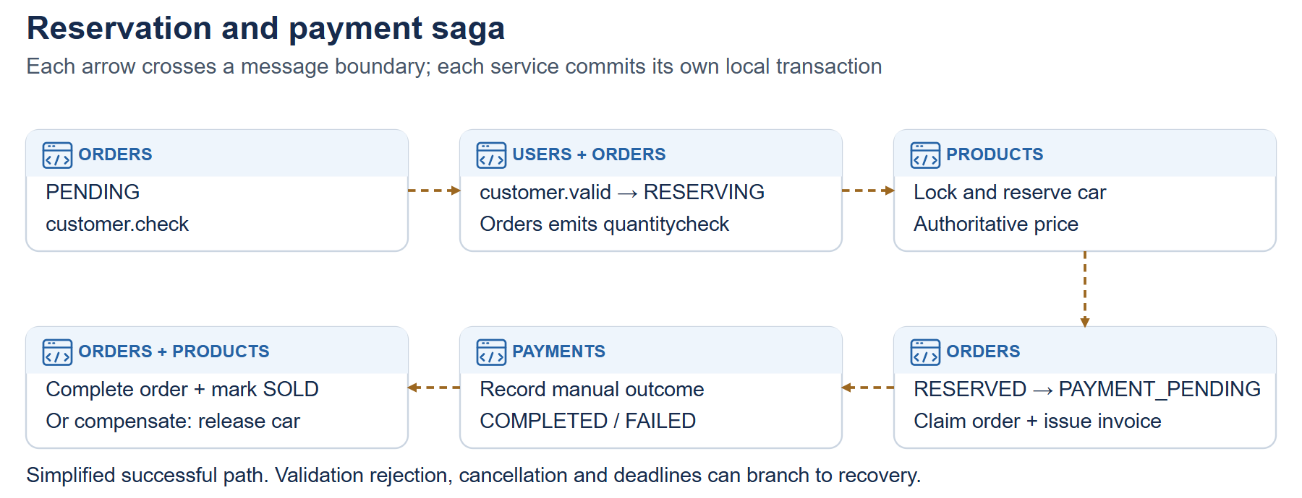
MANDATORY ASSIGNMENT 1
Communication and patterns
• AMQP coordinates reservation, payment outcomes and catalogue snapshots.
• CQRS, tombstones/snapshots, idempotence and selected commutative handling.
• Saga compensation, deadlines and explicit manual review.
• Outbox/inbox retain work and deduplicate selected redeliveries.
AJ MOTORS / Technical review · 12 November 2026
05
Notes:
Report 2.3–2.4. At-least-once delivery is not universal exactly-once processing.
Repository: https://github.com/AhmadAlkaseb/aj

Slide 6
MANDATORY ASSIGNMENT 1
Balanced Scrum-inspired work model
• Four workstreams: identity; catalogue/AI; commerce; operations.
• Each participant owns one stream and reviews another.
• Short planning cycles, shared board, brief standups and acceptance review.
• Allocation/reflection drafts need participant confirmation; no invented attendance.
AJ MOTORS / Technical review · 12 November 2026
06
Notes:
Report 5 and 7. This is the adopted balanced model, not measured equal hours or fabricated historical sprint evidence.
Repository: https://github.com/AhmadAlkaseb/aj

Slide 7
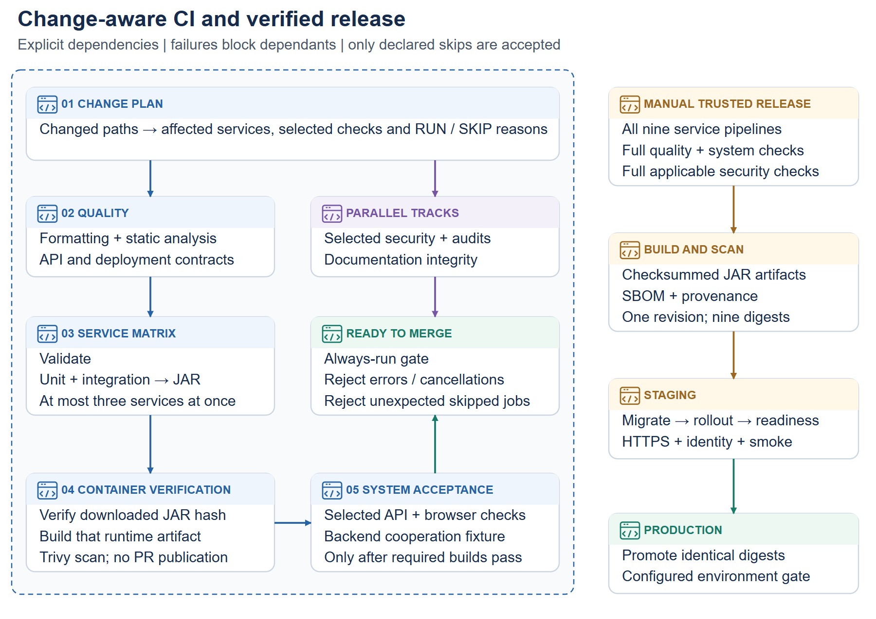
MANDATORY ASSIGNMENT 1
CI/CD and testing plan
• Change plan → selected quality → affected services → images → cooperation.
• Independent security/docs tracks join one strict Ready to merge gate.
• Unit + integration must pass before JAR packaging.
• Local results and actual GitHub runs remain different evidence.
AJ MOTORS / Technical review · 12 November 2026
07
Notes:
Report 3.2.2 and 4; CI-CD.md. Native summaries and free/open-source quality/security tools.
Repository: https://github.com/AhmadAlkaseb/aj

Slide 8
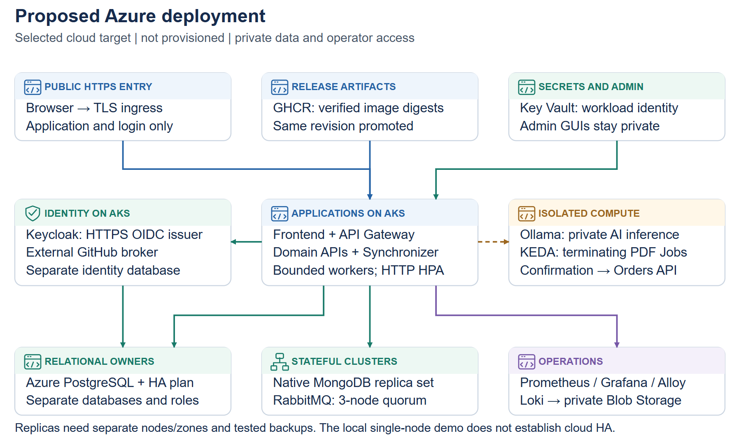
MANDATORY ASSIGNMENT 1
Cloud, operations and versioning
• Selected cloud plan: AKS, PostgreSQL, native MongoDB and RabbitMQ.
• Private identity/AI; KEDA PDF Jobs; secrets and tested recovery.
• Prometheus/Grafana/Alloy/Loki; Git, Flyway, API v1 and event schema.
• Cloud resources are planned, not purchased or deployed.
AJ MOTORS / Technical review · 12 November 2026
08
Notes:
Report 3.3 and 5.3. Primary references: Microsoft AKS baseline; RabbitMQ confirms; Keycloak; GitHub Actions.
Repository: https://github.com/AhmadAlkaseb/aj

Slide 9
MANDATORY ASSIGNMENT 1
Delivery and open evidence
• Report with included appendices; monorepo and installation procedure.
• Design and implementation figures are editable repository assets.
• External GitHub login needs an owned OAuth app and real browser verification.
• Upload this PowerPoint, report and repository link to itsLearning.
AJ MOTORS / Technical review · 12 November 2026
09
Notes:
Check documentation/submission/README.md before upload. Actual GitHub runs and participant history must not be inferred from slides.
Repository: https://github.com/AhmadAlkaseb/aj

